Slide 1
Topic 3: the chemistry of life
Multiple Choice questions

Slide 2
The three most common elements in the ‘molecules of life’ are:
A carbon, hydrogen and sodium.
B iron, hydrogen and oxygen.
C carbon, nitrogen and oxygen.
D carbon, hydrogen and oxygen.
D

Slide 3
In addition to carbon, hydrogen and oxygen, nucleic acids contain the element:
A sodium.
B potassium.
C phosphorus.
D iron.
C

Slide 4
Sucrose and maltose are examples of
A monosaccharides.
B disaccharides.
C polysaccharides.
D inorganic molecules.
B

Slide 5
Which one of the following is NOT a major function of lipids in the human body?
A as a short term energy source.
B synthesis of hormones.
C long term energy storage.
D insulation.
B

Slide 6
In the lock and key model for enzyme action, the enzyme:
A fits very closely onto a site on the substrate.
B has a hydrophobic head which dissolves in the substrate.
C has a hydrophilic head which dissolves in the substrate.
D attaches itself to the substrate by a chemical bond.
A

Slide 7
The process by which RNA is produced from a DNA
template is known as:
A transcription.
B translation.
C division.
D coding.
A

Slide 8
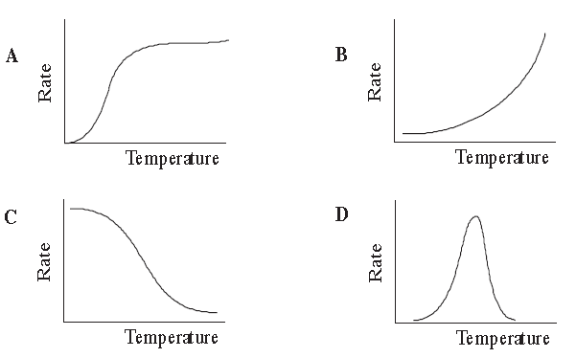
Which one of the following graphs best represents the reaction rate of an enzyme catalysed reaction.
D

Slide 9
Which one of the following statements is NOT true?
A Light is necessary for every stage of photosynthesis.
B Photosynthesis will not occur without light.
C Some stages of photosynthesis do not require light.
D Photosynthesis is a multi-step reaction.
A

Slide 10
Which one of the following is not a component of a nucleotide molecule?
A a pentose sugar.
B a phosphate group.
C an organic base.
D an inorganic base.
D

Slide 11
Which of the following reactions occurs when a dipeptide is formed from amino acids?
A. Hydrolysis
B. Denaturation
C. Condensation
D. Oxidation
C

Slide 12
What is the function of helicase?
A. It forms bonds between DNA nucleotides.
B. It adds new nucleotides to the DNA helix.
C. It forms the DNA helix.
D. It separates DNA strands.
D

Slide 13
A certain gene codes for a polypeptide that is 120 amino acids long. Approximately how many nucleotides long is the mRNA that codes for this polypeptide likely to be?
A. 30
B. 40
C. 360
D. 480
C

Slide 14
Of the following products, which is produced by both anaerobic respiration and aerobic respiration in humans?
I. Pyruvate
II. ATP
III. Lactate
A. I only
B. I and II only
C. I, II and III
D. II and III only
B

Slide 15
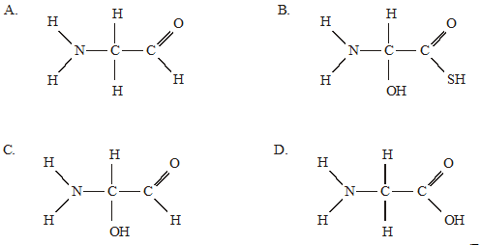
Which structure represents an amino acid?
D

Slide 16
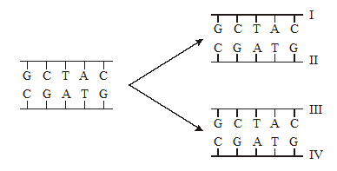
The diagram below shows a short section of DNA molecule before and after replication. If the nucleotides used to replicate the DNA were radioactive, which strands in the replicated molecules would be radioactive?
A. II and III only
B. I and III only
C. I and II only
D. I, II, III and IV
A

Slide 17
Pigments are extracted from the leaves of a green plant. White light is then passed through the solution of pigments. What effect do the leaf pigments have on the white light?
A. Green wavelengths are absorbed and red and blue wavelengths are transmitted.
B. Red and blue wavelengths are absorbed and green wavelengths are transmitted.
C Blue wavelengths are absorbed and green and red wavelengths are transmitted.
D. Green and red wavelengths are absorbed and blue wavelengths are transmitted.
B

Slide 18
Aerobic respiration involves conversion of glucose into pyruvate and conversion of pyruvate into carbon dioxide and water. Where do these processes occur in a eukaryotic cell?
B

Slide 19
During the process of translation which of the following statements describes the relationship between nucleic acids?
A. Anticodons on mRNA bind to complementary codons on DNA.
B. Anticodons on tRNA bind to complementary codons on mRNA.
C. Bases on DNA bind to complementary bases on mRNA.
D. A single strand of mRNA is produced from the DNA in the nucleus.
B

Slide 20
Topic 3: the chemistry of life
Multiple Choice questions

