Slide 1
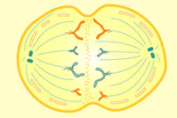
Meiosis Monday, 16 April 2018
Key words: Homologous pairs, Haploid, Diploid, Variation
Starter:
1. Definitions for each of the key words.
2. Why can sex cells not divide by mitosis?

Slide 2
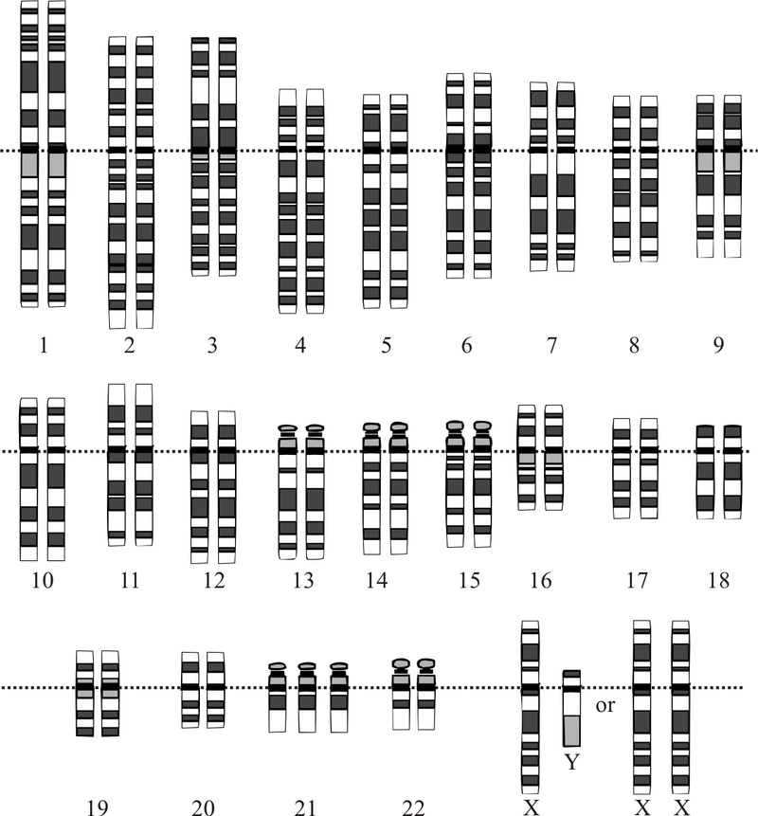
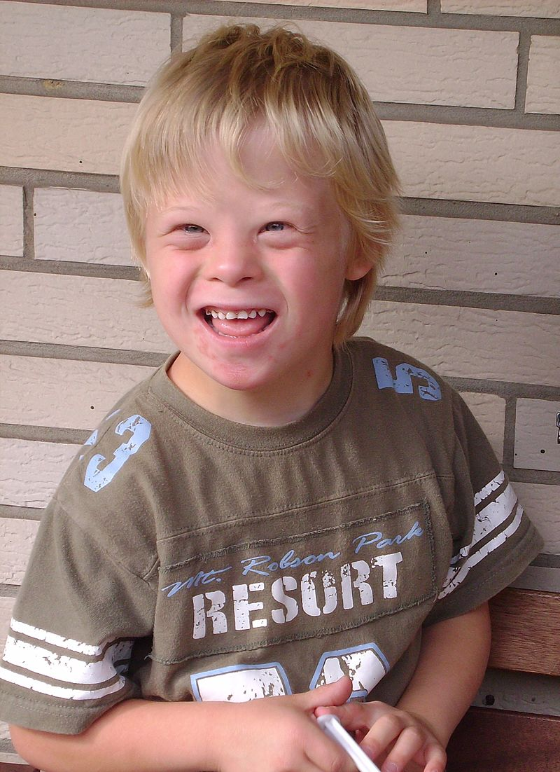
What’s unusual about this genome?

Slide 3
The big picture: “How does meiosis differ from mitosis?”
Learning outcomes
To explain how gametes are formed.
To analyse the step by step process of meiosis
To compare the differences between mitosis and meiosis.

Slide 4
What is meiosis?
https://www.youtube.com/watch?v=toWK0fIyFlY
Listen out for:
What meiosis is
What the products of meiosis are

Slide 5
What is meiosis?
Gametes are formed from cells in the reproductive organs by a type of cell division called meiosis.
The cells that are formed by meiosis have half the number of chromosomes as a body cell (they are haploid).
The main features of meiosis are: -
The cell divides twice, forming four gametes
The gametes are genetically different from each other.

Slide 6
Meiosis
Gametes are formed in the reproductive organs by meiosis.
 | Male | Female
Reproductive Organs | Testes | Ovaries
Gametes | Sperm | Egg

Slide 7
Mitosis Model
Each string of beads represents a chromosome
Each bead represents a gene
Red (ish) chromosomes inherited from mother
Blue (ish) chromosomes inhertited from father

Slide 8
Meiosis Model
In this example, the cell has a chromosome complement of 4
This is known as the DIPLOID NUMBER
What is the Diploid Number for Humans?

Slide 9
1st Meiotic Division
The Chromosomes shorten and thicken and become visible under the microscope (if stained)
Nuclear Membrane

Slide 10
1st Meiotic Division
Each Chromosome replicates itself
The chromosomes are made up of 2 CHROMATIDS held together by a CENTROMERE
Chromatid
Centromere
Chromatid

Slide 11
1st Meiotic Division
Each Chromosome replicates itself
Prophase

Slide 12
1st Meiotic Division
Nuclear Membrane disappears
HOMOLOGOUS chromosomes PAIR UP
They may swap or CROSS OVER homologous genes (genes for the same characteristic)
Crossover

Slide 13
Crossing Over
During prophase I, the individual chromosomes of each homologous pair, come into very close contact with each other.
They twist and almost look ‘tangled’.
Wherever the chromatids cross over, is called a chiasma

Slide 14
1st Meiotic Division
Spindle fibres form
The Homologous Chromosome pairs line up, at random, along the equator of the spindle

Slide 15
1st Meiotic Division
The spindle fibres contract pulling the Homologous chromosomes away from their partners
The Homologous partners move to opposite “poles” of the cell

Slide 16
1st Meiotic Division
2 cells form
Nuclear membranes reform
How many chromosomes are there in each cell?
How does this compare to the original number?
This chromosome number is known as the HAPLOID NUMBER

Slide 17
2nd Meiotic Division
Each of the Haploid cells undergoes a second Meiotic division
A new spindle forms
The chromosomes arrange themselves at random along the equator of the cell

Slide 18
2nd Meiotic Division
The spindle fibres contract pulling the chromatids apart and to opposite poles of the cell
Once separated, the chromatids are now known as chromosomes

Slide 19
End Result
Each new cell is known as a GAMETE (sex) Cell
How many gamete cells are formed from the original “Mother” Cell”?
How many chromosomes are in each Gamete cell?

Slide 20
End Result
Do any of your gamete cells look exactly alike?

Slide 21
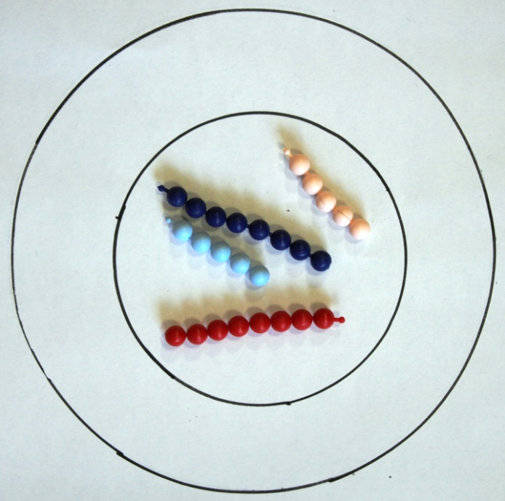
Gamete “Mother Cell”
(2n)
Meiosis
4 “Daughter Cells” (n)

Slide 22
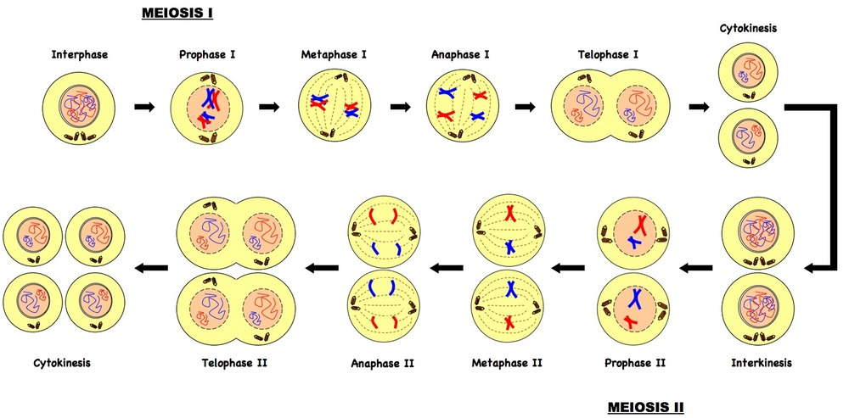
Stages of meiosis
Tasks
1: Copy and explain the diagram above
2: Why do the cells in meiosis need to have the haploid number of chromosomes?
3: Why are the cells produced in meiosis genetically different from each other?
Extra challenge: Why do these cells need to be genetically different from each other?

Slide 23
Genetic Variation
During all of the amazing things that happen during meiosis, two events in particular, are very interesting.
These two processes create genetic variation during meiosis:
Crossing Over
Independent Segregation of Chromosomes
Crossing over occurs during prophase I.
Basically the two chromosomes in each homologous pair twist around each other.
Wherever they ‘touch’, genetic material is swapped between them.
At the end of crossing over the genetic composition of each c’some is now different
Independent segregation happens in metaphase I.
Basically, when the homologous chromosomes line up, they do so randomly.
This means that when they are pulled apart in anaphase, the combination of chromosomes going into the daughter cells is also random.

Slide 24
Comparing mitosis and meiosis
 | Mitosis | Meiosis
How many cell divisions are there?
How many cells produced
How many chromosomes does it have?
When is used for?
Where in the body does it happen?

Slide 25
Comparing mitosis and meiosis
 | Mitosis | Meiosis
How many cell divisions are there?
How many cells produced
How many chromosomes does it have?
When is used for?
Where in the body does it happen?

Slide 26
Comparing mitosis and meiosis
 | Mitosis | Meiosis
How many cell divisions are there? | The cell divide once | The cell divides twice
How many cells produced | 2 | 4
How many chromosomes does it have? | 46 chromosomes – the same number as the original cell | 23 chromosome – half the number of chromosomes as the original cell
When is used for? | To make new body cells | This is how gametes are made
Where in the body does it happen? | It happens in all parts of the body | It happens only in the testes and ovaries

Slide 27
Plenary: Mitosis and Meiosis?

Slide 28
Plenary: Mitosis and Meiosis?

Slide 29
Plenary: Mitosis and Meiosis?

Slide 30
Plenary: Mitosis and Meiosis?

Slide 31
Plenary: Mitosis and Meiosis?

Slide 32
Plenary: Mitosis and Meiosis?

Slide 33
Plenary: Mitosis and Meiosis?

Slide 34
Plenary: Mitosis and Meiosis?

Slide 35
Plenary: Mitosis and Meiosis?

Slide 36
Plenary: Mitosis and Meiosis?

