Slide 1
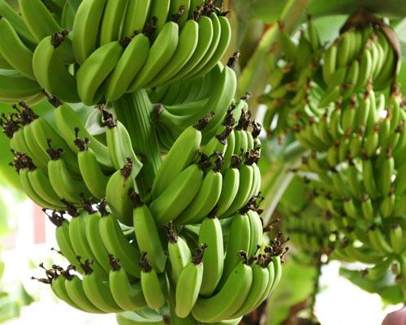
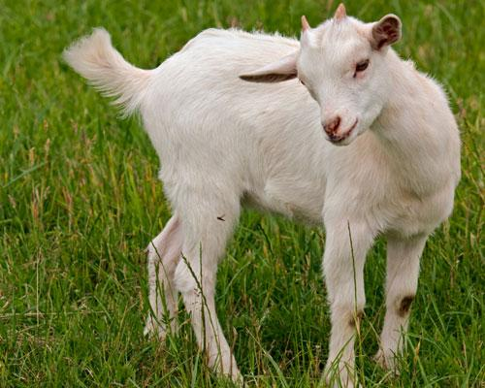
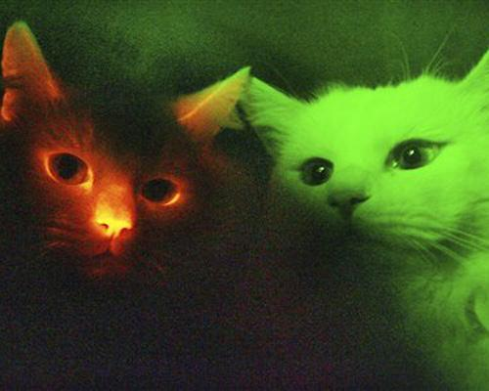
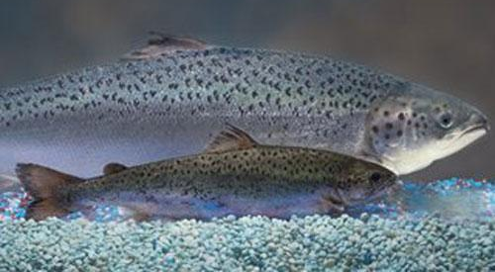
Genetic engineering
Friday, 11 May 2018
Key words: Insulin, Enzymes, Plasmids
Starter: What have these pictures got to do with todays lesson?

Slide 2
The big picture: “What is genetic engineering?”
Learning outcomes
To describe what genetic engineering is using examples.
To analyse how human insulin can be produced in bacteria.
To evaluate the pro’s and con’s of producing insulin this way.

Slide 3
What is genetic engineering?
Scientists can add, remove, or change an organism’s genes to alter it’s characteristics – it is genetically modified (GM)
Genetic modification works in animals, plants and microorganisms

Slide 4
Example of genetic engineering | How it’s been modified | Benefits/ risks or side effects?

Slide 5
Examples of genetic engineering
Look at the presentation showing examples of genetic engineering.
You should fill in your table as you read about each examples.

Slide 6
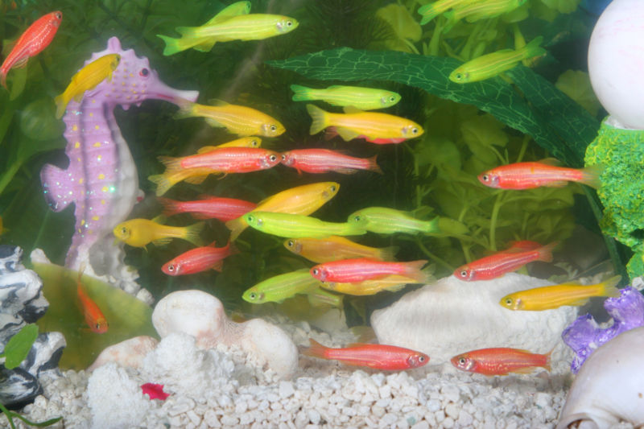
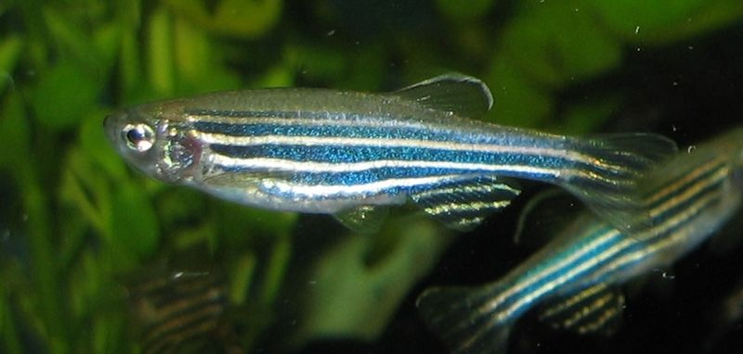
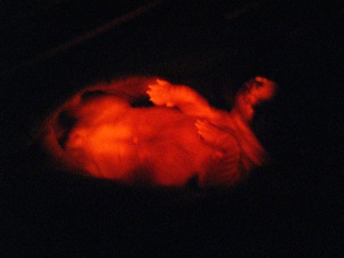
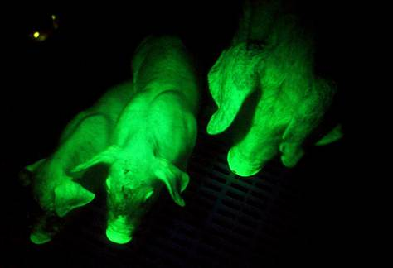
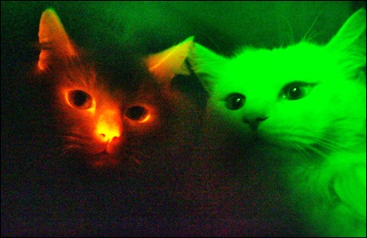
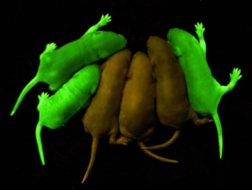
GloFish
Originally created in an attempt to show levels of pollutions in rivers.
Native to India and Bangladesh. None have survived in American rivers.
Zebra fish with a gene inserted from jellyfish or coral to make them fluoresce.
The first genetically engineered organism to be sold as a pet.
They can reproduce, but it is illegal to do so!
How does this fish benefit us?
Other fluorescent organisms

Slide 7
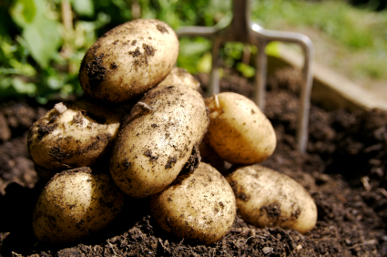
Superspuds
The ‘Protato’ contains 60% more protein per gram than a ‘normal’ potato, it also has a larger yield.
A gene was used from the grain Amaranth which codes for storage protein.
Could the Protato face the same opposition as Amflora?
Amflora
Potato created for the starch industry.
Used antibiotic resistance marker gene.
Fear that the genes could escape into the environment.
It was proposed that the waste potato was fed to livestock.
This caused outrage from some European countries, why?
In tests with rats and rabbits there have been no side effects and no allergic affects.

Slide 8
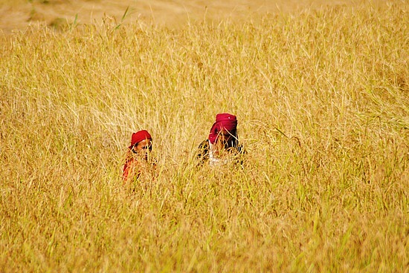
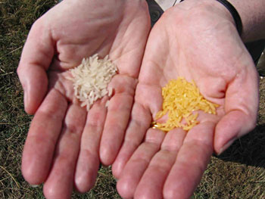
Golden Rice
Genetically engineered rice which contains a gene from carrots (or other vegetable) which causes the rice to contain the building blocks for vitamin A production in the body.
Vitamin A deficiency causes blindness and death.
125 million children suffer from vitamin A deficiency. Most of these children live in developing countries where rice is the staple food.
Too much vitamin A causes other health problems.
Some people think that GM crops like this one promote the use of GM foods to people that are not in the position to say no.

Slide 9
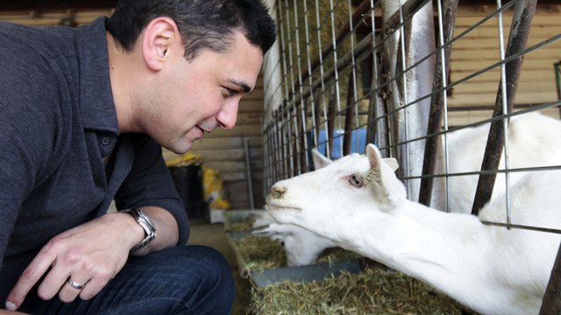
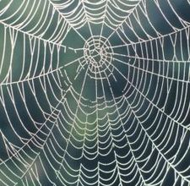
Spider-Goat
Spider silk is stronger than steel, lightweight, and very elastic.
It holds it’s strength between -40°C and 220°C.
Spider silk could be used to manufacture;
replacement ligaments
wound covering (it has antiseptic properties and vitamin K which helps with blood clotting!)
optical communications
bullet proof clothing
waterproof clothing!!
Goats which produce spider silk in their milk!
The gene transferred from a spider causes the goats to produce an extra protein in their milk which can be extracted and spun into spider silk thread.
About 75% of spider goats are euthanised as there are strict controls meaning that they cannot leave the facility where they are created.
Why create a life to destroy it?
Spiders cannot be farmed as they are cannibalistic –
they eat each other!

Slide 10
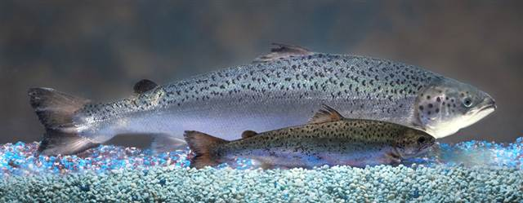
AquAdvantage Salmon
This fish has not been consumed by humans yet – is it safe?
A gene which controls the growth hormone from one breed of salmon is inserted into the DNA of another.
This causes it to grow much quicker than ‘normal’ salmon.
What affect could the AquAdvantage salmon have on wild salmon if it escaped?
Could this gene be transferred to humans if we eat it?
What could happen if this occurred?
AquAdvantage salmon
Normal salmon

Slide 11
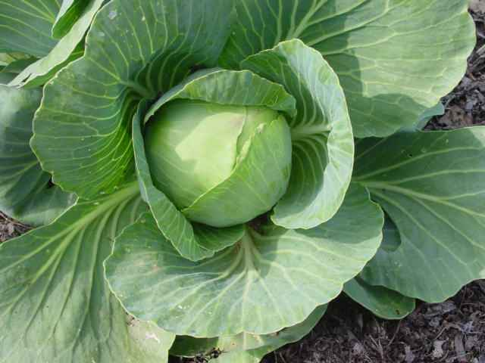
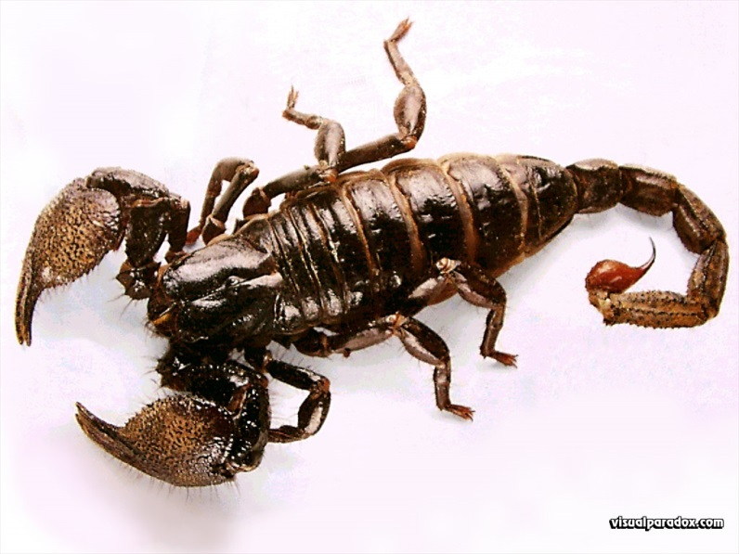
Venomous cabbage
Cabbage which has been genetically engineered to include the gene for Scorpion venom.
This reduces the use of chemical pesticides sprayed on crops.
The venom is poisonous to caterpillars – it acts as a pesticide.
The toxin has been altered - it does not kill human cells
What if the toxin mutates and alters again?
What affect will the toxin have on the biodiversity of the area?

Slide 12
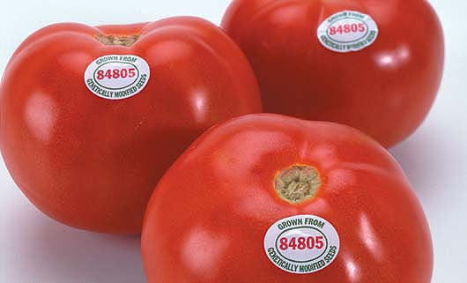
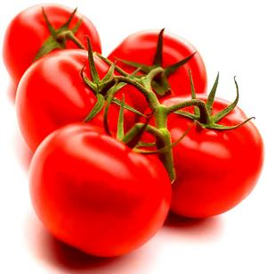
Flavr Savr Tomato
Normally, tomatoes are picked while green and transported many miles before being sprayed with ethylene to ripen them.
This prevents damage and perishing on the journey.
The Flavr Savr tomato is a genetically engineered tomato which has a gene inserted to extend shelf-life by slowing down the rotting process.
The Flavr Savr tomato was the first GM fruit to be sold in the World.
Is it better to spray tomatoes with ethylene than genetically engineer them?

Slide 13
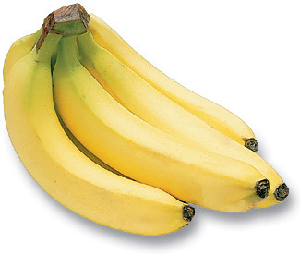
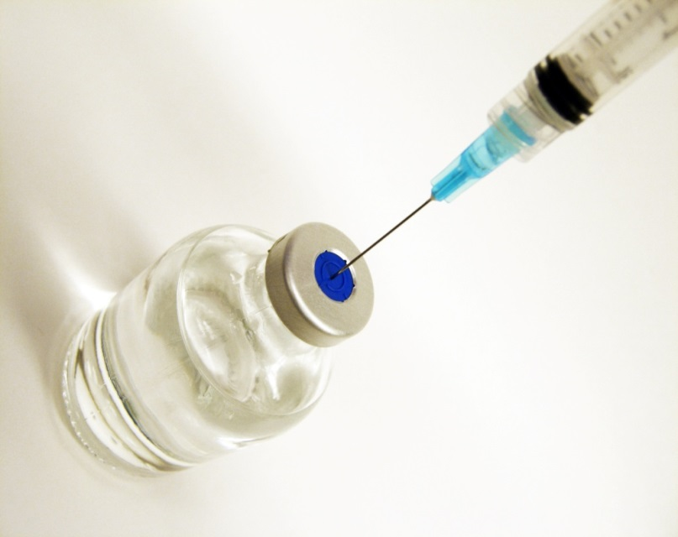
Banana Vaccine
Bananas, carrots, potatoes and lettuce have all been genetically engineering to deliver vaccines for diseases.
The banana has been the most successful in testing.
The virus’ genes are transferred to the banana cells and become a permanent part of that banana’s genetic code.
Is there a risk of people taking the vaccine without realising they are doing so?
When the gene has been inserted into the banana, it’s cells produces virus proteins (not the infectious part).
When you eat the banana you ingest these proteins and the body produces antibodies against them – this is exactly how injected vaccines work!

Slide 14
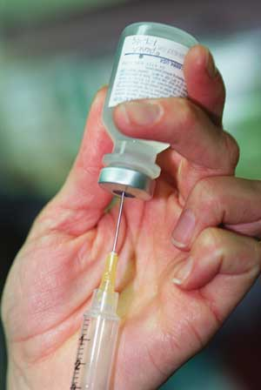
Human insulin
What is insulin used for?
To control blood sugar levels
Where can we get it from?
Pigs and cows
What are the problems with using animal insulin in humans?
Not enough can be produced – 2.6 million people suffer from diabetes in the UK.
Some people think it is ethically wrong.
May not work as well.
Against some religions.
GM insulin has solved this problem!

Slide 15
Task
Cut and stick the pictures in the correct order to show how human insulin can be produced by bacteria.
2. What are enzymes and why are they used in this process.

Slide 16
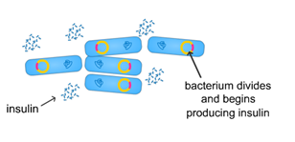
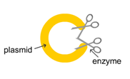
Put the process in the correct order. What are the enzymes used to cut and join the DNA fragments?

Slide 17
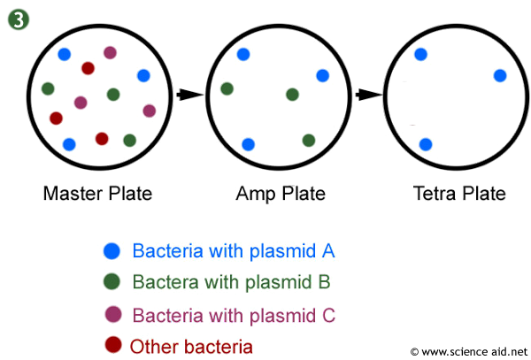
Not all bacteria take up the plasmid!
There are 3 possible types of colony that may grow in this process:
Some from bacteria that did not take up the plasmid.
Some from bacteria that have taken up a plasmid that has not sealed in a copy of the gene but has sealed up on itself to reform the original plasmid.
Some – the ones we want – that have taken up the recombinant plasmid. We call these TRANSFORMED bacteria.

Slide 18
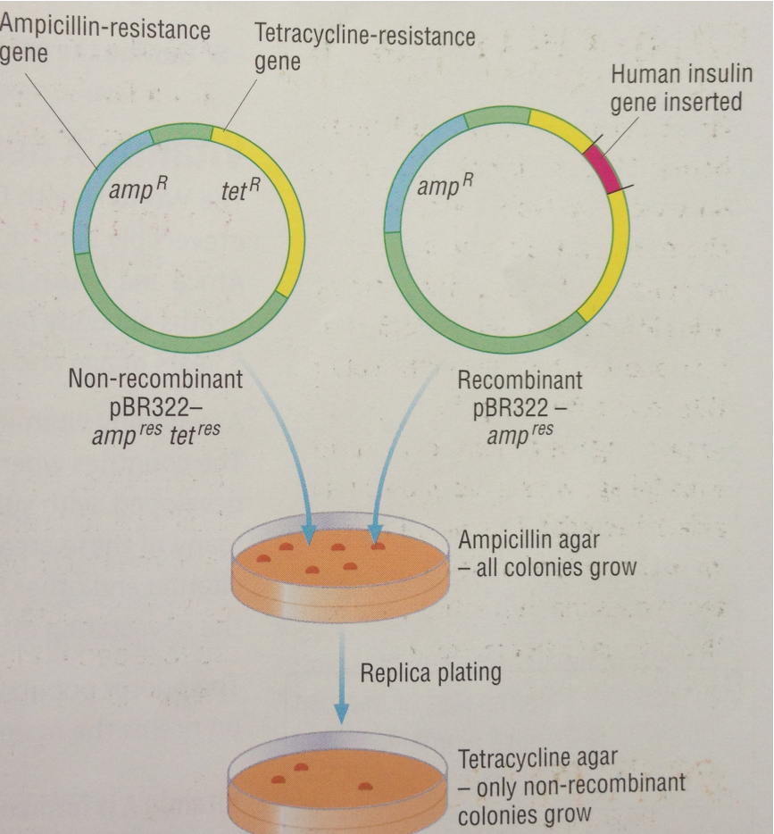
Replica Plating
The bacteria are grown on standard nutrient agar, so all bacteria cells grow to form colonies.
Some cells from the colonies are transferred onto agar that has been made with ampicillin, so that only those that have taken the plasmid will grow.
Some cells from these colonies are transferred onto agar that has been made with tetracycline so only those that have taken up a plasmid that does not have the insulin gene will grow.

Slide 19
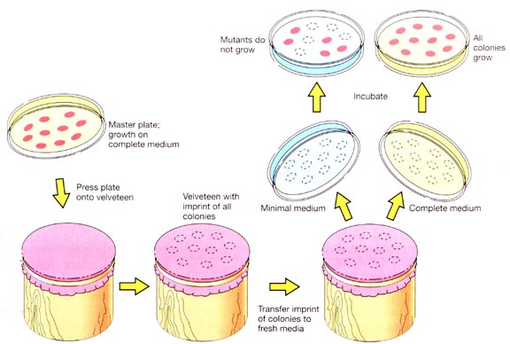
Replica Plating
By keeping track of which colonies are which, we know that any bacteria that grow on the ampicillin agar, but not on the tetracycline agar, must have taken up the plasmid with the insulin gene.
We can now identify the colonies we want and grow them on a large scale. These bacteria then produce insulin on a large scale which can be harvested for use.

Slide 20
Pro’s and Con’s
Read the statements as a table and produce a table of pro’s and con’s in producing insulin using genetic engineering.

Slide 21
Antibiotic resistance can spread because the antibiotic resistance gene acts as a marker to show which bacteria contain the insulin gene.
Many religions disagree with producing pig/ animal insulin.
More insulin can be produced using genetic engineering.
Unknown long term side effects of using bacteria to produce insulin.
Cow/ pig insulin may not work as well as human insulin.
It is wrong to alter the genes of any organism.
New, harmful strains of bacteria could be produced.
It is cheaper to produce GM insulin.
GM insulin is the only way we can meet the increasing demand of this drug.
Genetic engineering produces human insulin.

