Slide 1
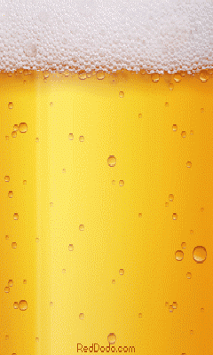
Option F Biotechnology and Microbes
F 4 Microbes and Food

Slide 2
Assessment statements
F.4.1 Explain the use of Saccharomyces in the production of beer, wine and bread.
F.4.2 Outline the production of soy sauce using Aspergillus oryzae.
F.4.3 Explain the use of acids and high salt or sugar concentrations in food preservation.
F.4.4 Outline the symptoms, method of transmission and treatment of one named example of food poisoning.

Slide 3
F.4.1 Explain the use of Saccharomyces in the production of beer, wine and bread.
Beer
Beer is made from barley grains which are moistened and allowed to sprout. During germination a proportion of the starch reserves are converted by enzymes to maltose. However, in addition the process allows the development of enzymes which are important in the later stages of brewing. The process is known as malting and requires oxygen. The sprouting barley is termed malt.
Crushing and roasting the sprouted grains gives a
darker colour and richer flavours. This process is
known as kilning and allows brewers to store it for up
to a year.
LINK
The resulting grist is then mashed with hot water. This gelatinises the starch and further enzyme action in the mash produces glucose and simple nitrogen-containing compounds. This nutrient rich liquid is termed wort. It is filtered and the spent grain removed.

Slide 4
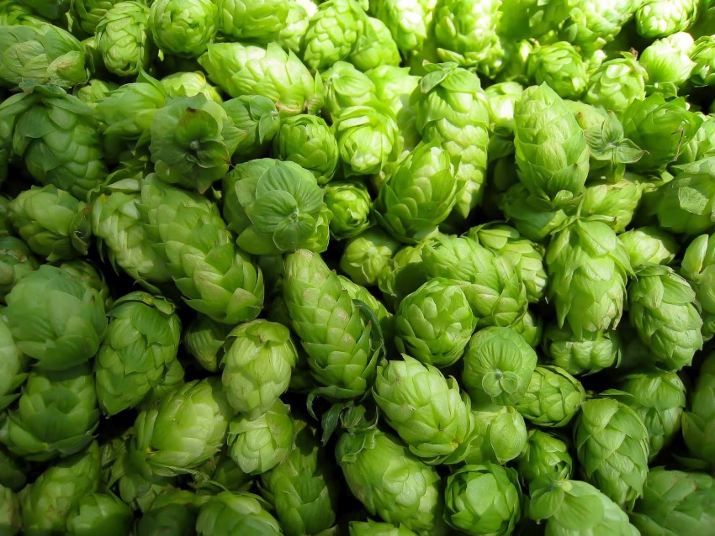
F.4.1 Explain the use of Saccharomyces in the production of beer, wine and bread.
The higher the sugar (Glucose) content of the mash the higher the percentage of ethanol made. Brewers may also add additional enzymes, for example, amylase (Why?), to the mash to maximize the amount of sugar. This results in a low carbohydrate or ‘lite’ beer.
C₆H₁₂O₆ --> 2 H₃C-CH₂OH + 2 CO₂
_{Glucose} _{Ethanol} _{Carbon dioxide}
Hops or hop extract are added to the wort with colourings and the mash is boiled. The hops give beer it characteristic bitter flavour and also have anti-microbial activity (by allowing movement across bacterial membranes).

Slide 5
F.4.1 Explain the use of Saccharomyces in the production of beer, wine and bread.
After cooling, the mixture is run into a fermentation tank and inoculated with strains of Saccharomyces cerevisiae, brewer’s yeast. The wort contains dissolved air and hence initially the yeast respires aerobically and multiplies rapidly. Later when the oxygen is consumed the yeast respires anaerobically and cell division stops. The dense layer of carbon dioxide generated by the activity of the yeast ensure that the tank is anaerobic thereby ensuring fermentation occurs.
Ethanol is produced as a result of the anaerobic fermentation of sugars. Fermentation usually stops when the fermentable sugars have been used up. The beer is then separated from the yeast, clarified, treated to prevent spoilage, carbonated and packaged.

Slide 6
Task for now:
Discover the process for WINE production. Make sure you include the function of microbes.

Slide 7
F.4.1 Explain the use of Saccharomyces in the production of beer, wine and bread.
Wine
Wines were traditionally made with mild yeast found on the skins of the grapes. Different yeast strains are often confined to small areas and each gives a particular flavour and aroma (smell) to the wine which is characteristic of that region. Each grape type has a slightly different chemical composition in its fruit which affects the wine it is made into. Modern wineries use specific strains of yeast which give consistency to the wine and reduce souring by bacteria.
The grapes are picked and gently crushed which loosens the soft skins and stems resulting in the formation of a must. The must is then screened to remove stems and treated with sulfur dioxide gas to kill microorganisms that cause spoilage.

Slide 8
F.4.1 Explain the use of Saccharomyces in the production of beer, wine and bread.
Wine yeasts are then added to convert the sugars to ethanol. White wine is made when the skins are removed early. The fermentation is performed at 25 °C; anthocyanin and tannin pigments are leached out of the grape skins. The wine is run off and ‘racked’: the pulp is allowed to settle and then removed and pressed.
It is then reintroduced to the wine and the fermentation allowed to finish. The dregs or ‘lees’ are allowed to settle. It is then stored and allowed to mature. It is then filtered, fined and bottled.
LINK

Slide 9
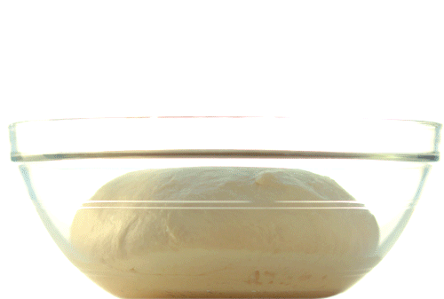
F.4.1 Explain the use of Saccharomyces in the production of beer, wine and bread.
Bread
When flour is made into a dough, amylases from the original wheat grain act on starch to produce a mixture of glucose and maltose. Specialised varieties of the yeast strain Saccharomyces cerevisiae ferment these sugars generating carbon dioxide gas. This makes the dough rise as bubbles of gas are caught in the mixture.
Water and ethanol are also generated, but are driven off as gases during the baking of the dough. The high temperatures kill the yeast, preventing further action.

Slide 10
F.4.2 Outline the production of soy sauce using Aspergillus oryzae.
Soy sauce is made from soya beans and wheat. It is food flavour and has a high salt and peptide content. It is a very important ingredient in Asian cooking and is used to enhance the flavour of fish, rice, bean curd (tofu) and boiled vegetables.
LINK
Soy sauce is prepared on the industrial scale by using
enzymes to hydrolyse beans and cereal proteins. The fungi Aspergillus oryzae and Rhizopus together with lactobacilli and yeasts provide the enzymes to break down proteins and starch.
The soya beans are soaked and boiled and the wheat is rusted and crushed. They are then mixed together and inoculated with a culture of Aspergillus oryzae. The fungus grows for several days on the mixture, which is aerated and spread out. Salt water is added and the mash left in deep, cool fermentation tanks for several months.
The lactobacilli and the yeasts grow and lactic acid and alcohol fermentations occur and the mixture is aged to make raw soy sauce. It is then filtered, pasteurised and the sediments and oils removed.

Slide 11
F.4.2 Outline the production of soy sauce using Aspergillus oryzae.
SUMMARY
Main ingredients used are soybeans, wheat, salt and water
(mold) Aspergillus oryzae/A. sojae are added to the roasted wheat and steamed soybeans
Carbohydrates are fermented to produce alcohol and lactic acid.
Proteins are broken down to peptides/amino acids
Colour due to 6–8 month maturation process

Slide 12
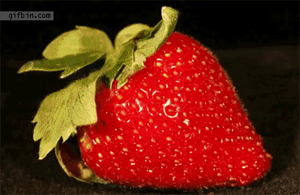
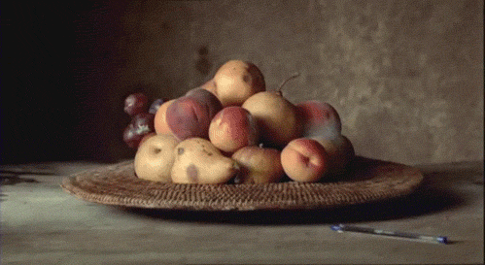
F.4.3 Explain the use of acids and high salt or sugar concentrations in food preservation.
Many foods are preserved using salt or sugar. The majority of microorganisms will not be able to grow under such conditions, due to water loss via osmosis.
Jams contain a very high concentration of sugar, typically fifty to seventy
per cent. They are boiled before pouring into hot glass jars. This sterilises the jam which is then sealed to prevent further contamination from air borne fungi and bacteria. Once the jar is opened, bacteria cannot grow, but some strains of yeast and fungi can tolerate the high dissolved
sugar content.

Slide 13
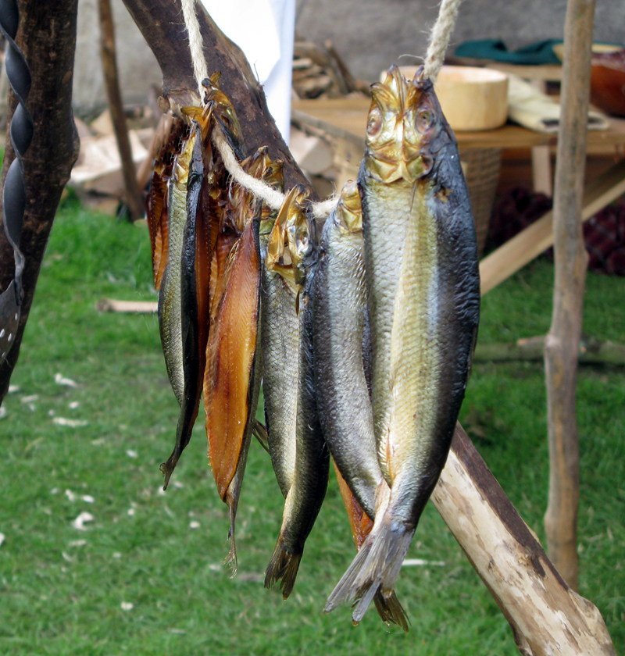
F.4.3 Explain the use of acids and high salt or sugar concentrations in food preservation.
Both salt and sugar absorb moisture from the atmosphere and this accelerates the spoilage process as the concentration of sugar or salt falls with time. Salting and brining uses salt (sodium chloride) concentrations of twenty to thirty percent and is used for meat, fish and vegetables.
LINK
Weak acids are used to lower the pH of micro-organisms, stopping their multiplication. Acetic acid is used for example to pickle unions.

Slide 14
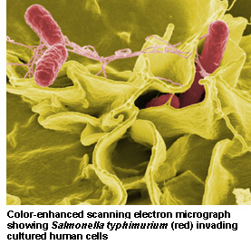
F.4.4 Outline the symptoms, method of transmission and treatment of one named example of food poisoning.
Food poisoning is best described as food infection since it is caused by pathogenic bacteria, viruses or fungi. Such contamination usually arises from improper handling, preparation, or food storage. Good hygiene practices before, during, and after food preparation can reduce the chances of contracting an illness. Bacteria are a common cause of food poisoning. Salmonella is a Gram negative genus of bacteria commonly responsible for food poisoning

Slide 15
F.4.4 Outline the symptoms, method of transmission and treatment of one named example of food poisoning.
Salmonella produce enterotoxins, which are active in the human gut. An enterotoxin is a toxin released by a microorganism in the lower intestine. The enterotoxin alters the permeability of the intestinal wall. This causes water and electrolytes to leak into the intestinal tract, causing diarrhoea. In more serious cases the bacteria may enter the lymphatic system.
LINK
Salmonella also produces endotoxins, which when present in large amounts cause fever, diarrhea and inflammation in the human host. However, with Salmonella infection the diarrhea does not occur until one to two days after eating infected eggs or uncooked fish or chicken.
The delay occurs because the bacteria from the infected food stick to the surface of epithelial cells lining the intestine. The Salmonella bacteria then enter the cells via phagocytosis. The cells are damaged when the Salmonella bacteria multiply and produce endotoxins.

Slide 16
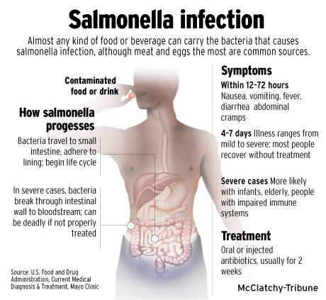
F.4.4 Outline the symptoms, method of transmission and treatment of one named example of food poisoning.
Most mild types of salmonella infection clear up in four to seven days without requiring any treatment other than rest and plenty of liquid. A more severe infection may cause excessive diarrhoea, stomach cramps, severe dehydration.
In such cases, treatment with antibiotics may be necessary and a doctor should be consulted.

Slide 17
Option F Biotechnology and Microbes
F 4 Microbes and Food

