Slide 1
Option F Biotechnology and Microbes
F2 Microbes and the Environment

Slide 2
Assessment statements
F.2.1 List the roles of microbes in ecosystems, including producers, nitrogen fixers and decomposers.
F.2.2 Draw and label a diagram of the nitrogen cycle.
F.2.3 State the roles of Rhizobium, Azotobacter, Nitrosomonas, Nitrobacter and Pseudomonas denitrificans in the nitrogen cycle.
F.2.4 Outline the conditions that favour denitrification and nitrification.
F.2.5 Explain the consequences of releasing raw sewage and nitrate fertilizer into rivers.
F.2.6 Outline the role of saprotrophic bacteria in the treatment of sewage using trickling filter beds and reed bed systems.
F.2.7 State that biomass can be used as raw material for the production of fuels such as methane and ethanol.
F.2.8 Explain the principles involved in the generation of methane from biomass, including the conditions needed, organisms involved and the basic chemical reactions that occur.

Slide 3
F.2.1 List the roles of microbes in ecosystems, including producers, nitrogen fixers and decomposers.
Bacteria play a major role in recycling many chemical elements and compounds in ecosystems, both on land and in water. The chemical elements involved include phosphorus, sulphur, carbon and nitrogen.
A number of bacteria are decomposers and breakdown the remains of dead organisms to release nutrients which re‑enter the environment. Decomposers play very important roles in the carbon cycle and the nitrogen cycle.
LINK
Strains of specialised bacteria known as nitrogen fixers convert gaseous nitrogen into nitrates or nitrites as part of their metabolism, and the resulting products are released into the environment. They form an important part in the nitrogen cycle.
Producers convert raw energy to organic molecules and nutrients useful to themselves and other organisms. This is a varied group of bacteria and includes photosynthetic bacteria, for example, the cyanobacteria and chemosynthetic bacteria

Slide 4
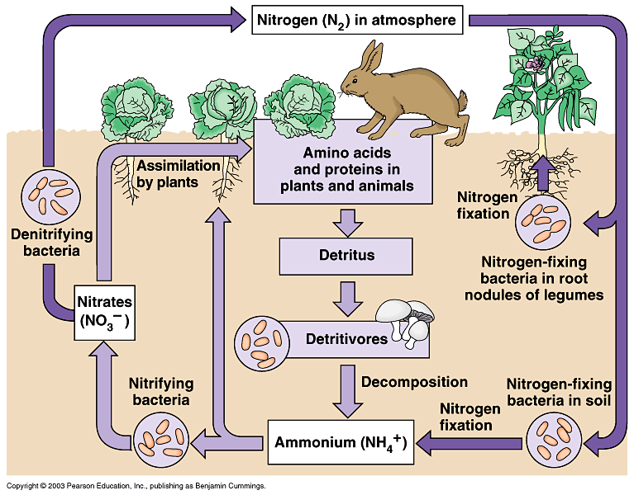
F.2.2 Draw and label a diagram of the nitrogen cycle.

Slide 5
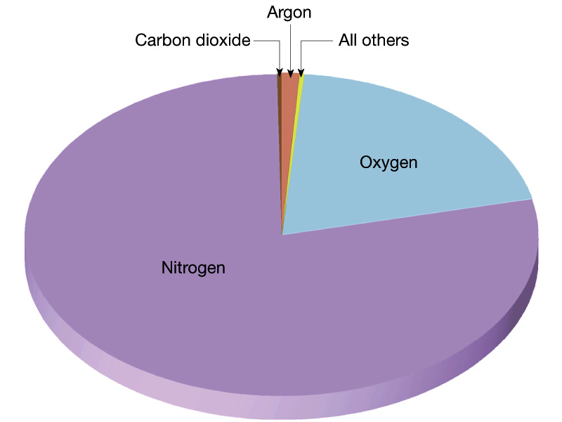
F.2.3 State the roles of Rhizobium, Azotobacter, Nitrosomonas, Nitrobacter and Pseudomonas denitrificans in the nitrogen cycle.
Nitrogen gas forms about 80% by volume of the atmosphere. It is an important constituent of all living organisms.
Nitrogen gas exists in the form of diatomic molecules (N₂) held together by a strong triple covalent bond.
Very few organisms possess the enzymes needed to split nitrogen molecules and use the gas directly. The majority of living organisms must obtain nitrogen in a fixed form, that is, in the form of nitrogen-containing compounds.

Slide 6
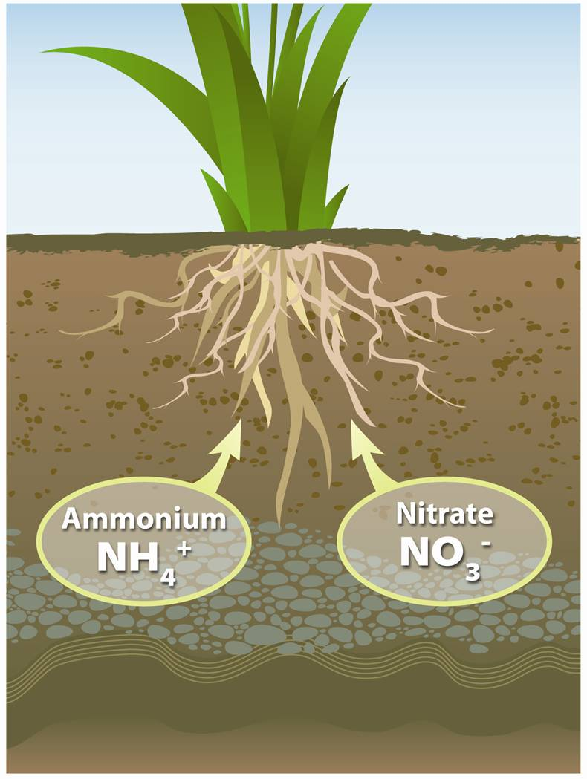
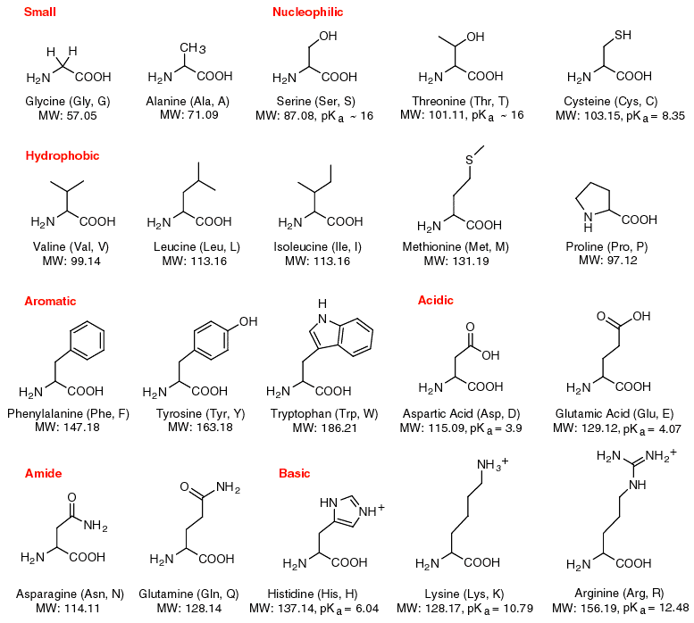
F.2.3 State the roles of Rhizobium, Azotobacter, Nitrosomonas, Nitrobacter and Pseudomonas denitrificans in the nitrogen cycle.
In the case of plants, the most accessible form are nitrate ions, NO3- (aq), although they can also absorb ammonium ions, NH₄+ (aq) or urea, CO(NH₂)₂.
Animals require nitrogen in an organic form, usually in the form of amino acids.

Slide 7
F.2.3 State the roles of Rhizobium, Azotobacter, Nitrosomonas, Nitrobacter and Pseudomonas denitrificans in the nitrogen cycle.
Nitrogen fixation
In this process nitrogen gas from the atmosphere is incorporated into nitrogen compounds, such as nitrates (NO₃⁻), nitrites (NO₂⁻) or ammonia (NH₃).
Lightning is one source of nitrogen fixation: the high temperatures cause nitrogen and oxygen to form nitrogen monoxide.
This is then oxidized by oxygen to form nitrogen dioxide which reacts with water to form nitrate ions:
Step 1: N₂ (g) + O₂ (g) → 2NO (g)
Step 2: 2NO (g) + O₂ (g) → 2NO₂ (g)
Step 3: 3NO₂ (g) + H₂O (l) → 2H+ (aq) + 2NO₃- (aq) + NO (g)
LINK

Slide 8
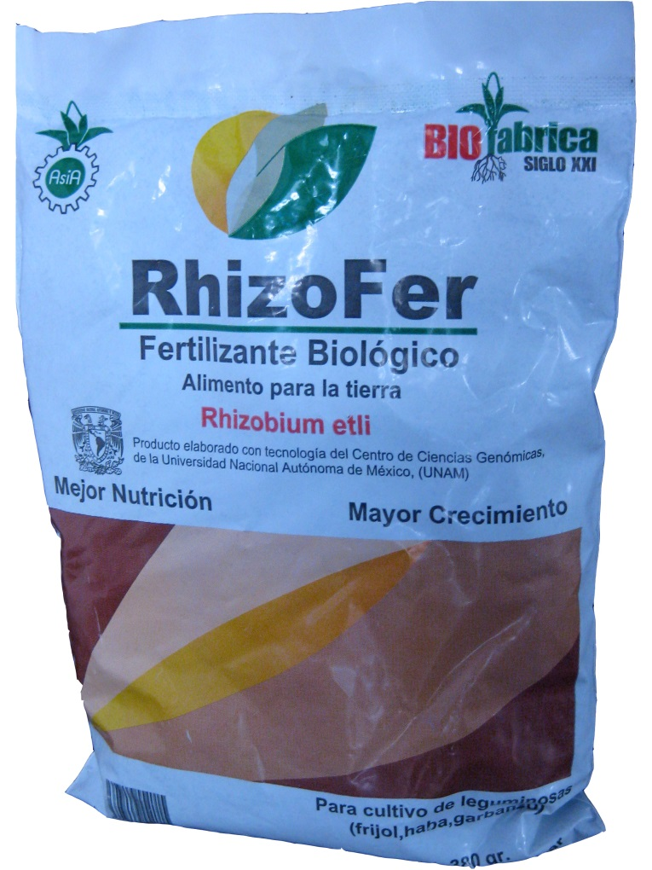
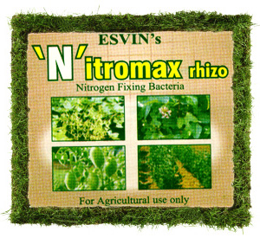
F.2.3 State the roles of Rhizobium, Azotobacter, Nitrosomonas, Nitrobacter and Pseudomonas denitrificans in the nitrogen cycle.
Nitrogen fixation is also performed by a number of organisms. Examples include Rhizobium bacteria living in root nodules and the free living bacteria Azotobacter.
Some species of cyanobacteria (see Topic F.5.5) are able to fix nitrogen. Both of these nitrogen fixing bacteria utilise an enzyme known as nitrogenase.

Slide 9
F.2.3 State the roles of Rhizobium, Azotobacter, Nitrosomonas, Nitrobacter and Pseudomonas denitrificans in the nitrogen cycle.
The process of nitrogen fixation also requires large amounts of ATP. Ammonia is produced which is then incorporated into proteins, nucleic acids and other nitrogenous biological chemicals.
N₂ + 6NADH + H⁺ + 16ATP → 16ADP + 16P + 2NH₃
Microorganisms that fix nitrogen require 16 moles of adenosine triphosphate (ATP) to reduce each mole of nitrogen (Hubbell & Kidder, 2009)
Nitrogen fixation occurs in the Haber Process in which hydrogen and nitrogen gases are reacted together at high temperature and pressure in the presence of an iron catalyst to form ammonia.
N₂ (g) + 3H₂ (g) → 2NH₃ (g)
This method is used to manufacture artificial fertilisers, for example, ammonium nitrate and ammonium sulfate.
LINK

Slide 10
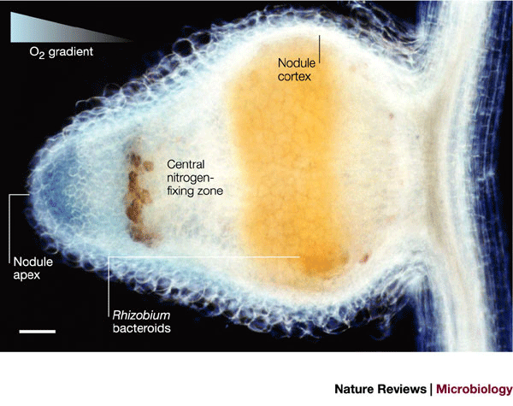
F.2.3 State the roles of Rhizobium, Azotobacter, Nitrosomonas, Nitrobacter and Pseudomonas denitrificans in the nitrogen cycle.
Root nodules
Some plants, including peas, beans and clover, and other plants known as legumes, have roots which are capable of forming a mutualistic association with nitrogen-fixing bacteria such as Rhizobium.
They multiply inside small swellings called root nodules. The bacteria are chemically attracted to the legume root and they enter into the cells of the cortex by means of tiny channels called infection threads. Once inside the host the bacteria multiply and become non-motile.
Nitrogenase only functions in the absence of oxygen, so the nodule contain leghemoglobin which has a high affinity for oxygen and storing as it enters
the root cells.

Slide 11
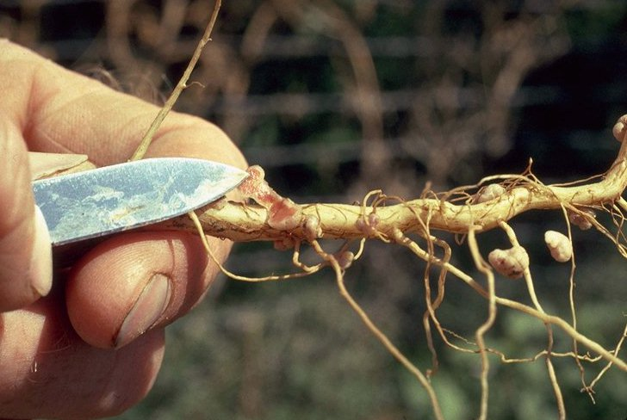
LINK

Slide 12
F.2.4 Outline the conditions that favour denitrification and nitrification.
Nitrification
This process involves the oxidation of nitrogen compounds to produce nitrate ions in the soil.
Nitrate ions are often absorbed via active transport by the root hairs from the soil.
They are then incorporated by metabolic pathways into proteins and nucleic acids.
They are then passed through the various trophic levels in a food pyramid in organic form.
The compounds return to the soil in faeces or contained in dead material.
These are then broken down by decomposers in a process called deamination which results in the release of ammonia.
A more direct process of recycling occurs through the excretion by animals of urea or uric acid.

Slide 13
F.2.4 Outline the conditions that favour denitrification and nitrification.
Ammonia in the soil can be used as an energy source by nitrifying bacteria, for example, Nitrosomonas, which oxidises ammonia molecules to nitrite ions.
2NH₃ + 3O₂ → 2NO₂⁻ + 2H₂O + 2H⁺ + energy
Nitrobacter is another group of nitrifying bacteria. It oxidizes nitrite ions to nitrate ions.
2NO₂⁻ + O₂ → 2NO₃⁻ + energy
Both groups of bacteria require carbon dioxide. Nitrification occurs in well aerated soil and water. Most of the ammonium and nitrate compounds produced by nitrifying bacteria are reused by living organisms.
Ammonium ions tend to be retained by soil, but nitrate ions can be washed into lakes and rivers and cause pollution.

Slide 14
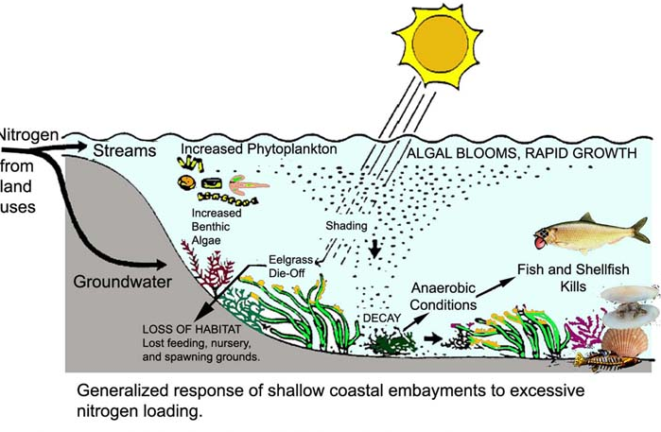

Slide 15
F.2.4 Outline the conditions that favour denitrification and nitrification.
Denitrification
Some of the nitrogen contained in nitrates is returned to the atmosphere through the action of denitrifying bacteria. They live in soil or water where oxygen is in short supply and use nitrate ions as a source of oxygen for aerobic respiration. Nitrogen gas is released a waste product form this process. Pseudomonas denitrificans is an example of a denitrifying bacterium.
2NO₃⁻ + 10 e⁻ + 12H⁺ → N₂ + 6H₂O

Slide 16
F.2.5 Explain the consequences of releasing raw sewage and nitrate fertilizer into rivers.
Sewage from houses consists mainly of human faeces and kitchen waste which will include food residues and detergents. Sewage is also likely to include industrial waste which contain strongly acidic or alkaline chemicals. Toxic metals ions, such as chromium, copper and zinc may also be present.
Water pollution may also result from the leakage of animal waste and other farm waste. Run off water from farm fields may also contain artificial fertilizers, especially nitrates.
LINK
LINK

Slide 17
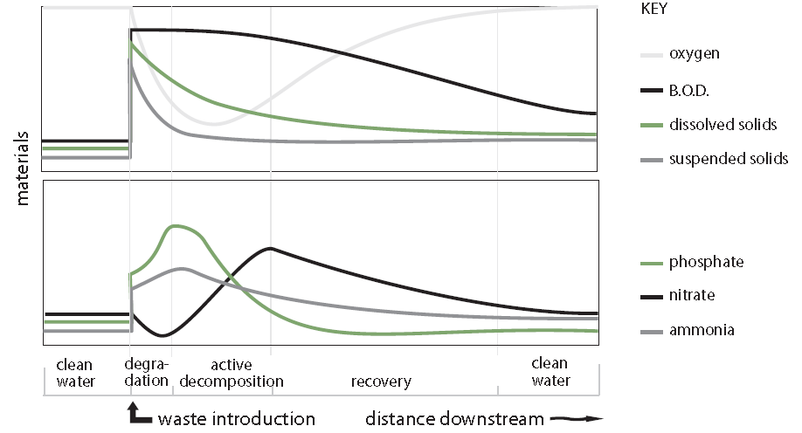
F.2.5 Explain the consequences of releasing raw sewage and nitrate fertilizer into rivers.
If raw sewage and nitrate polluted run off water from farms is discharged into a river there will be rapid changes in the physical factors of the environment.
The biochemical oxygen demand (BOD) of a sample of water is measured under standard conditions at 20 °C over a period of five days. The presence of polluting organic material leads to increased activity from bacteria involved in the decomposition of this material, resulting in a high demand for dissolved oxygen. The BOD measurement thus gives an indication of the level of organic pollution.

Slide 18
F.2.5 Explain the consequences of releasing raw sewage and nitrate fertilizer into rivers.
In the initial stage, just below the point at which the raw sewage enters the river, there is immediate decomposition of organic material by aerobic bacteria. The demand for dissolved oxygen in the water is high, resulting in a rapid decrease in the concentration of oxygen. This ‘oxygen sag’ occurs when the rate of consumption during respiration is greater than the rate at which oxygen is produced. As the organic material is decomposed, the numbers of aerobic bacteria decrease, but the numbers of protozoa, which feed on other organisms, increases.

Slide 19
F.2.5 Explain the consequences of releasing raw sewage and nitrate fertilizer into rivers.
The numbers of algae increase when the suspended solids begin to settle
and the water becomes clearer allowing light to penetrate and photosynthesis to occur. Consequently, levels of dissolved oxygen rise. The nitrate and phosphate ions will be absorbed by the increasing population of algae.

Slide 20
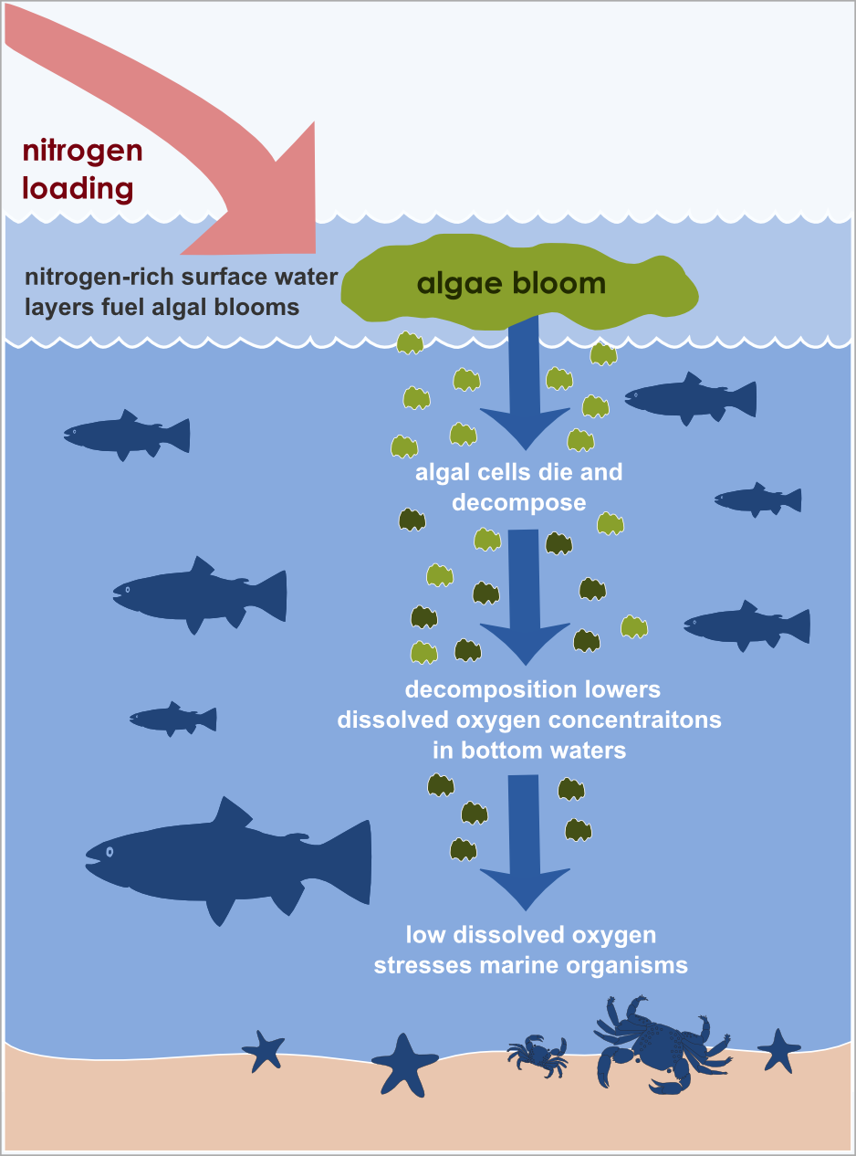
F.2.5 Explain the consequences of releasing raw sewage and nitrate fertilizer into rivers.
Eutrophication refers to the artificial enrichment of nutrients in a river or
lake. The excess nutrients in the water encourages rapid growth of algae and blue-green bacteria resulting in an algal bloom.
When the algae die, they are broken down by the aerobic bacteria and if the oxygen level falls very low, there may be a sudden death of masses of fish, a fish kill.
The recovery of the river or lake occurs when the oxygenation of the water improves as well as dilution of the sewage and nutrients.

Slide 21
F.2.6 Outline the role of saprotrophic bacteria in the treatment of sewage using trickling filter beds and reed bed systems.
A sewage treatment plant uses natural decay processes and provides the best possible conditions for the growth of microorganisms and hence the breakdown or decomposition of organic material.
The final breakdown products from aerobic processes are carbon dioxide, which is released to the atmosphere and nitrate, sulfate and phosphate ions, which remain dissolved in the water. A large amount of sediment and sludge accumulates which is decomposed anaerobically to produce methane.
LINK

Slide 22
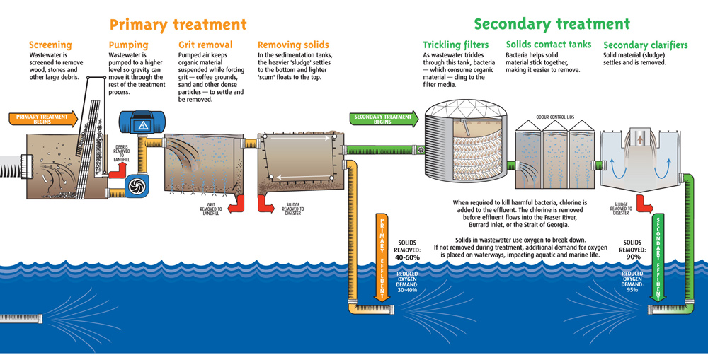
F.2.6 Outline the role of saprotrophic bacteria in the treatment of sewage using trickling filter beds and reed bed systems.

Slide 23
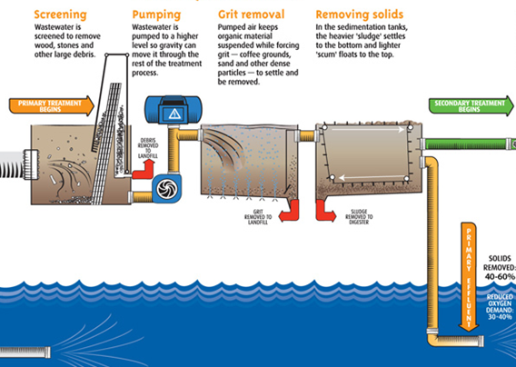
F.2.6 Outline the role of saprotrophic bacteria in the treatment of sewage using trickling filter beds and reed bed systems.
The first step of sewage treatment involves screening the water and allowing it to enter a grit settlement tank. Grit (sand and small stones) and stones settle out and some organic materials flocculate (clump together). After grit settlement the water is then passed to a trickling filter.

Slide 24
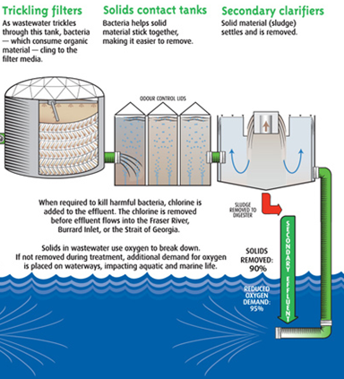
F.2.6 Outline the role of saprotrophic bacteria in the treatment of sewage using trickling filter beds and reed bed systems.
The trickling filter bed is made from carefully graded stones, grit and clinker. Clinker is a general name given to waste from industrial processes - particularly those that involve smelting metals or burning fossil fuels. Bacteria, fungi and protozoa degrade organic matter as the waste water (effluent) trickles through the bed and these are consumed by predatory protozoa and insect larvae.

Slide 25
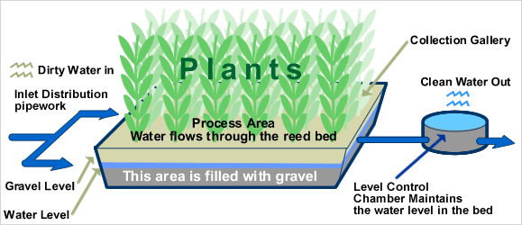
F.2.6 Outline the role of saprotrophic bacteria in the treatment of sewage using trickling filter beds and reed bed systems.
An alternative and organic alternative to traditional methods of sewage treatment is the use of a reed bed. A reed bed is an artificially created wetland planted with specially selected species of reed that have the ability to absorb oxygen from the air and release it through their roots. This creates ideal conditions for the development of huge numbers of micro-organisms which are able to break down any soluble material present. The need for chemical treatment is avoided.
LINK

Slide 26
F.2.7 State that biomass can be used as raw material for the production of fuels such as methane and ethanol.
Biomass is defined as the total mass of living material in an area. Plants use solar energy in the process of photosynthesis. Solar energy is hence incorporated into biomass, a potential human fuel. The biomass value is the dry mass in kilograms per square metre. Biomass includes plants, animals and microorganisms, but is usually restricted to the plant mass above the ground.
Fermentation of sugar by yeasts (Saccharomyces) can convert the energy of biomass into ethanol, which can be used a fuel. An example is the fuel gasohol which consists of unleaded petrol mixed with ethanol (10 – 20%) and used in modified motor vehicles.
The sugar is obtained from sugar cane, grown in tropical countries, and sugar beet, grown in temperate countries.
LINK
Link ??

Slide 27
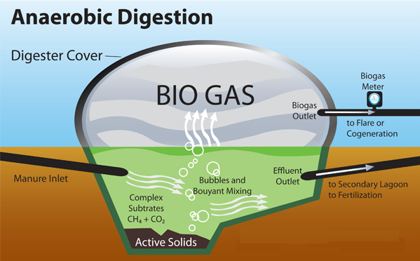
F.2.7 State that biomass can be used as raw material for the production of fuels such as methane and ethanol.
Fermentation by bacteria can convert the energy in biomass into biogas, a gaseous fuel which consists mainly of methane, CH₄, the major component of natural gas.
However, carbon dioxide will be present together with traces of hydrogen sulfide and ammonia. Biogas generation exploits the metabolism of several different groups of bacteria which digest organic matter, for example, animal faeces, under aerobic conditions.
LINK

Slide 28
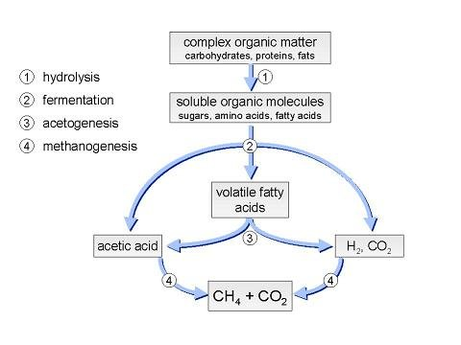
F.2.8 Explain the principles involved in the generation of methane from biomass, including the conditions needed, organisms involved and the basic chemical reactions that occur.
During the fermentation of faeces aerobic bacteria initially hydrolyse any carbohydrate, lipids and protein to sugars, fatty acids, glycerol and amino acids. As the available oxygen is used up, acetogenic bacteria convert
the sugars to short chain fatty acids, especially ethanoate ions (acetate), together with some carbon dioxide and hydrogen. This stage is termed acetogenesis.

Slide 29
F.2.8 Explain the principles involved in the generation of methane from biomass, including the conditions needed, organisms involved and the basic chemical reactions that occur.
The final stage is methanogenesis which is carried out in anaerobic conditions by methanogenic bacteria. It involves the conversion of ethanoate and other acids to methane.
Methanogenic bacteria are obligate anaerobes and are only active in the absence of oxygen. They are members of the archaebacteria (see Topic F.1.1).
CH₃COOH → CH₄ + CO₂
Successful biogas production depends on a temperature of between 30 to 40 degrees Celsius being maintained. Biogas production is often performed in an enclosed tank called a digester. These can be found in countries like
China, Nepal and India. In developed countries they are used to dispose of large quantities of animal waste from intensive farming.

Slide 30
Option F Biotechnology and Microbes
F2 Microbes and the Environment

