Slide 1
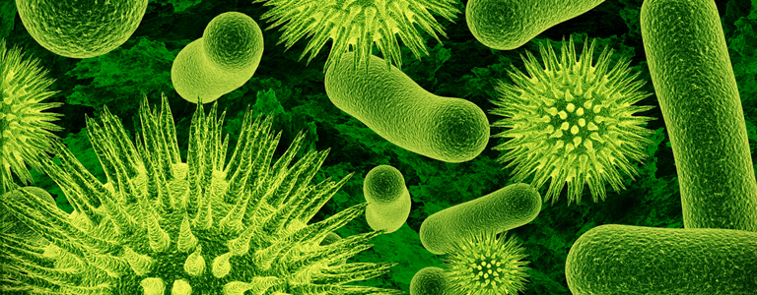
Option F Biotechnology and Microbes
F1Diversity of Microbes

Slide 2
Assessment statements
F.1.1 Outline the classification of living organisms into three domains.
F.1.2 Explain the reasons for the reclassification of living organisms into three domains.
F.1.3 Distinguish between the characteristics of the three domains.
F.1.4 Outline the wide diversity of habitat in the Archaea as exemplified by methanogens, thermophiles and halophiles.
F.1.5 Outline the diversity of Eubacteria, including shape and cell wall structure.
F.1.6 State, with one example, that some bacteria form aggregates that show characteristics not seen in individual bacteria.
F.1.7 Compare the structure of the cell walls of Gram-positive and Gramnegative Eubacteria.
F.1.8 Outline the diversity of structure in viruses including: naked capsid versus enveloped capsid; DNA versus RNA; and single stranded versus double stranded DNA or RNA.
F.1.9 Outline the diversity of microscopic eukaryotes, as illustrated by Saccharomyces, Amoeba, Plasmodium, Paramecium, Euglena and Chlorella.

Slide 3
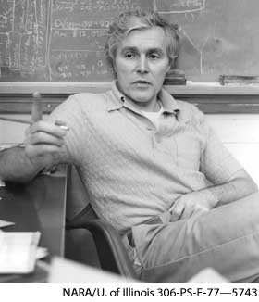
F.1.1 Outline the classification of living organisms into three domains.
In Topic 2 Cells, cells were divided into two fundamental types: eukaryotes (see Topic 2.3) and prokaryotes (bacteria). Eukaryotes include protists (unicellular organisms and algae), fungi, plants and animals. The grouping of all bacteria as prokaryotes (see Topic 2.3) was based on microscopic observations.
However, in 1978 the American Biologist Carl Woese proposed a three domain classification. He suggested that there are three distinct types of cellular organisms: the eukaryotes (see Topic 2), the eubacteria (‘true bacteria’) and the archaebacteria (from archaios, meaning ancient). In effect this is a sub-division of the prokaryotes.
LINK

Slide 4
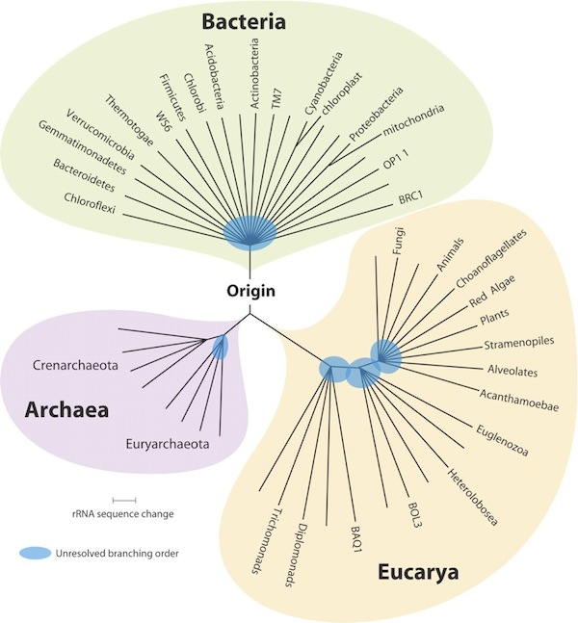

Slide 5
F.1.2 Explain the reasons for the reclassification of living organisms into three domains.
Archaeabacteria are similar to other prokaryotes in most aspects of cell structure and metabolism. However, their transcription and replication do not show many typical bacterial features, and are in many aspects similar to those of eukaryotes.
Woese’s three domain system was initially based upon comparing the sequences of nucleotides in ribosomal RNA (16S rRNA).Ribosomal RNA was chosen by Woese since it is the most conserved (least variable) gene in all cells.
Later studies involved analysing the DNA sequences of the genes coding for RNA polymerase which is an enzyme involved in transcription (see Topic 3.4).

Slide 6
F.1.2 Explain the reasons for the reclassification of living organisms into three domains.
The base sequence in part of the gene for 16S RNA, the smaller of the two main RNA components of the ribosome was compared.
Corresponding segments of nucleotides from a eukaryote (human), an archaebacterium (Methanococcus jannaschii) and a eubacterium (E. coli) were aligned.
The sequences from these three organisms all differ from one another to a similar degree. He concluded that the archaebacteria should be defined as a new domain or kingdom of life, in other words not all prokaryotes should be classified as bacteria.
Human GTT CCG GGG GGA GTA TGG TTG CAA GCT GAA CTT AAA GGA ATT GAC GG..
Methanococcus GCC GCC TGG GGA GTA CGG TCG CAA GAC TGA AAC TTA AAG GAA TTG GC..
E. coli ACC GCC TGG GGA GTA CGG CCG CAA GGT TAA AAC TCA AAT GAA TTG AC..
The data above suggests that eubacteria branched off from the eukaryotes and archeabacteria relatively early, that is, eubacteria is the older kingdom.

Slide 7
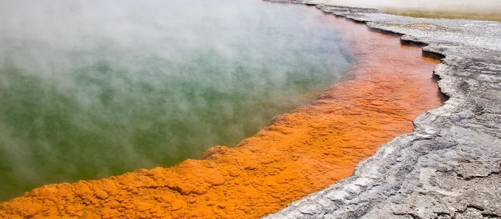
F.1.2 Explain the reasons for the reclassification of living organisms into three domains.
Many strains of archaebacteria are extremophiles and live at high temperatures, but others live in very cold habitats or in highly saline (salty water) or acidic water. However, other archaebacteria are mesophiles and have been found in marshland, seage, soil and sea water. They are also found in the intestines of cows, termites and humans. Archaebacteria are not known to cause any diseases.
An extremophile (from Latin extremus meaning "extreme" and Greek philiā (φιλία) meaning "love") is an organism that thrives in physically or geochemically extreme conditions that are detrimental to most life on Earth.
A mesophile is an organism that grows best in moderate temperature, neither too hot nor too cold, typically between 20 and 45 °C.

Slide 8
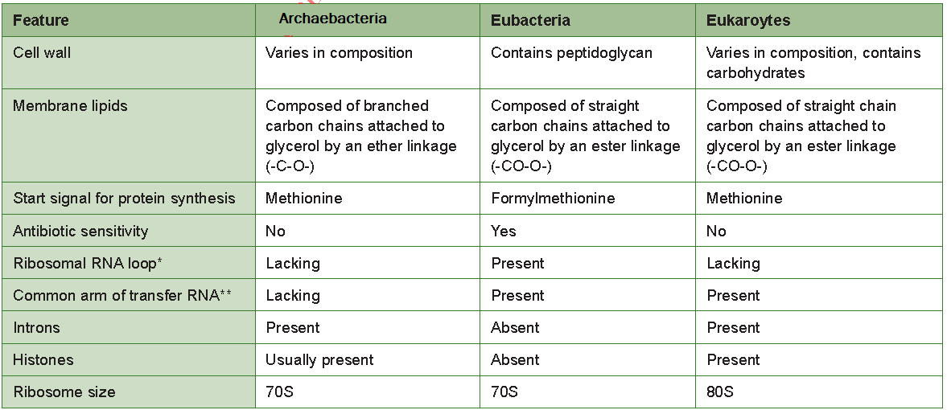
F.1.3 Distinguish between the characteristics of the three domains.
Archaebacteria differ from eubacteria with regard to their membrane structure, transfer RNA molecule structure and sensitivity to antibiotics (see Topics 6.3.2 and F.6.5).

Slide 9
F.1.4 Outline the wide diversity of habitat in the Archaea as exemplified by methanogens, thermophiles and halophiles.

Slide 10
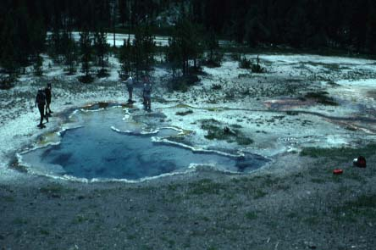
F.1.4 Outline the wide diversity of habitat in the Archaea as exemplified by methanogens, thermophiles and halophiles.
Archaebacteria often live in extreme environments and carry out unusual metabolic processes.
The archaebacteria are classified into three groups:
methanogens
halophiles
thermophiles
LINK

Slide 11
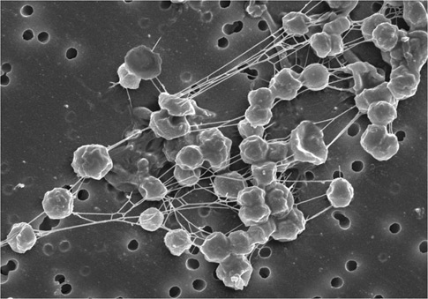
F.1.4 Outline the wide diversity of habitat in the Archaea as exemplified by methanogens, thermophiles and halophiles.
Methanogens
Methanogens are anaerobic and are rapidly killed by the presence of oxygen. Some strains termed hydrotropic, use carbon dioxide as a source of carbon and, hydrogen as a reducing agent). Some of the carbon dioxide is reacted with the hydrogen to produce methane, which produces a proton motive force across a membrane to generate ATP.
They are common in wetland, where they are responsible for marsh gas (Methane), and in the intestines of cows where they are responsible for wind. They are also common in soils in which the oxygen has been depleted. Others are extremophiles and live in hot springs and submarine hydrothermal vents.

Slide 12
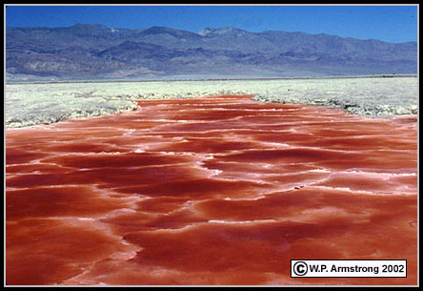
F.1.4 Outline the wide diversity of habitat in the Archaea as exemplified by methanogens, thermophiles and halophiles.
Halophiles
Extreme halophiles or haloarchaea are found in salt lakes, inland seas, and evaporating lakes of seawater, such as the Dead Sea. They require sodium chloride for growth. They are heterotrophs and respire aerobically.

Slide 13
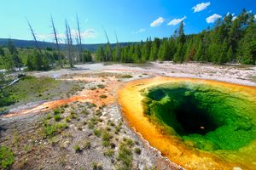
F.1.4 Outline the wide diversity of habitat in the Archaea as exemplified by methanogens, thermophiles and halophiles.
Thermophiles
Thermophiles have been found in hot and deep sea hydrothermal vents. Thermophiles contain enzymes that can function at high temperature. Some of these enzymes are used in molecular biology (for example, heat-stable DNA polymerases for polymerase chain reaction (PCR)), and in washing agents.

Slide 14
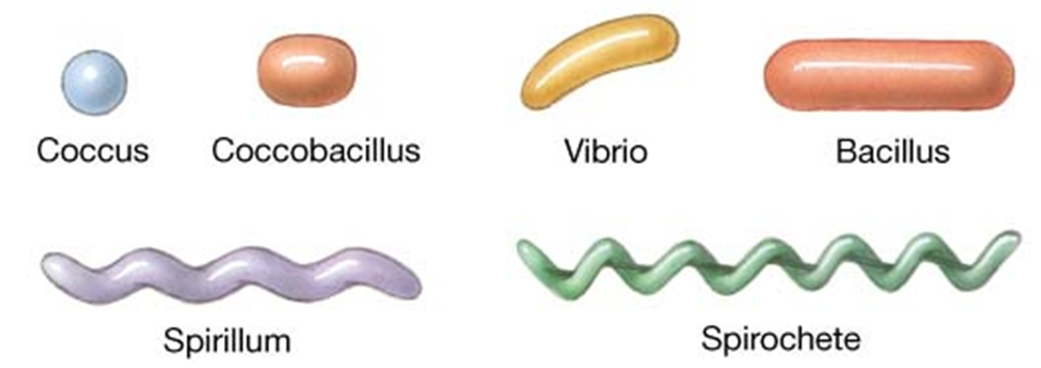
F.1.5 Outline the diversity of Eubacteria, including shape and cell wall structure.
An early attempt at bacterial classification was based upon their shape when viewed with a light microscope:
bacilli (singular bacillus) – rod shaped
cocci (singular coccus) – spherical
spirilli (singular spirillum)
vibrio – comma-shaped

Slide 15
F.1.5 Outline the diversity of Eubacteria, including shape and cell wall structure.
It should be noted that bacteria can alter their shape as a result of ageing, or due to an environmental shock, such as a rapid change in temperature – a phenomenon known as pleomorphy. This can cause confusion if the identification of bacteria strains if based only on morphological features.

Slide 16
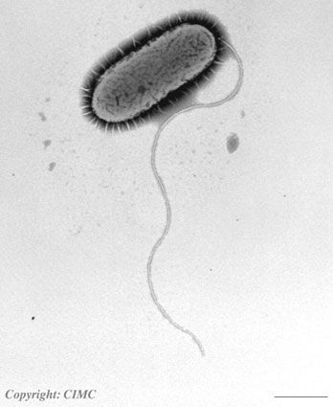
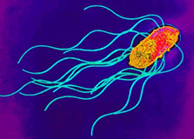
F.1.5 Outline the diversity of Eubacteria, including shape and cell wall structure.
Further classification considered whether the cells were single or formed chains and clusters and whether or not flagella were present. Many bacteria possess flagella (singular: flagellum) and these may occur all over the cell or are limited to a group at one end.
Different positions in which flagella occur in bacterial:
polar attachment (flagella attached at one or both ends)
b) peritrichous attachment
(flagella dispersed randomly over the
surface of the bacterium)

Slide 17
F.1.5 Outline the diversity of Eubacteria, including shape and cell wall structure.
Bacteria can be divided into two different groups based upon a simple staining technique known as Gram staining. Gram positive bacteria include Bacillus and the majority of cocci, such as Staphylococcus. Gram negative bacteria include Escherichia coli (E. coli), Salmonella and some cocci.
Gram staining differentiates bacteria by the chemical and physical properties of their cell walls by detecting peptidoglycan.

Slide 18
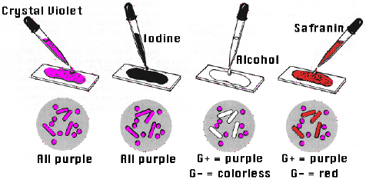
Extra information
Would you rather like to be infected by a gram positive or negative bacteria?
A gram positive bacteria doesn’t have a cell wall so is affected by antibiotics.

Slide 19
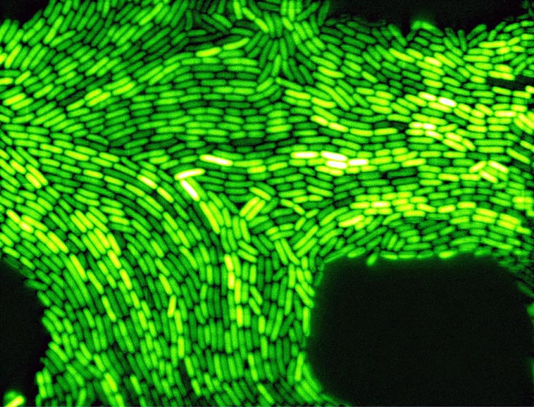
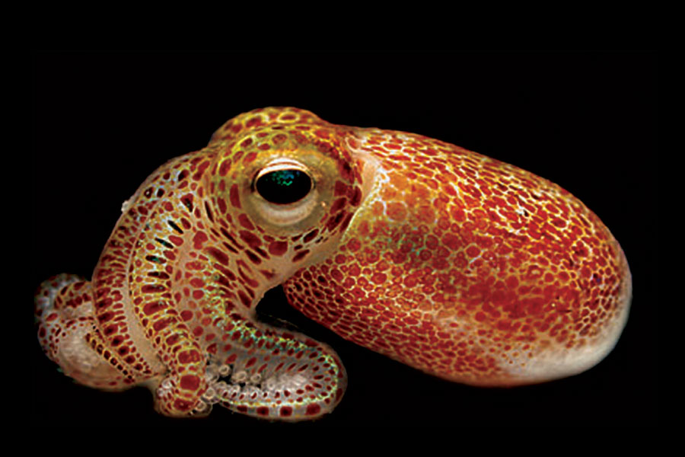
F.1.6 State, with one example, that some bacteria form aggregates that show characteristics not seen in individual bacteria.
Example I
Vibrio fischeri is a rod-shaped bacterium found in warm sea water. It is heterotrophic and has flagella. Free living Vibrio fischeri is usually a saprotroph and survives on decaying organic matter.
The bacterium has bioluminescent properties, and is often found in symbiosis with the bobtail squid (Euprymna scolopes).

Slide 20
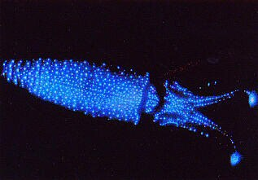
F.1.6 State, with one example, that some bacteria form aggregates that show characteristics not seen in individual bacteria.
Free-living Vibrio fischeri enters and ‘inoculates’ the light organs of juvenile squid. Ciliated cells within the squid light organs draw in the symbiotic bacteria. These cells promote the growth of the symbionts and actively
reject any competitors.
Inoculation is the placement of something that will grow or reproduce.
Inside the squid the population can reach high cell densities and under these conditions the bacteria bio-luminesce. The light organs are an ideal environment since the squid provides a nutrient rich solution which promotes rapid bacterial growth to densities which are sufficient to trigger bioluminescence. In return the squid uses the bacterial bioluminescence to hide its silhouette when viewed from below by matching the amount of light striking the top of the squid’s body.

Slide 21
F.1.6 State, with one example, that some bacteria form aggregates that show characteristics not seen in individual bacteria.
Quorum sensing is the regulation of a bacterial process that depends on the density of the bacterial population.
In the case of Vibrio fischeri bioluminescence is under the control of quorum sensing. The process relies upon the bacteria producing and releasing signal molecules which diffuses outwards from the bacterium. This allows the bacteria population to communicate with each other and coordinate their behaviour when a certain population size is reached.
The signal molecule only diffuses out of the bacteria when in contact with other bacteria. High concentrations of the signal give the sign to the bacteria that the population size is large and a gene is switched on which starts luminescence.
LINK

Slide 22
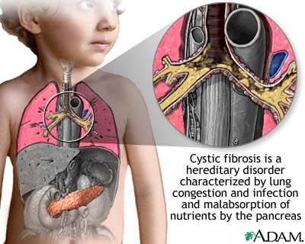
F.1.6 State, with one example, that some bacteria form aggregates that show characteristics not seen in individual bacteria.
Example II
A biofilm is a complex aggregation of microorganisms marked by the excretion of a protective and adhesive extracellular matrix. Biofilms can contain many different
types of microorganisms, for example:
bacteria
archaebacteria
protozoa
algae
Cystic fibrosis is a relatively common genetic disease that affects the entire body, causing progressive disability and early death. Difficulty in breathing and excessive mucus production are the most common symptoms and results from frequent lung infections, often involving large colonies of pseudomonas aeruginosa, which are resistant to antibiotics.
Pseudomonas aeruginosa controls the production of enzymes and the formation of biofilms. Both of these processes are under the control of quorum sensing. The production of the biofilm provides the organism with protection against antibiotics and the enzymes damage the lung epithelium.

Slide 23
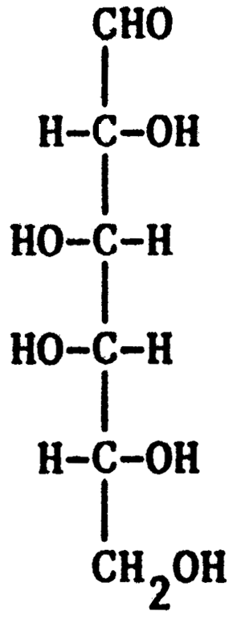
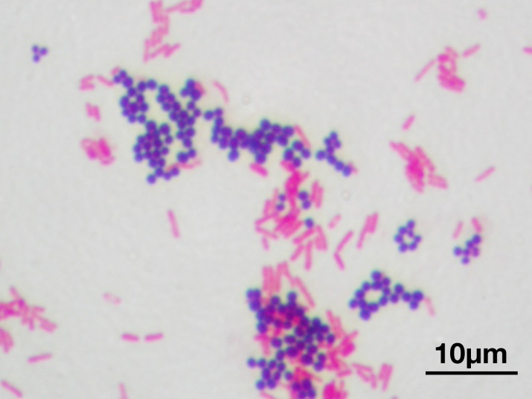
F.1.7 Compare the structure of the cell walls of Gram-positive and Gramnegative Eubacteria.
The bacterial cell wall is mainly composed of a complex mixed polymer of hexose (C6) sugars and amino acids called peptidoglycan or murein. It provides a strong but flexible framework, supporting the bacterial cell contents and protecting the bacterial cells from lysis in concentrated
solutions.
Eubacteria can be divided into two groups based upon a simple staining test. A dye known as crystal violet is applied to a bacterial smear on a slide. Iodine solution is then applied and the preparations are then rinsed in ethanol (alcohol) and counterstained with the red dye, safranin.
Eubacteria with thick cell walls retain the crystal violet and it is not washed out by ethanol.
However, in eubacteria with thinner cell walls, the ethanol dissolves the lipids on the surface and subsequently removes the dye from the peptidoglycan layer.

Slide 24
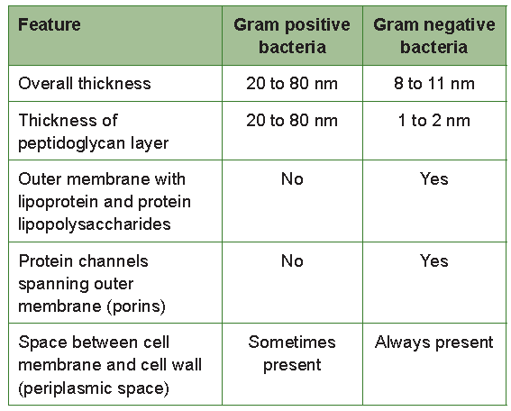
F.1.7 Compare the structure of the cell walls of Gram-positive and Gram-negative Eubacteria.
Electron microscopy has revealed the nature of the differences in cell wall structure.
Porins are integral proteins which and act as a pore through which molecules can diffuse. Unlike other membrane transport proteins, porins are large enough to
allow passive diffusion.
The lipid rich outer layer of Gram negative bacteria
protects them from lysozyme, an antibacterial enzyme
found in saliva and tears. The lipid layer also provides
protection against the antibiotic penicillin.

Slide 25
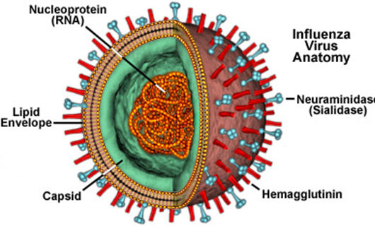
F.1.8 Outline the diversity of structure in viruses including: naked capsid versus enveloped capsid; DNA versus RNA; and single stranded versus double stranded DNA or RNA.
Viruses diver widely in their shape and appearance but all virus particles
contain nucleic acid and are surrounded by a protective protein coat called a capsid.
The capsid is made from proteins encoded by the viral genome and its shape varies depending on the type of virus.
Viruses are not considered to be living organisms because they cannot reproduce independently; they need a living a host cell in order to do so. This means they are strictly pathogenic.

Slide 26
F.1.8 Outline the diversity of structure in viruses including: naked capsid versus enveloped capsid; DNA versus RNA; and single stranded versus double stranded DNA or RNA.
Viruses are classified using features of their capsids and genetic material:
• capsids – some have naked capsids with the protein coat having no membrane or envelope surrounding it, while others have enveloped capsids with a lipid bilayer surrounding them.
• nucleic acid – some viruses contain DNA, while others have RNA. It
can be either single or double stranded.
The nucleic acid may be single stranded or double stranded RNA or DNA. In retroviruses the enzyme reverse transcriptase (see Topic F.3.1) synthesis a single strand of DNA from single stranded RNA. It then directs the formation of a complementary double strand of DNA which is then inserted, under enzyme control, into a chromosome in the host cell, where it codes for retroviral proteins.
LINK

Slide 27
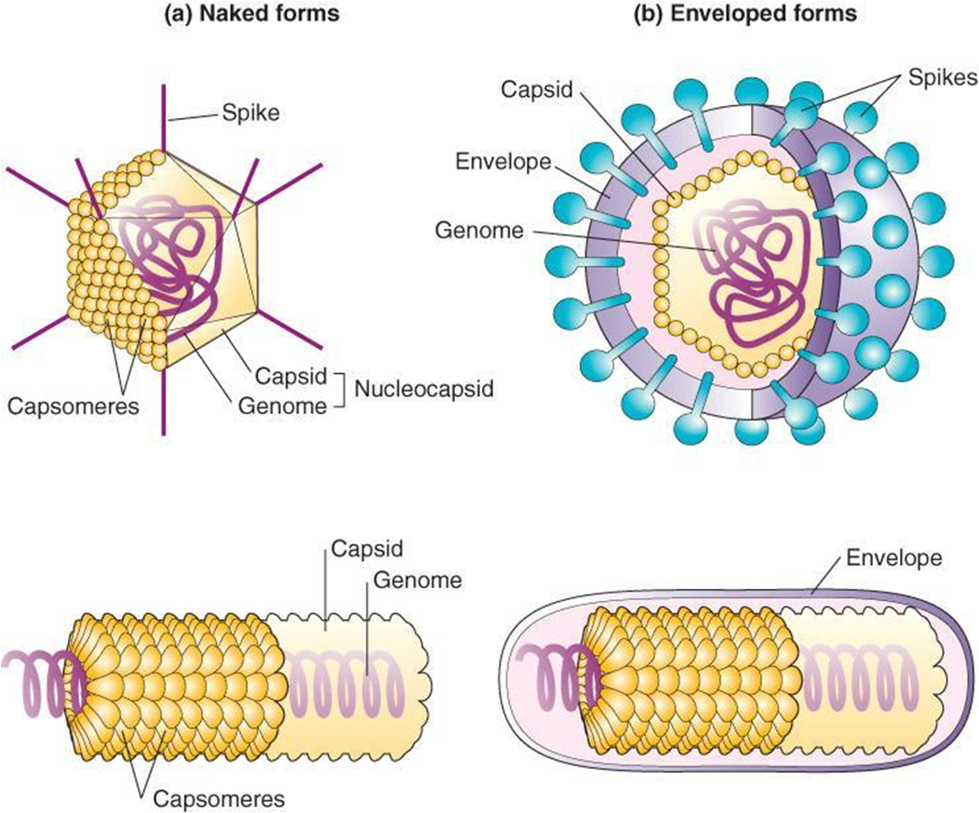
F.1.8 Outline the diversity of structure in viruses including: naked capsid versus enveloped capsid; DNA versus RNA; and single stranded versus double stranded DNA or RNA.

Slide 28
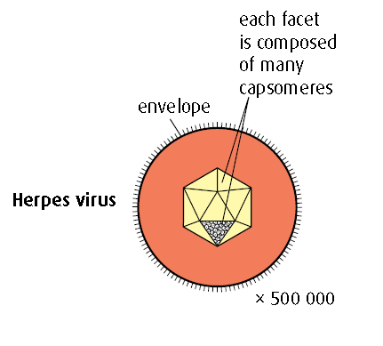
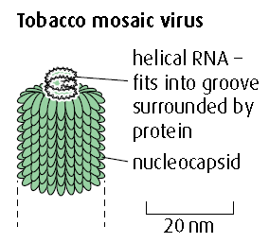
F.1.8 Outline the diversity of structure in viruses including: naked capsid versus enveloped capsid; DNA versus RNA; and single stranded versus double stranded DNA or RNA.
Polyhedrons
Capsomeres arranged into multifaceted shapes. The herpes virus has 162 capsomeres and has an envelope as a protective coating.
Most viruses are geometric in shape and may be spheres, cylinders or polygons. The capsid is made up of units called
capsomeres. When combined with the enclosed nucleic acid, the capsid is called a nucleocapsid.
Helices
Conical capsomeres arranged helically in capsid in which RNA is embedded, forming a nucleocapsid.
LINK

Slide 29
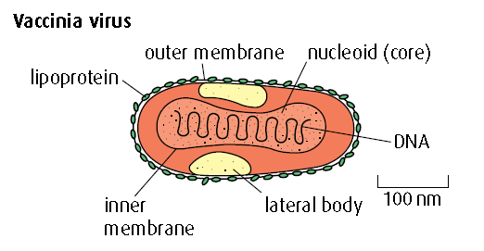
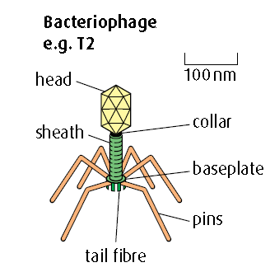
F.1.8 Outline the diversity of structure in viruses including: naked capsid versus enveloped capsid; DNA versus RNA; and single stranded versus double stranded DNA or RNA.
Complex
More complex structure than other groups. Vaccinia (smallpox) virus has outer double membrane and inner core with DNA.
Many bacteriophages (viruses that attack bacteria) are complex.
A bacteriophage is a virus
which uses a bacterium as its host.
LINK

Slide 30
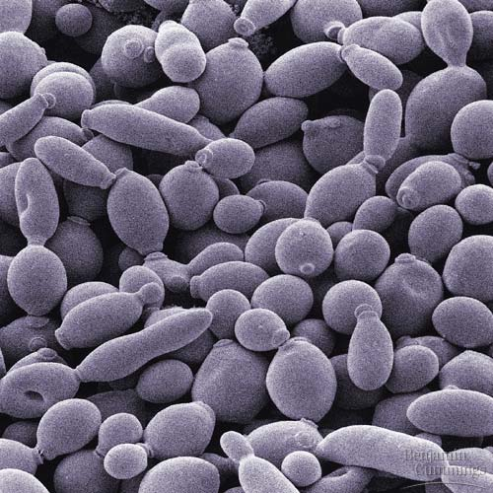
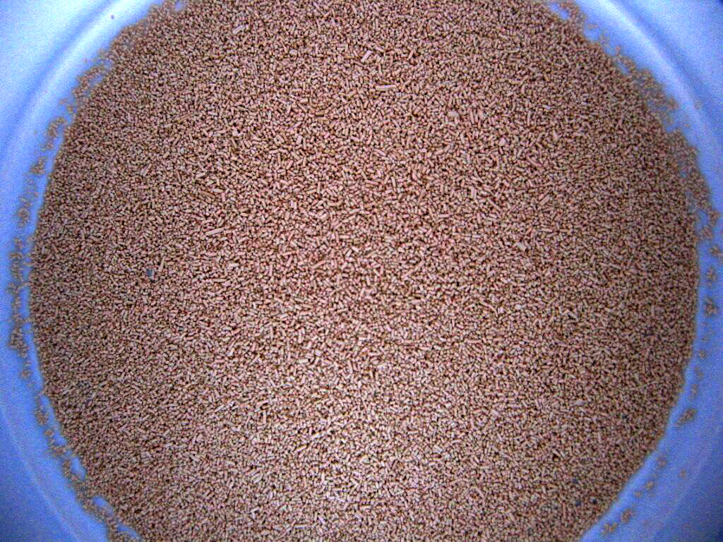
F.1.9 Outline the diversity of microscopic eukaryotes, as illustrated by Saccharomyces, Amoeba, Plasmodium, Paramecium, Euglena and Chlorella.
Saccharomyces
Saccharomyces is a genus of single-celled fungus. They are known as yeasts and are employed in the fermentation processes associated with the baking and brewing industries. Yeast cells take the form of ellipses or spheres. They are surrounded by a cell wall containing the polymers
of glucose and mannose. In the cytoplasm, the nucleus is situated to one side of large central vacuole. The cytoplasm usually contains glycogen granules and the vacuole may contain lipid droplets.

Slide 31
F.1.9 Outline the diversity of microscopic eukaryotes, as illustrated by Saccharomyces, Amoeba, Plasmodium, Paramecium, Euglena and Chlorella.
Saccharomyces reproduces asexually by budding, during which a daughter cell develops as an outgrowth from the end of a mature yeast cell.

Slide 32
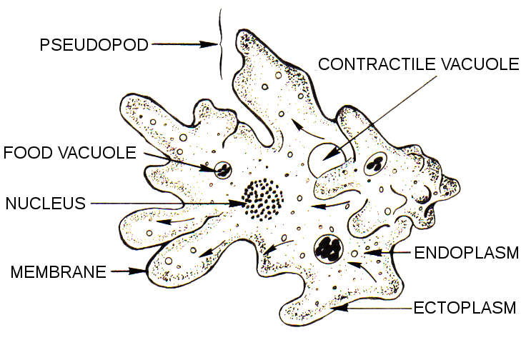
F.1.9 Outline the diversity of microscopic eukaryotes, as illustrated by Saccharomyces, Amoeba, Plasmodium, Paramecium, Euglena and Chlorella.
Amobea
Amobea inhabits the bottom sediments of freshwater ponds. The cytoplasm is in the form of two layers: an outer transparent ectoplasm and an inner jelly-like endoplasm. Amoeba has a relatively large surface area to volume ratio and performs gas exchange and excretion by simple diffusion across its plasma membrane.
Movement and food capture occur by pseudopodia (singular: pseudopodium). Pseudopodia are pushed out to surround the prey or food particle and engulf it completely, forming a food vacuole.

Slide 33
F.1.9 Outline the diversity of microscopic eukaryotes, as illustrated by Saccharomyces, Amoeba, Plasmodium, Paramecium, Euglena and Chlorella.
Amobea

Slide 34
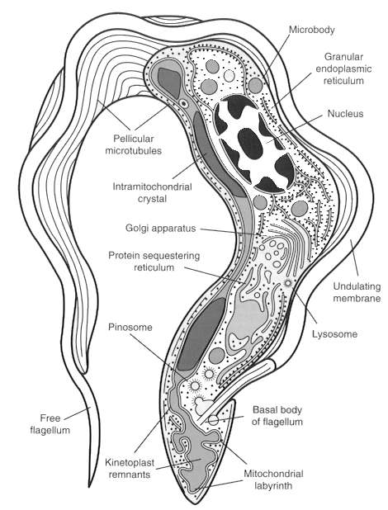
F.1.9 Outline the diversity of microscopic eukaryotes, as illustrated by Saccharomyces, Amoeba, Plasmodium, Paramecium, Euglena and Chlorella.
Plasmodium
Plasmodium is a genus of parasitic protozoa. Infection with this genus is known as malaria (see Topic F.6.9). The parasite always has two hosts in its complex life cycle: a mosquito vector and a vertebrate host. At least ten species infect humans.
LINK
Cell motility is accomplished through the action of a single flagellum that emerges from the basal body apparatus near
the posterior end of the cell. The flagellum is surrounded by its own membrane that is distinct from the plasma membrane.

Slide 35
F.1.9 Outline the diversity of microscopic eukaryotes, as illustrated by Saccharomyces, Amoeba, Plasmodium, Paramecium, Euglena and Chlorella.
Paramecium
Paramecium is a ciliated protozoan. The cilia beat with a coordinated rhythm and mover the organism rapidly through its freshwater environment. The bases of the cilia are embedded in stiff outer covering called the pellicle which gives the organism a fixed slipper-like shape. Paramecium feeds on bacteria which are collected from the water by the beating of the cilia lining the oral groove. Captured bacteria are then transferred
via the gullet to the cytosome where food vacuoles are
formed.

Slide 36
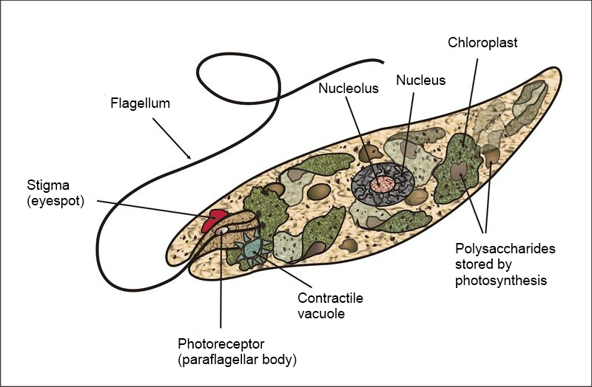
F.1.9 Outline the diversity of microscopic eukaryotes, as illustrated by Saccharomyces, Amoeba, Plasmodium, Paramecium, Euglena and Chlorella.
Euglena
Euglena is flagellated protozoan and commonly present in pond water. Near the base of the flagellum is a light absorbing red granule known as the stigma. Its function is to orientate the organism towards light to optimize its photosynthetic rate. Euglena contains chloroplasts, but
lack a cellulose cell wall and does not store starch.
LINK

Slide 37
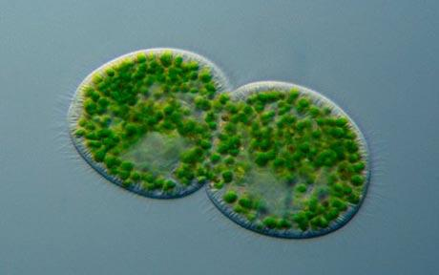
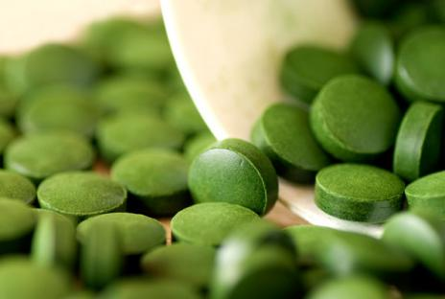
F.1.9 Outline the diversity of microscopic eukaryotes, as illustrated by Saccharomyces, Amoeba, Plasmodium, Paramecium, Euglena and Chlorella.
Chlorella
Chlorella is genus of unicellular green algae in the phylum Chlorophyta. It possesses a single, cup shaped chloroplast with chlorophylls very similar to those in green plants. The cytoplasm contains starch grains and oil droplets and a crystalline structure, and is embedded in the chloroplast. It is concerned with the formation of starch.
Chlorella is and can be easily cultured in the laboratory and has been used in experiments investigating photosynthetic pathways. It has a high protein content and could be a possible food source.

Slide 38
Option F Biotechnology and Microbes
F1Diversity of Microbes

