Slide 1
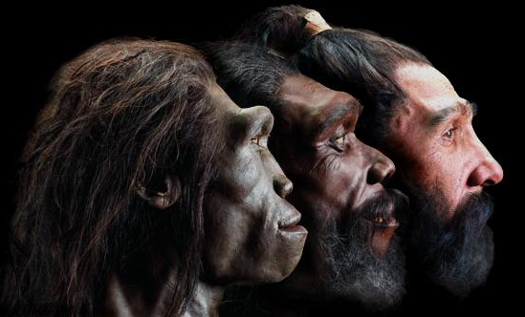
Option D: Evolution
D3 Human Evolution

Slide 2
ASSESSMENT STATEMENTS
D.3.1 Outline the method for dating rocks and fossils using radioisotopes, with reference to 14C and 40K.
D.3.2 Define half-life.
D.3.3 Deduce the approximate age of materials based on a simple decay curve for a radioisotope.
D.3.4 Describe the major anatomical features that define humans as primates.
D.3.5 Outline the trends illustrated by the fossils of Ardipithecus ramidus, Australopithecus including A. afarensis and A. africanus, and Homo including H. habilis, H. erectus, H. neanderthalensis and H. sapiens. Knowledge of approximate dates and distribution of the named species is expected. Details of subspecies or particular groups (Cro-Magnon, Peking, and so on) are not required.
D.3.6 State that, at various stages in hominid evolution, several species may have coexisted.
D.3.7 Discuss the incompleteness of the fossil record and the resulting uncertainties about human evolution.
D.3.8 Discuss the correlation between the change in diet and increase in brain size during hominid evolution.
D.3.9 Distinguish between genetic and cultural evolution.
D.3.10 Discuss the relative importance of genetic and cultural evolution in the recent evolution of humans.

Slide 3
D.3.1 Outline the method for dating rocks and fossils using radioisotopes, with reference to 14C and 40K.
Radioacarbon dating
Carbon-12, 12C, is an abundant and non-radioactive isotope of carbon. Carbon-14, 14C, is a radioactive isotope and occurs in trace quantities in air, surface water and living organisms. Carbon-14 is constantly being produced in the atmosphere by the action of cosmic rays on nitrogen
and oxygen nuclei.
An equilibrium exists between the production of carbon- 14 and the loss of carbon-14 by radioactive decay. Carbon- 14 is found occurring freely as ¹⁴CO₂ and the ratio of 14C:12C compounds remains constant.
Plants absorb carbon-14 as carbon dioxide and animals absorb carbon-14 containing compounds in their diet. However, at death no more carbon is taken in and the carbon- 14 continues to decay according to the rate determined by the half life. By calculating the amount of carbon-14 in the dead organism and comparing it with the amount of carbon-14 in a living organism, the age of the dead organism can be estimated.
LINK

Slide 4
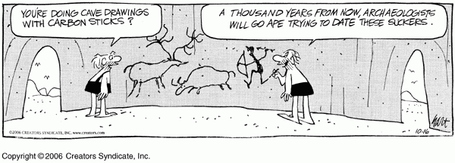
D.3.1 Outline the method for dating rocks and fossils using radioisotopes, with reference to 14C and 40K.
For example, if the amount of carbon-14 in a fossil mammalian bone was found to be one eight that in the same bone from a recently killed mammal and the half life is 5.6 x 10³ years, the estimated age of the fossil bone would be 22.4 x 10³ years. Radiocarbon dating can be used to date organic remains fairly accurately for up to 10.0 x 10⁴ years.
Radiocarbon labs generally report an uncertainty, for example, 3000―30BP indicates a standard deviation of 30 radiocarbon years. The maximum range of radiocarbon dating appears to be about 50,000 years, after which the amount of 14C is too low to be distinguished from background radiation. The potassium-argon (K-Ar) decay series is used in dating older objects.

Slide 5
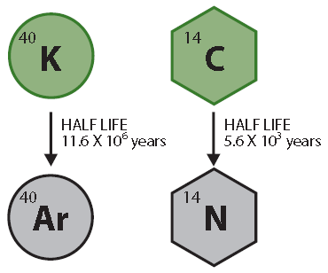
D.3.1 Outline the method for dating rocks and fossils using radioisotopes, with reference to 14C and 40K.
In the potassium-argon dating method, the element potassium (K) contains a small proportion of a radioactive isotope potassium-40. The radioactive isotope decays to give argon-40, a stable isotope of the element argon. The isotope potassium-40 is released in lava from active volcanoes, though at this temperature any argon released at the same time would be lost as gas. The eruption of the volcano effectively sets the clock to zero. The potassium-40 is incorporated into sedimentary deposits where it slowly decays to 40-argon.
The ratio of 40-potassium to 40-argon in the fossil under examination gives an indication of its age. Calculation of the actual age of the fossil is based on the half life of potassium-40 (1.3 x 10⁹ years). Potassium-argon dating has been used mainly for dating materials in volcanic rocks older than one million years. The accuracy of potassium argon dating is about 50,000 years.

Slide 6
D.3.2 Define half-life.
The atoms of radioactive elements release energy in the form of radiation. This process is called radioactive decay and takes place at a constant rate which is independent of physical conditions, such as temperature and pressure.
Each radioactive isotope undergoes a different rate of decay. The decay rates of different radioactive isotopes are measured in terms of the half life. The half life is the time for half of the radioactive atoms in a sample to undergo decay.
LINK

Slide 7
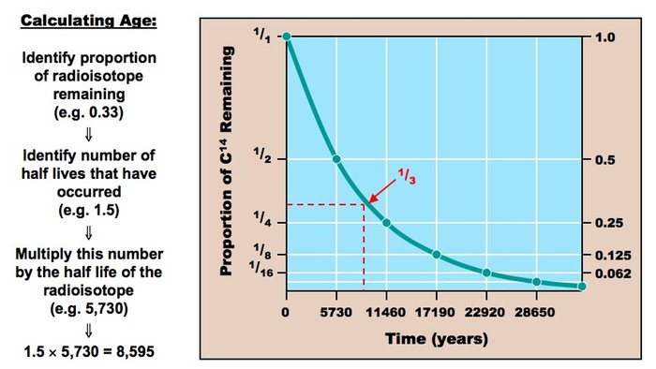
D.3.3 Deduce the approximate age of materials based on a simple decay curve for a radioisotope.

Slide 8
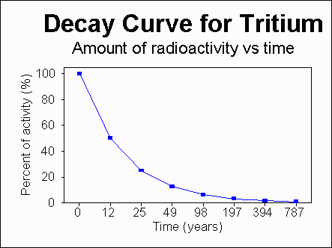
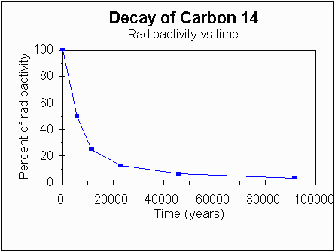
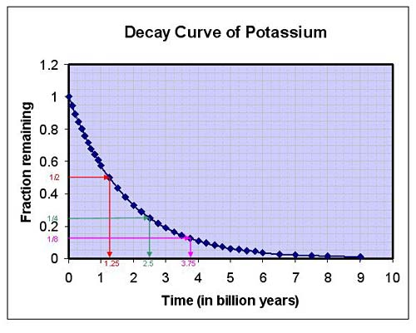
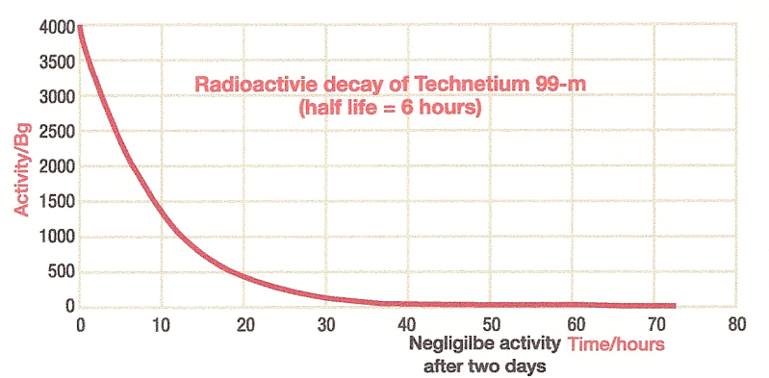
D.3.3 Deduce the approximate age of materials based on a simple decay curve for a radioisotope.

Slide 9
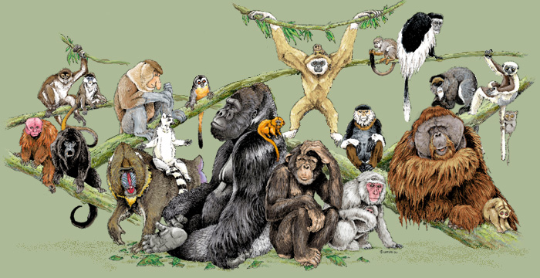
D.3.4 Describe the major anatomical features that define humans as primates.
Humans belong to the order known as the primates. Primates include humans, lemurs, monkeys, gibbons and the apes: orang-utans, gorillas, chimpanzees.
Apes and humans are distinguished from the rest of the primates by being tailless and by having the ability to swing their arms freely, around and up and over their heads. Primates exhibit adaptations to life in a forest environment. (However, it should be noted that primates are generalists and hence difficult to define).

Slide 10
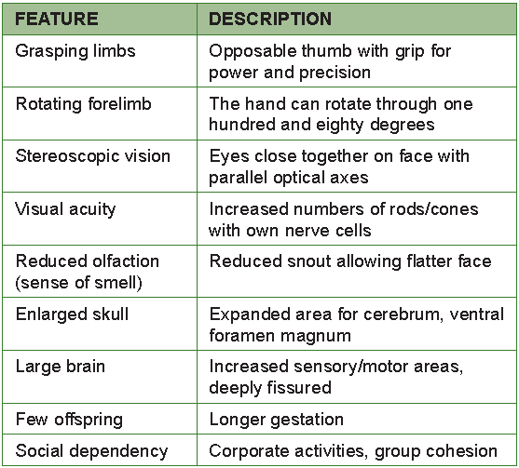
D.3.4 Describe the major anatomical features that define humans as primates.

Slide 11
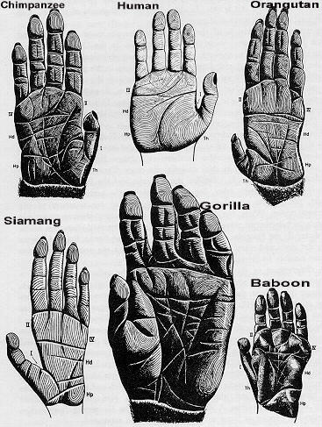
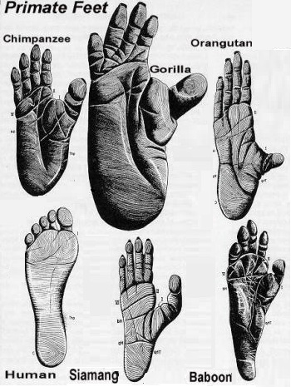
D.3.4 Describe the major anatomical features that define humans as primates.
Primates are adapted to an arboreal or tree dwelling life in a forest environment. However, these also served to pre-adapt human ancestors to exploit the new ecological niches which appeared when the African forests gave way to drier grassland savannahs about five million years ago.
The term pre-adaptation refers to organisms that have characteristics or traits that fortuitously (that is, by chance) fit an organism for a different habitat or ecological niche.

Slide 12
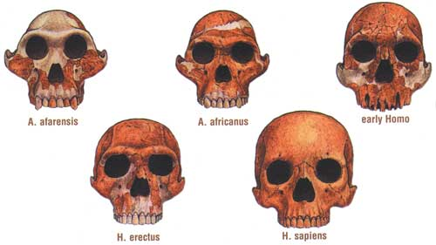
D.3.5 Outline the trends illustrated by the fossils of Ardipithecus ramidus, Australopithecus including A. afarensis and A. africanus, and Homo including H. habilis, H. erectus, H. neanderthalensis and H. sapiens. Knowledge of approximate dates and distribution of the named species is expected. Details of subspecies or particular groups (Cro-Magnon, Peking, and so on) are not required.
The study of human evolution is an active area of research and is performed by studying fossils and where appropriate the tools of hominids. Few complete skeletons have been found and often only skulls and teeth are left, due to their thickness and hardness. The tools and bones are dated from the age of the rocks they are found in (relative dating) and dating the tools and
bones directly (absolute dating) using radioactive dating methods.

Slide 13
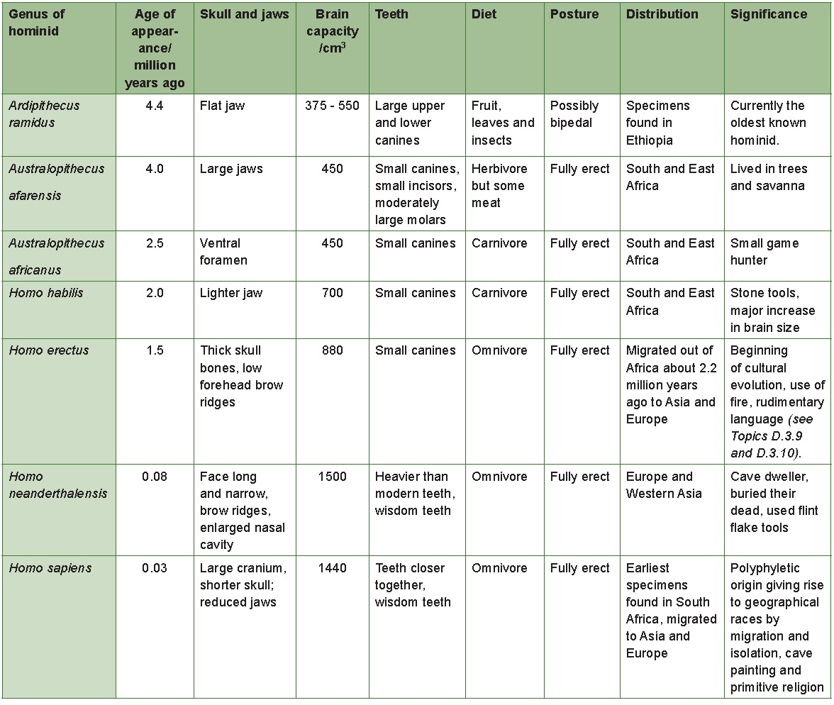
D.3.5 Outline the trends illustrated by the fossils of Ardipithecus ramidus, Australopithecus including A. afarensis and A. africanus, and Homo including H. habilis, H. erectus, H. neanderthalensis and H. sapiens. Knowledge of approximate dates and distribution of the named species is expected. Details of subspecies or particular groups (Cro-Magnon, Peking, and so on) are not required.

Slide 14
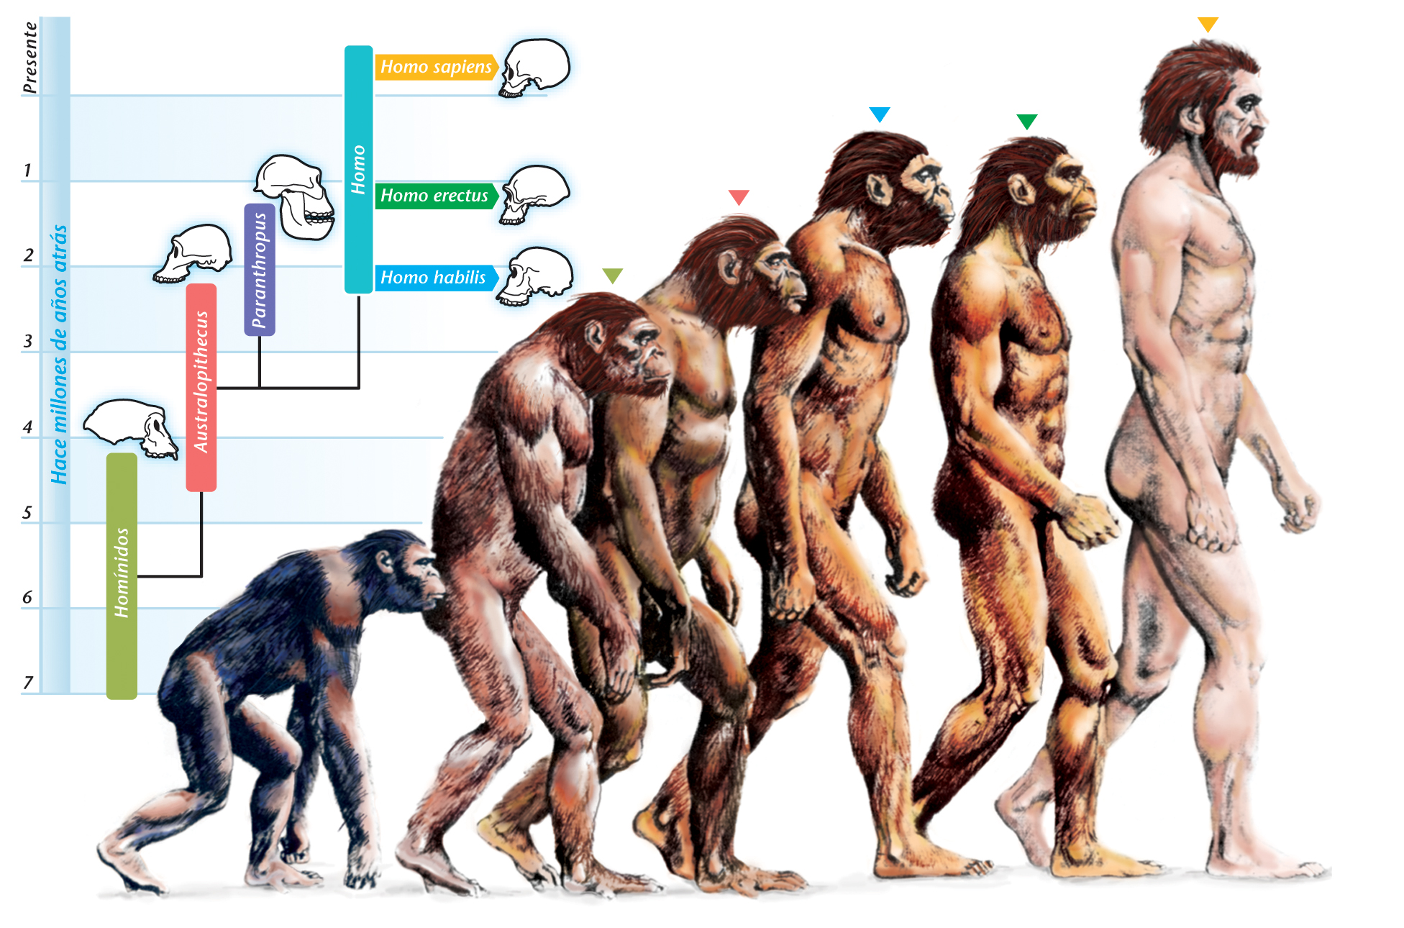
D.3.5 Outline the trends illustrated by the fossils of Ardipithecus ramidus, Australopithecus including A. afarensis and A. africanus, and Homo including H. habilis, H. erectus, H. neanderthalensis and H. sapiens. Knowledge of approximate dates and distribution of the named species is expected. Details of subspecies or particular groups (Cro-Magnon, Peking, and so on) are not required.

Slide 15
D.3.5 Outline the trends illustrated by the fossils of Ardipithecus ramidus, Australopithecus including A. afarensis and A. africanus, and Homo including H. habilis, H. erectus, H. neanderthalensis and H. sapiens. Knowledge of approximate dates and distribution of the named species is expected. Details of subspecies or particular groups (Cro-Magnon, Peking, and so on) are not required.
Summary of the trends and features during hominid evolution
Skulls and brain size
Humans have the largest skull size (in relation to body mass) to other hominids. The enlarged cranium accommodates a larger brain. There has been a relatively rapid increase in cranium size during hominid evolution.
The human skull has a protruding jaw and a shortened face. Brow ridges present in other hominids are not present in modern humans (Homo sapiens).
The evolution of bipedalism is believed to have occurred early in hominid evolution and is believed to have facilitated the enlargement of the brain. Bipedalism also allowed hominids to carry objects and gave them increased height and range of vision.

Slide 16
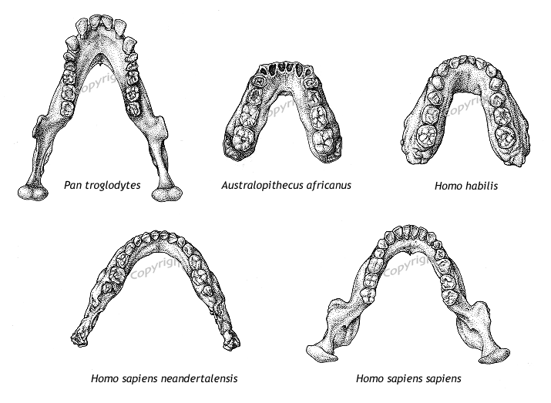
D.3.5 Outline the trends illustrated by the fossils of Ardipithecus ramidus, Australopithecus including A. afarensis and A. africanus, and Homo including H. habilis, H. erectus, H. neanderthalensis and H. sapiens. Knowledge of approximate dates and distribution of the named species is expected. Details of subspecies or particular groups (Cro-Magnon, Peking, and so on) are not required.
Teeth and jaws
The U-shaped jaw of ancestral hominids has been replaced by a more V-shaped jaw in modern humans. The large conical canines have been lost and the molars have been reduced.

Slide 17
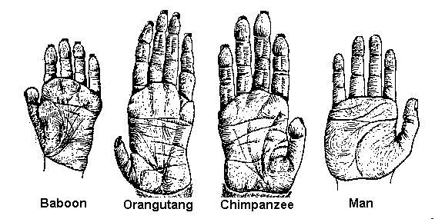
D.3.5 Outline the trends illustrated by the fossils of Ardipithecus ramidus, Australopithecus including A. afarensis and A. africanus, and Homo including H. habilis, H. erectus, H. neanderthalensis and H. sapiens. Knowledge of approximate dates and distribution of the named species is expected. Details of subspecies or particular groups (Cro-Magnon, Peking, and so on) are not required.
Hands
The modern human hand is prehensile and able to grasp and pick up objects between the thumb and the finger tips. The thumb is opposable so that its tip can touch other fingers, making the thumb joint highly mobile.
Humans have relatively long fingers, but gorillas have shorter fingers which allows knuckle walking. The ability of the thumb to rotate, the mobility of the fingers and the ability of the wrist to rotate allow humans to perform a
wide variety of precision movements. The palms of the modern human hand are very sensitive and convey large amounts of sensory and tactile information to the brain.

Slide 18
D.3.5 Outline the trends illustrated by the fossils of Ardipithecus ramidus, Australopithecus including A. afarensis and A. africanus, and Homo including H. habilis, H. erectus, H. neanderthalensis and H. sapiens. Knowledge of approximate dates and distribution of the named species is expected. Details of subspecies or particular groups (Cro-Magnon, Peking, and so on) are not required.
Skeleton, locomotion and posture
The human rib cage is more barrel-shaped than the great apes, because human arms are not used for locomotion. Compared to great apes, the human vertebral column has additional forward curves in the neck and lower
back. These help to bring the head and trunk (chest, back and abdomen) above the centre of mass in the upright position.
The human pelvis is broader and lower than that of the great apes. Human legs are longer than their arms so a greater proportion of their body mass and hence their centre of mass is lower. The broad flexible shoulder blade allows free arm rotation during walking. The human femur is angled out towards the knee which allows the knee to be brought under the body. Humans extend their legs fully when walking and the bones of the leg form a straight line. The big toe is opposable in apes, but non-opposable in humans. This means that humans cannot grasp objects with their big toe. This gives the humans a characteristic footprint an arched foot.

Slide 19
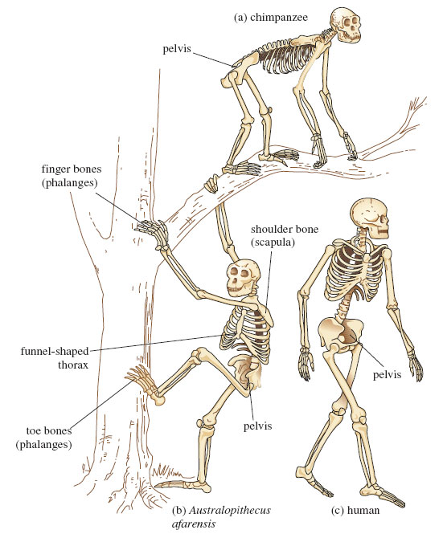
D.3.5 Outline the trends illustrated by the fossils of Ardipithecus ramidus, Australopithecus including A. afarensis and A. africanus, and Homo including H. habilis, H. erectus, H. neanderthalensis and H. sapiens. Knowledge of approximate dates and distribution of the named species is expected. Details of subspecies or particular groups (Cro-Magnon, Peking, and so on) are not required.

Slide 20
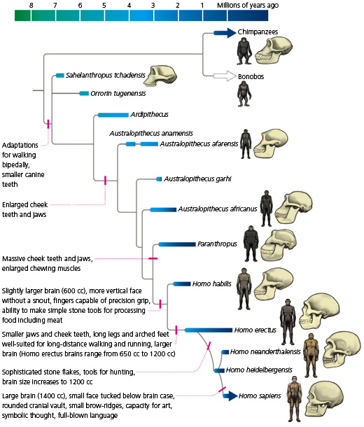
D.3.6 State that, at various stages in hominid evolution, several species may have coexisted.
Although distinct evolutionary trends can be observed in hominids it does not imply that one hominid evolved directly into the succeeding type. Homo habilis co-existed with the various species and forms of australopithecines for
approximately 2 million years, before the australopithecines became extinct. Homo erectus also co-existed with the later australopithecines.
Homo erectus was probably a common ancestor to both Homo sapiens and to the Neanderthals. The co-existence of various hominids is probably due to the different species occupying different ecological niches.

Slide 21
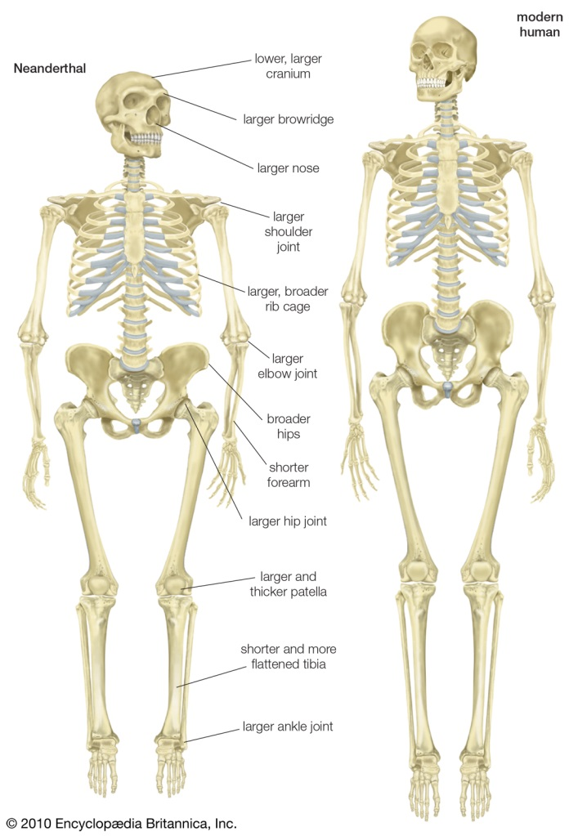
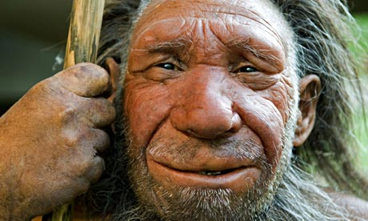
D.3.6 State that, at various stages in hominid evolution, several species may have coexisted.
The majority of Neanderthals became extinct relatively suddenly perhaps because of competition with Homo sapiens. Neanderthal man and Homo sapiens overlapped in Europe for half a million years but about forty five
thousand years ago the numbers began to decreased significantly. It is possible that there was gene flow and the Neanderthals were absorbed into the Homo sapiens linage. Neanderthals are not regarded as a full species by some researchers.

Slide 22
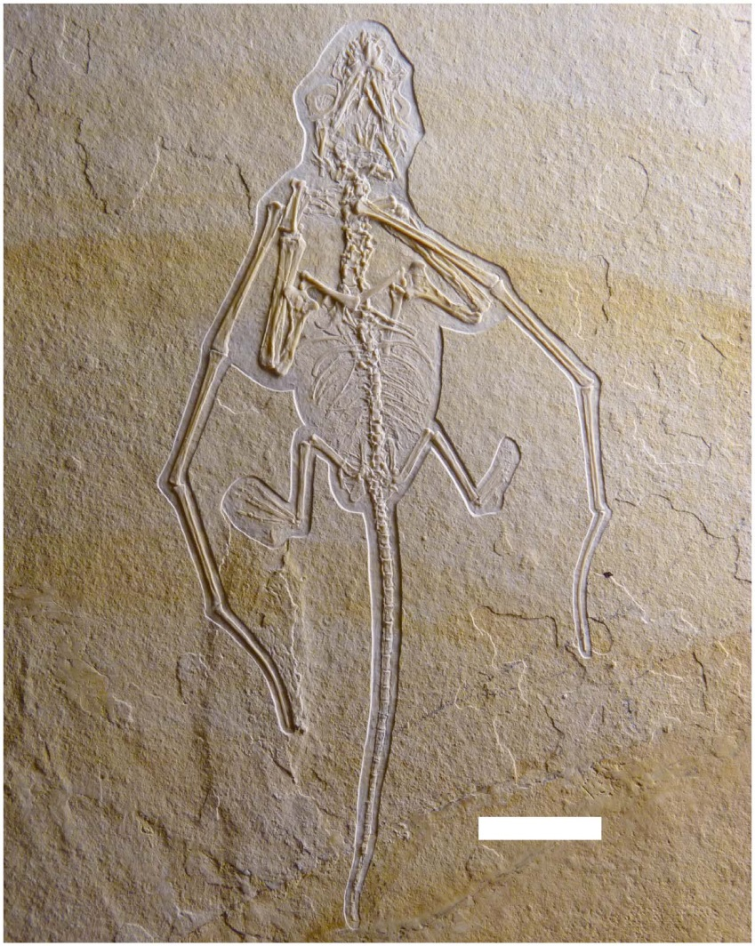
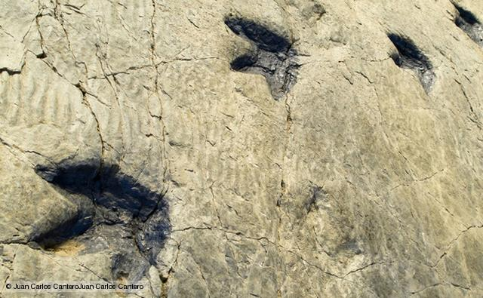
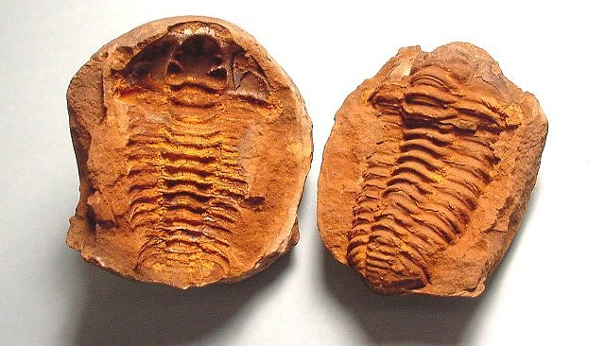
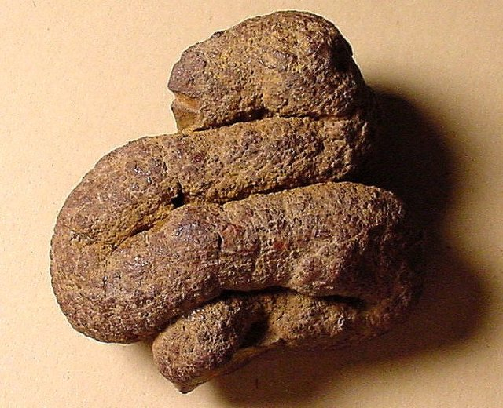
D.3.7 Discuss the incompleteness of the fossil record and the resulting uncertainties about human evolution.
Palaeontology is the study of fossils. Fossils are any form of preserved remains derived from a living organisms. They may include the following: entire organisms, hard skeletal structures, moulds and casts, petrifications, impressions, imprints and coprolites.

Slide 23
D.3.7 Discuss the incompleteness of the fossil record and the resulting uncertainties about human evolution.
In the fossil record many species appear at an early level or strata of rock and disappear, often abruptly, at a later level. This is interpreted in evolutionary terms at which the species originated and became extinct.
Ecological considerations also match the fossil record, for example, plants appeared on land before animals, and insects appeared before insect-pollinated flowers.
One of the criticisms of using fossils in support of the concept of evolutionary change is the lack of a continuous record and the many gaps or ‘missing links’. Many more ‘missing links’ are being discovered. For example, the discovery of well preserved fossils of the amphibious bird (Gansus yumenensis) in northwest China.
However, there are many explanations to account for the incompleteness:
Dead organisms decompose rapidly.
Dead organisms are eaten by scavengers Soft-bodied organism do not fossilise easily.
Only a small fraction of living organisms will have died in conditions favourable for fossilisation.
Only a tiny fraction of the fossils have been unearthed

Slide 24
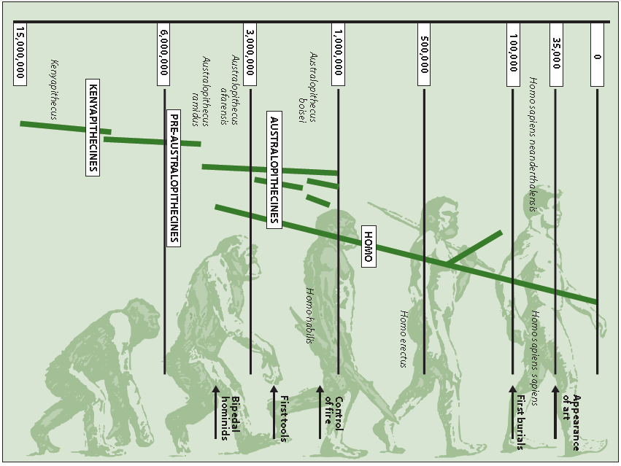
D.3.7 Discuss the incompleteness of the fossil record and the resulting uncertainties about human evolution.
Very few complete fossils of hominids have been discovered. Bones, other than the teeth and the cranium, tend to be softer and disintegrate. In particular, there is a large gap in our knowledge of hominid evolution between eight to four million years ago.

Slide 25
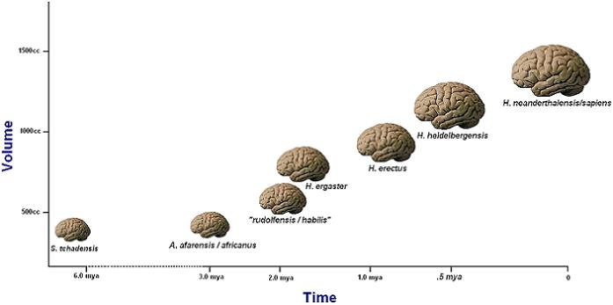
D.3.8 Discuss the correlation between the change in diet and increase in brain size during hominid evolution.
There are obvious advantages to the increase in brain capacity. The increasing size of the brain meant hominids had greater behavioural flexibility to adapt to different environmental circumstances. These would include the ability to make more complex tools, construct stronger and longer lasting shelters, and use fire for warmth, protection from animals and cooking. It also helped in the transmission of cultural behaviour from one generation to the next
However, large brains also have costs. A longer gestation period and extension of the period of care for the infant following birth is required. Much of the development of the human brain occurs after birth. There is a period of critical care for a human infant for a period of two years after birth. The growth of the brain requires a high level of energy intake for the mother not only during the longer gestation, but for a relatively long period following birth.

Slide 26
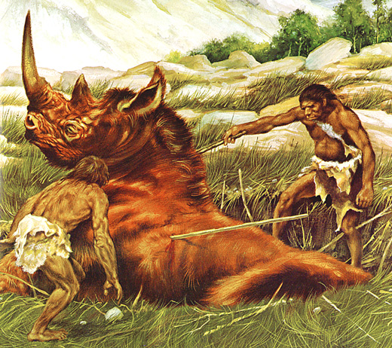
D.3.8 Discuss the correlation between the change in diet and increase in brain size during hominid evolution.
Hominids with greater brain size and effective energy intake for infant development and care may have been better able to survive and reproduce. Therefore, the trend for increased brain capacity may have been coupled with a trend for increased nutritional intake. This is thought
to have been achieved by hominids progressing from an omnivorous diet to a more carnivorous diet: fatty meat and bone marrow are rich sources of energy. A large more complex brain would have facilitated the hunting and killing of animals.

Slide 27
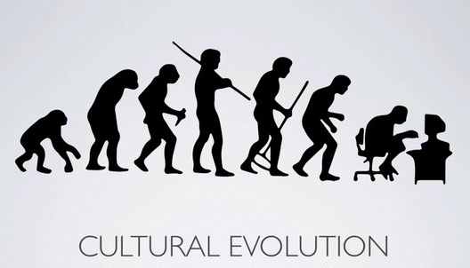
D.3.9 Distinguish between genetic and cultural evolution.
Cultural evolution
Cultural evolution refers to the changes in the actions, and ideas of society, including their transmission from one generation to another. Cultural evolution occurs via the written word, the spoken word and images.
Genetic evolution
Genetic evolution refers to the genetic changes that have occurred during hominid evolution. It also refers to the differences observed between individuals and different racial or cultural groups.
LINK

Slide 28
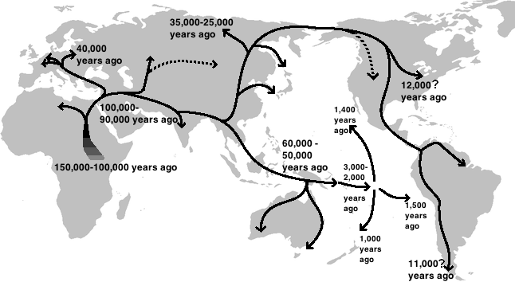
D.3.9 Distinguish between genetic and cultural evolution.
Studies of proteins and later DNA sequences of people have allowed Biologists to produce a human ‘family tree’ for the past hundred thousand years. In addition the study of mitochondrial DNA and the Y chromosome, have been used to trace human migration patterns.
LINK
Considerable genetic evidence has accumulated to support
the Out of Africa hypothesis which states that modern humans evolved in Africa before 200,000 to 100,000 years ago, with members of one branch leaving Africa about 80,000 years ago. These emigrants spread to the rest of the world replacing but not interbreeding with other Homo species already there, such as Homo erectus and the Neanderthals.

Slide 29
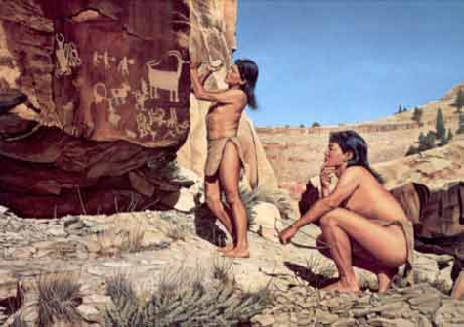
D.3.10 Discuss the relative importance of genetic and cultural evolution in the recent evolution of humans.
The physical evolution of hominids was accompanied by changes in the development of social behaviour. The process of becoming human is known
as hominisation and is believed to have been due to the evolution of manipulative skills and speech. In addition changes in sexual behaviour
encouraged the formation of life long relationships between men and women, who began to live together in communities with their children.
Hominisation also included food sharing which benefited individuals and the community. These changes were transmitted from person to person by communication, rather than inherited genetically. This process is known as cultural evolution and includes many different aspects of the life of modern day humans and their ancestors: customs, art, rituals, shared knowledge,
language, beliefs, laws and religions.

Slide 30
D.3.10 Discuss the relative importance of genetic and cultural evolution in the recent evolution of humans.
The increased brain size of Homo habilis led to the development of stone tools. The earliest cultural artifacts were chopping tools, hammer stones and flakes of lava or quartz used for scraping meat off bones. Homo erectus
produced hand held axes which had two cutting edges leading to a point. More sophisticated tools made from flint, bone and wood were produced by Homo sapiens about 35,000 years ago.
Spoken and written language is unique to humans and requires the coordinated action of the lips, tongue, larynx and three areas of the brain: the speech motor cortical area (controlling the delivery of speech) and two further areas in the left side of the cerebrum. Studies of fossil skulls shows that there was significant development in both Australopithecus africanus and Homo habilis.
The recent history of modern human cultural evolution has clearly been dominated by cultural evolution. Science and technology are products of cultural evolution. The gene pool of modern humanity is assumed to be little different from our first Homo sapiens ancestors, Cro-Magnon man, who lived 20, 000 years ago in France.

Slide 31
Option D: Evolution
D3 Human Evolution

