Slide 1
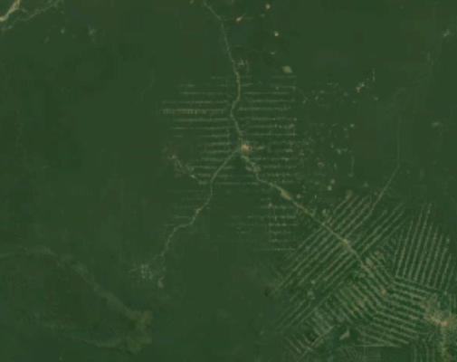
Option C Ecology and Conservation
C4 Conservation of biodiversity

Slide 2
Nature of science
Scientists collaborate with other agencies—the preservation of species involves international cooperation through intergovernmental and non-governmental organizations. (4.3)
Understandings:
An indicator species is an organism used to assess a specific environmental condition.
Relative numbers of indicator species can be used to calculate the value of a biotic index.
In situ conservation may require active management of nature reserves or national parks.
Ex situ conservation is the preservation of species outside their natural habitats.
Biogeographic factors affect species diversity.
Richness and evenness are components of biodiversity.

Slide 3
Applications and skills
Application: Case study of the captive breeding and reintroduction of an endangered animal species.
Application: Analysis of the impact of biogeographic factors on diversity limited to island size and edge effects.
Skill: Analysis of the biodiversity of two local communities using Simpson’s reciprocal index of diversity.
ToK
None
Essential idea: Entire communities need to be conserved in order to preserve biodiversity.

Slide 4
Guidance
The formula for Simpson’s reciprocal index of diversity is:
D = diversity index, N = total number of organisms of all species found and n =
number of individuals of a particular species.

Slide 5
Indicator species
An indicator species is an organisms used to assess a specific environmental condition
PREPARED BY MANUEL!!!

Slide 6
Calculation of biotic index
Relative numbers of indicator species can be used to calculate the value of a biotic index
PREPARED BY MANUEL!!!

Slide 7
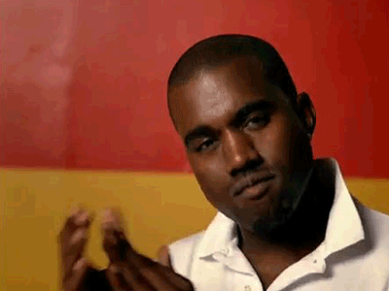
In-situ conservation
In situ conservation might require actie management of nature reserves or national parks
PREPARED BY THOMAS!!!

Slide 8
Ex-situ conservation
En situ conservation is the preservation of species outside their natural habitat
PREPARED BY THOMAS!!!

Slide 9
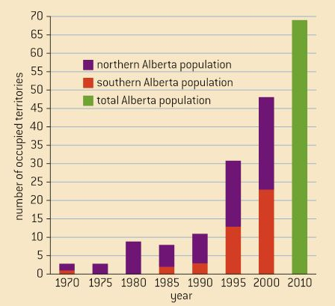
Captive breeding to restore populations of endangered species
Case study of the captive breeding and reintroduction of an endangered animal
The peregrine falcon became endangered in North America because DDT made the shells of their eggs very thin resulting in less eggs hatching.
In a captive breeding programme, researchers took the eggs from the nests of the birds and preplaced them with dummy eggs. The eggs they incubated in the lab under controlled conditions. After they hatched they were reintroduced to the nests to be taken care of by the mother bird again. The success is evident

Slide 10
Different groups work together to conserve biodiversity
Scientists colaborate with other agencies : The preservation of species involves coorperation through intergovernmental and non-governmental organisations
Scientific research can inform best practice but needs the support of agencies that can effect proposals for conservation. National governments can do a lot when setting aside land for national reserves.
Clearly threats to biodiversity spreads beyond borders, conservation involves international cooperation.
Intergovernmental organisations like the International Union for the Conservation of Nature (IUCN) can facilitate agreements between nations.
One thing the IUCN publishes is the Red List of endangered species which states the status of the conservation of species.
Also CITES (Convention on International Trade in Endangered Species) was created by this organisation. An example of a non-governmental NGO’s is the WWF.

Slide 11
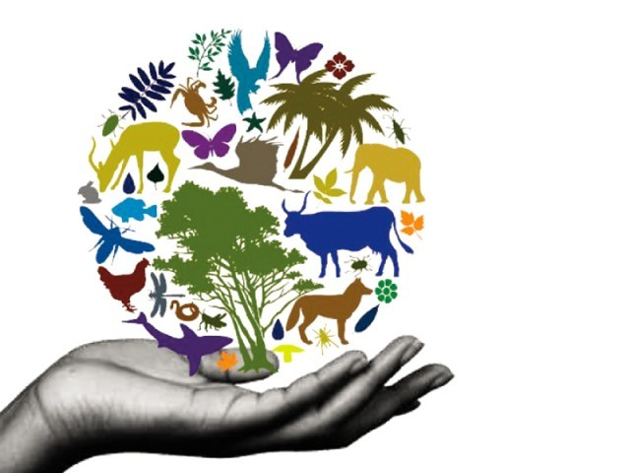
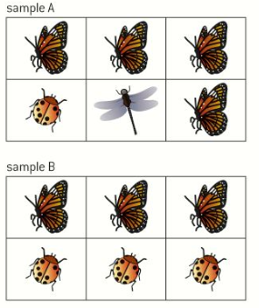
Components of biodiversity
Richness and evenness are components of biodiversity
Biological diversity, or biodiversity, has two components. Richness refers to the number of different species present. Evenness refers to how close in numbers each species is. If two individuals were to be taken from the sample randomly, evenness would be an indicator of the likelihood that the two individuals would be from different species.
Sample A has more richness but sample B is more even.
VIDEO

Slide 12
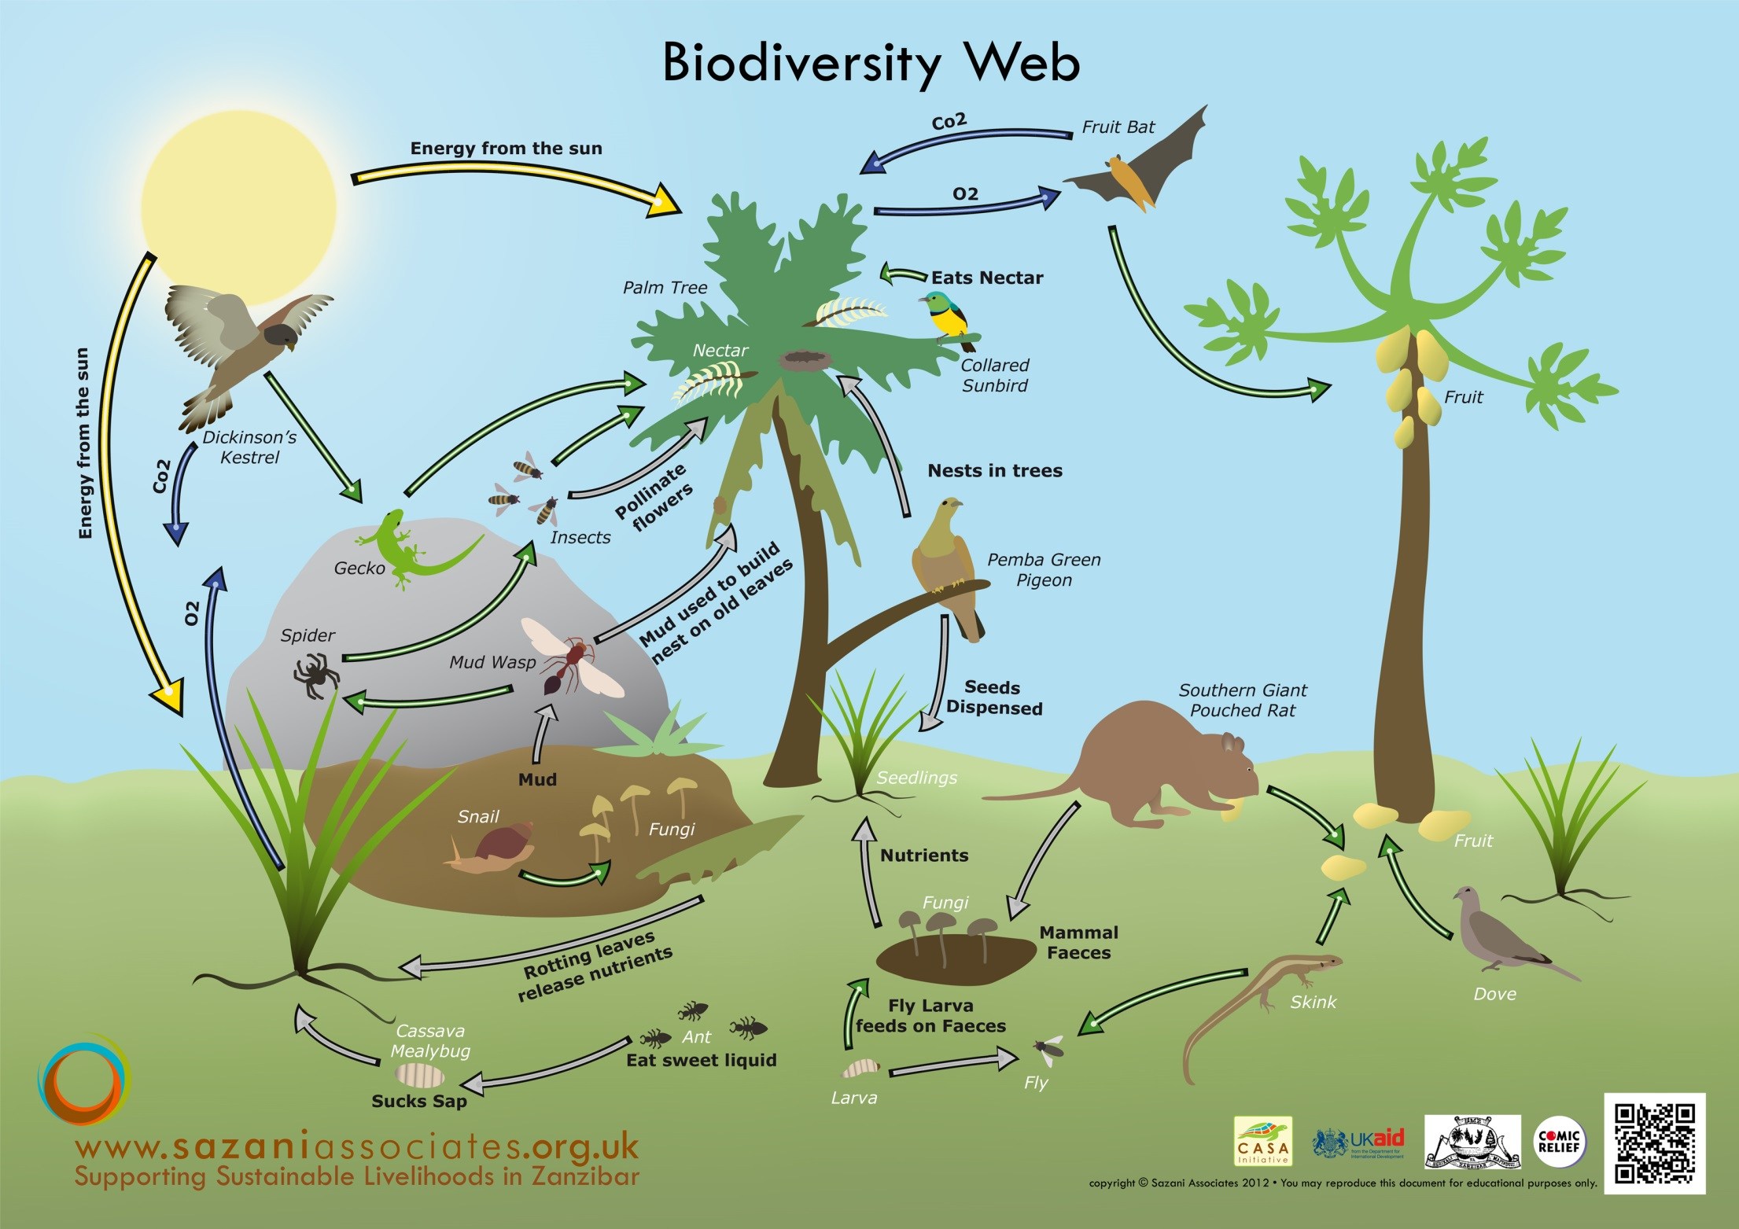

Slide 13
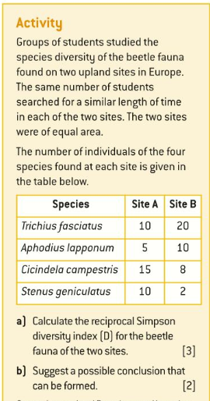
https://www.youtube.com/watch?v=zxzwvWDeTT8

Slide 14
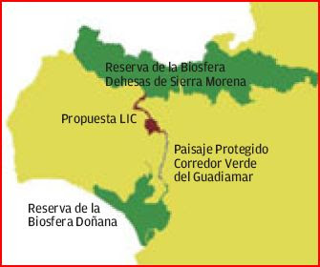
Biogeography can influence diversity
Biogeographic factors affect species diversity
The effectiveness of nature reserves at conserving biodiversity depends on it biogeographical features.
Large nature reserves are more effective at maintaining biodiversity than small ones. This is consistent with the island biogeographical model, if nature reserves are like islands. The larger the island is the greater the biodiversity found there. The larger the area the higher the population of a certain species can be supported and the less likely that small populations will be extirpated by random events.
Connected nature reserves are more effective than isolated ones. Corridors can increase effectiveness of nature reserves. Even narrow corridors, just to cross roads, are enough sometimes

Slide 15
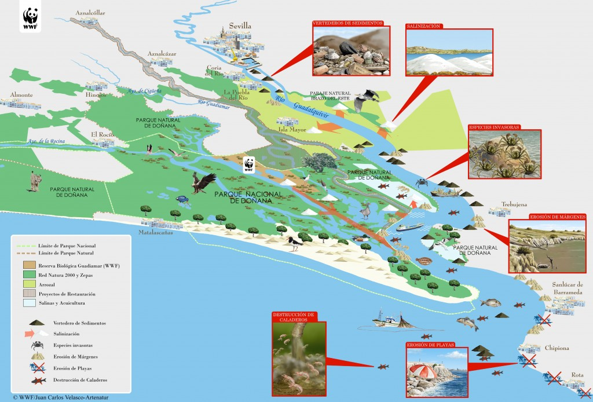

Slide 16
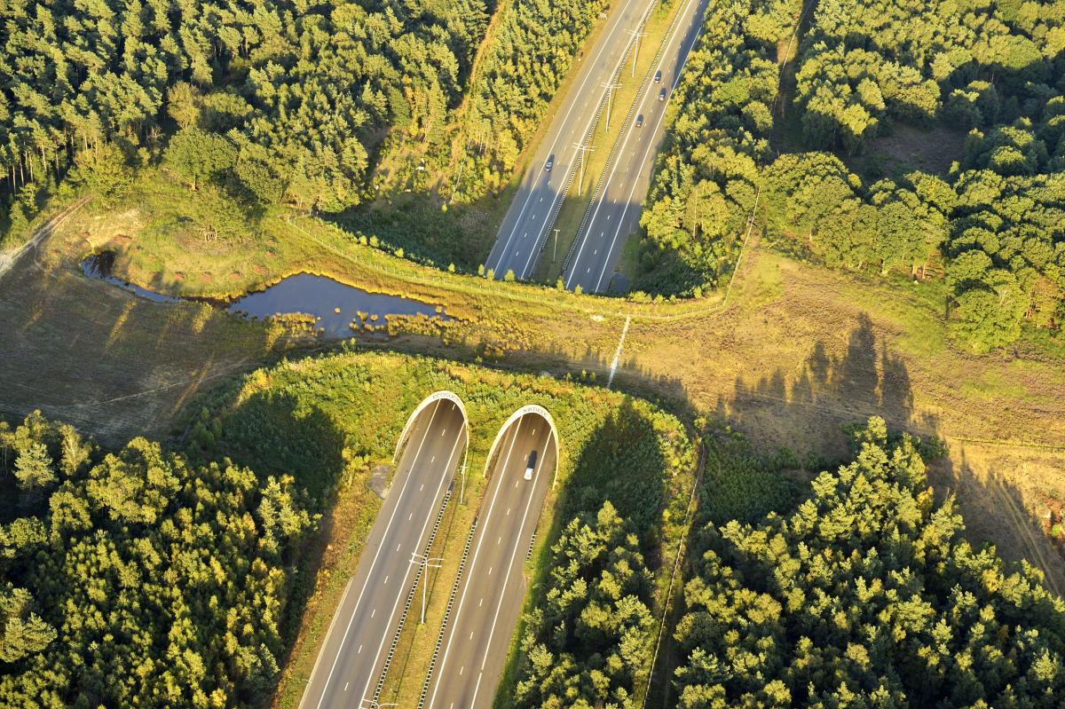
Ecoduct, National park ‘Hoge Veluwe’, The Netherlands

Slide 17
Biogeography can influence diversity
Biogeographic factors affect species diversity
The ecology in the edges of ecosystems is very different from the interior ecology so the shape of a reserve is important. A circular reserve is more effective at maintaining biodiversity than a long strip of land.

Slide 18
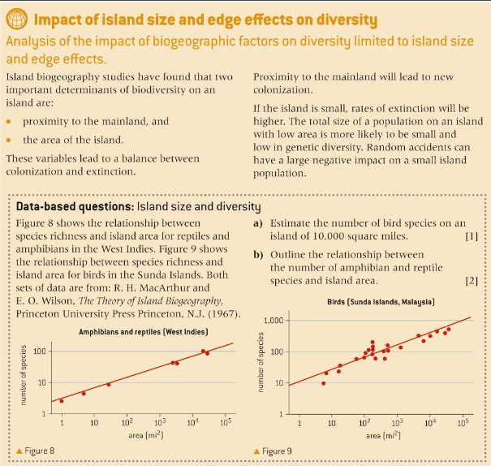

Slide 19
Option C Ecology and Conservation
C4 Conservation of biodiversity

