Slide 1
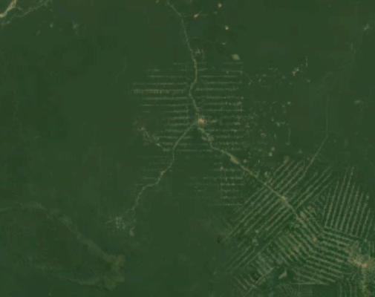
Option C Ecology and Conservation
C3 Impacts of humans on ecosystems

Slide 2
Nature of science
Assessing risks and benefits associated with scientific research—the use of biological control has associated risk and requires verification by tightly controlled experiments before it is approved. (4.8)
Understandings:
Introduced alien species can escape into local ecosystems and become invasive.
Competitive exclusion and the absence of predators can lead to reduction in the numbers of endemic species when alien species become invasive.
Pollutants become concentrated in the tissues of organisms at higher trophic levels by biomagnification.
Macroplastic and microplastic debris has accumulated in marine environments.

Slide 3
Applications and skills
Application: Study of the introduction of cane toads in Australia and one other local example of the introduction of an alien species.
Application: Discussion of the trade-off between control of the malarial parasite and DDT pollution.
Application: Case study of the impact of marine plastic debris on Laysan albatrosses and one other named species.
Skill: Analysis of data illustrating the causes and consequences of biomagnification.
Skill: Evaluation of eradication programmes and biological control as measures to reduce the impact of alien species.
ToK
None
Essential idea: Essential idea: Human activities impact on ecosystem function.

Slide 4
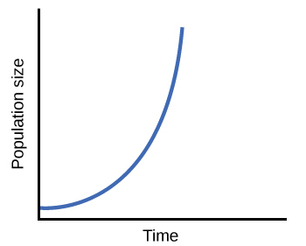
Alien and invasive species
Introduced alien species can be introduced into local ecosystems and become invasive
An organisms trophic level is its position in a food chain. Because feeding relations in an ecosystem are often web-like, an organism can occupy various positions.
Introduction video
Species which are native to an area are endemic to that area. They are part of the already established ecosystem and its population size is balanced by the biotic and abiotic components of the ecosystem.
If species from other ecosystems are introduced to a new area, and if they find an ecological niche with few limiting factors, they can become invasive.
Water hyacinth

Slide 5
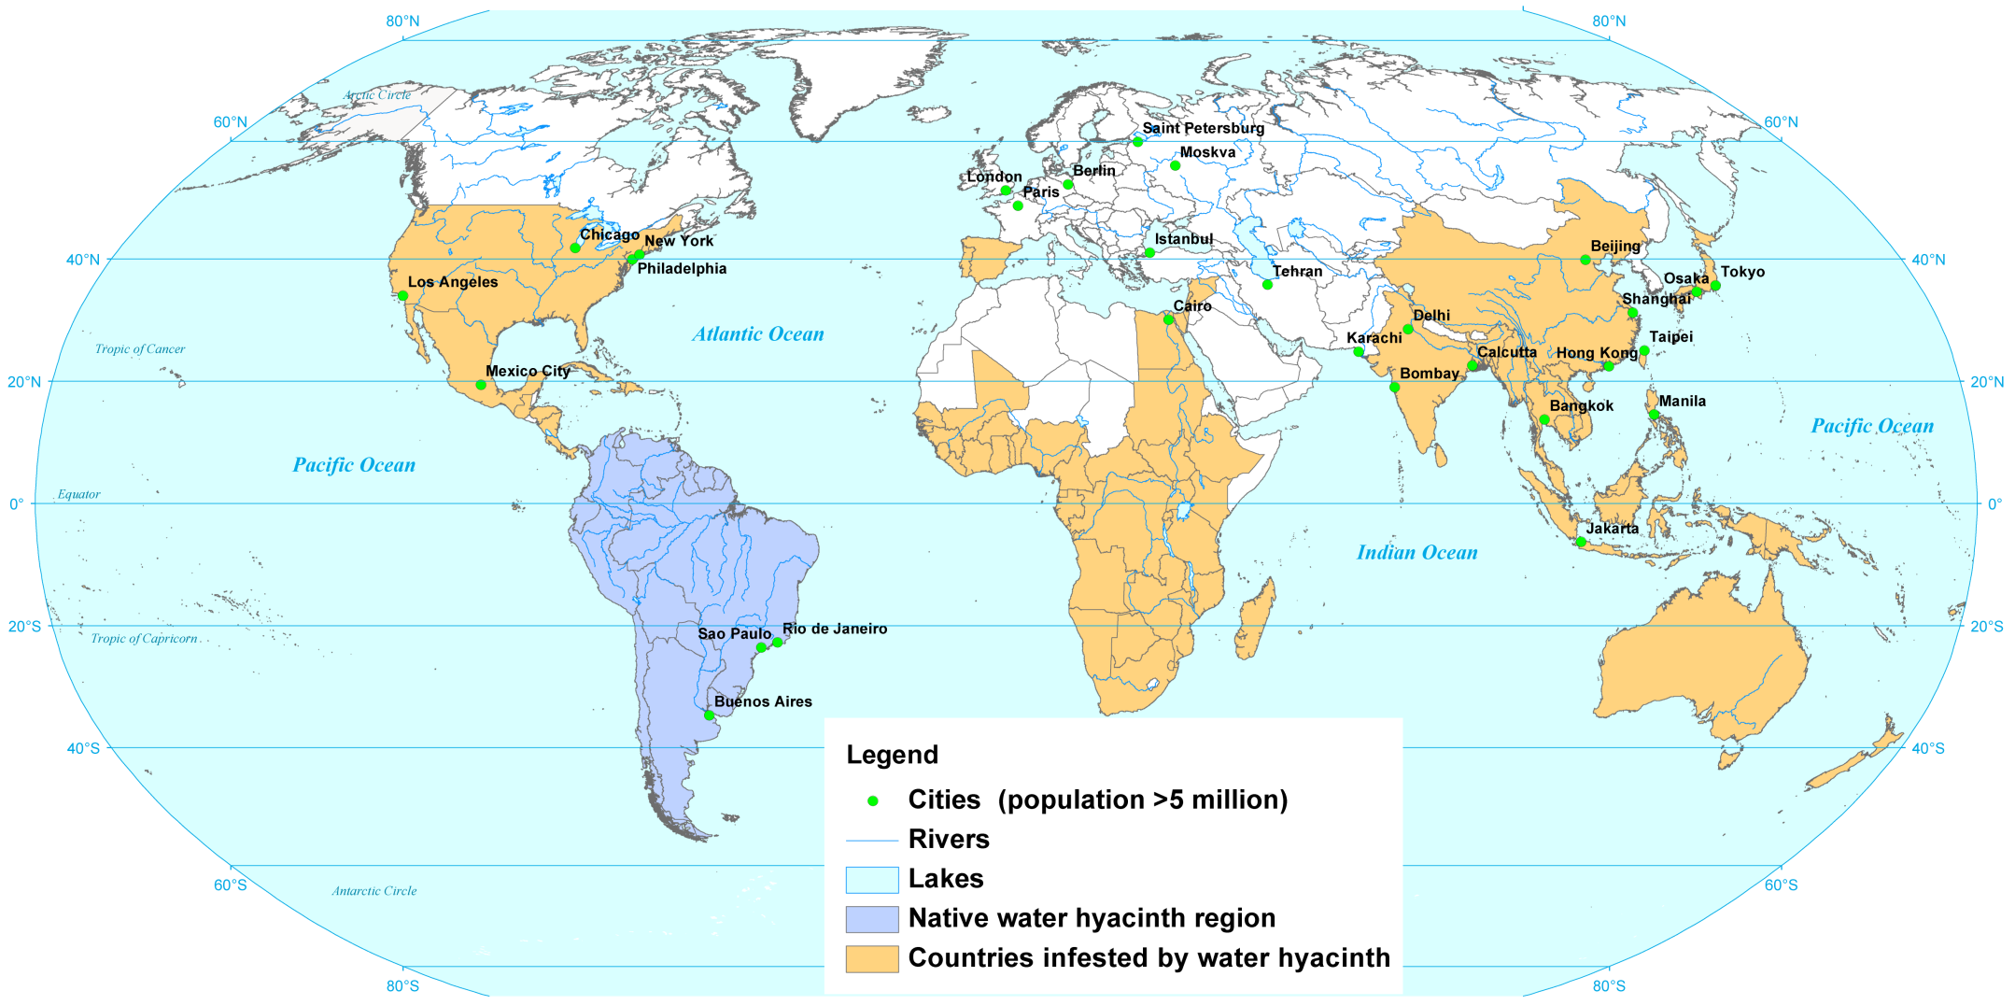
Water hyacinth invasion

Slide 6
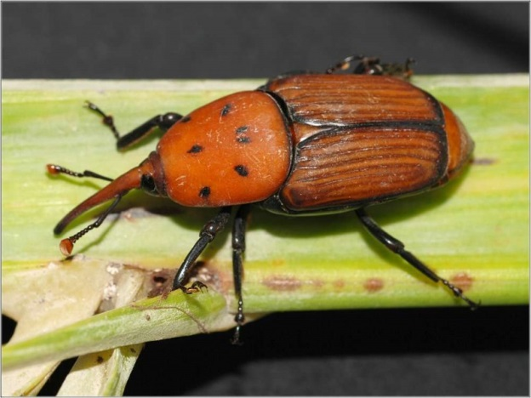
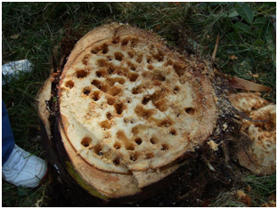
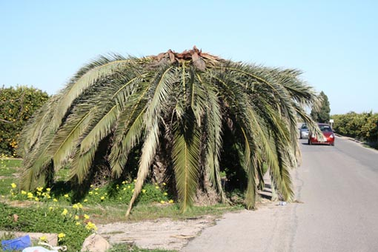
Alien species compete with native species
Competitive exclusion and the absence of predators can lead to reduction in the number of endemic species when alien species become inivasive
An alien species can become some successful and aggressive in a new ecosystem that it outcompetes native inhabitants and becomes a serious treat for the ecosystem.
When the niche of the invasive species overlaps with the native species competitive exclusion might be the result.
EXAMPLES IN ANDALUCIA
But the competition of native species can also prevent an alien species from becoming invasive.

Slide 7
The risk of biological control
Assessing risks and benefits accosiated with scientific research: the use of biological control has risks and requires verifiction by tightly controlled experiments before approved.
In some cases biological control can be used to control invasive species. Usually natural predators of the invasive species are introduced to control it from spreading.
Usually the natural enemy will be kept with the invasive species in an enclosed environment to assess the effects and to make sure the ecosystem itself is not disturbed.
Disasters in Australia
Success story

Slide 8
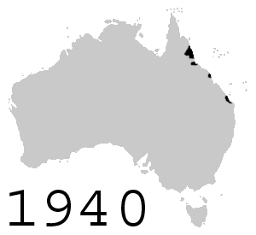
Read this part on page 627. What is your opinion about these methods.
ANOTHER EXAMPLE
Cane toads in Australia

Slide 9
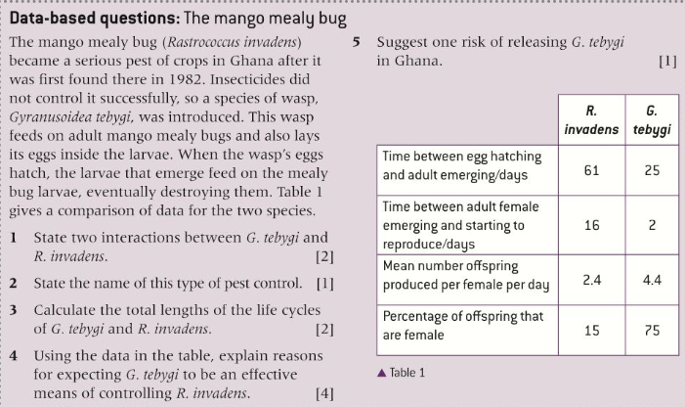
Homework for Monday: the databased questions on page 628 and 629

Slide 10
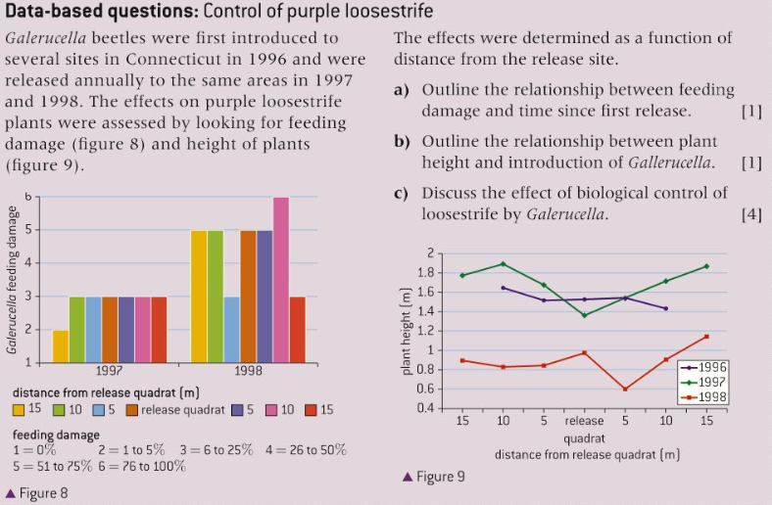

Slide 11
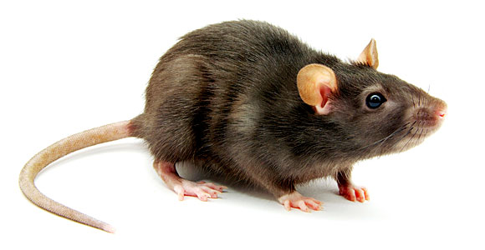
Biological control is not the only method by which invasive species can be controlled. Eradication programmes involve application of herbicides and selective harvesting of invasive plants as well as trapping and culling of animals.
This worked very well in New Zealand with the Norway rats, a highly invasive rat which has been eradicated in many islands.
Care is needed as the ecosystem might have already adapted itself to the invader and prey populations for example can suddenly rise fast.

Slide 12
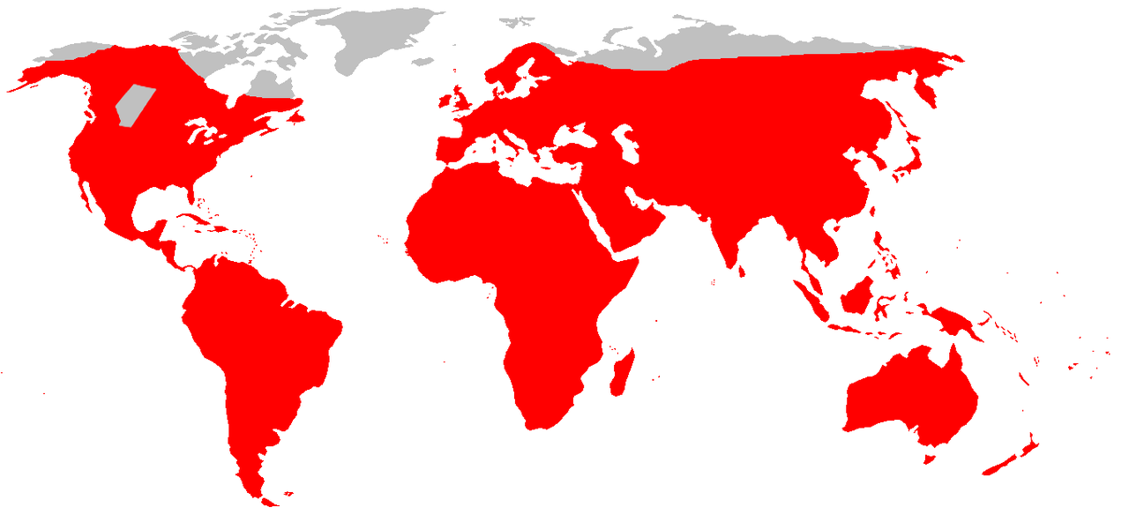
Brown rat distribution

Slide 13
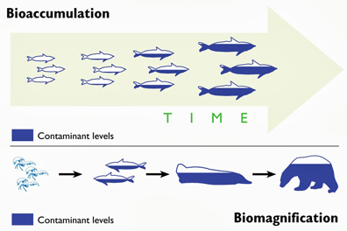
Biomagnification
Pollutants become concentrated in the tissues of organisms at higher trophic levels by biomagnification
Some toxins build up in the body of organisms, especially when they are fat-soluble and not easily excreted. This is known as bioaccumulation.
Biomagnification is the process by which chemical substances become more concentrated at each trophic level. At each stage of the food chain the predator will accumulate a higher concentration than its prey. This is because the predator consumes large quantities of prey during its lifetime and bioaccumulates the toxins they contain.

Slide 14
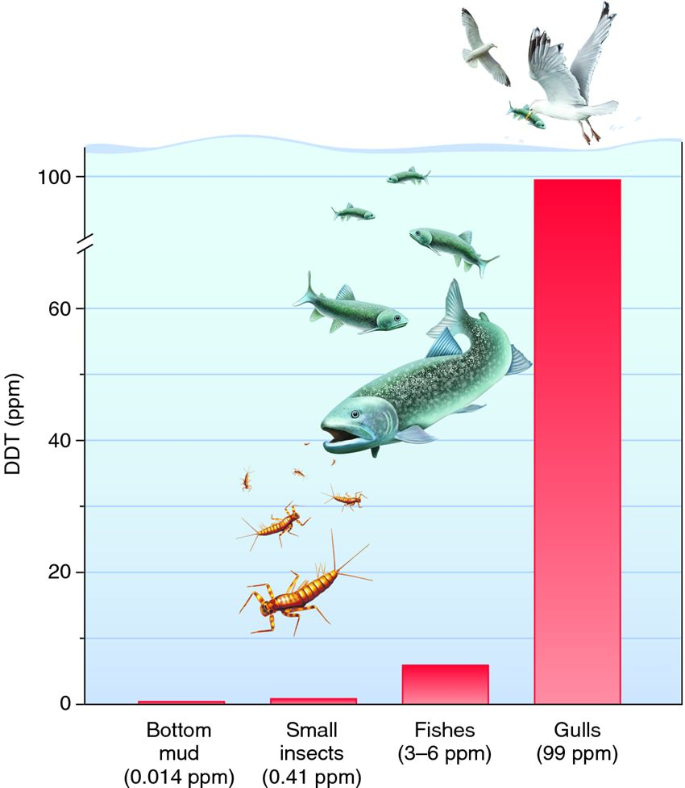
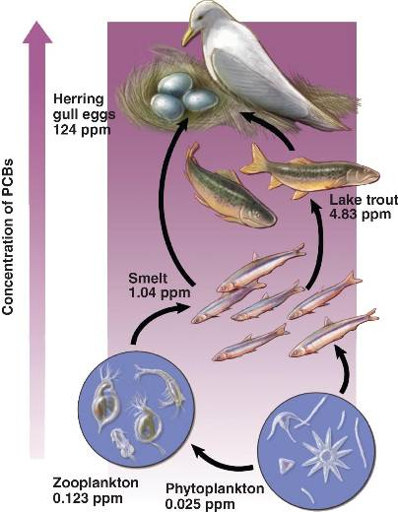
Biomagnification
Pollutants become concentrated in the tissues of organisms at higher trophic levels by biomagnification

Slide 15
The benefits and risks of DDT use
Discussion if the trade off between control of the malarial parasite and DDT pollution
Read page 632 and 633 of your book on the topic.
When are the benefits more convincing than the limitations?

Slide 16
Plastics in the ocean
Macroplastic and microplastic debris has accumulated in marine environments.
10 minute documentary and posterior discussion

Slide 17
Option C Ecology and Conservation
C3 Impacts of humans on ecosystems

