Slide 1
Option C Ecology and Conservation
C2 Communities and ecosystems

Slide 2
Nature of science
Use models as representations of the real world—pyramids of energy model the energy flow through ecosystems. (1.10)
Understandings:
Most species occupy different trophic levels in multiple food chains.
A food web shows all the possible food chains in a community.
The percentage of ingested energy converted to biomass is dependent on the respiration rate.
The type of stable ecosystem that will emerge in an area is predictable base on climate.
In closed ecosystems energy but not matter is exchanged with the surroundings.
Disturbance influences the structure and rate of change within ecosystems.

Slide 3
Applications and skills
Application: Conversion ratio in sustainable food production practices.
Application: Consideration of one example of how humans interfere with nutrient cycling.
Skill: Comparison of pyramids of energy from different ecosystems.
Skill: Analysis of a climograph showing the relationship between temperature, rainfall and the type of ecosystem.
Skill: Construction of Gersmehl diagrams to show the inter-relationships between nutrient stores and flows between taiga, desert and tropical rainforest.
ToK
Do the entities in scientists’ models, for example trophic levels or Gersmehl diagrams, actually exist, or are they primarily useful inventions for predicting and explaining the natural world?
Essential idea: Changes in community structure affect and are affected by organisms.

Slide 4
Ecosystems
Link to video

Slide 5
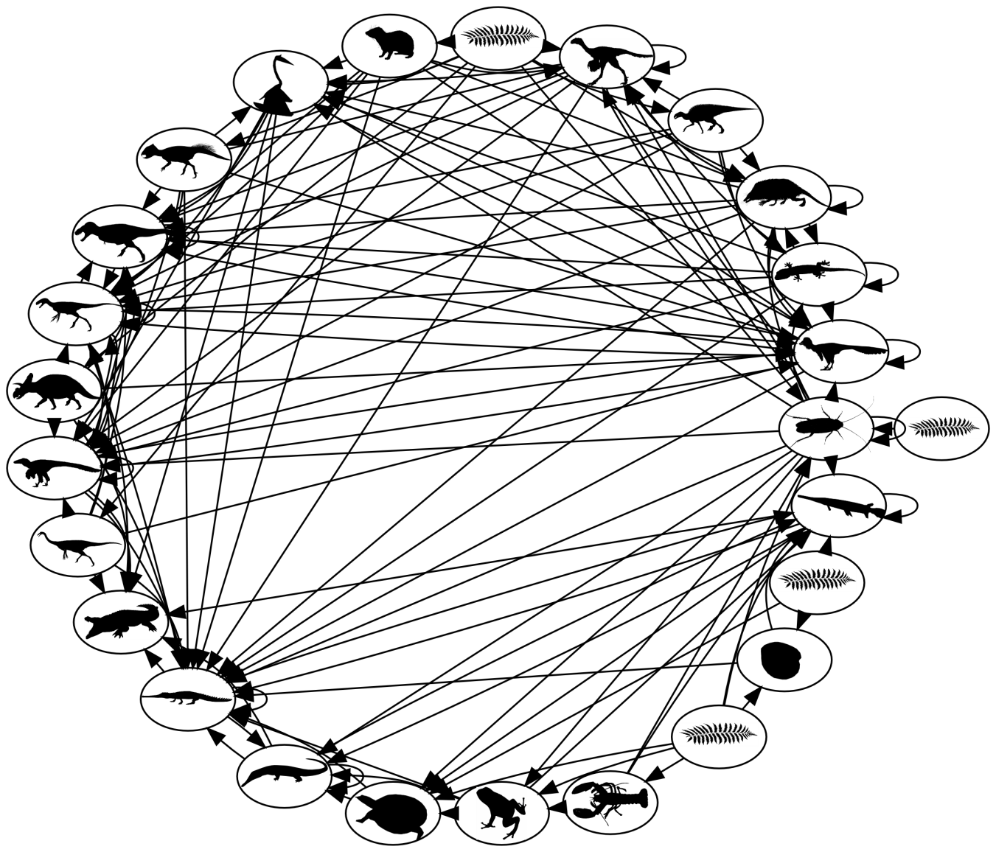
Trophic levels
Most organisms occupy different trophic levels in an ecosystem
An organisms trophic level is its position in a food chain. Because feeding relations in an ecosystem are often web-like, an organism can occupy various positions.

Slide 6
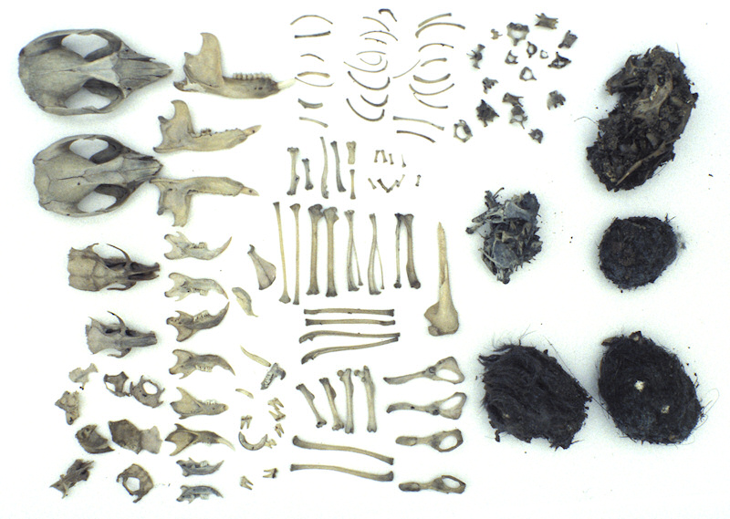
Trophic levels
Most organisms occupy different trophic levels in an ecosystem
An owl pellet is a mass of undigested remains of the owl’s prey. Analysing this you can get a clear idea of what the owl has been eating and about the structure of an ecosystem.
If a species is found in the pellet its trophic level can be deduced. The contents show the owl has been feeding on more than one trophic level. The different mice skulls show that some were primary consumers and other were secondary consumers, just by analysing their teeth.

Slide 7
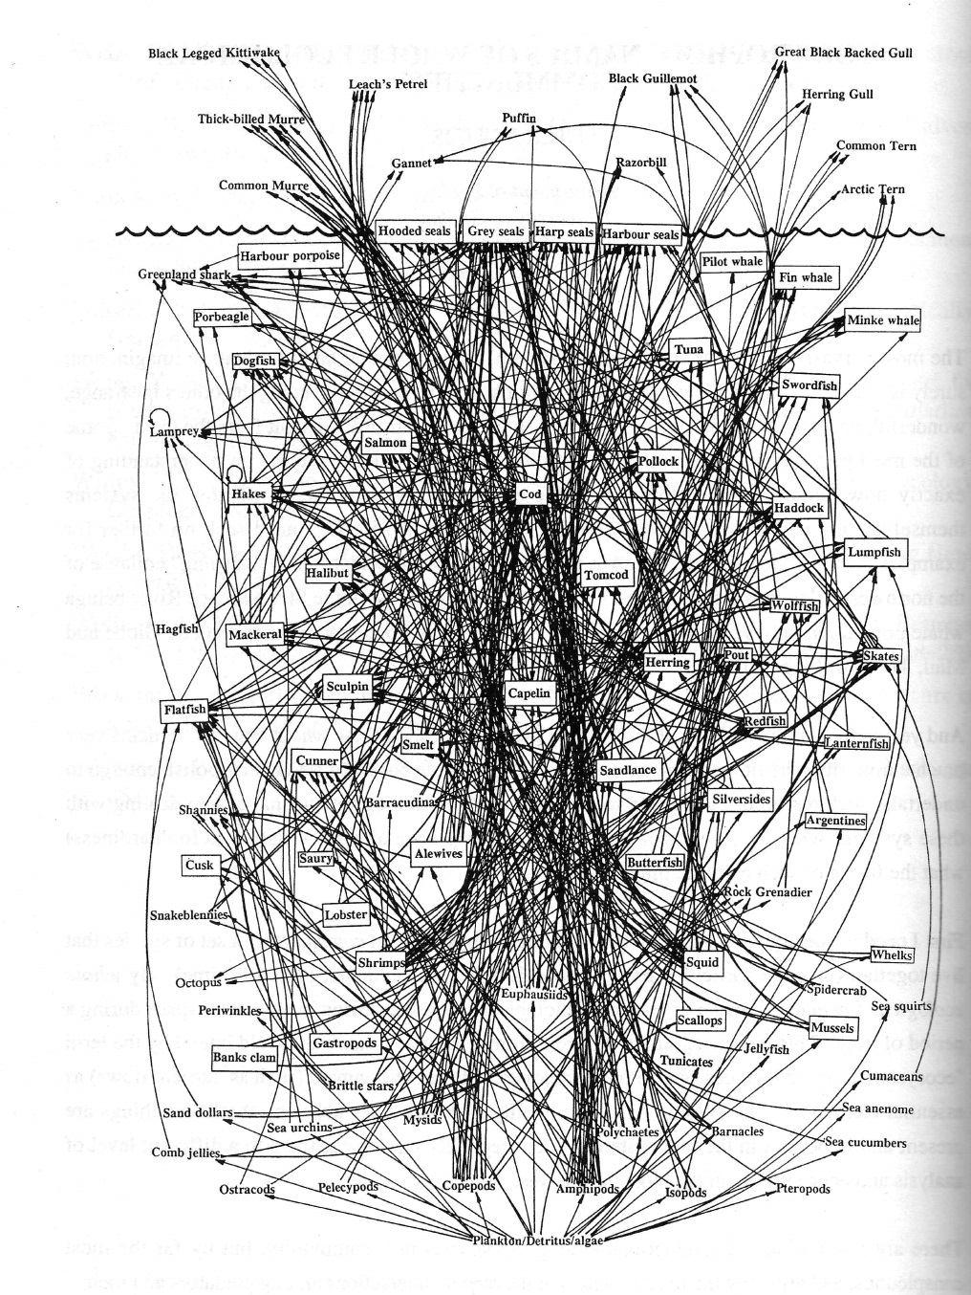
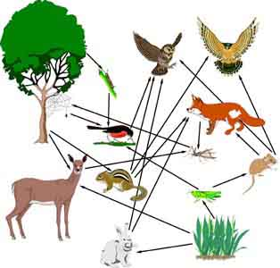
Food webs
A food web shows all the possible food chains in an ecosystem
Food webs can be very simply illustrated:
But are usually very complex:
Trophic relationships in an ecosystem tend to be web like as most organisms feed on various layers in the food chain. In a food web consumers at the same trophic level are usually shown at the same height in the chain.

Slide 8
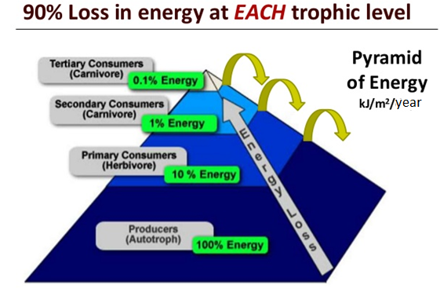
Pyramids of energy as models
Models are representations of the real world: Pyramids of energy model the flow of energy through the food chain.
A pyramid of energy is a type of bar chart that is used to show the relative amount of energy flowing through each level. The lowest bar represents the producers, and is the largest. Then above you find the primary consumers, secondary consumers, tertiary consumers etc.
When constructing a pyramid of energy each level should be labelled and the unit should be indicated, usually kJ m⁻² year ⁻¹. Ideally the same scale bar should be used for each bar but in most text books this is not done to make it fit on the page.
The main limitation is that diets differ in each season and therefor these pyramids are very dynamic.

Slide 9
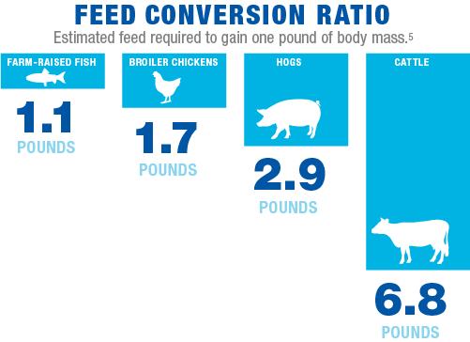
Food conversion ratios
Conversion ratio in sustainable food production practices
The production of meat for consumption require the animals to be fed. Food conversion ratios refer to the quantity of dietary input of grams required t produce a certain quantity of biomass in livestock or fish.
LINK
For example, a feed conversion of 1.2 means that 120g of fed is required to produce 100g of biomass.
For example, a feed conversion of 1.2 means that 120g of fed is required to produce 100g of biomass.

Slide 10
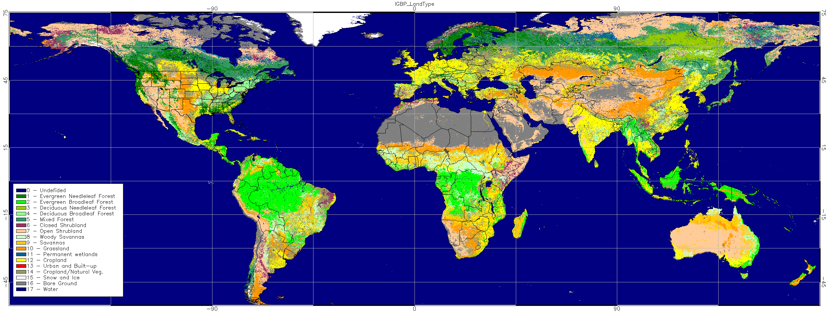
The impact of climate on ecosystem type
The type of stable ecosystem that will emerge in an area is predictable based on an area
Climate is a property which emerges from the interaction of various variables, like temperature and precipitation.
Temperature influences the distribution of species. Temperature influences the rate of photosynthesis, cell respiration, decomposition, transpiration and ultimately has an influence on productivity.
Precipitation also influences productivity by having an impact on photosynthesis and rate of decomposition. Information about the relative combinations of these variables in an area can allow for predictions about what type of stable ecosystem will exist in that area.
LINK

Slide 11
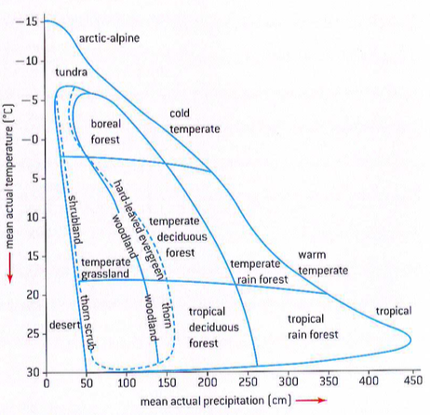
Interpreting a Whitaker climograph
Analysis of a climograph showing the relationship between temperature, rainfall and ecosystem type
A climograph is a diagram which shows the relative combination of temperature and precipitation in an area. It shows the most likely ecosystem which will emerge in an area under certain climatic condition.
Lets answer question a, b and c from page 617

Slide 12
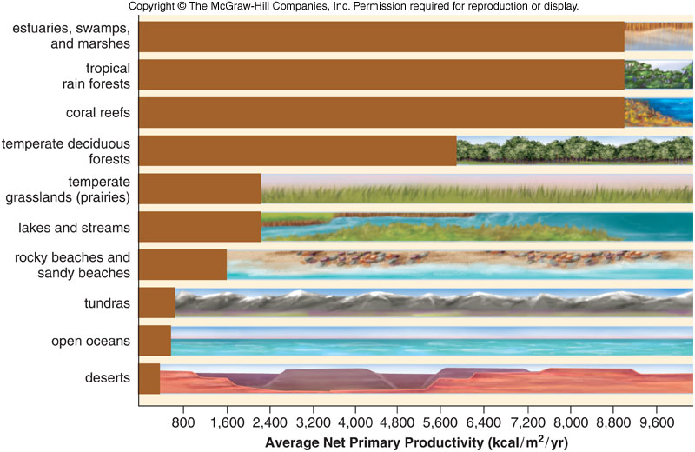
Comparison of pyramids of energy of different ecosystems
LINK
The lengths of food chains is determined by net level of primary energy production. The higher the productivity the longer the food chain and the broader the tropic level at each of the stages of the pyramid.

Slide 13
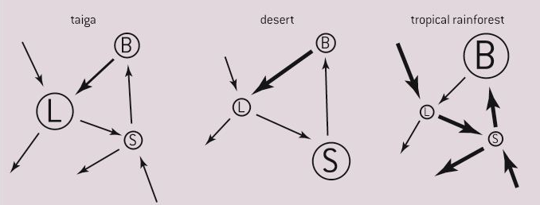
Gersmehl nutrient cycle diagrams
Contruction of Gersmehl diagrams to show the inter relationships between nutrient stores and flow of Taiga, desert and tropical rainforest
A Gersmehl diagram is a model of nutrient storage and flow for terrestial ecosystems. Here below are three diagrams for taiga, desert and tropical rainforest.
The model presumes three storage compartments; biomass, litter and soil. Storage compartments, or pools are represented by circles, or ovals. Arrows represent nutrient flows, or fluxes. The thickness of the arrows represent rates of flow of nutrients. Each arrow represents more than one process.

Slide 14
Gersmehl nutrient cycle diagrams
Contruction of Gersmehl diagrams to show the inter relationships between nutrient stores and flow of Taiga, desert and tropical rainforest

Slide 15
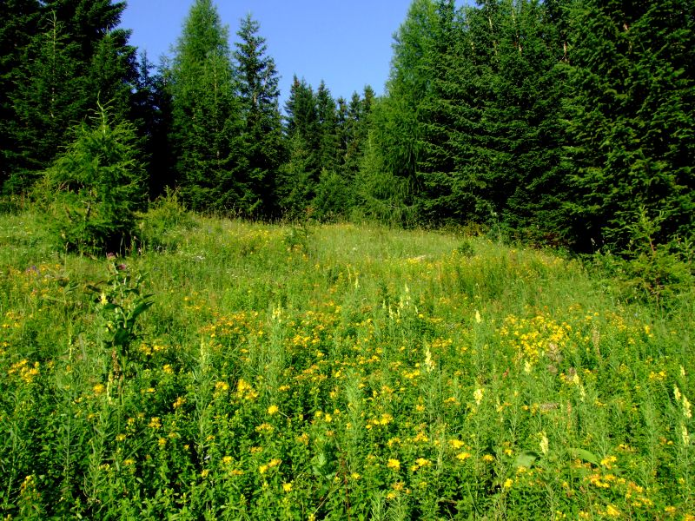
Primary succesion
Analysis of data showing primary succesion
Introduction video
Ecological successions are the changes in an ecosystem over time. These changes involve both the species living in the ecosystem and their abiotic environment.
As you have learned, in an ecosystem the abiotic factors set limits to the distribution of living organisms, and those organisms in their turn have an effect on the abiotic factors.
Consider a forest next to grassland, the forest is cooler humid because of the shade below the leaves. Also it will have less light intensity, there will be more water infiltration in the soil and more nutrients etc.
So in succession the abiotic factors give rise to biotic factors, which in turn hange the abiotic factors again.

Slide 16
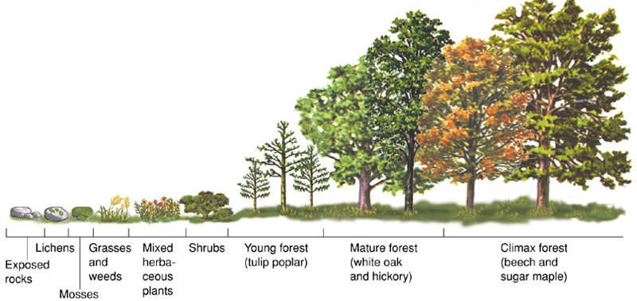
Primary succesion
Analysis of data showing primary succesion

Slide 17
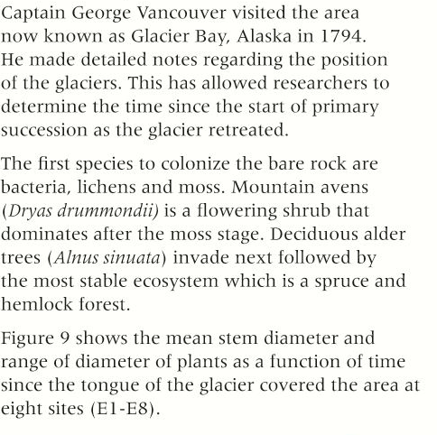
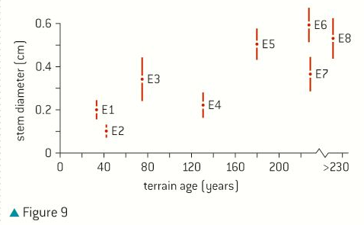
Primary succesion
Analysis of data showing primary succesion

Slide 18
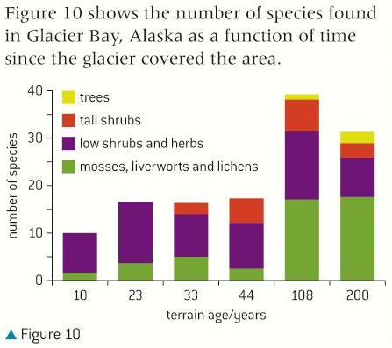
Primary succesion
Analysis of data showing primary succesion

Slide 19
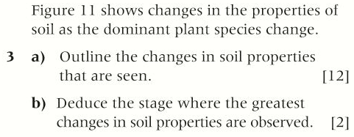
Primary succesion
Analysis of data showing primary succesion

Slide 20
Respiration rates and biomass accumulation
The percentage of ingested energy converted to biomass is dependent on the respiration rate
Production in plants happens when organic matter in synthesised in photosynthesis. In animals it occurs when food is absorbed after ingestion. To measure this production the unit kilojoules (kJ) is often used. The amount is usually measured per area (m²) and time (year).
Gross and net production can be calculated with the following formula:
net production= gross production – respiration
Gross production is the total amount of organic matter produced per unit area per time in a certain trophic level of an ecosystem.
Net production is the amount of organic matter remaining after subtracting the amount used for respiration.

Slide 21
Respiration rates and biomass accumulation
The percentage of ingested energy converted to biomass is dependent on the respiration rate
In the early stages of primary succession, the high availability of sunlight means that gross production is high, and there is little total biomass in the community. As a result the total respiration to support the small biomass is low.
As succession proceeds the standing biomass increases and the total respiration too. Furthermore the amount of gross biomass production begin to decline when all available spaces are taken.
An equilibrium is reached when the total community production to the total community respiration equals 1.

Slide 22
Secondary succession
Disturbances influences the structure and rate of change in ecosystems
Secondary succession takes place in places where there is already or has recently been an ecosystem. The succession is initiated by a change in conditions. Old road might become disused and plants grow cover them, old oil fields, parking lots or agricultural areas, when left untouched, can turn into completely new ecosystems.
VIDEO
The pace of succession slows down as succession proceeds, close to the time of disturbance, rates of system respiration and productivity increase rapidly and there is an accumulation of biomass. Species diversity increase quickly close to the time of the disturbance. This slows down until a climax is reached and a more stable ecosystems settles.

Slide 23
Studying secondary succession
Investigation into the effect of an environmental disturbance on an ecosystem
Which indicators could you think of?
A number of possible factors to investigate are:
Species diversity
Stem density
Above ground biomass
Leaf area index
Volume of leaf litter
Water cycle variables: water infiltration and run off data
Soil variables: Moisture, pH, nutrients, compaction levels.
Light levels
bulk soil densities
etc

Slide 24
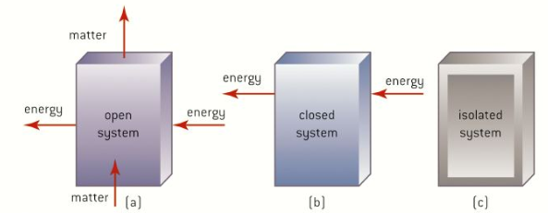
Closed ecosystems
In closed ecosystems energy but not matter is shared with the surroundings.
There are three systems that can be modelled:
Open systems
Matter and energy is exchanged with the environment.
Closed system
A closed system exchanges energy but not matter with the surroundings. Like the biosphere 2

Slide 25
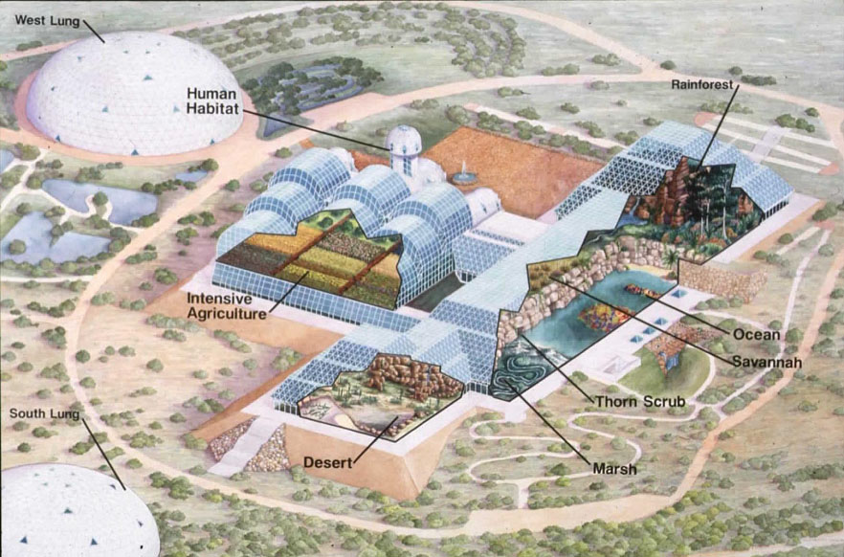
Biosphere 2

Slide 26
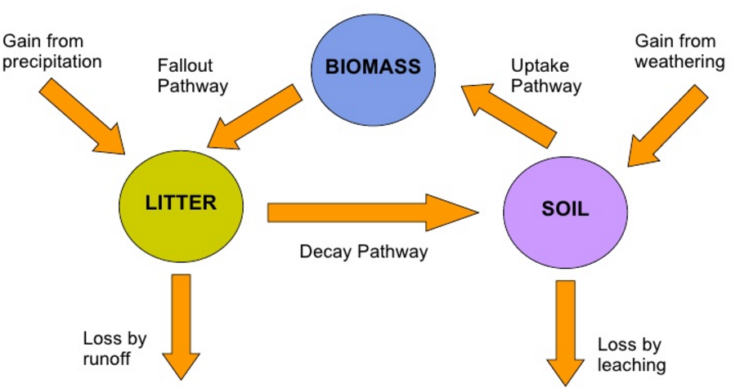
Disruptions of the nutrient cycle
Considerations of one example of how humans interfere with the nutrient cycle

Slide 27
Option C Ecology and Conservation
C2 Communities and ecosystems

