Slide 1
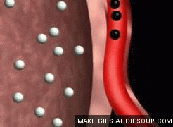
Topic 6: Human Health and Physiology
6.4 Gas exchange

Slide 2
ASSESSMENT STATEMENTS
6.4.1 Distinguish between ventilation, gas exchange and cell respiration.
6.4.2 Explain the need for a ventilation system.
6.4.3 Describe the features of alveoli that adapt them to gas exchange.
6.4.4 Draw and label a diagram of the ventilation system, including trachea, lungs, bronchi, bronchioles and alveoli.
6.4.5 Explain the mechanism of ventilation of the lungs in terms of volume and pressure changes caused by the internal and external intercostal muscles, the diaphragm and abdominal muscles

Slide 3
6.4.1 Distinguish between ventilation, gas exchange and cell respiration.
Breathing is the act of inhaling and exhaling which allows ventilation of the lungs.
Gas exchange is the intake of oxygen and excretion of carbon dioxide which takes place at the (specialised respiratory) surface of an organism.
Cell respiration is the process of releasing energy from food (large organic molecules), often using oxygen.
Ventilation is the process of moving air into and out of lungs. It involves muscular movement and as such requires energy (released by cell respiration). Ventilation is required to maintain a concentration gradient so that gaseous exchange can occur. Oxygen will diffuse from the air in the
lungs into the blood only if the concentration of oxygen in the air in the lungs is higher than that in the blood. As the oxygen diffuses into the blood, the concentration of oxygen in the air of the lungs decreases. By refreshing the air in the lungs, the concentration gradient is maintained.

Slide 4
6.4.1 Distinguish between ventilation, gas exchange and cell respiration.
Gas exchange is the movement of oxygen from the air in the lungs into the blood and carbon dioxide in the opposite direction. First, the oxygen dissolves in the film of water around the cells that make the walls of the alveoli. The dissolved oxygen then diffuses through the alveoli cells and through the walls of the capillaries into the erythrocytes in the blood. The circulation of the blood will take the oxygen away from the area of gas exchange, which also serves to maintain the concentration gradient.
The movement of carbon dioxide, produced in the tissues, takes place in the opposite direction. The blood carries carbon dioxide to the lungs. Here, it diffuses from the blood, across the walls of the capillaries and the walls of the alveoli into the air in the lungs. The circulatory system will continue to bring blood carrying carbon dioxide to the lungs and ventilation of the lungs will refresh the air so that the concentration gradient is maintained.
LINK

Slide 5
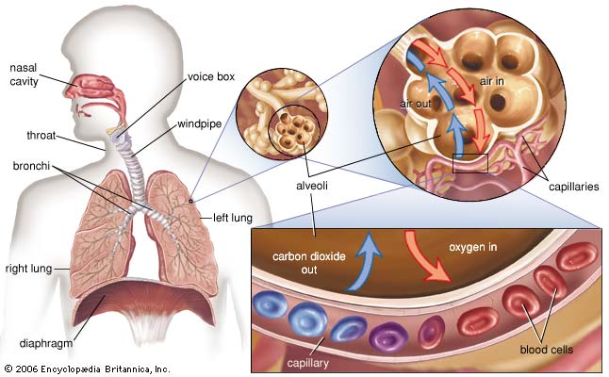

Slide 6
6.4.1 Distinguish between ventilation, gas exchange and cell respiration.
Cell respiration, is the release of energy from large organic molecules. Every living cell requires energy for its metabolic processes, which means that cell respiration takes place in all living cells. Cell respiration can use oxygen as its ultimate electron acceptor. This is called aerobic respiration and this process releases more energy per molecule glucose than anaerobic respiration.
Ventilation, gas exchange and cell respiration are all dependent on each other:
Ventilation requires energy provided by cell respiration.
Gas exchange depends on a concentration gradient of respiratory gases, which is maintained by ventilation.
Cell respiration is more efficient when using oxygen. The oxygen needed and the carbon dioxide produced are exchanged with the environment via gas exchange in the lungs.
Ventilation moves air into and out of lungs.
Gas exchange removes carbon dioxide from the blood and takes oxygen into the blood.
Cellular respiration uses oxygen to release energy from food and produces carbon dioxide.

Slide 7
6.4.1 Distinguish between ventilation, gas exchange and cell respiration.
 | Ventilation | Gas exchange | Cellular respiration
Place | involves muscles to move ribs and move air into and out of lungs | at the exchange surface where alveoli are next to blood capillaries | in cytoplasm(glycolysis) and mitochondria (Krebs cycle and Oxidative phosphorylation)
Energy | Muscle movements require energy | diffusion is a passive process, no energy needed | converts energy into a useable form
Physical or chemical | physical | hpysical | chemical

Slide 8
6.4.2 Explain the need for a ventilation system.
One of the characteristics of life is respiration. Respiration in this case has the biological meaning of the release of energy. This means that cellular respiration goes on in every living cell. Since anaerobic respiration releases about 5-7% of the energy that aerobic respiration releases, most cells require a constant supply of oxygen to function properly. A few species of bacteria, living in the mud at the bottom of ponds and lakes, cannot tolerate oxygen; they employ alternative pathways to release energy.
Unicellular organisms and small multicellular organisms have few problems in gaseous exchange. The required gases will easily diffuse into and out of their system. For larger organisms this is not possible due to their smaller surface area over volume ratio. The decrease of the surface area over volume ratio is quite rapid as the size of an organism increases. (Please remember from topic 2, Cells)
LINK

Slide 9
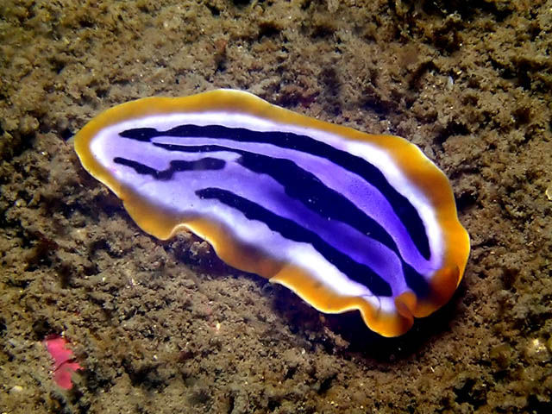
6.4.2 Explain the need for a ventilation system.
So, when organisms become larger, there is simply not enough surface for gaseous exchange. An added problem is that the oxygen, once inside the organism, has to travel a long way to reach some cells. Since diffusion in liquids
is a fairly slow process, this is unsatisfactory. The same principle applies to other organs that exchange material with the internal or external environments e.g. intestine and kidney.
When the size of the organism is limited, the problems can be solved by flattening the body (e.g. flatworms). This increases the surface area and decreases the diffusion distance. However,
in larger organisms, even this measure is insufficient and a need for a respiratory surface exists.
Insects have a system of tracheal tubes. These many tubes run from the exoskeleton throughout the insect’s body. They are partially air-filled, which ensures much faster diffusion. Larval amphibians often have external gills. These are thin structures with a large surface area especially suited for gaseous exchange. Due to their position, however, they are easily damaged.

Slide 10
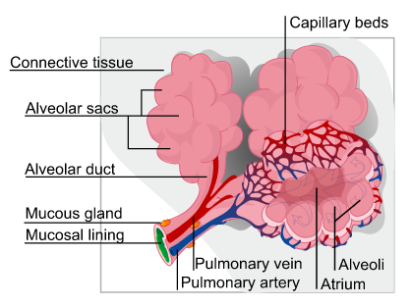
6.4.3 Describe the features of alveoli that adapt them to gas exchange.
Four features of alveoli allow efficient gas exchange:
large surface area
thin (short diffusion distance)
moist (gases need to dissolve before passing through membranes)
good blood supply (maintains the concentration gradient)

Slide 11
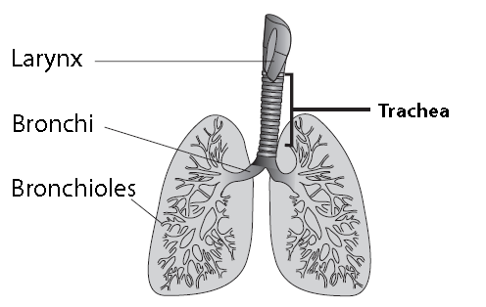
6.4.4 Draw and label a diagram of the ventilation system, including trachea, lungs, bronchi, bronchioles and alveoli.
Lungs

Slide 12
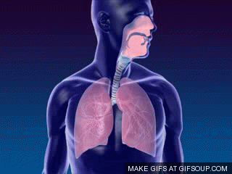
6.4.5 Explain the mechanism of ventilation of the lungs in terms of volume and pressure changes caused by the internal and external intercostal muscles, the diaphragm and abdominal muscles
Ventilation of the lungs
The air in the lungs constantly needs to be refreshed. Since the lungs only have one connection with the atmosphere, the ‘old’ air needs to be exhaled before fresh air can be taken in.
Inspiration
The external intercostal muscles contract and move the rib cage up and outward. The diaphragm contracts, flattening it downward. Both actions have the effect of increasing the volume of the chest cavity. If the volume increases, the pressure decreases and the air will flow into the lungs.
LINK
Expiration
The relaxation of the intercostal muscles and the diaphragm will bring them back into their original position . The volume decreases and the resultant increase in pressure will make the air leave the lungs.

Slide 13
Topic 6: Human Health and Physiology
6.4 Gas exchange

