Slide 1
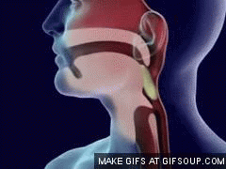
Topic 6: Human Health and Physiology
6.1 Digestive system

Slide 2
ASSESSMENT STATEMENTS
6.1.1 Explain why digestion of large food molecules is essential.
6.1.2 Explain the need for enzymes in digestion.
6.1.3 State the source, substrate, products and optimum pH conditions for one amylase, one protease and one lipase.
6.1.4 Draw and label a diagram of the digestive system.
The diagram should show the mouth, oesophagus, stomach, small intestine, large intestine, anus, liver, pancreas and gall bladder. The diagram should clearly show the interconnections between these structures.
6.1.5 Outline the function of the stomach, small intestine and large intestine.
6.1.6 Distinguish between absorption and assimilation.
6.1.7 Explain how the structure of the villus is related to its role in absorption and transport of the products of digestion.

Slide 3
6.1.1 Explain why digestion of large food molecules is essential.
Food contains starch, proteins and lipids. These molecules are very large. Large food molecules need to be digested before being absorbed. The process of absorption of food molecules requires them to pass into a cell lining the gut. To do so, molecules must be small and soluble. Therefore large molecules like polysaccharides, proteins and lipids need to be broken down into their building blocks before they can be absorbed.
Even if we could absorb the food as large molecules, many of these molecules would not be useful to us as such. Plants may contain a lot of starch which is useful for releasing energy, but only after it has been digested down to glucose. Steak contains proteins but probably not the exact same ones we need. If we break the proteins down into amino acids, we can use them as monomers or ‘building blocks’ and then used to produce exactly the right proteins.

Slide 4
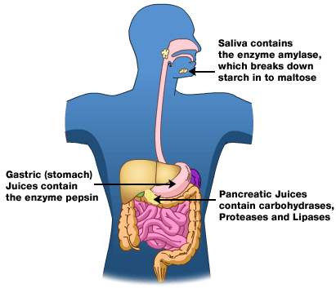
6.1.2 Explain the need for enzymes in digestion.
Like many other biological reactions, the breakdown of starch, proteins and lipids is a slow process at body temperature. Enzymes lower the required activation energy and make this process sufficiently fast.

Slide 5
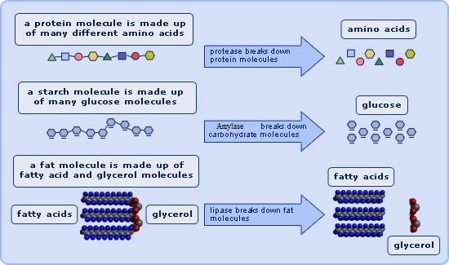
6.1.3 State the source, substrate, products and optimum pH conditions for one amylase, one protease and one lipase.
The three kinds of macronutrients are carbohydrates, lipids and proteins. Since enzymes are highly specific, each molecule has at least one enzyme to break it down into its building blocks. But as we can recognise three kinds of macronutrients, we can recognise three groups of enzymes:
the amylases digest most carbohydrates
the proteases digest proteins
the lipases digest lipids
LINK

Slide 6
6.1.3 State the source, substrate, products and optimum pH conditions for one amylase, one protease and one lipase.

Slide 7
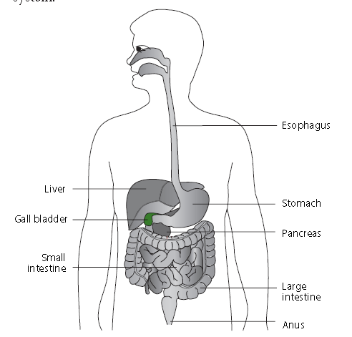
6.1.4 Draw and label a diagram of the digestive system.
The diagram should show the mouth, oesophagus, stomach, small intestine, large intestine, anus, liver, pancreas and gall bladder. The diagram should clearly show the interconnections between these structures.

Slide 8
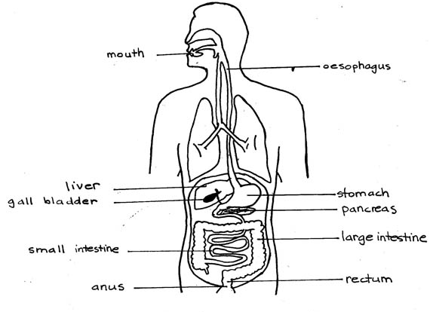
Example of drawing

Slide 9
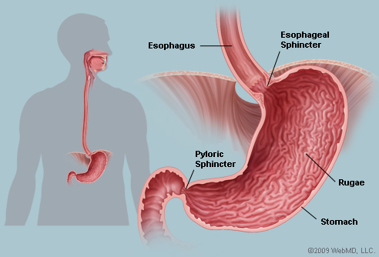
6.1.5 Outline the function of the stomach, small intestine and large intestine.
Functions of the stomach:
Temporarily store food
chemically digest proteins
kill pathogens.
The stomach receives the food from the mouth via the oesophagus and will pass it on to the small intestine. Food is eaten in less time than it can be digested by the small intestine so it is stored in the stomach for a while. It is then moved along by waves of muscular contraction of the intestinal wall called peristalsis.
Pepsin is the best known enzyme in the stomach. Pepsin chemically digests proteins and breaks them down into shorter polypeptides.
LINK

Slide 10
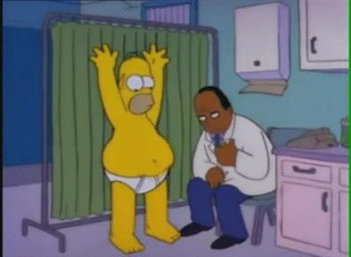
6.1.5 Outline the function of the stomach, small intestine and large intestine.
Pepsinogen is the inactive precursor of pepsin. It is produced by chief cells in the wall of the stomach and activated by the presence of hydrochloric acid (HCl). The hydrochloric acid necessary to activate pepsinogen is produced by the parietal cells in the wall of the stomach. Due to the hydrochloric acid, the pH in the stomach is very low (pH 2). The very acidic condition protects us from disease as it will kill most pathogens.

Slide 11
6.1.5 Outline the function of the stomach, small intestine and large intestine.
Functions of the small intestine are:
digestion
absorption of products of digestion
Enzymes are secreted into the small intestine from two sources: the wall of the small intestine and the exocrine part of the pancreas (via the pancreatic duct). These enzymes are responsible for a large part of the digestion of food. A third fluid is secreted into the small intestine: bile.
Bile is NOT an enzyme. Bile contains bile salts which break drops of fat into smaller droplets (emulsification) so that the enzyme (pancreatic lipase) has more surface area to work on.
Absorption of digested food takes place in the small intestine. To ensure enough surface area for absorption, the small intestine is long (6 metres in humans) and has folds on its inner surface. The surface also has villi (fingerlike projections into the hollow centre) and microvilli on these villi to further increase surface area.
LINK

Slide 12
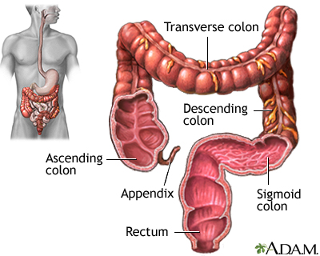
6.1.5 Outline the function of the stomach, small intestine and large intestine.
Functions of the large intestine:
absorption of liquids
absorption of minerals
In the process of digestion, a lot of fluid is added to the "food" as it moves through the alimentary canal. Glucose is actively absorbed in the small intestine and minerals are actively absorbed in the large intestine and water follows by osmosis.
LINK

Slide 13
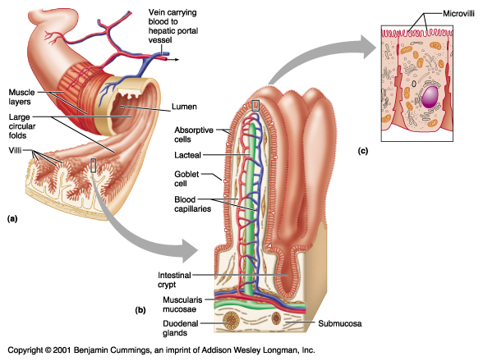
6.1.6 Distinguish between absorption and assimilation.
Absorption
Absorption means taking in substances through cell membranes or layers of cells, in particular from the lumen of the gut into the blood or lymph capillaries.
Assimilation
Assimilation involves the conversion of nutrients into fluid or solid parts of the organism. Assimilation can only occur after absorption has taken place.

Slide 14
6.1.7 Explain how the structure of the villus is related to its role in absorption and transport of the products of digestion.
The small intestine is a very important place for chemical digestion but it is also the major site of absorption. For this reason the wall of the small intestine is not just simply a smooth inner surface of a tube, as you may have imagined from the schematic and simplified diagrams, but covered with villi (singular: villus), which are small finger-like projections made of many cells. The cells of the villus often
also have projections into the lumen of the gut: microvilli (similar in function to plant root hairs).
The purpose of villi and microvilli is to increase the surface area of the small intestine.

Slide 15
6.1.7 Explain how the structure of the villus is related to its role in absorption and transport of the products of digestion.
As the function of the small intestine is absorption, the relationship of its role to its structure is the increased surface area of the villi. More products of digestion can be absorbed at the same time due to the larger surface area. Inside the villi, a capillary bed can be seen.
Small carbohydrates (such as glucose) and amino acids are absorbed into the blood and transported to the liver. Lipids are absorbed in the lacteals, which are part of the lymphatic system.

Slide 16
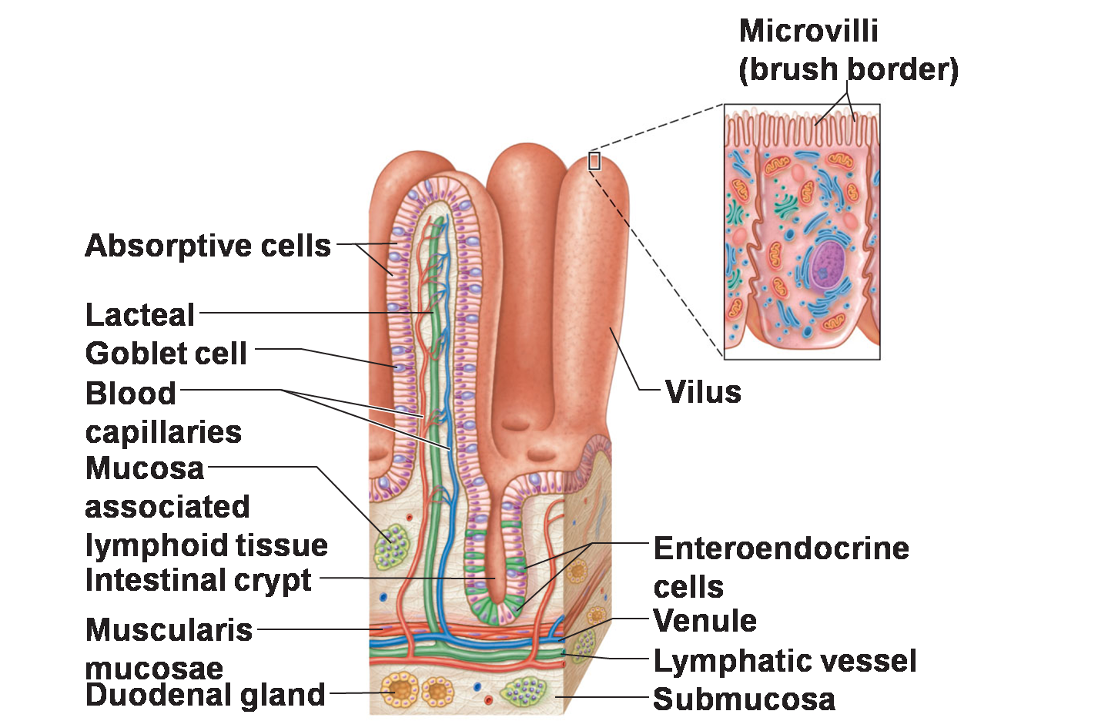
6.1.7 Explain how the structure of the villus is related to its role in absorption and transport of the products of digestion.
So the relationship of structure and function of the villi, with regards to transport, is found in the presence of blood capillaries to remove water, small carbohydrates and amino acids from the small intestine. The lacteals remove fats from the small intestine. Absorbed products of digestion need to be moved away from the area where they are absorbed as soon as possible in order to maintain the concentration gradient which helps the absorption process.

Slide 17
Topic 6: Human Health and Physiology
6.1 Digestive system

