Slide 1
Topic 5: Ecology and evolution
5.4 Evolution

Slide 2
ASSESSMENT STATEMENTS
5.4.1 Define evolution.
5.4.2 Outline the evidence for evolution provided by the fossil record, selective breeding of domesticated animals and homologous structures.
5.4.3 State that populations tend to produce more offspring than the environment can support.
5.4.4 Explain that the consequence of the potential overproduction of offspring is a struggle for survival.
5.4.5 State that the members of a species show variation.
5.4.6 Explain how sexual reproduction promotes variation in a species.
5.4.7 Explain how natural selection leads to evolution.
5.4.8 Explain two examples of evolution in response to environmental change; one must be antibiotic resistance in bacteria.

Slide 3
5.4.1 Define evolution.
Evolution is the cumulative change in the heritable characteristics of a population.
If we accept not only that species can evolve, but also that new species arise by evolution from pre-existing ones, then the whole of life can be seen as unified by its common origins.
Variation within our species is the result of different selection pressures operating in different parts of the world, yet this variation is not so vast to justify a construct such as race having a biological or scientific basis.
For evolution to take place, it is necessary to have two separate processes taking place:
a source of variation between individuals of one species
2. a change in the frequency of the genes in the gene pool
of a population

Slide 4
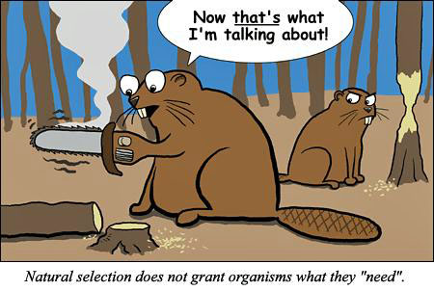
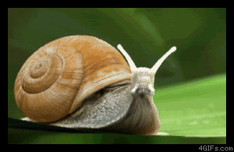
5.4.1 Define evolution.
The source of variation can be mutation, crossing over and/or independent assortment . A change in the gene frequency can be caused by natural selection.
Natural selection assumes that if certain (combinations of) alleles will make the individual better adapted to its environment, then that individual is likely to have a larger number of offspring survive to reproductive age. Since the individual will pass on its genetic material, the offspring will have some of the successful alleles which are then likely to become more frequent in the population over
time.

Slide 5
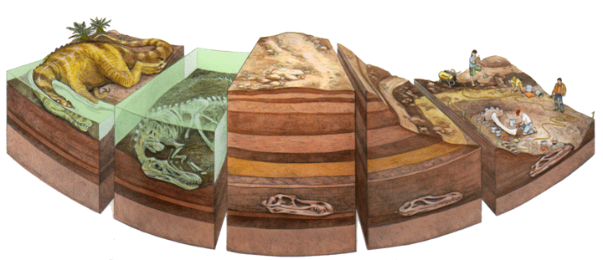
5.4.2 Outline the evidence for evolution provided by the fossil record, selective breeding of domesticated animals and homologous structures.
FOSSIL RECORD
The fossil record consists of all fossils, discovered and undiscovered that exist. Fossils are the mineralised remains of organisms. Fossilisation is the process that produces fossils.

Slide 6
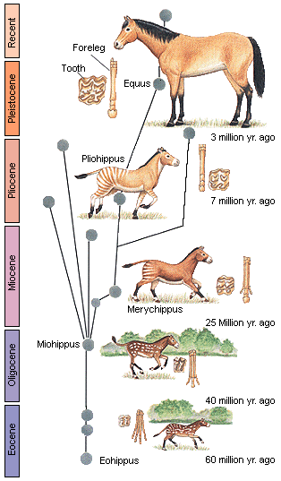
5.4.2 Outline the evidence for evolution provided by the fossil record, selective breeding of domesticated animals and homologous structures.
One of the most complete fossil records found has shown us the evolution of the horse. The study of fossil skeletons allows inferences about form and function and clearly suggests a process of gradual change over time.

Slide 7
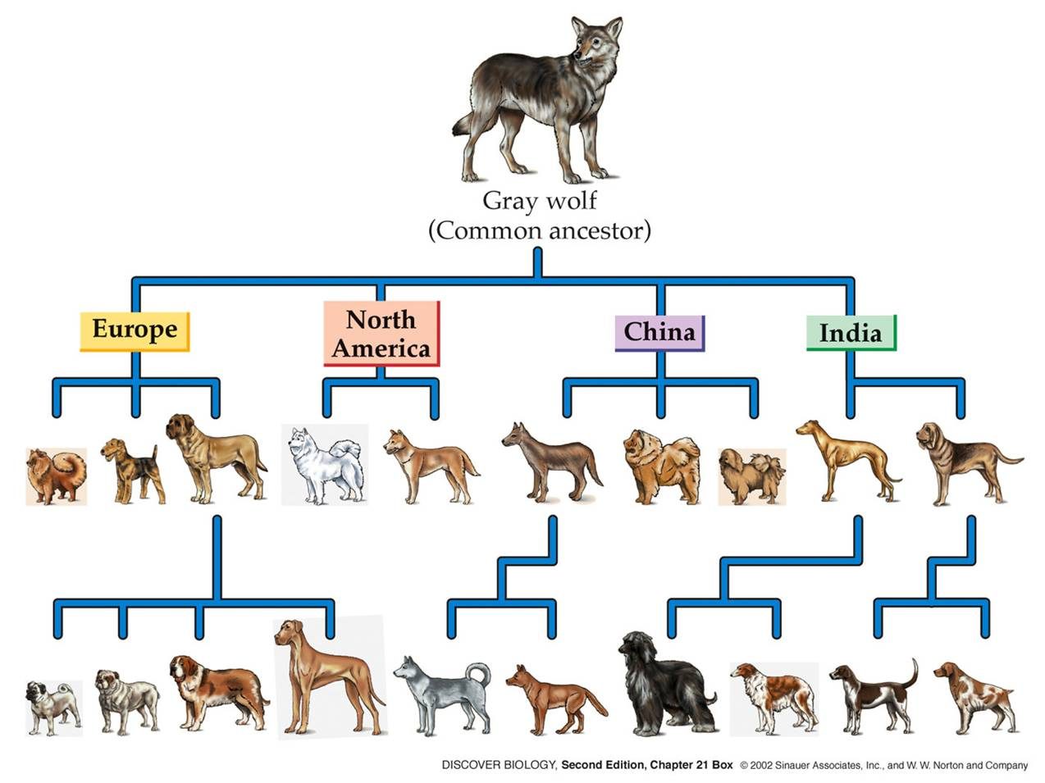
5.4.2 Outline the evidence for evolution provided by the fossil record, selective breeding of domesticated animals and homologous structures.
SELECTIVE BREEDING OF DOMESTICATED ANIMALS
Humans and dogs share a long history. It is very likely that dogs were the first animals to be domesticated by humans. The first dogs, which looked very much like wolves, were probably used for hunting, pulling sledges and some magic and religious rituals.
As breeding started, selection must have taken place. By selecting the best hunters for hunting, the strongest dogs for pulling sledges and the most unusual for rituals, humans made the start to the many different breeds of dog we know today.

Slide 8
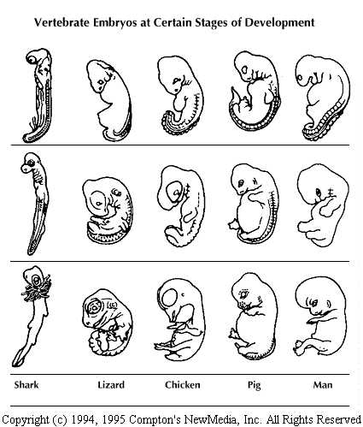
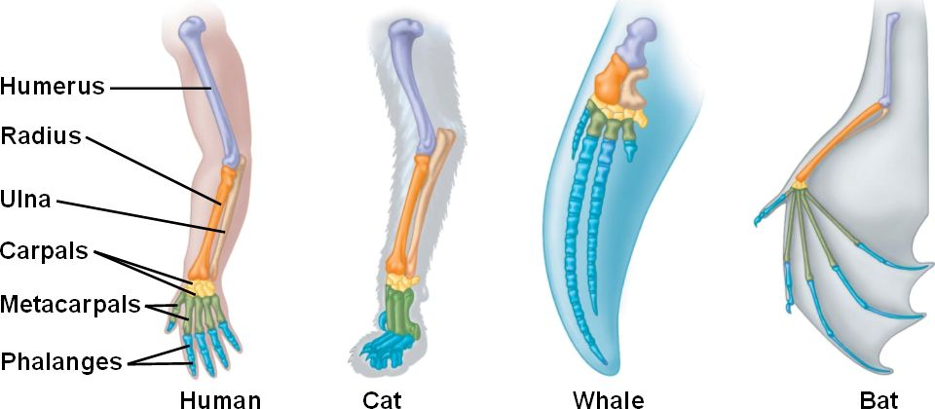
5.4.2 Outline the evidence for evolution provided by the fossil record, selective breeding of domesticated animals and homologous structures.
HOMOLOGOUS STRUCTURES
Evolution suggests that many different species may have originated from a
common ancestor. This pattern of divergence would then suggest that
they should still have some things in common. These structures do exist
and are called homologous structures. Their existence supports the concept of evolution.
Human arms are similar in structure
to the front paws of a dog, the wings of
a bat and the flipper of a dolphin. The
structure is called the pentadactyl limb
(=“five fingered”) and it is common to
all tetrapods. They all have the same
bones, although the relative size of the
bones may differ.

Slide 9
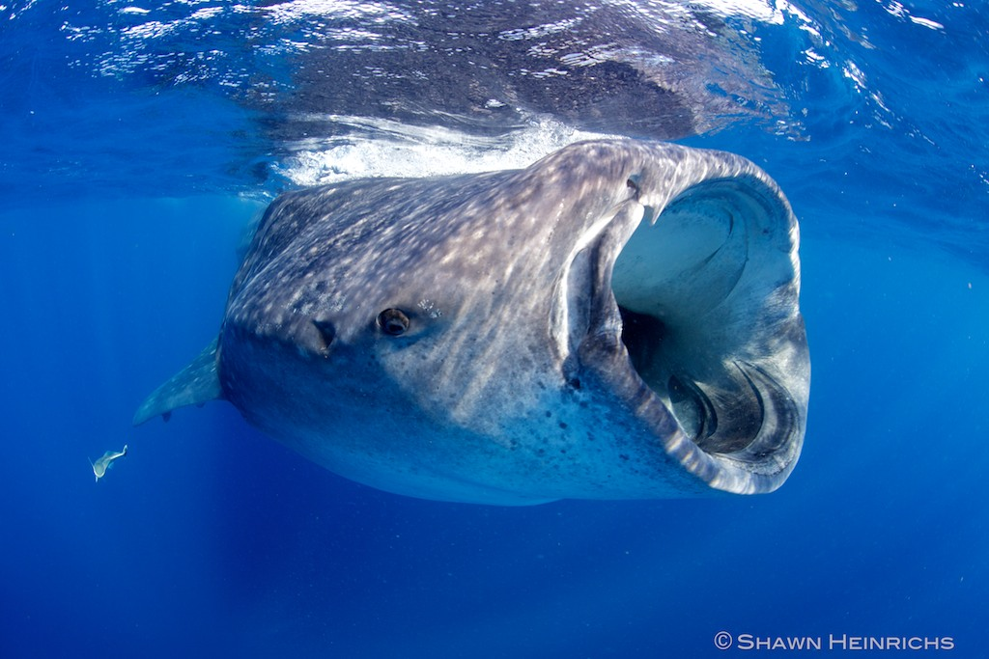
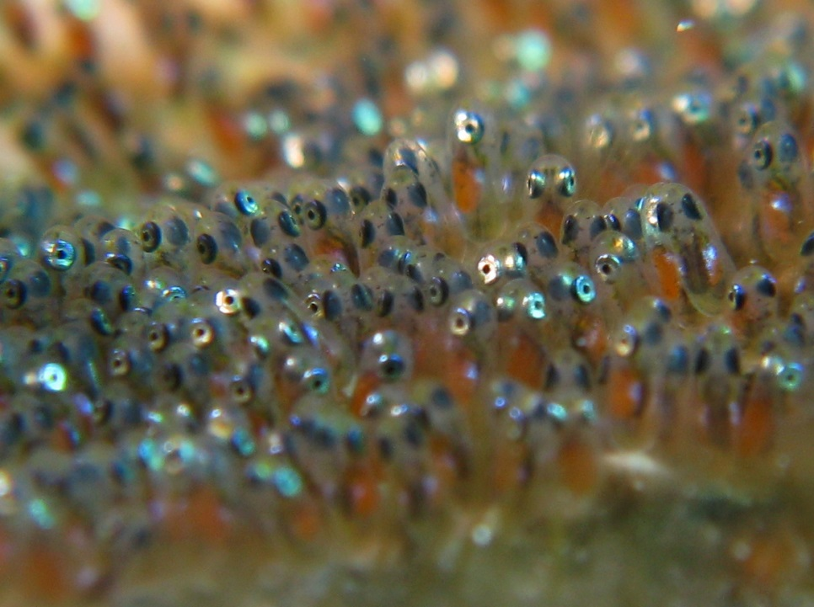
5.4.3 State that populations tend to produce more offspring than the environment can support.
Most species are capable of producing many more offspring than the environment can support. Even elephants with a gestation time of 22 months can produce a large population over time if there are no factors limiting the growth of the population. They can live many years.
LINK

Slide 10
5.4.4 Explain that the consequence of the potential overproduction of offspring is a struggle for survival.
The competition between individuals in a population will allow the more successful individuals to grow faster and they will be able to produce
more offspring (or seeds).
The offspring will carry some of the genes that made the parents better adapted so the offspring may also be more successful and pass on their genes more successfully. This struggle for survival between individuals
of the same species (or even between species sharing the same habitat) is called natural selection.

Slide 11
5.4.5 State that the members of a species show variation.
Due to independent assortment and crossing over in meiosis, the gametes produced by one individual are not identical. In sexual reproduction, two gametes need to fuse to produce a new individual. As a results, individuals are different from each other. This is called variation.

Slide 12
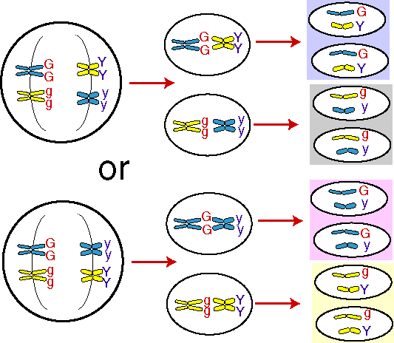
5.4.6 Explain how sexual reproduction promotes variation in a species.
There are two processes in meiosis that can cause variation:
independent assortment
crossing over
INDEPENDENT ASSORTMENT
Independent assortment occurs during Metaphase I when the homologous pairs of chromosomes (also known as bivalents or tetrads) move to the equator of the cell and line up.
LINK
There are two possibilities for the homologous pairs to arrange themselves on the equator and each will result in the
formation of different gametes. One cell undergoing meiosis
might go through the process as drawn under Possibility 1 whereas
the next cell might go through Possibility 2. So an individual
could produce all four kinds of gametes.

Slide 13
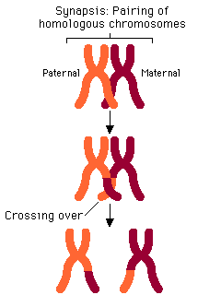
5.4.6 Explain how sexual reproduction promotes variation in a species.
CROSSING OVER
Crossing over occurs during Prophase I when the homologous chromosomes pair up (and form bivalents or tetrads).
Each chromosome consists of two identical sister chromatids. When the non-sister chromatids overlap, they may break and re-attach to the other chromosome, exchanging genetic material.
Both of these processes will cause the gametes to differ from each other resulting in variation between the offspring of one set of parents.
LINK

Slide 14
5.4.7 Explain how natural selection leads to evolution.
When a population produces more offspring than the environment can support, the individuals of the population will compete with each other for resources such as food and shelter. The variation between the individuals (resulting from independent assortment and crossing over during gametogenesis before the process of sexual reproduction) will make some more successful in this struggle for survival than others. The more successful ones are likely to also be more successful in reproduction, passing on the genes that made them successful.
The situation will repeat itself and after many generations, the advantageous genetic traits will be very common.
This process describes “the cumulative change in the heritable characteristics of a population”, so we call it evolution.
LINK

Slide 15
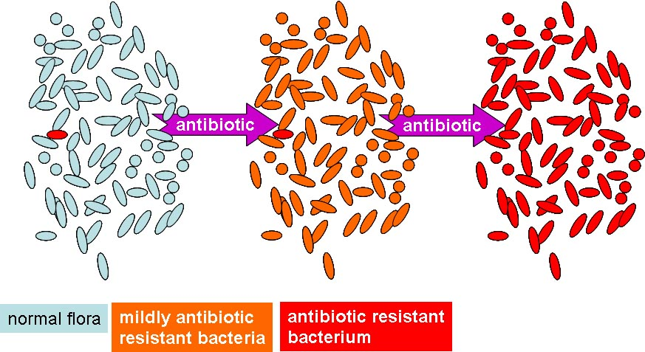
5.4.8 Explain two examples of evolution in response to environmental change; one must be antibiotic resistance in bacteria.
If a species cannot adapt to the changing environment, then the species will die out. As the dinosaurs did not find a way to deal with the climate becoming colder, they did not survive. Their place was taken by the homeothermic (warm-blooded) mammals.
LINK
ANTIBIOTIC RESISTANCE IN BACTERIA
Antibiotic resistance means that bacteria can survive in the presence of an antibiotic.
Many diseases caused by bacteria have been successfully treated with penicillin and other antibiotics. However, since the Second World War, when the use of antibiotics became widespread, many disease-causing bacteria have developed resistance against antibiotics.
There are strains of bacteria that cause tuberculosis which are resistant to all known antibiotics. Cholera is almost the same, as there is only one effective antibiotic available.

Slide 16
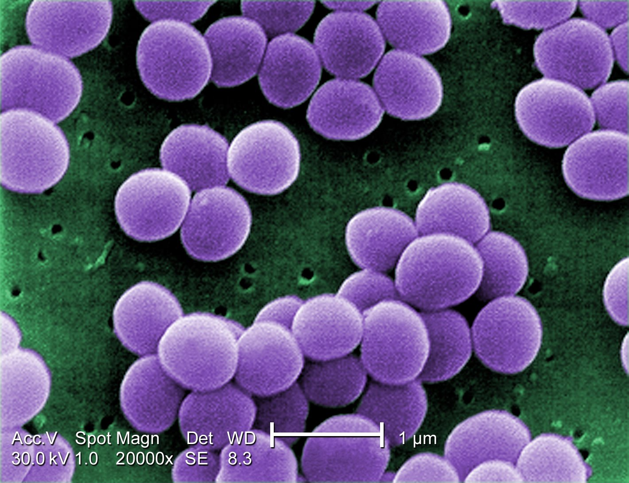
5.4.8 Explain two examples of evolution in response to environmental change; one must be antibiotic resistance in bacteria.
Staphylococcus aureus is a common bacterium found living on the skin. This species is usually harmless but, in certain circumstances, can invade the bloodstream, infect tissues in the kidneys or bones and can become fatal. These days, strains of S. aureus exist which are resistant to all known
antibiotics.

Slide 17
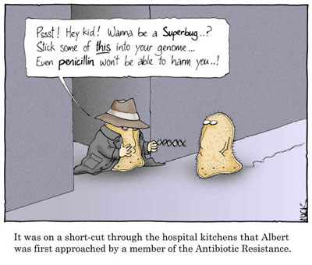
5.4.8 Explain two examples of evolution in response to environmental change; one must be antibiotic resistance in bacteria.
The resistance against antibiotics in bacteria is probably caused by a spontaneous mutation. As a result, the bacterium produces e.g. penicillinase, an enzyme which breaks down penicillin. If the bacteria are exposed to penicillin, the ones without resistance will be killed. However, those with resistance to penicillin, will survive and, due to a lack of competition, grow rapidly.

Slide 18
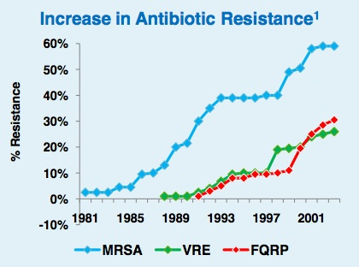
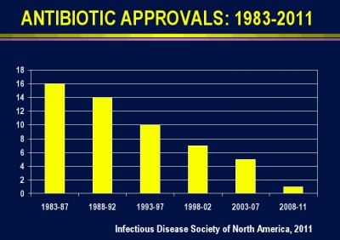
5.4.8 Explain two examples of evolution in response to environmental change; one must be antibiotic resistance in bacteria.
The genetic information for antibiotic resistance is often found on plasmids which can be spread rapidly over a population and can even cross over into other species of bacteria. (Remember ‘Plasmid transfer’)
Antibiotic resistance is more likely to occur when a small dose of antibiotics is used for a short time. It will kill some of the bacteria but not all and may lead to the creation of bacteria that have some resistance.
The next time antibiotics are used, these bacteria are less vulnerable and some more of them may survive.
Antibiotics do not work against viral disease and will not cure the flu or the common cold.

Slide 19
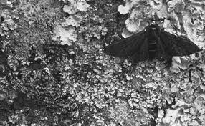
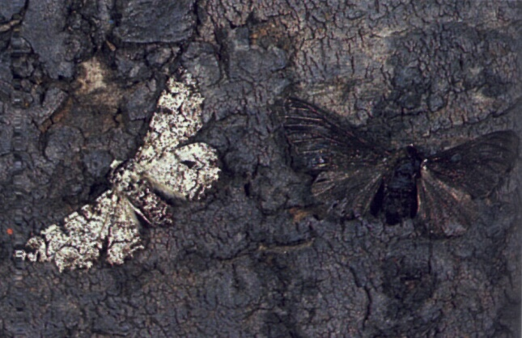
5.4.8 Explain two examples of evolution in response to environmental change; one must be antibiotic resistance in bacteria.
PEPPERED MOTH
Another example of evolution in response to environmental change can be found in the case of the peppered moth. Biston betularia (peppered moth) is found near Manchester, England and elsewhere in the UK.
Before 1848, trees on which the moths rested were covered with off-white lichen. The moths were speckled and therefore camouflaged from predation by birds. Occasionally a black moth would appear. It, of course, was highly visible on the lichen-covered trees and would have a very high chance of being eaten by a bird before reproducing.
Due to (coal-based) industry, the trees became covered with soot and the white moths were easily spotted and eaten.
LINK
Before
After

Slide 20
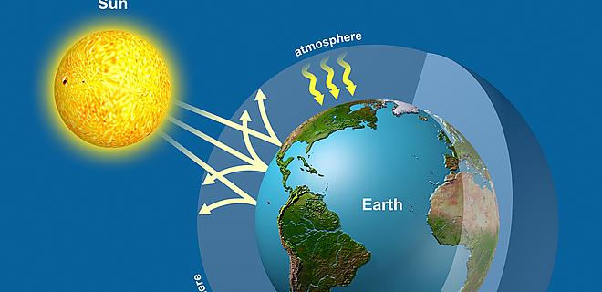
Topic 5: Ecology and evolution
5.4 Evolution

