Slide 1
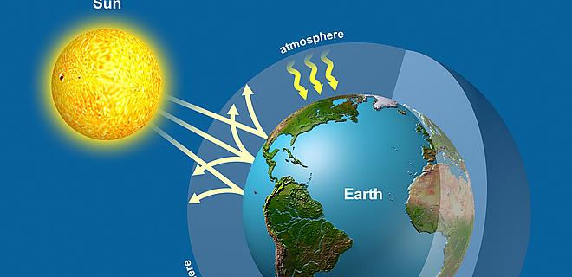
Topic 5: Ecology and evolution
5.2 The Greenhouse Effect

Slide 2
ASSESSMENT STATEMENTS
5.2.1 Draw and label a diagram of the carbon cycle to show the processes involved.
5.2.2 Analyse the changes in concentration of atmospheric carbon dioxide using historical records.
5.2.3 Explain the relationship between rises in concentrations of atmospheric carbon dioxide, methane and oxides of nitrogen and the enhanced greenhouse effect.
5.2.4 Outline the precautionary principle.
5.2.5 Evaluate the precautionary principle as a justification for strong action in response to the threats posed by the enhanced greenhouse effect.
5.2.6 Outline the consequences of a global temperature rise on arctic ecosystems.

Slide 3
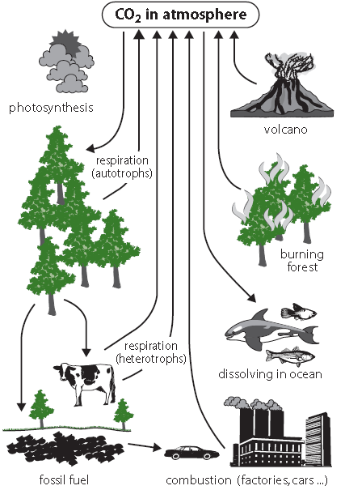
5.2.1 Draw and label a diagram of the carbon cycle to show the processes involved.
The details of the carbon cycle you draw should include the interaction of living organisms and the biosphere through the processes of photosynthesis, cell respiration, fossilization and combustion.
Only the first of these processes removes carbon dioxide from the atmosphere; the other three add to levels of carbon dioxide
LINK

Slide 4
TOK What are metaphors in science?
Metaphors are helpful in relating a concept that we are unfamiliar with to one that we are. Metaphors help us to connect ideas and develop new knowledge. Organelles are often related to body parts to introduce their function, for example the nucleus is like a brain of a cell. The Gaia hypothesis is a metaphor for ecosystems, stating that Each Is like a finely tuned machine, with the functioning of the whole dependent on the individual parts.
Try to explain an ecosystem in terms of this metaphor.
How helpful are metaphors in understanding the Biological principle? Should the ‘Gaia hypothesis’ really have the status of a hypothesis if it is a metaphor?
LINK

Slide 5
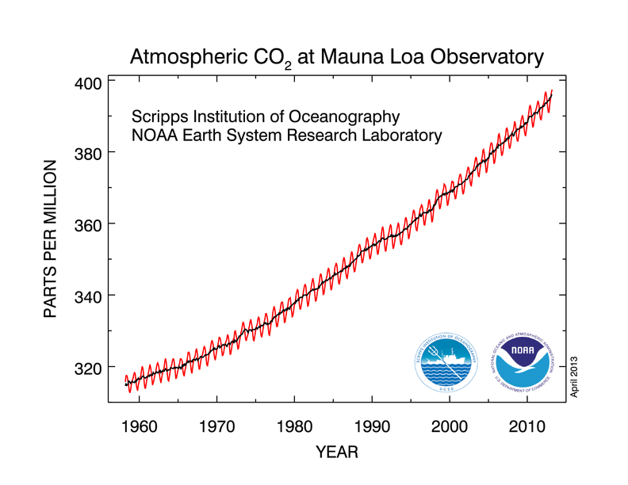
5.2.2 Analyse the changes in concentration of atmospheric carbon dioxide using historical records.
Describe the trend you are observing. Why does the red line fluctuate so much?

Slide 6
5.2.2 Analyse the changes in concentration of atmospheric carbon dioxide using historical records.
It can be seen that the average carbon dioxide concentration has increased since 1960 from around 315 ppm (0.0315%) to 380 ppm (0.0380%).
The graph is not smooth but goes up and down to reflect the changes in the amount of atmospheric carbon dioxide due to the seasons; in autumn, the leaves drop and plants no longer take up carbon dioxide. As a result, atmospheric carbon dioxide levels go up. In spring, when plants grow leaves again and start to photosynthesise, the levels drop.

Slide 7
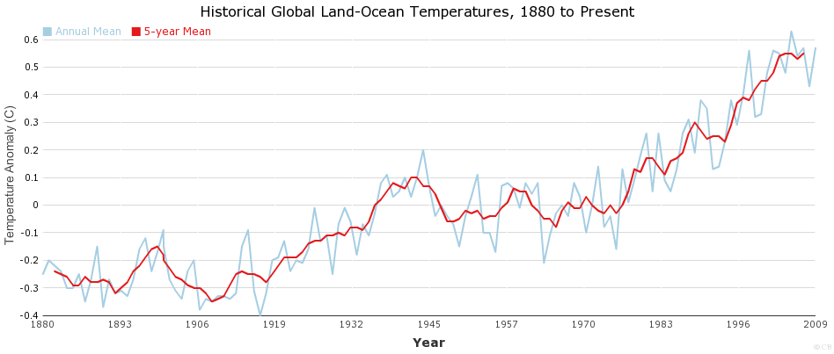
5.2.2 Analyse the changes in concentration of atmospheric carbon dioxide using historical records.
Do you observe any relation between the CO₂ levels and the temperature rise?
Correlation or causation??

Slide 8
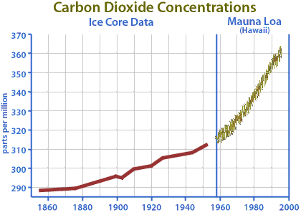
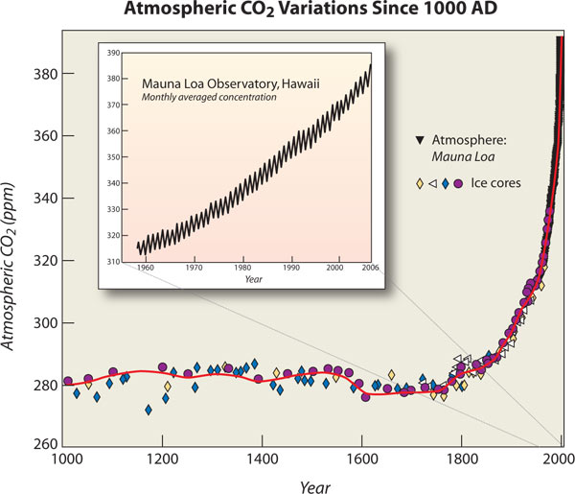

Slide 9
5.2.3 Explain the relationship between rises in concentrations of atmospheric carbon dioxide, methane and oxides of nitrogen and the enhanced greenhouse effect.
Many factors suggest that the increase in average yearly temperatures is, at least in part, caused by the additional carbon dioxide in the air.
Longer term studies involve the use of ice from the polar regions. Scientists in Antarctica and the North Pole have taken samples of the ice, each which contain small amounts of air. Although the entire theory is complicated, in principle the idea is that the deeper you drill to get your ice, the “older” the air will be. When the ice is crushed, you can get the air and use a gas chromatograph to measure the level of carbon dioxide.
LINK

Slide 10
5.2.3 Explain the relationship between rises in concentrations of atmospheric carbon dioxide, methane and oxides of nitrogen and the enhanced greenhouse effect.
THE GREENHOUSE EFFECT
Most energy from the Sun reaches the Earth in the form of light radiation which has relatively short wavelengths. About 30% of this is reflected back into space. The remaining 70% warms up the Earth’s surface and will eventually radiate out as infra red radiation, which has much longer wavelengths.
The greenhouse effect is the common name for the fact that some gases in the Earth’s atmosphere (greenhouse gases) absorb some of the infra red radiation, with the longer wavelength, that would otherwise leave the Earth.
As a result, the Earth is about 30°C warmer than it would be without any greenhouse gases in the atmosphere.
Greenhouse gases are naturally occurring and have been around for a long time but the enhanced or anthropogenic (“made by people”) greenhouse effect is currently a cause for concern.

Slide 11
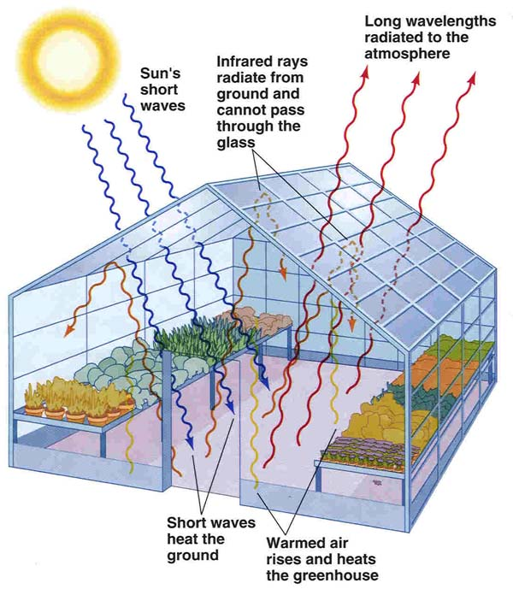
5.2.3 Explain the relationship between rises in concentrations of atmospheric carbon dioxide, methane and oxides of nitrogen and the enhanced greenhouse effect.
The name “greenhouse effect” is based on the observation that the temperature inside a greenhouse (made of glass) is
higher than outside. The heat seems to be trapped inside.

Slide 12
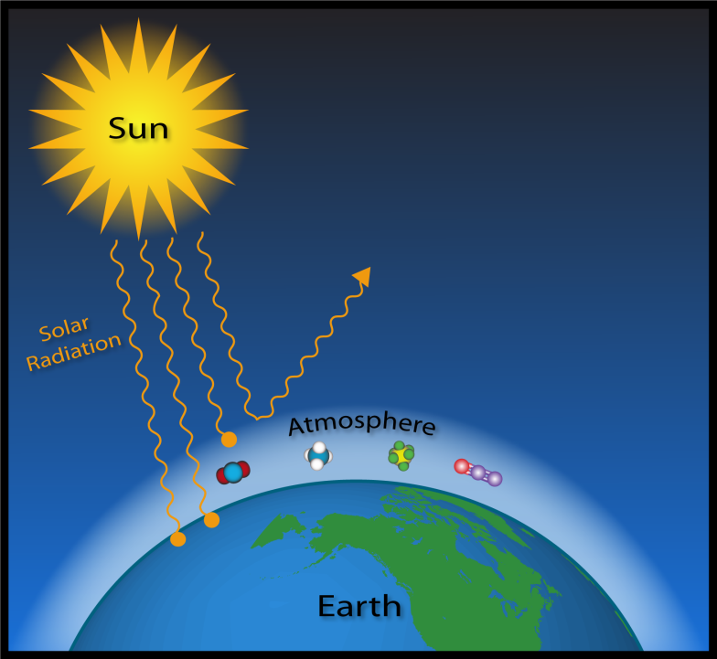
5.2.3 Explain the relationship between rises in concentrations of atmospheric carbon dioxide, methane and oxides of nitrogen and the enhanced greenhouse effect.
Most of the atmosphere is made of nitrogen (N₂) and oxygen (O₂). Neither of these gases absorbs much infra red radiation.
Carbon dioxide (CO2), methane (CH4) and oxides of nitrogen (NOx) are the best known examples of greenhouse gases. Methane contributes much more (20 times) to the greenhouse effect than carbon dioxide but they all operate on the same principle. Greenhouse gases absorb the longer wavelength infrared radiation which prevents it from escaping into space. As a result of the radiation spending a longer time in the atmosphere, the
temperature of the atmosphere is slightly increased.
LINK

Slide 13
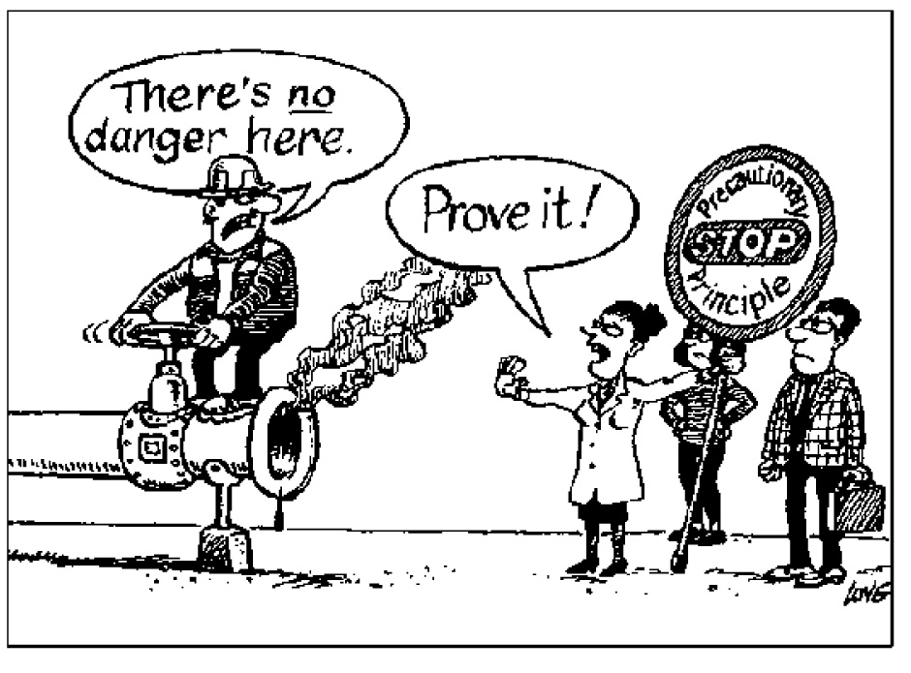
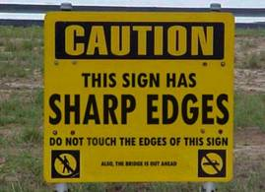
5.2.4 Outline the precautionary principle.
The precautionary principle is the concept that someone wishing to take a certain kind of action should prove that the action does not cause serious or irreversible harm to the public if there is no scientific consensus about the outcome of the action. This is the reverse of the normal situation, where those who are concerned about the change would have to prove that it will do harm in order to prevent such changes going ahead.
In slightly simpler wording, it means that if we are not certain what the results of a change in our behaviour will be, the people wanting this change should prove that it will not be harmful.
LINK

Slide 14
5.2.4 Outline the precautionary principle.
The precautionary principle is often applied to situations involving the environment, our health, food and medicine. These are aspects that concern all of us and therefore need to be dealt with carefully. An application of the precautionary principle can be seen in legalisation of new medication; the producer needs to prove that the medicine
will do what it promises and that it has no serious and/or lasting side effects.
Both the European Union and the United Nations have adopted the precautionary principle as a foundation for some of their policies.
Not everyone agrees with the precautionary principle as a basis for environmental policies.
Those opposing the principle claim that the principle includes assumptions of consequences that have not been proven and that the principle is more concerned with the degree of seriousness of possible consequences than with the chance of them actually occurring.

Slide 15
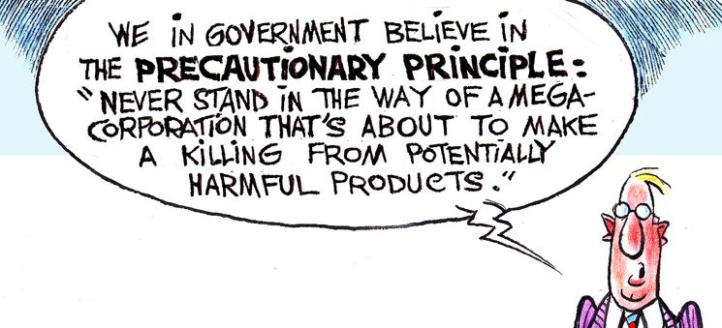
5.2.4 Outline the precautionary principle.
Another criticism of the precautionary principle is that it is often used to scare people with doomsday scenarios because “fear is funding”. This would benefit those involved in the research but not necessarily the rest of the
population.

Slide 16
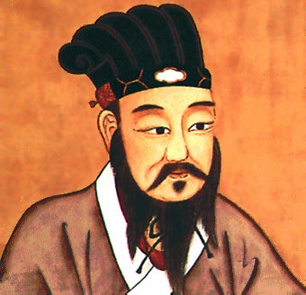
5.2.5 Evaluate the precautionary principle as a justification for strong action in response to the threats posed by the enhanced greenhouse effect.
Since we are not sure what the exact effects of increasing carbon dioxide levels are, the precautionary principle could be applied. Countries could agree to reduce greenhouse emissions and boycott trade with countries that do not comply. However, in poorer countries, it may not be possible to reduce greenhouse emissions without delaying economic growth. This in itself may cause hunger and even cause large numbers of people to die.
For some, the consequence of the precautionary principle might be worse than the consequence it is trying to avoid.
It makes sense to prioritise some possibilities. For example, immediate danger should be dealt with before causes that are dangerous later on. Another one could be that human life comes before environmental concerns and the more likely it is that something can become a threat, the more we need to deal with it.
We have to be careful though. Like the Chinese philosopher Lao Tzu wrote in fourth century BCE; ‘small problems are easy to solve but, when not solved are likely to grow into big problems’.

Slide 17
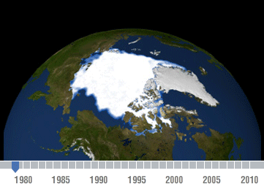
5.2.6 Outline the consequences of a global temperature rise on arctic ecosystems.
A global temperature rise would affect many ecosystems but the effects would be clearly visible on arctic ecosystems.
The average temperature in the arctic region is rising at twice the speed compared to the rest of the world. This results in the polar cap shrinking.
The snow and ice covering the Arctic reflects a lot of the Sun’s radiation. When this snow and ice melts, the Arctic will absorb more heat and warm up even faster.
Melting permafrost in Siberia would release more methane which is a greenhouse gas. This is an example of positive feedback, which, in biology, usually has undesirable consequences.

Slide 18
5.2.6 Outline the consequences of a global temperature rise on arctic ecosystems.
Many species are changing their migration patterns to respond to changes in their feeding patterns. This includes caribou, polar bears and seals and as a result, Native People of the Arctic find it more difficult to hunt them. In addition, many villages have to move since their environment is turning into a swamp as a result of the permafrost disappearing.
One possible advantage is that the melting the arctic ice will give us access to more oil and gas reserves but again this could lead to positive feedback.
Many of the plant species in the Arctic survive because there is little competition. A milder climate would enable other species to survive in the Arctic and they could possibly compete with the specialised native species which might disappear as a result of this competition

Slide 19
Topic 5: Ecology and evolution
5.2 The Greenhouse Effect

