Slide 1
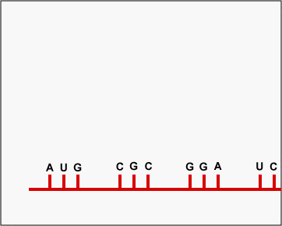
Topic 3: The chemistry of life
3.5 Transcription and translation

Slide 2
ASSESSMENT STATEMENTS
3.5.1 Compare the structure of RNA and DNA.
3.5.2 Outline DNA transcription in terms of the formation of an RNA strand complementary to the DNA strand by RNA polymerase.
3.5.3 Describe the genetic code in terms of codons composed of triplets of bases.
3.5.4 Explain the process of translation, leading to polypeptide formation.
3.5.5 Discuss the relationship between one gene and one polypeptide.

Slide 3
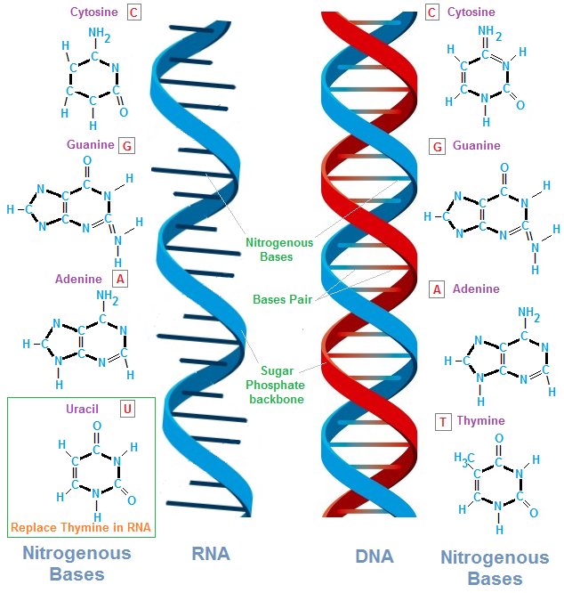
3.5.1 Compare the structure of RNA and DNA.
 | Deoxyribonucleic acid | Ribonucleic acid
Shape | Double helix | Single helix
Sugar | Deoxyribose | Ribose
Bases | A,T,C,G | A,U,C,G
Three main kinds of RNA are commonly found in cells:
Ribosomal RNA (rRNA ) which is a major component of ribosomes
Transfer RNA (tRNA) which is folded upon itself and carries amino acids to mRNA
Messenger RNA (mRNA) which consists of a sequence of nucleotides that determines the primary sequence of a polypeptide.

Slide 4
3.5.2 Outline DNA transcription in terms of the formation of an RNA strand complementary to the DNA strand by RNA polymerase.
The process of protein (or polypeptide) synthesis can be divided into two parts:
Transcription: the process by which RNA is produced from a DNA template.
Translation: the assembly of a polypeptide in a sequence specified by the order of nucleotides in the mRNA.
Transcription is similar to DNA replication in that it takes place in the nucleus and involves a section of DNA which needs to unzip. Then only one of the two strands of DNA is transcribed (the ’anti-sense’ strand) and a complementary RNA strand to this strand is made. This is called messenger
RNA (mRNA) and it has the same sequence of nucleotides, except for U instead of T, as the sense strand of the DNA (the strand that is NOT transcribed). After transcription, the mRNA leaves the nucleus through the pores in the nuclear envelope and goes into the cytoplasm.
LINK

Slide 5
3.5.3 Describe the genetic code in terms of codons composed of triplets of bases.
The genetic code is based on sets of 3 nucleotides called codons. Since 20 amino acids are commonly found in cells, it is not possible to have 4 different nucleotide codes for all of them. If we tried using a set of 2 nucleotides, we could create 4² = 16 different combinations, which is insufficient for the 20 different amino acids.
So, therefore, we need to use a set of 3 nucleotides which will create 4³ = 64 possibilities. This is more than is required for the 20 different amino acids.
As a result, the code is said to be degenerated, meaning that more than one codon can code for a single amino acid. The sequence of the codons in the mRNA determines the sequence of the amino acids in the polypeptide.

Slide 6
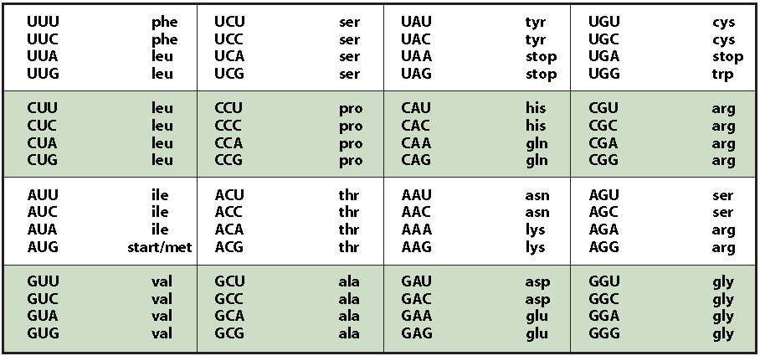
3.5.3 Describe the genetic code in terms of codons composed of triplets of bases.
Here are some examples:

Slide 7
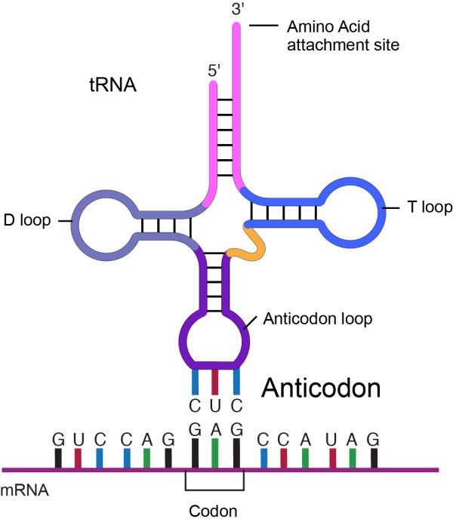
3.5.4 Explain the process of translation, leading to polypeptide formation.
After the mRNA has reached the cytoplasm, translation takes place. In the cytoplasm, ribosomes attach to the mRNA. The ribosome covers an area of three codons on the mRNA.
The first tRNA carrying an amino acid will come in and the anti-codon exposed on the tRNA will have complementary binding with the codon of the mRNA in the A site of the ribosome. The ribosome will move and the first tRNA will be in the P site on the ribosome.
LINK

Slide 8
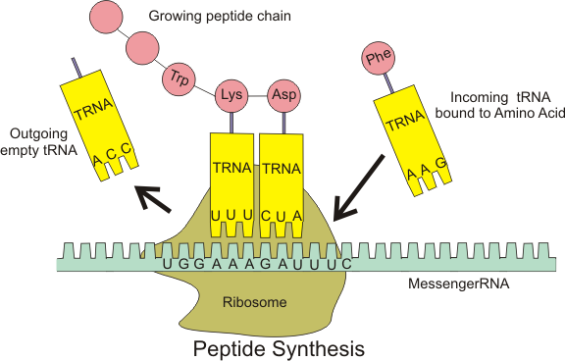
3.5.4 Explain the process of translation, leading to polypeptide formation.
The second tRNA with its own anti-codon, and consequently carrying a specific amino acid, will complementary bind to the second codon on the mRNA, filling the A site in the ribosome.
The second amino acid will attach to the first (formation of a peptide bond by a condensation reaction) and the first amino acid will be released from the first tRNA. The ribosome will move in relation to the mRNA. The first tRNA (without amino acid) is now found in the E site of the ribosome. The second tRNA will be in the P site and the A site is empty.
(Please use the animation on the website to understand this process better)

Slide 9
3.5.4 Explain the process of translation, leading to polypeptide formation.
The anticodon of the third tRNA will bind to the third codon of the mRNA in the A site of the ribosome. The anticodon of first tRNA (without its amino acid) will dissociate from the first codon of the mRNA in the E site of the ribosome.
The second amino acid will form a peptide bond with the third amino acid and the second amino acid will be released from the second tRNA. The ribosome will move so that the second tRNA (without amino acid) will now occupy the first site of the ribosome.
The second site is occupied by the third tRNA, which has a chain of three amino acids attached. The third site is free and the next tRNA will come in, carrying its own amino acid.
This process continues until a STOP codon is reached. The STOP codon does not code for an amino acid but terminates translation.

Slide 11
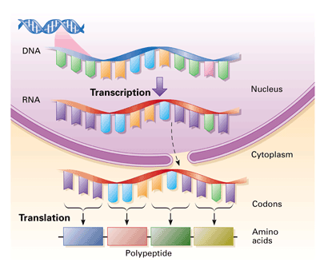
3.5.5 Discuss the relationship between one gene and one polypeptide.
The ‘one gene – one polypeptide’ concept means that every polypeptide chain is coded for by one gene. It also means that a gene only codes for one polypeptide chain. Haemoglobin contains four polypeptide chains, 2 alpha
chains and 2 beta chains. To make a haemoglobin therefore requires 2 genes: one for the alpha chains and one for the beta chains.
It can be assumed that every biological reaction is catalysed by enzymes and does not occur without them. The presence or absence of the enzyme will decide if the reaction takes place. So if you have the allele for brown
eyes, it means that you have the allele that makes the enzyme which catalyses the reaction which makes brown pigment. You therefore make the brown pigment. You do not have the allele for the enzyme which makes the blue
Pigment. (Or you do but it is recessive and won’t be expressed)

Slide 12
Topic 3: The chemistry of life
3.5 Transcription and translation

