Slide 1
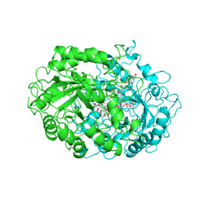
Topic 3: The chemistry of life
3.2 Carbohydrates, lipids and proteins

Slide 2
ASSESSMENT STATEMENTS
3.2.1 Distinguish between organic and inorganic compounds.
3.2.2 Identify amino acids, glucose, ribose and fatty acids from diagrams showing their structure.
3.2.3 List three examples each of monosaccharides, disaccharides and polysaccharides.
3.2.4 State one function of glucose, lactose and glycogen in animals, and of fructose, sucrose and cellulose in plants.
3.2.5 Outline the role of condensation and hydrolysis in the relationships between monosaccharides, disaccharides and polysaccharides; between fatty acids, glycerol and triglycerides; and between amino acids and polypeptides.
3.2.6 State three functions of lipids.
3.2.7 Compare the use of carbohydrates and lipids in energy storage.

Slide 3
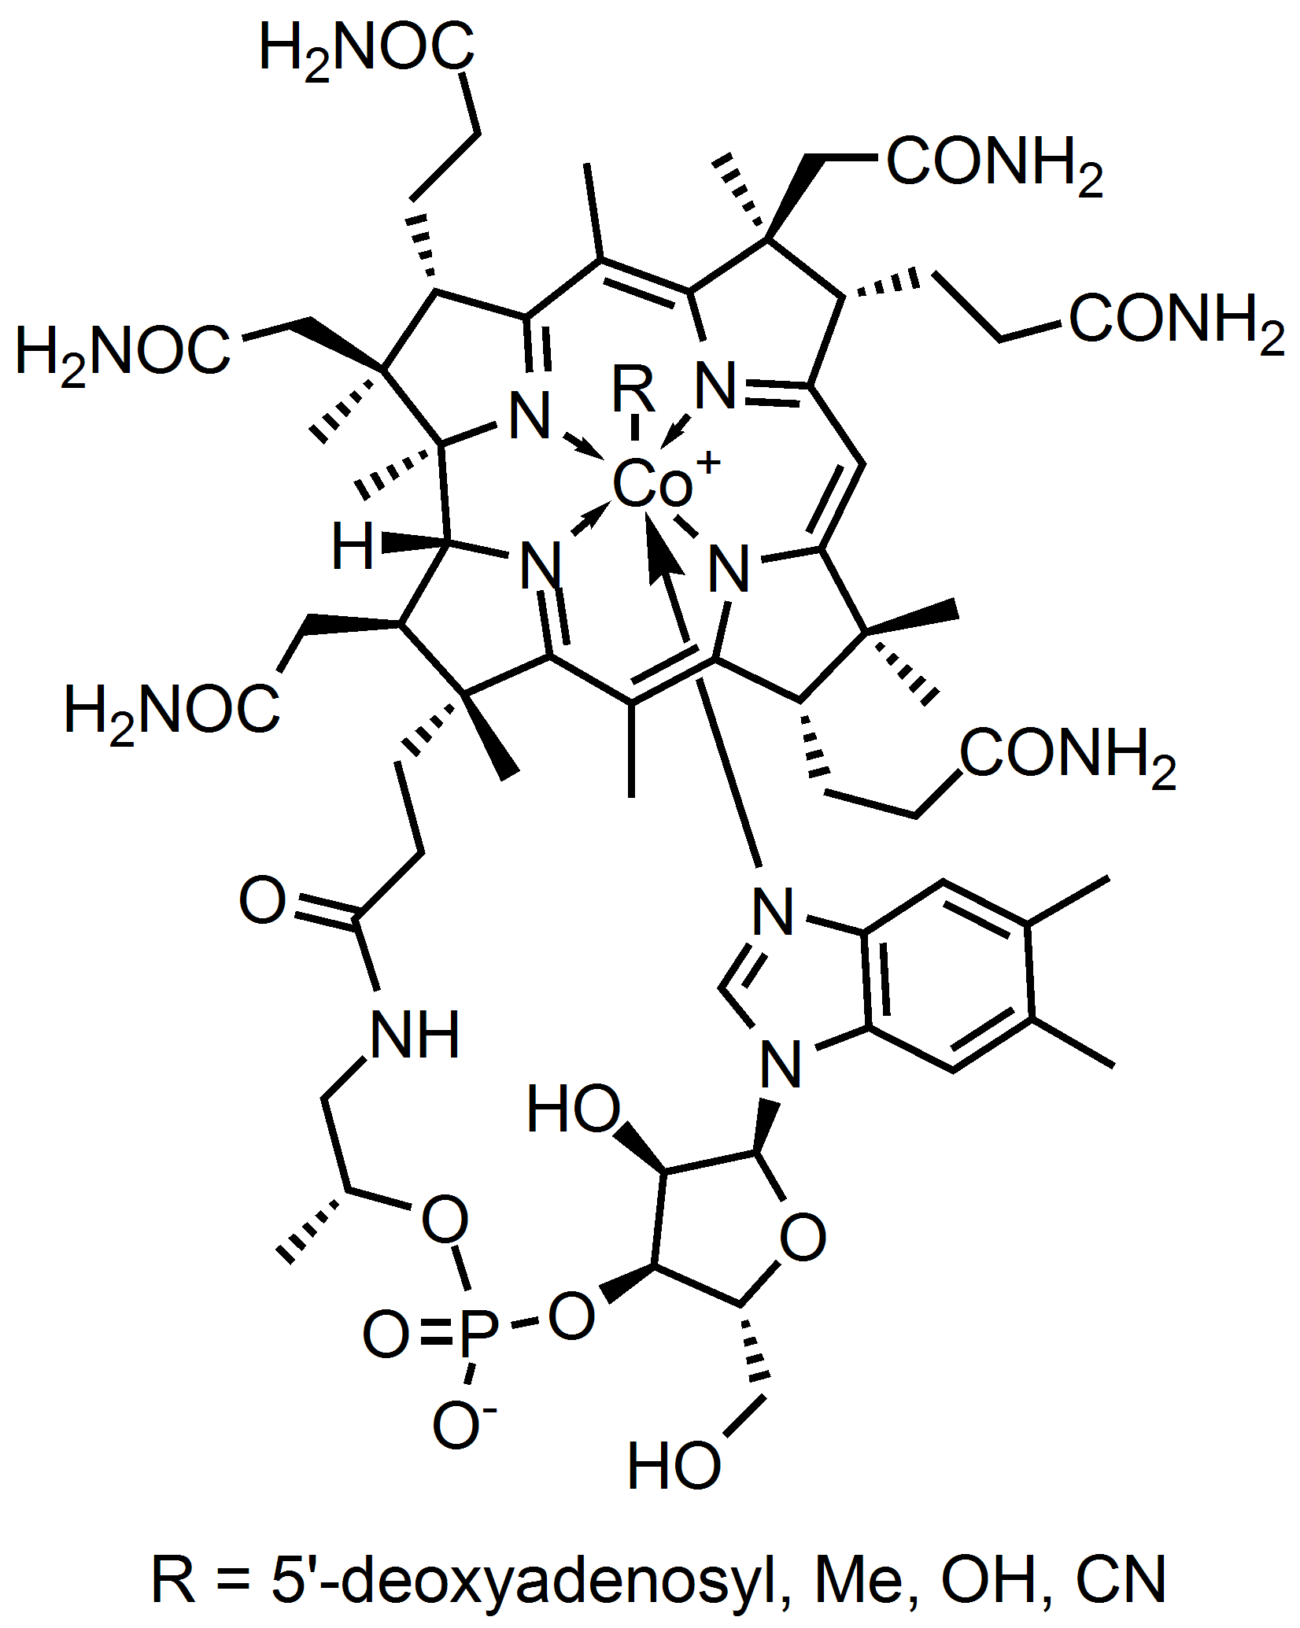
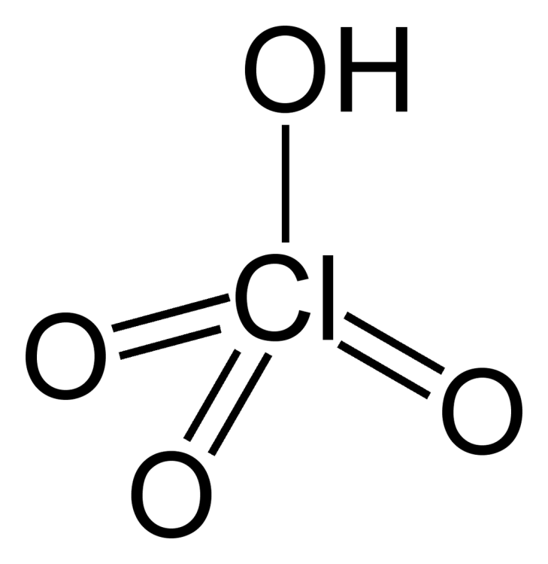
3.2.1 Distinguish between organic and inorganic compounds.
Organic compounds
Organic compounds are produced by living things and include all compounds containing carbon that are found in living organisms except hydrogen carbonates (HCO³ ⁻), carbonates (CO₃ ²⁻) and oxides of carbon (CO and CO₂).
Inorganic compounds
Inorganic compounds are all other compounds. There are many more different organic compounds than inorganic compounds.
Vitamin B12
Perchloric acid

Slide 4
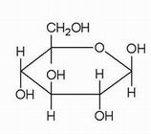
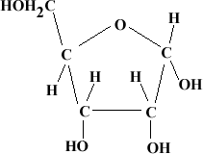
3.2.2 Identify amino acids, glucose, ribose and fatty acids from diagrams showing their structure.
Carbohydrates are compounds that contain carbon, hydrogen and oxygen (C, H, O). Monosaccharides are simple sugars, the building blocks of disaccharides and polysaccharides.
Glucose has the formula C₆H₁₂O₆ and is an example of a monosaccharide. A glucose molecule has the shape of a 6-sided ring (hexagon)
Glucose
Glucose molecules linked together: Starch
Ribose: C₅H₁₀O₅

Slide 5
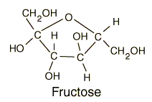
3.2.3 List three examples each of monosaccharides, disaccharides and polysaccharides.
Examples of monosaccharides include:
glucose
fructose
galactose
Examples of dissaccharides are:
maltose
sucrose
lactose
Examples of polysaccharides are:
starch
glycogen
cellulose

Slide 6
3.2.4 State one function of glucose, lactose and glycogen in animals, and of fructose, sucrose and cellulose in plants.
Functions of some of the above carbohydrates in animals are:
Glucose is a source of energy. It can be broken down to produce ATP in the process called ‘respiration’.
Lactose is the sugar found in the milk of mammals. It provides a source of energy to the young drinking the milk.
Glycogen is used for short term energy storage (between meals) in the liver.
Functions of some of the above carbohydrates in plants are:
Fructose is very sweet and a good source of energy. It is found in honey and onions.
Sucrose is used to transport and store energy, e.g. in sugarbeets and sugar cane.
Cellulose fibres, arranged in layers, provide strength to the cell wall.

Slide 7
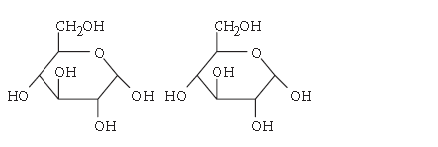
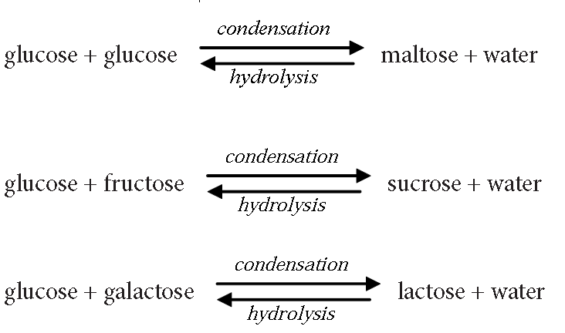
3.2.5 Outline the role of condensation and hydrolysis in the relationships between monosaccharides, disaccharides and polysaccharides; between fatty acids, glycerol and triglycerides; and between amino acids and polypeptides.
Two monosaccharides can combine to form a disaccharide and a molecule of water.
glucose + glucose → maltose + water
This is called a condensation reaction because it produces water. The reaction can be reversed and is then called a hydrolysis reaction. (hydro - water, lysis - splitting).

Slide 8
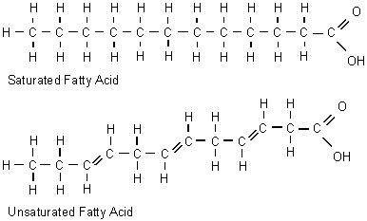
3.2.2 Identify amino acids, glucose, ribose and fatty acids from diagrams showing their structure.
Lipids are a group of fats which generally come from animals and oils which are usually derived from plants. Lipids are made by a condensation reaction between glycerol and 3 fatty acids. Fatty acids are carboxylic acids. That means that they have a carboxylic group (-COOH). The rest of the molecule is a chain (or ring) of carbon atoms with hydrogen atoms. If there are no double bonds in this chain, then the fatty acid is ‘saturated’. If there are one or more double bonds between the carbon molecules of the chain, it is referred to as an ‘unsaturated’ fatty acid.

Slide 9
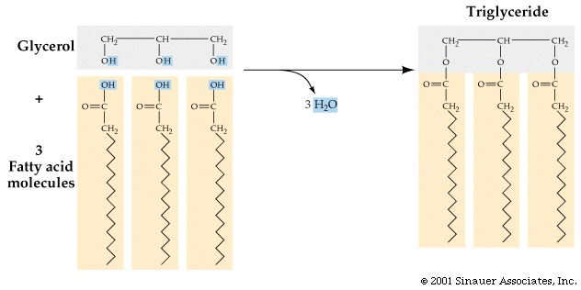
3.2.5 Outline the role of condensation and hydrolysis in the relationships between monosaccharides, disaccharides and polysaccharides; between fatty acids, glycerol and triglycerides; and between amino acids and polypeptides.
Lipids are composed of glycerol and 1, 2 or 3 fatty acids.
Triglycerides are a sub-group of lipids that are composed of glycerol and 3 fatty acids. Triglycerides are formed by the reaction of glycerol and three fatty acids. Again water is produced as a larger molecule is formed and this is a condensation reaction. The reverse reaction is hydrolysis.

Slide 10
3.2.6 State three functions of lipids.
The main functions of lipids are:
Energy storage because one gram of lipids contains twice as much energy as one gram of carbohydrates or proteins.
Thermal insulation, for example a layer of lipids under the skin(subcutaneous layer) reduces the loss of heat from the organism.
Cell membranes because the main component of cell membranes are phospholipids.
Please remember this YouTube channel!!

Slide 11
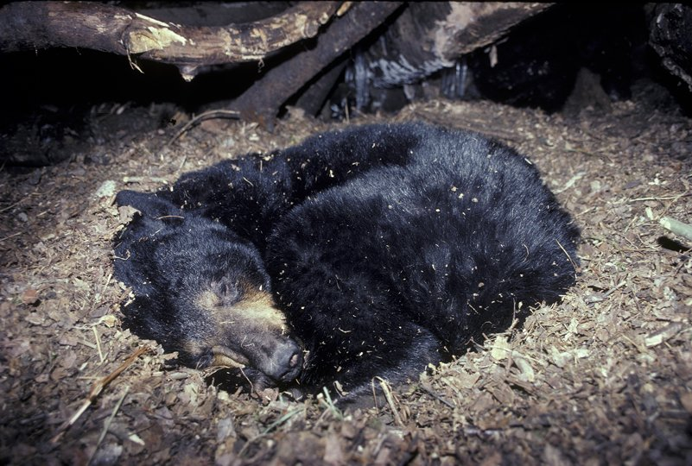
3.2.7 Compare the use of carbohydrates and lipids in energy storage.
One gram of lipid releases twice as much energy as one gram of carbohydrates (or proteins). Since most of the energy of a lipid is stored in its fatty acid chains, the lipids used to store energy are triglycerides.
Animals use glycogen to store the energy from a meal. This energy is likely to be used before the next meal. Overnight, we already need to use energy from triglycerides as the energy from glycogen stored in the liver is not enough for all our body processes (keeping warm, breathing, etc). Some birds use this stored fat for long flights and many animals store fat for the time spent in aestivation or hibernation

Slide 12
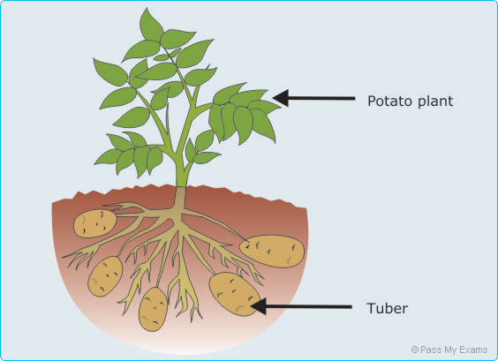
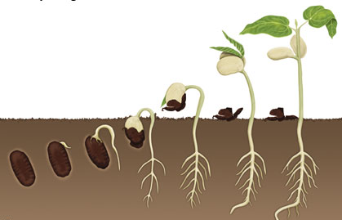
3.2.7 Compare the use of carbohydrates and lipids in energy storage.
Lipids (triglycerides) are used for the longer term storage of energy because storing the same amount of energy as carbohydrates, would involve more weight. As the animal moves, it would have to carry this weight.
Plants use carbohydrates to store energy in parts of the plant that do not move. A good example are potato tubers, growing underground. They do not need to move anywhere so it does not matter if they are heavier. But if you consider vegetable oil, good examples are rapeseed oil or sunflower oil. These are seeds that need to store energy to germinate. But the seeds also need to move away from the parent plant so the lighter they are, the more distance they are likely to cover. Therefore, you find energy stored as lipids in the seeds of plants but not in other parts that do not need to move.

Slide 13
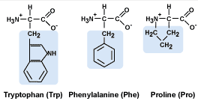
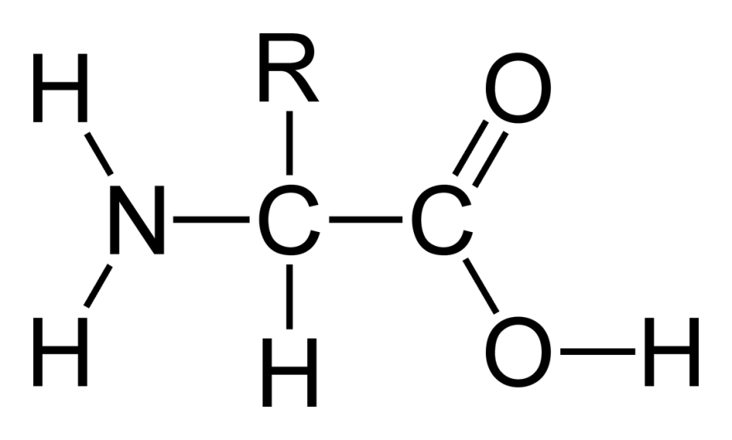
3.2.2 Identify amino acids, glucose, ribose and fatty acids from diagrams showing their structure.
Proteins
Polypeptides are long chains of amino acids. There are many different amino acids but they have some structures in common:
amino acids have a central C atom
there are four different groups attached to this central C atom:
- the amine group -NH₂
- the (carboxylic) acid group -COOH
- an simple -H group
- the ‘R’ group which is different in different amino acids

Slide 14
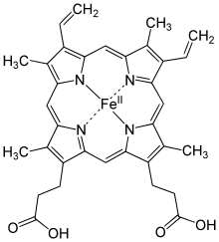
3.2.5 Outline the role of condensation and hydrolysis in the relationships between monosaccharides, disaccharides and polysaccharides; between fatty acids, glycerol and triglycerides; and between amino acids and polypeptides.
Two amino acids can combine to form a dipeptide. This, again, is a condensation reaction.
The Thicker bond is called the peptide linkage or simply a peptide bond. It is a special bond between a C (with a double bonded O attached on
one side) and an N (with an H attached) on the other side. Again the reverse of this reaction is hydrolysis.
As more amino acids are added they produce a polypeptide and more water (depending on how many amino acids were added).
A polypeptide can be a protein by itself or it may need to combine with other polypeptide chains to form a functional protein. For example, haemoglobin is made of 4 polypeptide chains, 2 alpha chains and 2 beta chains.

Slide 15
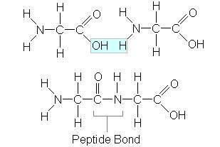
3.2.5 Outline the role of condensation and hydrolysis in the relationships between monosaccharides, disaccharides and polysaccharides; between fatty acids, glycerol and triglycerides; and between amino acids and polypeptides.
Amino acid 1
Amino acid 2
= dipeptide

Slide 16
Topic 3: The chemistry of life
3.2 Carbohydrates, lipids and proteins

