Slide 1
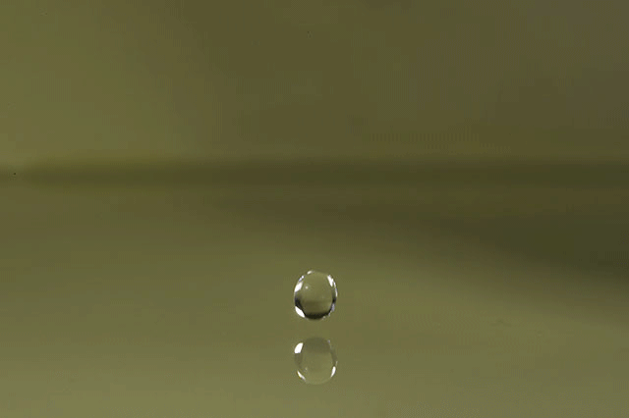
Topic 3: The chemistry of life
3.1 Chemical elements and water

Slide 2
ASSESSMENT STATEMENTS
3.1.1 State that the most frequently occurring chemical elements in living things are carbon, hydrogen, oxygen and nitrogen.
3.1.2 State that a variety of other elements are needed by living organisms, including sulfur, calcium, phosphorus, iron and sodium.
3.1.3 State one role for each of the elements mentioned in 3.1.2.
3.1.4 Draw and label a diagram showing the structure of water molecules to show their polarity and hydrogen bond formation.
3.1.5 Outline the thermal, cohesive and solvent properties of water.
3.1.6 Explain the relationship between the properties of water and its uses in living organisms as a coolant, medium for metabolic reactions and transport medium.

Slide 3
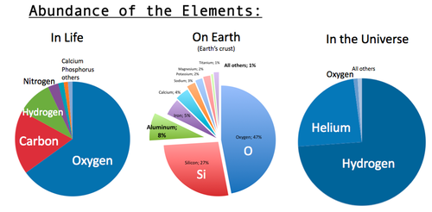
3.1.1 State that the most frequently occurring chemical elements in living things are carbon, hydrogen, oxygen and nitrogen.
Living things consist largely of compounds containing the element carbon. The elements that most commonly associate with carbon are hydrogen, oxygen and nitrogen. The approximate proportions of these elements in living organisms are Oxygen (65%), Carbon (19%), Hydrogen (10%) and Nitrogen (3%). Carbon has the symbol C and forms 4 covalent bonds with other atoms, and can form long chains with other carbon atoms. Nitrogen has the symbol N and forms 3 covalent bonds with other atoms. Oxygen has the symbol O and forms 2 covalent bonds with other atoms. Hydrogen has the symbol H and forms 1 covalent bond with another atom.

Slide 4
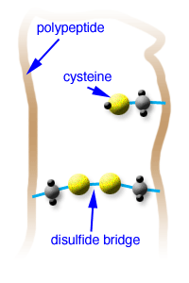
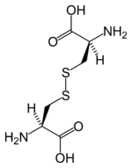
3.1.2 State that a variety of other elements are needed by living organisms, including sulfur, calcium, phosphorus, iron and sodium.
3.1.3 State one role for each of the elements mentioned in 3.1.2.
Sulfur
Some amino acids contain sulfur and can form a bond with another amino acid which also contains sulfur. These connections are called disulfide bridges. They can occur within a polypeptide chain which causes folding of the chain. They can also occur between polypeptide chains and keep the chains together.

Slide 5
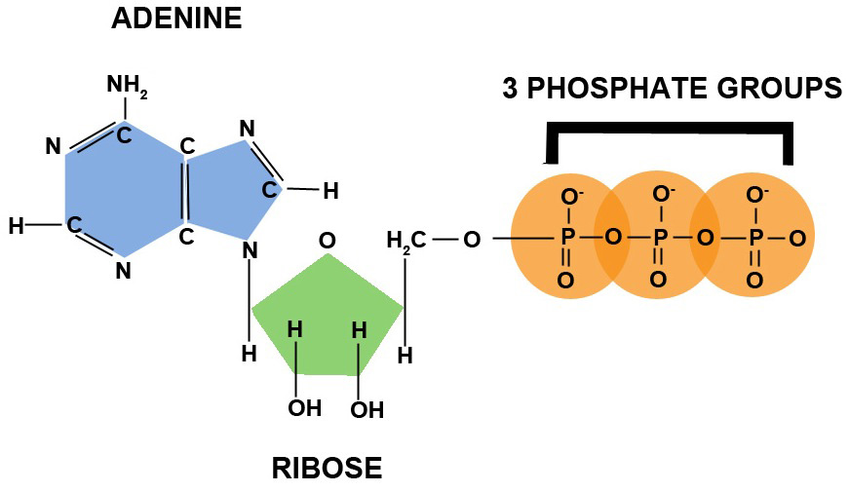
3.1.2 State that a variety of other elements are needed by living organisms, including sulfur, calcium, phosphorus, iron and sodium.
3.1.3 State one role for each of the elements mentioned in 3.1.2.
Phosphorus
Below you see an image of an ATP molecule, the molecule responsible for carrying energy within and between cells. Note that the three phosphates have high energy bonds between them. Each phosphate contains the elements phosphorus and oxygen.

Slide 6
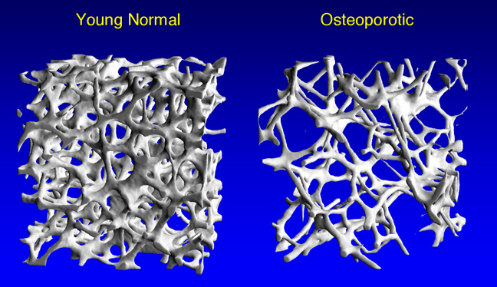
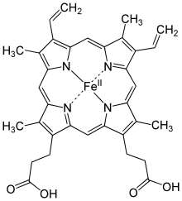
3.1.2 State that a variety of other elements are needed by living organisms, including sulfur, calcium, phosphorus, iron and sodium.
3.1.3 State one role for each of the elements mentioned in 3.1.2.
Calcium
Calcium is needed to form bone tissue.
Iron
The illustration here on the right shows the structure of one of the four polypeptide chains that makes up hemoglobin. Each chain has a ‘heme’ group containing iron associated with it. Iron is also
needed to help form chlorophyll in plants.

Slide 7
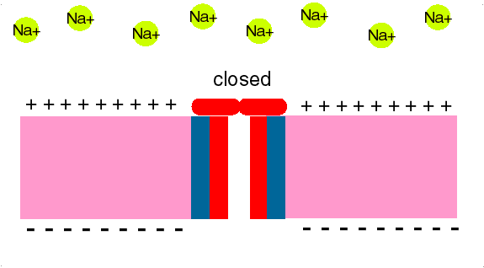
3.1.2 State that a variety of other elements are needed by living organisms, including sulfur, calcium, phosphorus, iron and sodium.
3.1.3 State one role for each of the elements mentioned in 3.1.2.
Sodium
During a nerve impulse, in the first part of an action potential, sodium channels open across the plasma membrane and sodium will diffuse into the neuron.

Slide 8
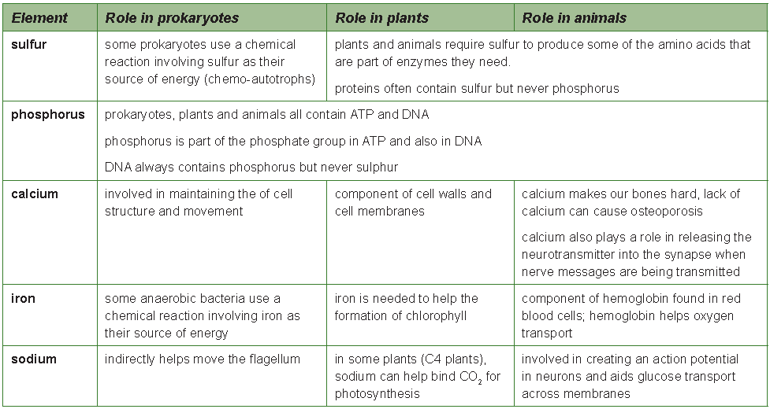
3.1.2 State that a variety of other elements are needed by living organisms, including sulfur, calcium, phosphorus, iron and sodium.
3.1.3 State one role for each of the elements mentioned in 3.1.2.

Slide 9
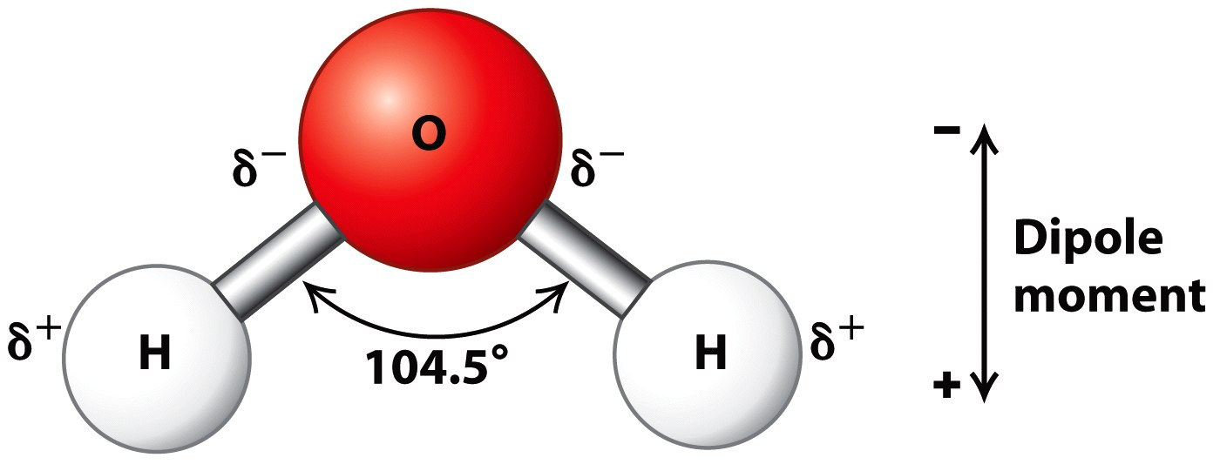
3.1.4 Draw and label a diagram showing the structure of water molecules to show their polarity and hydrogen bond formation.
A molecule of water is made from one atom of oxygen and two atoms of hydrogen. Covalent bonds (sharing of electrons) keeps the atoms together. The structure of a water molecule is fixed: the (small) hydrogen atoms bond
to the (larger) oxygen atom at a fixed angle.

Slide 10
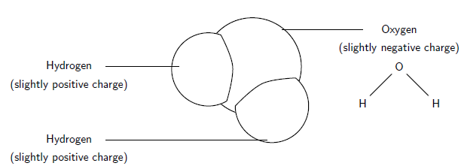
3.1.4 Draw and label a diagram showing the structure of water molecules to show their polarity and hydrogen bond formation.
Although the electrons are shared, oxygen pulls harder at them than hydrogen. This results in a slightly negative oxygen atom and slightly positive hydrogen atoms. Since positive and negative charges attract, there will be an attraction force (hydrogen bond) between the (slightly positive) hydrogen of one water molecule and the (slightly negative) oxygen of the adjacent molecule.
Due to the water molecule having a (slightly) positive and a (slightly) negative side, we can say it has two poles: a positive and a negative pole. That means that water is polar and that polar solutes are likely to dissolve in it, whereas non-polar molecules will not. Hydrogen bonding in water is a result of its polarity.

Slide 11
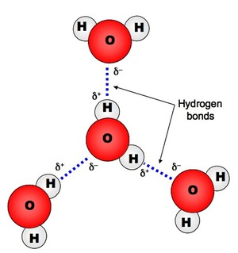
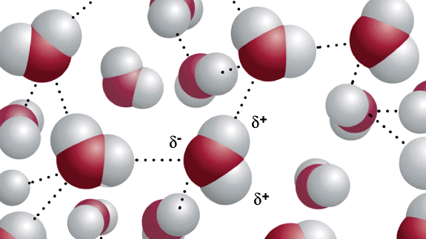
3.1.4 Draw and label a diagram showing the structure of water molecules to show their polarity and hydrogen bond formation.
Hydrogen bonds are not complete chemical bonds. There is no sharing or transferring of electrons. Instead, it is an attraction force between a slightly positive hydrogen atom and a slightly negative oxygen atom. Hydrogen bonds are much weaker than covalent or ionic bonds. They are significant though, because they are very common.

Slide 12
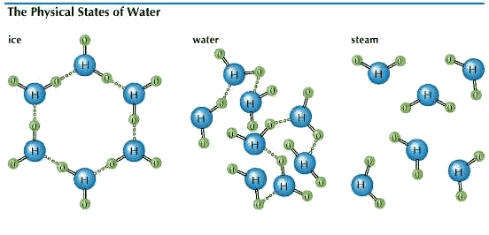
3.1.5 Outline the thermal, cohesive and solvent properties of water.
The properties of water all come from the fact that it is polar. As a result of its polarity, there are attraction forces between the molecules and this gives water its cohesive properties.
When an object is warmed up, its particles (e.g. molecules) will move faster. This means that they have to break away from cohesion with adjacent molecules more times per minutes. Due to the cohesive properties of water, this takes a lot of energy.
The same goes for evaporation. A water molecule that evaporates, escapes from the liquid and the other water molecules with which it interacted. Again, due to cohesion, this requires a lot of energy.

Slide 13
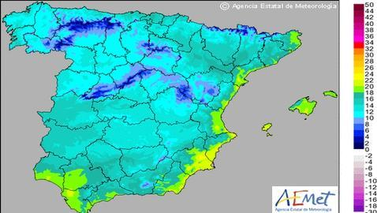
3.1.6 Explain the relationship between the properties of water and its uses in living organisms as a coolant, medium for metabolic reactions and transport medium.
Water has a high ‘specific heat capacity’ wich means that water will not warm up much, even when the sun shines on it all day. You know that because when you go to the beach on a warm day, the water is much cooler than the sand. Water needs to take in a lot of energy to go from liquid to gas, this is called the ‘latent heat of vaporisation’. That means that the water evaporating from the sea on a hot day will take up a lot of the energy of the sun shining on it instead of warming up the rest of the water. In winter, water will give off the energy as heat. So, near the sea, the summers are not as hot and the winters not as cold.
Spain in summer
Spain in winter

Slide 14
3.1.6 Explain the relationship between the properties of water and its uses in living organisms as a coolant, medium for metabolic reactions and transport medium.
Water is a very good solvent and can dissolve many solids and gases. This property is very important in living things because it acts as a medium for reactions and also a medium for transport of materials around the body, particularly in the blood and lymph systems.

Slide 15
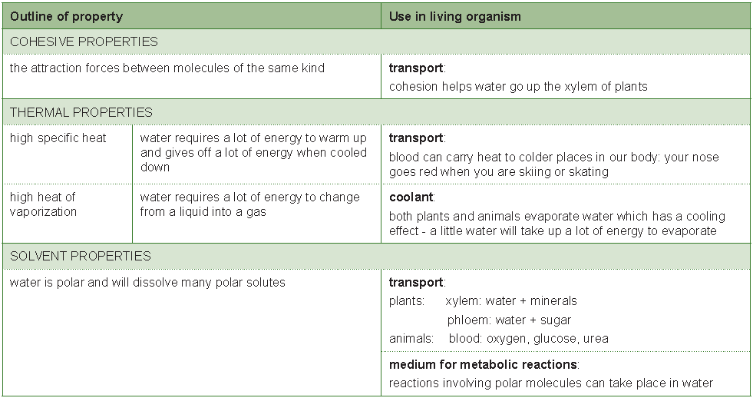
3.1.6 Explain the relationship between the properties of water and its uses in living organisms as a coolant, medium for metabolic reactions and transport medium.

Slide 16
Topic 3: The chemistry of life
3.1 Chemical elements and water

