Slide 1
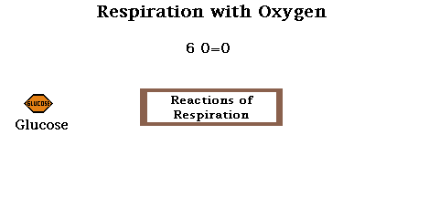
Topic 2 Molecular biology
2.8 Cell respiration

Slide 2
Nature of science
Assessing the ethics of scientific research—the use of invertebrates in respirometer experiments has ethical implications. (4.5)
Understandings:
Cell respiration is the controlled release of energy from organic compounds to produce ATP.
ATP from cell respiration is immediately available as a source of energy in the cell.
Anaerobic cell respiration gives a small yield of ATP from glucose.
Aerobic cell respiration requires oxygen and gives a large yield of ATP from glucose.

Slide 3
Applications and skills
Application: Use of anaerobic cell respiration in yeasts to produce ethanol and carbon dioxide in baking.
Application: Lactate production in humans when anaerobic respiration is used to maximize the power of muscle contractions.
Skill: Analysis of results from experiments involving measurement of respiration rates in germinating seeds or invertebrates using a respirometer.
ToK
None
Essential idea: Cell respiration supplies energy for the functions of life.

Slide 4
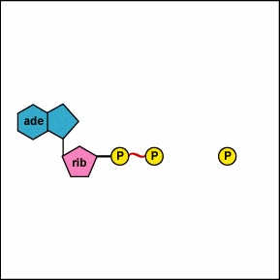
Release of energy by cell respiration
Cell respiration is the controlled release of energy from organic compounds to produce ATP
Cell respiration is one of the functions of life which all life performs. Organic compounds are broken down to release energy which can then be used in the cell.
The source of this energy in humans is our food. The organic compounds in our food are broken down and the energy is used to perform several functions in our cells. The most energy rich organic compounds are carbohydrates and lipids, but sometimes the amino acids of proteins are used if we eat too much protein. Plants use carbohydrates and lipids previously made by photosynthesis.
Click here for a 3D animation of the process
Cell respiration, like many of the biochemical processes we have seen so far, are carried out by using enzymes. The energy released is ‘captured’ in an energy carrying molecule called ATP (adenosine triphosphate). AS you see to the right, a phosphate is linked to ADP and energy is stored to later be released again.

Slide 5
ATP as a source of energy
ATP from cell respiration is immediately available as a source of energy in the cell
Cells require energy for three main types of activity:
Synthesising large molecules like RNA or DNA and proteins
Pumping molecules or ions across membranes by active transport
Moving things around inside the cell, such as chromosomes, vesicles, or in muscle cells, in the protein fibres that cause muscle contraction.
The energy of all these processes is supplied by ATP. The advantage of ATP of an energy source is that ATP is directly available. It is released simply by splitting ATP to ADP as you saw before. This ADP and the disconnected phosphate can that recombine to ATP again in cellular respiration.
The energy from ATP is directly used in cells, and converted to heat energy. This energy is used to keep the organism warm but it is lost in the environment eventually, so the supply of ATP must be continuous to keep the cell functioning.

Slide 6
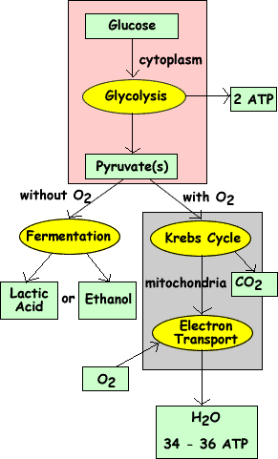
Anaerobic respiration
Anaerobic respiraton gives only a small yield of ATP from glucose
If there is no oxygen present, the cell needs to use the process of anaerobic cell respiration to obtain its energy. It will carry out glycolysis.
In order to be able to continue with glycolysis which produces a small amount of ATP, the cell needs to change the pyruvate into another substance.
Yeast cells will convert pyruvate (a three carbon compound) into ethanol (a two carbon compound) and carbon dioxide (a one carbon compound). Human cells will change pyruvate (a three carbon compound) into lactate (another three carbon compound). Neither of these equations requires the presence of oxygen. That is why they are part of anaerobic cell respiration.

Slide 7
Anaerobic respiration
Anaerobic respiraton gives only a small yield of ATP from glucose
The yield of ATP is small in anaerobic respiration but it is produced very quickly. This makes it useful for several situations:
When a short rapid burst of ATP production is needed
When oxygen supplies run out in respiring cells
In environments that are deficient in oxygen, like waterlogged soils (swamps)
So here are some summary equations:
In animals:
Glucose → Lactate (this lactic acid gives you the ‘sour’ feeling in muscles when exercising)
In yeast and plants Glucose → Ethanol + CO₂

Slide 8
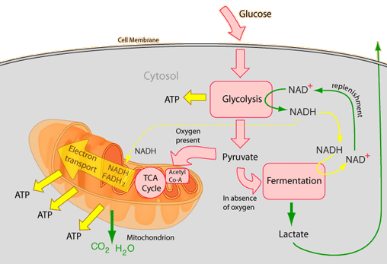
ATP as a source of energy
ATP from cell respiration is immediately available as a source of energy in the cell
We use the process of anaerobic cell respiration in our bodies when, for example, we run a sprint. The muscles suddenly require a lot of energy.
The body can only supply a limited amount of oxygen to the muscles and there can only be a limited amount of aerobic respiration. This does not produce enough energy to contract the muscles at the rate required. So, in addition to aerobic respiration, the cells in the muscles will use anaerobic respiration to release the remaining amount of energy. This produces lactate which, under certain conditions, may cause muscle cramps.

Slide 9
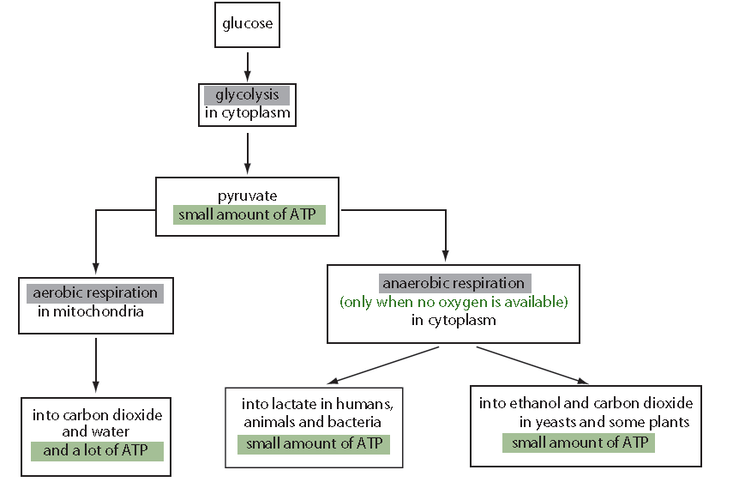
ATP as a source of energy
ATP from cell respiration is immediately available as a source of energy in the cell
If oxygen is present, the pyruvate produced in the cytoplasm during glycolysis will move into the mitochondria. Inside the mitochondria, pyruvate will be broken down to carbon dioxide and water. This process yields much more ATP than glycolysis or anaerobic respiration.
LINK

Slide 10
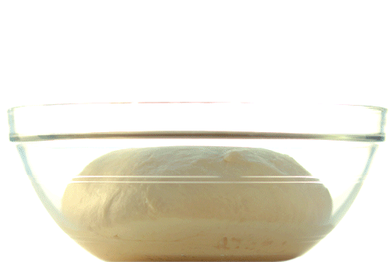
Yeast and its uses
Use of anaerobic cell respiration in yeasts to produce ethanol and carbon dioxide in baking
Introduction video
Anaerobic respiration is also used with yeast in bread making so that the dough will rise. The carbon dioxide produced will create bubbles in the dough which makes it rise. The alcohol produced will evaporate during baking.
Yeast is a unicellular organism you know well from the lab. It occurs in natural environments where glucose and other sugars are available, such as on the surface of fruits. It performs both aerobic as anaerobic respiration. The latter is used in the production of foods, drinks and even renewable energy.

Slide 11
Yeast and its uses
Use of anaerobic cell respiration in yeasts to produce ethanol and carbon dioxide in baking
Bread is made by adding water to flour, kneading the mixture to make dough and then bake it. The yeast is added to produce gas during the baking which will create the bubbles in the bread and makes it rise. For this the dough is supposed to be kept warm to the yeas respires, when the oxygen is used up the yeast turns to anaerobic respiration and the carbon dioxide produced . Ethanol is also produced but is vaporises during the baking process.

Slide 12
Yeast and its uses
Use of anaerobic cell respiration in yeasts to produce ethanol and carbon dioxide in baking
Bioethanol is ethanol produced by living organisms for use as renewable energy sources. Any plant matter can be used as a feed stock and and various living organisms can be used to convert the plant matter into ethanol. Most bioethanol is produced from sugar cane and corn (maize), using yeast.
Yeast converts sugars into ethanol in large fermenters by anaerobic respiration.
1st Enzymes break down starch and cellulose of the plant material into sugars
2nd Yeast breaks down the sugars and ethanol is produced
Most bioethanol is used as fuel in vehicles LINK
Lets see a video

Slide 13
Anaerobic respiration in humans
Lactate production in humans when anaerobic respiration is used to maximise the power of muscle contrations
The oxygen supply of the lungs to the blood and consequently to the muscles and organs is fast enough for aerobic respiration, but muscles sometimes need anaerobic respiration to get enough energy to perform their function.
VIDEO
In the past we needed this extra energy to escape from predators but nowadays anaerobic respiration in muscles usually occurs when doing sports. The concentration of lactate in the muscle increases but there is a maximum. We can only perform anaerobic respiration for a short time and therefor you can sprint only for a few hundred meters maximum.
Oxygen is needed to break down the lactate again, so after this burst of energy there is an ‘oxygen debt’ in your body and fast breathing is needed for a while after to get back to your normal state.

Slide 14
Aerobic respiration
Aerobic respiration requires oxygen and provided a large yield of ATP
If oxygen is available to a cell then glucose can be broken down more fully and so a larger quantity of energy is released than in anaerobic cell respiration.
Anaerobic cell repiration yields 2 ATP’s per glucose broken down whereas aerobic respiration it is 36 ATP’s.
Aerobic respiration involves a series of chemical reactions. Carbon dioxide and water are produced (as you know from previous courses).
Carbon dioxide is usually excreted as a waste product but the water produced is used by the organism, in humans about half a litre of water is produced this way.

Slide 15
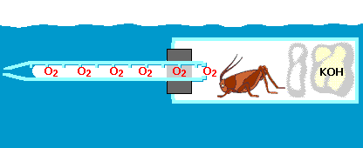
ACTIVITY
Respirometers
Take 15 minutes to read through page 127 of the book and after the part on ‘Ethics of anima use in respirometers’ on page 128 and 129.
In the next 15 minutes, try to think, individually, of at least three different experiments you could perform with a respirometer. Write down the research question, the dependent, independent and several controlled variables you can come up with, keep it brief.
Take 10 minutes to explain and discuss your experiments to your classmates. Did you get any interesting ideas?

Slide 16
Topic 2 Molecular biology
2.8 Cell respiration

