Slide 1
London forces
I₂
Add to the Fluorine atoms to show how London forces occur and then explain below in words:
Br₂
Cl₂
Ne
Ne
F₂
Describe and explain the graph above:
Step-by-step explanation:
1.
2.
3.
4.
5.
6,
Bonus question: Why do long and thin molecules have more London forces than bulky ones?

Slide 2
Permanent dipole-dipole forces
HI
HCl
HBr
Add a diagram below to show a dipole-dipole attraction then explain why they arise below.
Xe
Kr
Ar
H
Cl
H
Cl
Ar atoms and HCl molecules are of similar size so have similar London forces. Why then, are the boiling points so different?
Step-by-step explanation:
Why do halogen molecules (e.g. Cl₂) not have these forces?

Slide 3
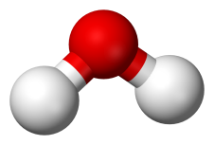
Hydrogen bonding
Add a dotted line to the diagram below to show any hydrogen bonds that may occur.
Use this diagram to explain why water has a higher boiling point that ammonia:
For H-bonding to occur, we must have a hydrogen bonded to one of three atoms:
1. 2. 3.
These atoms must have a ……… ………. of ………….
How does H-bonding relate to the remarkably low density of ice?

Slide 4
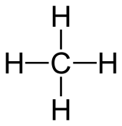
Complete this table by adding the structures of each compound, stating the bonding types and its boiling point.
Compound | Structure | London | Permanent dipole-dipole | Hydrogen bonding | Boiling point (ºC)
Methane |  | Yes | No | No | -162
Propane
Hydrogen iodide
Methoxy methane
Ethanol
Water

