Slide 1
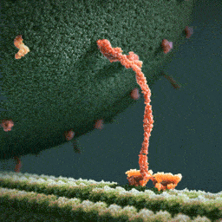
Topic 2 Molecular biology
2.4 Proteins

Slide 2
Nature of science
Looking for patterns, trends and discrepancies—most but not all organisms assemble proteins from the same amino acids. (3.1)
Understandings:
Amino acids are linked together by condensation to form polypeptides.
There are 20 different amino acids in polypeptides synthesized on ribosomes.
Amino acids can be linked together in any sequence giving a huge range of possible polypeptides.
The amino acid sequence of polypeptides is coded for by genes.
A protein may consist of a single polypeptide or more than one polypeptide linked together.
The amino acid sequence determines the three-dimensional conformation of a protein.
Living organisms synthesize many different proteins with a wide range of functions.
Every individual has a unique proteome.

Slide 3
Applications and skills
Application: Rubisco, insulin, immunoglobulins, rhodopsin, collagen and spider silk as examples of the range of protein functions.
Application: Denaturation of proteins by heat or by deviation of pH from the optimum.
Skill: Drawing molecular diagrams to show the formation of a peptide bond.
ToK
No Tok included
Essential idea: Proteins have a very wide range of functions in living organisms.

Slide 4
Some important notes
The detailed structure of the six proteins selected to illustrate the functions of proteins is not needed.
Egg white or albumin solutions can be used in denaturation experiments.
Students should know that most organisms use the same 20 amino acids in the same genetic code although there are some exceptions. Specific examples could be used for illustration.

Slide 5
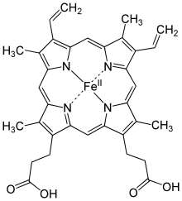
Amino acids and polypeptides
Amino acids are linked together by condensation to form polypeptides
Two amino acids can combine to form a dipeptide. This, again, is a condensation reaction. These reaction happen at the ribosomes in the process of translation.
The Thicker bond is called the peptide linkage or simply a peptide bond. It is a special bond between a C (with a double bonded O attached on
one side) and an N (with an H attached) on the other side. Again the reverse of this reaction is hydrolysis.
As more amino acids are added they produce a polypeptide and more water (depending on how many amino acids were added).
A polypeptide can be a protein by itself or it may need to combine with other polypeptide chains to form a functional protein. For example, haemoglobin is made of 4 polypeptide chains, 2 alpha chains and 2 beta chains.

Slide 6
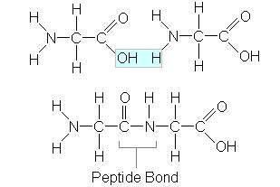
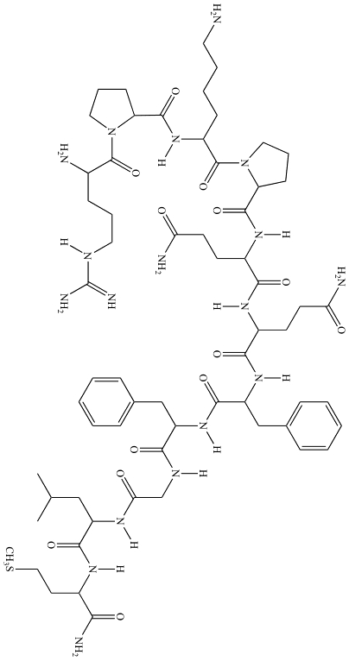
Amino acids and polypeptides
Amino acids are linked together by condensation to form polypeptides
Polypeptide
Amino acid 1
Amino acid 2
= dipeptide

Slide 7
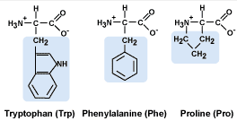
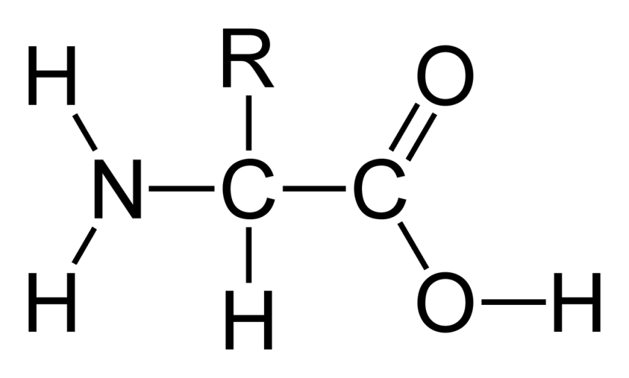
Amino acids and polypeptides
Amino acids are linked together by condensation to form polypeptides
Polypeptides are long chains of amino acids. There are many different amino acids but they have some structures in common:
amino acids have a central C atom
there are four different groups attached to this central C atom:
- the amine group -NH₂
- the (carboxylic) acid group -COOH
- an simple -H group
- the ‘R’ group which is different in different amino acids

Slide 8
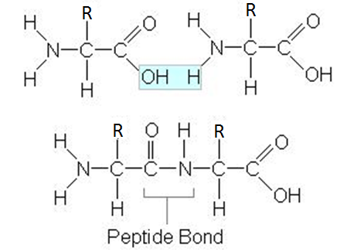
Drawing peptide bonds
Draw molecular diagrams to show the formation of peptide bonds
To draw a peptide bond you simply need to draw two amino acids next to each other but delete the hydroxide group of one and the hydrogen of the other, so a bond will form between the most right carbon of the 1st amino acid and the most left nitrogen of the 2nd.

Slide 9
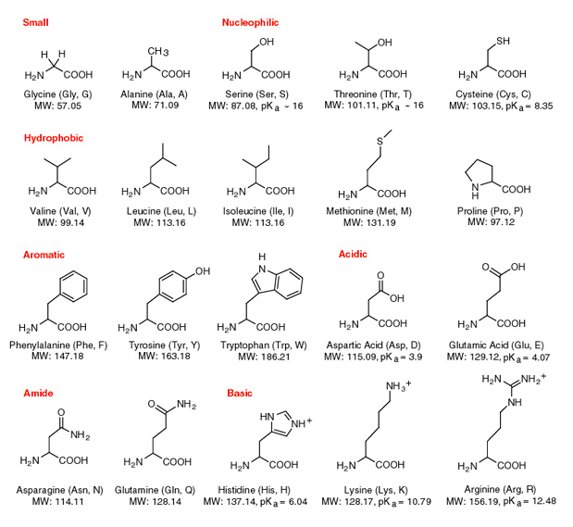
Do you see similarities between the 20 amino acids?

Slide 10
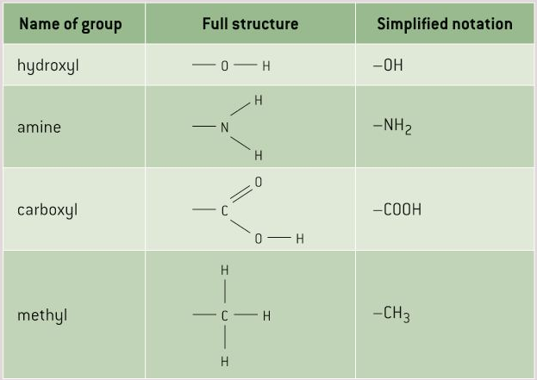
Diversity of amino acids
There are 20 different amino acids in polypeptides synthesised on ribosomes
The structure of the 20 amino acids is very similar: a carbon in the center linked to an amino group, a carboxyl group and a hydrogen atom. The carbon atom is also connected to an R group which is different in each amino acid.
Remember the groups

Slide 11
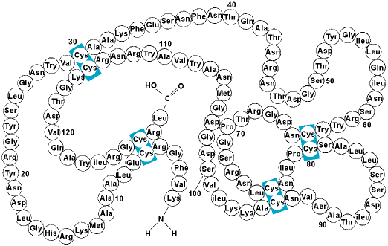
Diversity of amino acids
There are 20 different amino acids in polypeptides synthesised on ribosomes
The 20 different amino acids are linked together by condensation reactions by ribosomes in different combinations. All these combinations are decided by the order of the bases on the mRNA translated. Most part of the amino acids are the same, except for the R groups, that is where they differ.

Slide 12
Amino acids and origins
Patterns, trends and discrepancies; most but not all organisms assemble polypeptides from the same amino acids
In almost all organisms the same 20 amino acids are used to build proteins with, from bacteria to elephants to a rose. Sometimes amino acids can be modified after been fixed in a polypeptide.
There are several hypotheses for this:
These 20 Amino acids were the ones produced by chemical processes on the early Earth before the origin of life. All organisms used them after and are still using them.
They are the ideal 20 amino acids for making up a wide range of proteins. So natural selection will always favour organisms using them.
All life has evolved from one single ancestral species which used these 20 amino acids. Because of the ways proteins are synthesised by ribosomes it is very difficult to change this repertoire.
Biology is a very complicated science and therefore discrepancies are common. Some organisms have been found which use a certain codon for different, non standard amino acids.

Slide 13
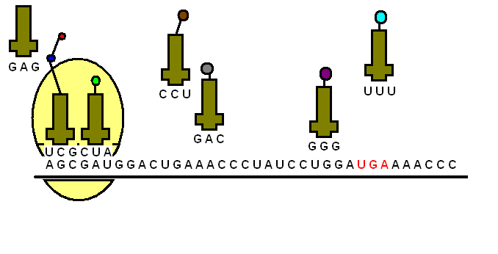
Polypeptide diversity
Amino acids can be linked together by any sequence giving a huge range of possible polypeptides.
Ribosomes link amino acids together, one at a time until a polypeptide is formed. Any sequence of amino acid is possible.
The number of possible amino acid sequences can be calculated starting with dipeptides. As dipeptides are composed from two amino acids, both any of the 20 varieties, you can have 20² possibilities (20 x 20 = 400). A tripeptide would have 20³ possibilities (20 x 20 x 20= 8000) etc.
The number of amino acids in a polypeptide can be anything from 1 to tens of thousands, the number of possibilities is almost infinite…

Slide 14
Genes and polypeptides
The amino acids of polypeptides is coded for by genes
Only a small fraction of the possible amino acid sequences is produced by an organism. All the information to produce the proteins an organisms needs to synthesise is written in the DNA. When this DNA is transcribed into mRNA, each three bases ‘letters’ codify for one of the twenty amino acids.
This is called the genetic code. So if a polypeptide is 400 amino acids long then there are 1200 bases needed on the gene (the segment of DNA codifying for a certain polypeptide) to codify for this.
The base sequence which actually codes for a polypeptide is known to molecular biologists as the open reading frame. One puzzle is that open reading frames only occupy a small proportion of the total DNA of a species.
LINK

Slide 15
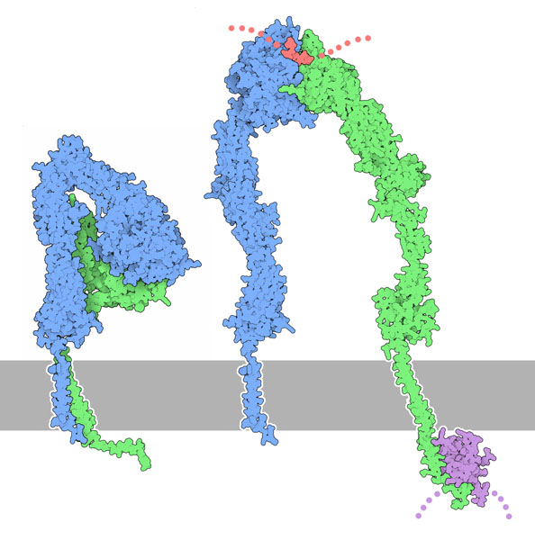
Proteins and polypeptides
A protein an consist of a single polypeptide or more than one linked together
Some proteins are single proteins but many are composed of two or more polypeptides linked together. A good example is integrin, a protein made out of two polypeptides (so two genes). These two polypeptides can be adjacent to each other or unfold and work apart.
Collagen consists of three long polypeptides (three genes) wound together to form a rope like molecule. This has a greater tensile strength then they would have if they’d separate. The winding allows some stretching without the molecule breaking.
Haemoglobin consists of four polypeptides (four genes) with associated non-polypeptide structures. These four part interact to transport oxygen more effectively than if they were separate.

Slide 16
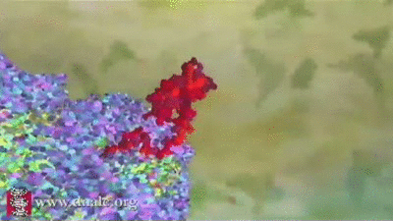
Proteins conformations
The amino acid sequence determines the three dimensional structure of a protein.
The conformation is a protein is its three dimensional structure. The conformation is determined by the amino acid sequence of a protein and it’s consequent polypeptides. Fibrous proteins such as collagen are elongated with a repeating structure. Many proteins are globular. In globular proteins the polypeptides gradually fold up as they are made. Bonds between the R groups make this shape more stable.

Slide 17
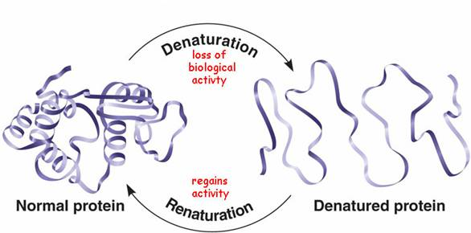
Denaturation of proteins
Denaturation of proteins by heat of pH extremes
The three dimensional structure of proteins is stabilized by bonds or interactions between R groups of the amino acids in the molecule. These bonds aren’t very strong and can be easily broken. In that case the proteins loses it’s conformation, so function and is denatured.
Usually a denatured protein can not return to its initial structure and therefor the denaturation is permanent. Soluble proteins can become insoluble and precipitate in a solution. The hydrophobic R groups of the amino acids which are usually in the centre of the molecule now have become exposed and therefor it can’t be dissolved anymore.
LINK

Slide 18
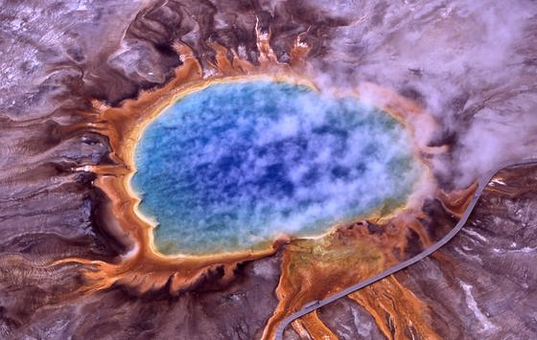
Denaturation of proteins
Denaturation of proteins by heat of pH extremes
Denaturation can be caused by heat, as the vibrations of the molecules causes the bonds to break. Proteins vary in heat tolerance (experiment idea!!) There are some extremophile bacteria which can live in volcanic springs of hot water up to 80ºC without denaturing their proteins.
A well know example is Thermus aquaticus, a prokaryote living in the hot springs of the Yellowstone national park. It’s DNA polymerase work best at 80ºC and therefore it is used a lot in biotechnology.

Slide 19
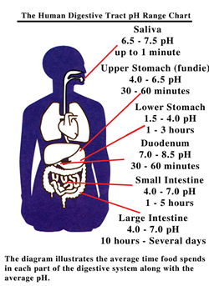
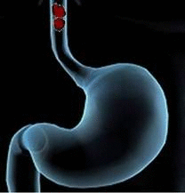
Denaturation of proteins
Denaturation of proteins by heat of pH extremes
Extremes of pH also cause denaturation. The charges of the R groups change and the ionic bonds are broken. This has the same denaturation effect as with heat.
Like always there are exceptions: the stomach has a pH of 1,5 to 3,5. this is the optimum pH for the protein digestion enzyme, pepsin.

Slide 20
Protein functions
Living organisms synthesise many different proteins with a wide range of functions
Proteins are the most versatile group of biomolecules with many different functions. Like:
Catalysis: Enzymes speed up the breaking down of biomolecules
Muscle contraction: Actin and myosin together cause the contraction of a muscle.
Cytoskeletons: tubulin is the subunit of microtubules that give animal cells their shape and pull on chromosomes during

Slide 21
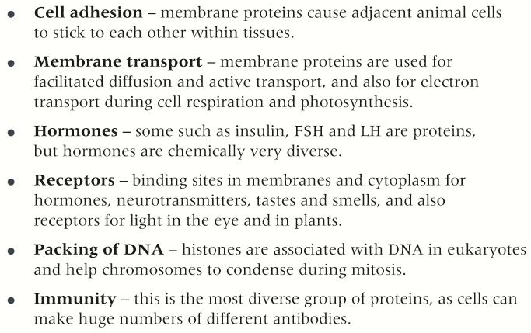
Protein functions
Living organisms synthesise many different proteins with a wide range of functions

Slide 22
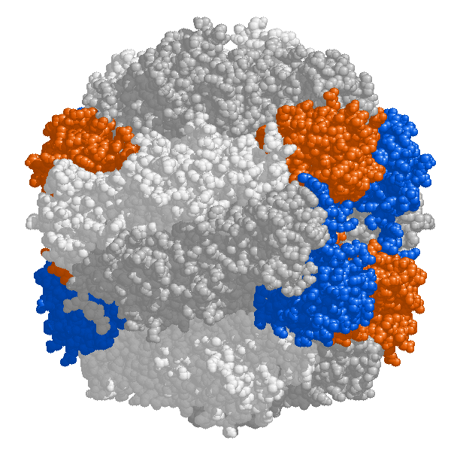
Examples of proteins
Rubisco, insulin, immunoglobulins, rhodopsin, collagen and spider silk are examples of the range or protein functions.
Rubisco
Probably the most important enzyme in the word as its active site allows for it to catalyse the reaction which fixes Carbon dioxide from the atmosphere. This is the source of carbon from which all carbon compounds needed by living organisms can be produced. This is probably the most abundant protein on Earth.
Insulin This is a hormone which signals cells in the body to absorb glucose and therefor it controls the glucose level of the body. When insulin binds to the binding site for insulin on the cell surface of cells the cells will start to absorb the glucose from the blood.

Slide 23
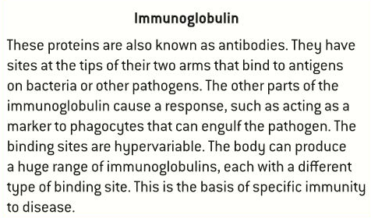
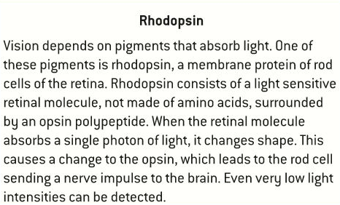
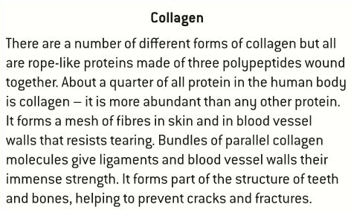
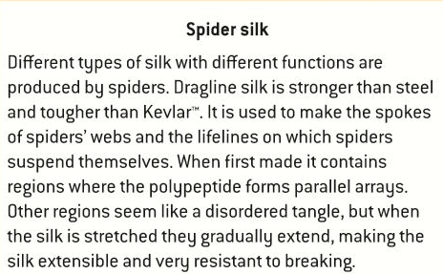
Examples of proteins
Rubisco, insulin, immunoglobulins, rhodopsin, collagen and spider silk are examples of the range or protein functions.

Slide 24
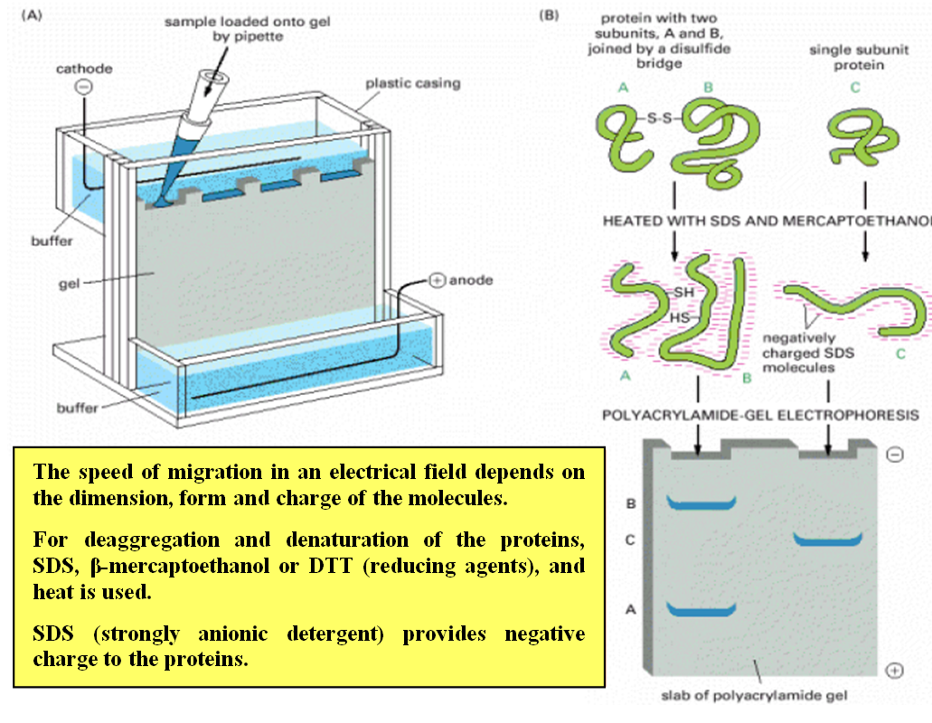
Proteomes
Every individual has a unique proteome.
A proteome is all the proteins used by a cell, a tissue or an organism (like the genome is ll the genes used by an organism). To know how many proteins are used by an organism the proteins need to be extracted from a sample of a cell or tissue and then by gel electrophoresis they are separated.

Slide 25
Proteomes
Every individual has a unique proteome.
To identify whether or not a particular protein is present, antibodies are lnked to a fluorescent marker. If the cell fluoresces, the protein is present.
The genome of an organism is fixed but the proteome is variable because each cell makes up different proteins. Even in one cell the proteins present aren’t always the same over time. So the proteome reveals what is actually happening in an organism, not what might happen.
Within a species there are many similarities to what happens in a proteome but also differences. The proteome of each individual is unique. The differences in activity and small differences in amino acid sequences of proteins are what makes them unique. Even the proteome of identical twins can differ over time.
Can you answer the question on page 95?

Slide 26
Topic 2 Molecular biology
2.4 Proteins

