Slide 1
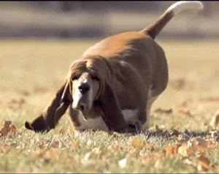
Topic 2 Molecular biology
2.3 Carbohydrates and lipids

Slide 2
Nature of science
Evaluating claims—health claims made about lipids in diets need to be assessed.
Understandings:
Monosaccharide monomers are linked together by condensation reactions to form disaccharides and polysaccharide polymers.
Fatty acids can be saturated, monounsaturated or polyunsaturated.
Unsaturated fatty acids can be cis or trans isomers.
Triglycerides are formed by condensation from three fatty acids and one glycerol

Slide 3
Applications and skills
Application: Structure and function of cellulose and starch in plants and glycogen in humans.
Application: Scientific evidence for health risks of trans fats and saturated fatty acids.
Application: Lipids are more suitable for long-term energy storage in humans than carbohydrates.
Application: Evaluation of evidence and the methods used to obtain the evidence for health claims made about lipids.
Skill: Use of molecular visualization software to compare cellulose, starch and glycogen.
Skill: Determination of body mass index by calculation or use of a nomogram.
ToK
There are conflicting views as to the harms and benefits of fats in diets. How do we decide between competing views?
Essential idea: Compounds of carbon, hydrogen and oxygen are used to supply and store energy.

Slide 4
Some important notes
The structure of starch should include amylose and amylopectin.
Named examples of fatty acids are not required.
Sucrose, lactose and maltose should be included as examples of disaccharides produced by combining monosaccharides.

Slide 5
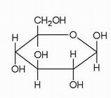
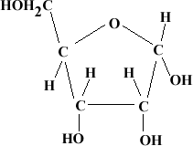
Carbohydrates
Monosaccharide monomers are linked together by condensation reactions to form disaccharides and polyccharide polymers
Carbohydrates are compounds that contain carbon, hydrogen and oxygen (C, H, O). Monosaccharides are simple sugars, the building blocks of disaccharides and polysaccharides.
Glucose has the formula C₆H₁₂O₆ and is an example of a monosaccharide. A glucose molecule has the shape of a 6-sided ring (hexagon)
Glucose:C₆H₁₂O₆
Glucose molecules linked together: Starch
Ribose: C₅H₁₀O₅

Slide 6
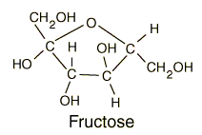
Carbohydrates
Monosaccharide monomers are linked together by condensation reactions to form disaccharides and polyccharide polymers
Examples of monosaccharides include:
glucose
fructose
galactose
Examples of dissaccharides are:
maltose
sucrose
lactose
Examples of polysaccharides are:
starch
glycogen
cellulose

Slide 7
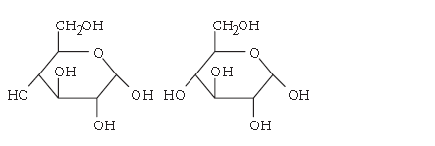
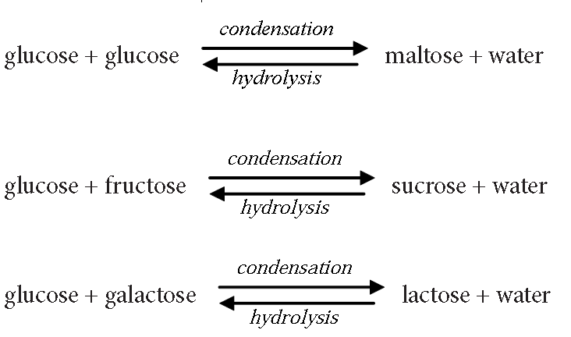
Carbohydrates
Monosaccharide monomers are linked together by condensation reactions to form disaccharides and polyccharide polymers
Two monosaccharides can combine to form a disaccharide and a molecule of water.
glucose + glucose → maltose + water
This is called a condensation reaction because it produces water. The reaction can be reversed and is then called a hydrolysis reaction. (hydro - water, lysis - splitting).

Slide 8
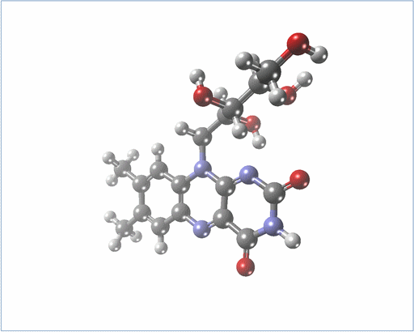
Imaging Carbohydrates Molecules
Use of molecular visualisation software to compareCellulose, starch and glycogen
1. Enter the website, go to topic 2.3 and click on the link to download Jmol molecule viewer.
2. Go to page 75 of your book and do exercise 1 to 7
3. In the next class we discuss the results

Slide 9
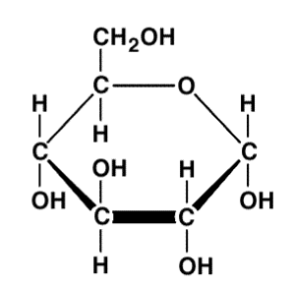
Polysaccharides
Structure and function of cellulose and starch in plants and glycogen in humans
Starch glycogen and cellulose are all made by linking together glucose but their structure and function are very different. The differences are in the types of glucose used to make them and in the bonds between the molecules.
As you know glucose had five –OH groups, all of them could be used in condensation reactions, but only three are used to link to another glucose molecule.
Most of the links are made with carbon one and carbon four of the molecule.
Carbon 6 (on top) is used to make side braches of polysaccharides (try to visualise this in the Jmol visualizer).

Slide 10
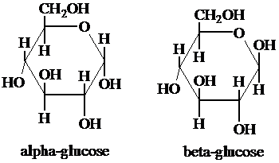
Polysaccharides
Structure and function of cellulose and starch in plants and glycogen in humans
Remember from the previous topic that there are two types of glucose you need to remember, α-Glucose and β-Glucose.
The difference is in the location of the –OH group.
This apparently small difference has major consequences for the polysaccharides produced.
Cellulose is made by linking β-Glucose together. As this positions the –OH group above the –OH group of the next molecule, one of the molecules needs to turn 180º.
So the glucose subunits are positioned up-down-up-down etc.
Notes:
MIRROR SECOND BETA GLUCOSE

Slide 11
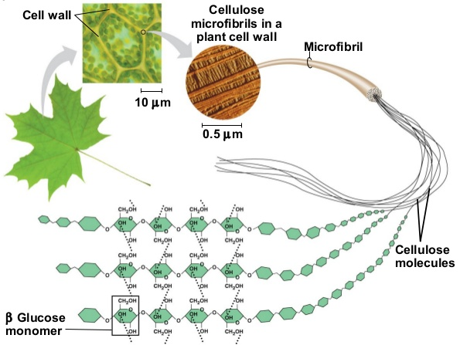
Polysaccharides
Structure and function of cellulose and starch in plants and glycogen in humans
Cellulose molecules are unbranched chains of β-Glucose which allow them to form bundles with hydrogen bonds linking the cellulose molecules. These bundeles are called cellulose microfibrils. They are used in cell walls

Slide 12
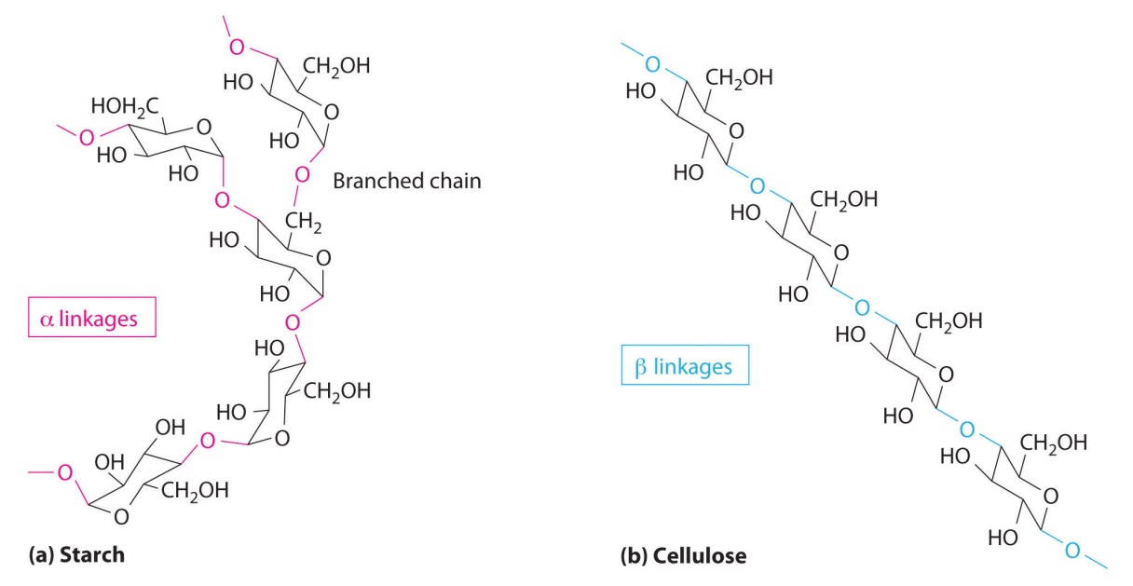
Polysaccharides
Structure and function of cellulose and starch in plants and glycogen in humans
Starch is made by linking a-Glucose molecules together. The same as in cellulose condensaton reaction link the –OH groups of the glucose molecules together with condensation reactions.
The a-Glucose molecules have the –OH groups on the 1th and 4th carbon both pointing downwards, so the molecules link all in the upright position.
This makes starch molecules slightly curved and no straight as is the case with cellulose.
LINK

Slide 13
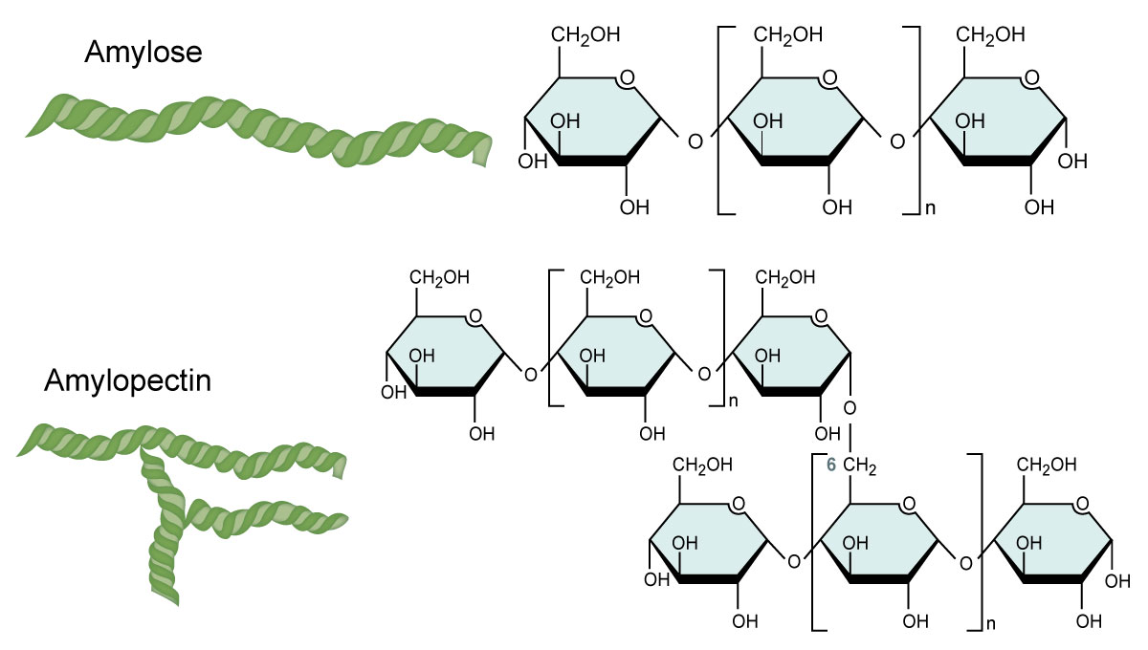
Polysaccharides
Structure and function of cellulose and starch in plants and glycogen in humans
There are two forms of starch, amylose and amylopectin. In amylose the chain of a-glucose molecules is unbranched and forms a helix. In amylopectin the chain is branched and has a more globular shape.

Slide 14
Polysaccharides
Structure and function of cellulose and starch in plants and glycogen in humans
Starch is ONLY made by plant cells. Starch is hydrophilic but the molecule is too large to dissolve in water.
Starch is used to store large amounts of glucose. If glucose would have been stored as monosaccharides in the cells then too much water would move in by osmosis.
You can find a lot of starch in seeds of plants because they need the energy to grow before they have their own roots to obtain nutrients from elsewhere.
You can also find starch in leafs of plants as glucose is the product of photosynthesis and when this glucose production happens fast the leaf stores it in the form of starch until it is transported elsewhere.

Slide 15
Polysaccharides
Structure and function of cellulose and starch in plants and glycogen in humans
Glycogen is very similar to the branched form of starch but there is more branching, making the molecule more compact. Glycogen is made by animals and some fungi. It is stored in the liver and in some muscles (later this course we come back to this).
Glycogen has the same fuction as starch in plants, it stores anergy. When enzymes hydrolise the bonds between the glucose molecules (catabolism) energy is released.
At both ends of the molecules of both starch and glycogen glucose molecules can be easily added or taken away, so theso molecules never have a fixed size.

Slide 16
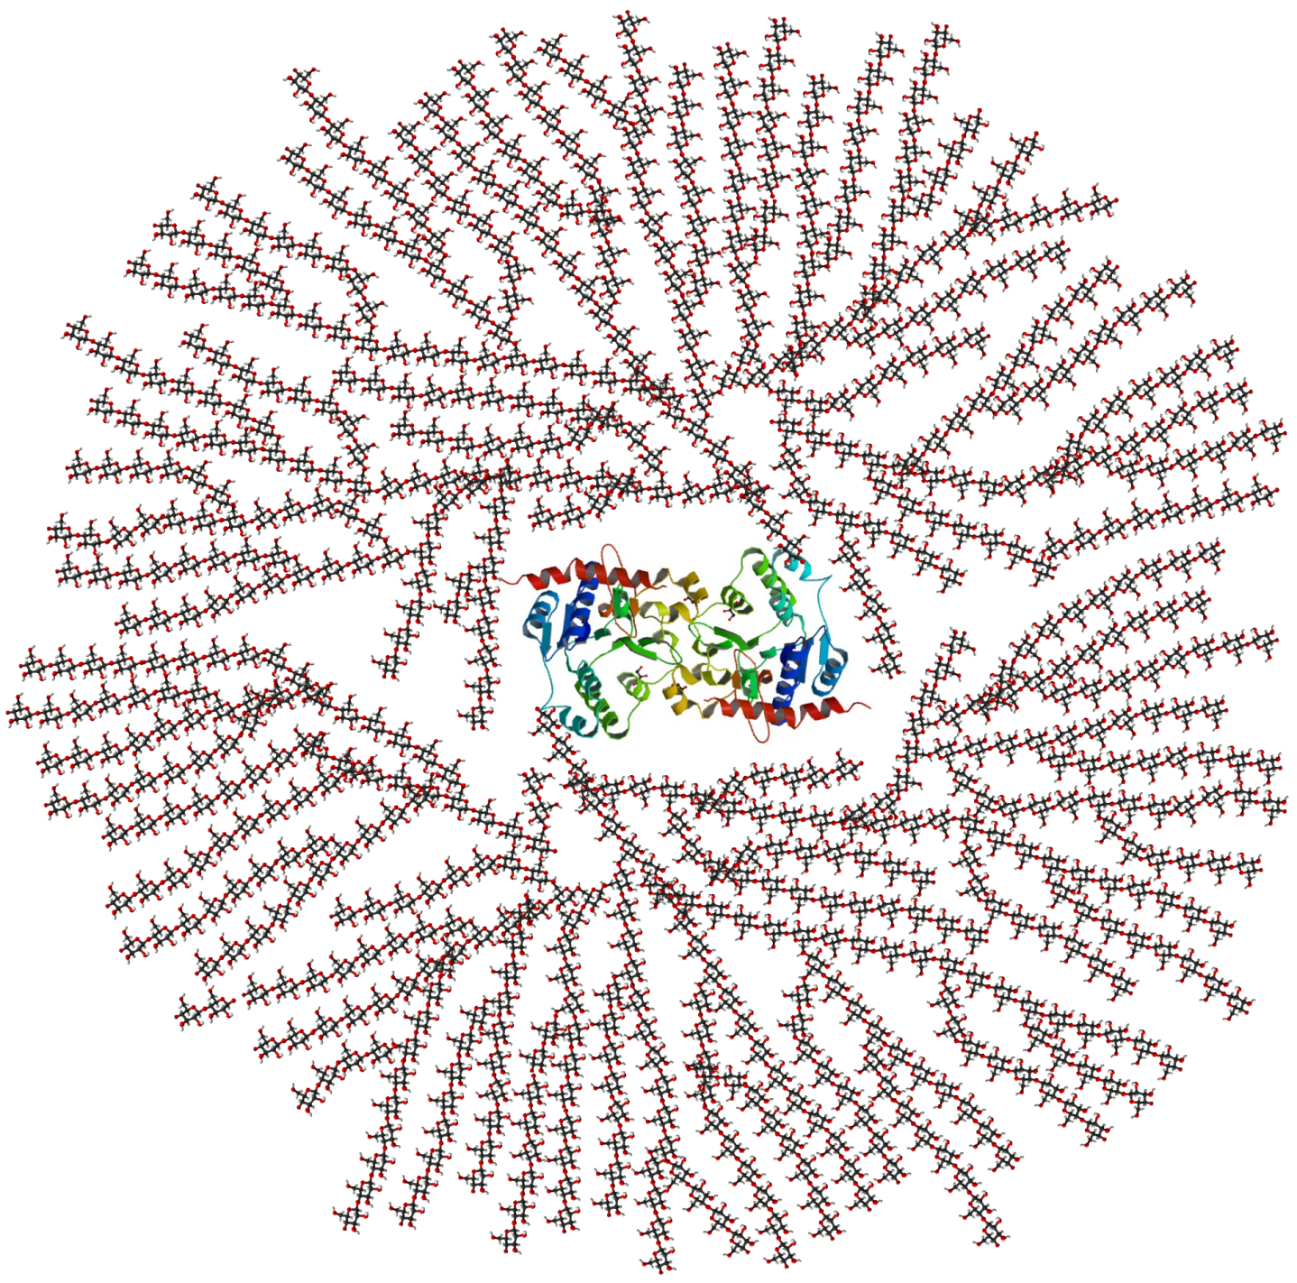
Polysaccharides
Structure and function of cellulose and starch in plants and glycogen in humans
Glycogen

Slide 17
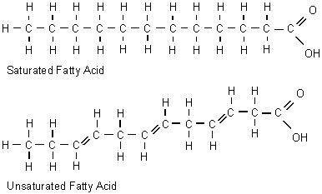
Lipids
Triglycerides are formed by condensation from three fatty acids and one glycerol
Lipids are a group of fats which generally come from animals and oils which are usually derived from plants. Lipids are made by a condensation reaction between glycerol and 3 fatty acids. Fatty acids are carboxylic acids. That means that they have a carboxylic group (-COOH). The rest of the molecule is a chain (or ring) of carbon atoms with hydrogen atoms. If there are no double bonds in this chain, then the fatty acid is ‘saturated’. If there are one or more double bonds between the carbon molecules of the chain, it is referred to as an ‘unsaturated’ fatty acid.

Slide 18
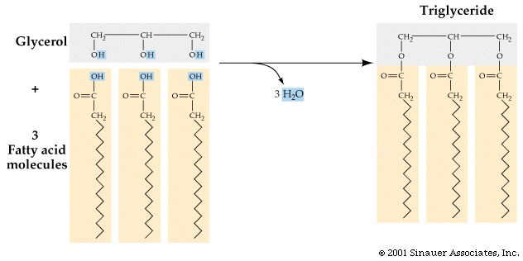
Lipids
Triglycerides are formed by condensation from three fatty acids and one glycerol
Lipids are composed of glycerol and 1, 2 or 3 fatty acids.
Triglycerides are a sub-group of lipids that are composed of glycerol and 3 fatty acids. Triglycerides are formed by the reaction of glycerol and three fatty acids. Again water is produced as a larger molecule is formed and this is a condensation reaction. The reverse reaction is hydrolysis.
Ester bonds

Slide 19
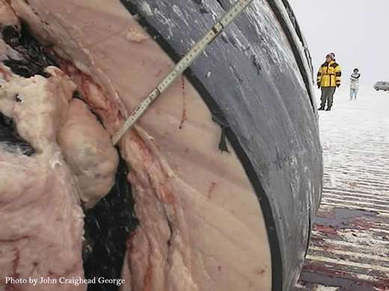
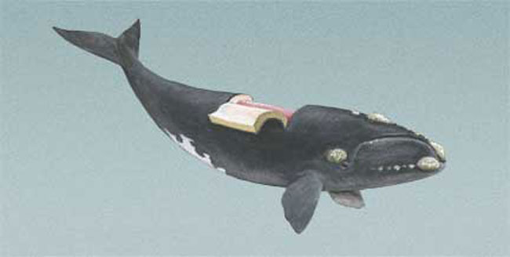
Lipids
Triglycerides are formed by condensation from three fatty acids and one glycerol
The main functions of lipids are:
Energy storage because one gram of lipids contains twice as much energy as one gram of carbohydrates or proteins.
Thermal insulation, for example a layer of lipids under the skin(subcutaneous layer) reduces the loss of heat from the organism.
Cell membranes because the main component of cell membranes are phospholipids.

Slide 20
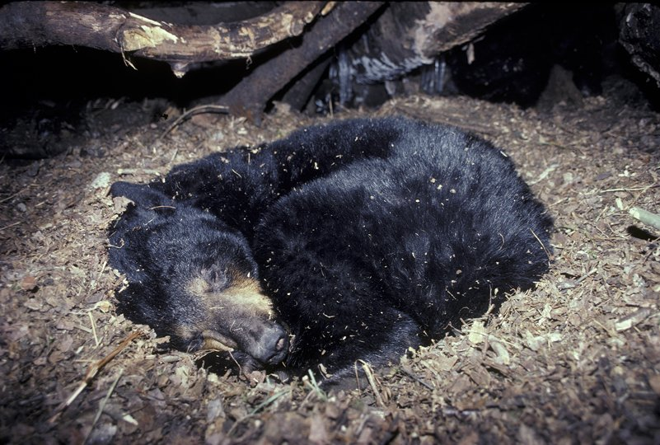
Energy storage
Triglycerides are formed by condensation from three fatty acids and one glycerol
One gram of lipid releases twice as much energy as one gram of carbohydrates (or proteins). Since most of the energy of a lipid is stored in its fatty acid chains, the lipids used to store energy are triglycerides.
Animals use glycogen to store the energy from a meal. This energy is likely to be used before the next meal. Overnight, we already need to use energy from triglycerides as the energy from glycogen stored in the liver is not enough for all our body processes (keeping warm, breathing, etc). Some birds use this stored fat for long flights and many animals store fat for the time spent in aestivation or hibernation

Slide 21
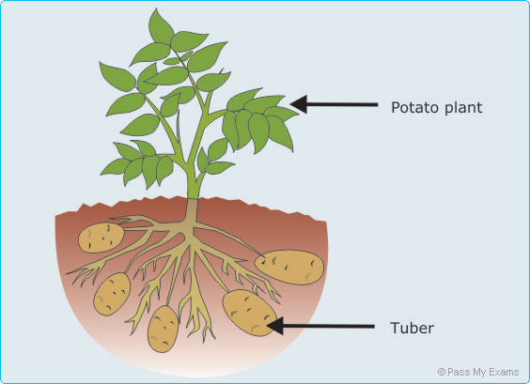
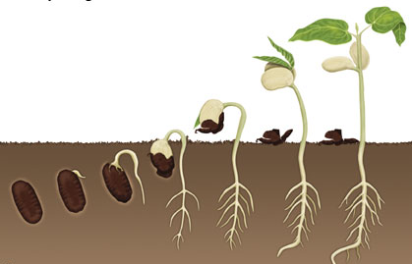
Energy storage
Triglycerides are formed by condensation from three fatty acids and one glycerol
Lipids (triglycerides) are used for the longer term storage of energy because storing the same amount of energy as carbohydrates, would involve more weight. As the animal moves, it would have to carry this weight.
Plants use carbohydrates to store energy in parts of the plant that do not move. A good example are potato tubers, growing underground. They do not need to move anywhere so it does not matter if they are heavier. But if you consider vegetable oil, good examples are rapeseed oil or sunflower oil. These are seeds that need to store energy to germinate. But the seeds also need to move away from the parent plant so the lighter they are, the more distance they are likely to cover. Therefore, you find energy stored as lipids in the seeds of plants but not in other parts that do not need to move.

Slide 22
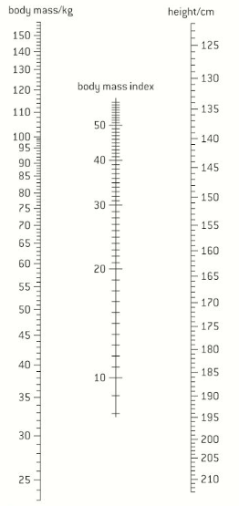
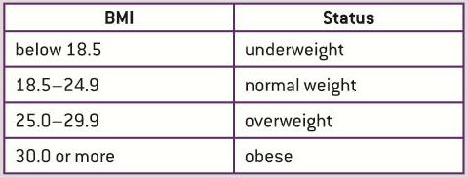
BMI
Determination of body mass index by calculation or nomogram
To calculate the BMI of a person two values are needed, the mass of the person in kilograms and their height in meters.
mass in kg
BMI= --------------------- so the unit of BMI is kg m⁻²
height in meters²
BMI can also be found using a nomogram
With a ruler from the body mass to the height you find the BMI on the central axis.

Slide 23
BMI
Determination of body mass index by calculation or nomogram
In some parts of the world food is not accessible to all in the same amount and there is a high incidence of underweight people. In the western world is has sometimes to do with diseases like anorexia nervosa.
Obesity is a big problem in developing countries and is related to excessive food intake, especially of carbohydrates and lipids, and a lack of exercise. LINK
You can use a skinfold calliper to measure the amount of fat.
Obesity increases the risk of coronary heart diseases and diabetes. Apart it reduces the life expectancy and it elevated the costs of health care in the countries with the highest incidence.
Statistics!!!
Lets have a look at the questions on page 81

Slide 24
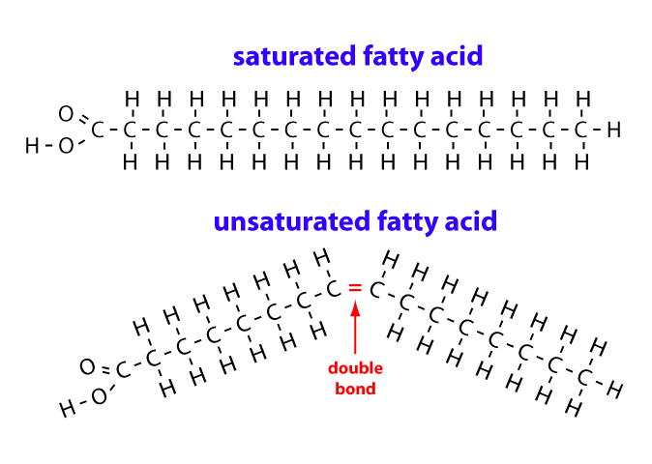
Fatty acids
Fatty acids can be saturated, monounsaturated or polyunsaturated
The length of fatty acid chains can vary but most are between 14 and 20 carbon atoms long. Again another variable feature is the bonding between the carbon atoms, there can be single or double bonds. If a carbon is linked to other carbons by a single bond, it can link to two adjacent hydrogen atoms too. If it is linked by a double bond there is only place to link to one hydrogen. So a saturated fatty acid is saturated with hydrogen atoms, and an unsaturated fatty acid could link to more if it were not for its double bonds
LINK

Slide 25
Fatty acids
Fatty acids can be saturated, monounsaturated or polyunsaturated
If there is only one double bond it is a monosaturated fatty acid, if there is more than one double bond it is a polysaturated fatty acid
mono
polyunsaturated fatty acid

Slide 26
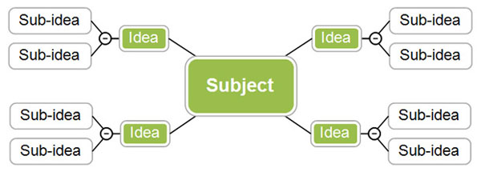
Lets take a break….
There has been a lot of information passing by you in a short time, lets do a mindmap to summarise all we have seen so far in this topic.
Recommended app: www.mindomo.com

Slide 27
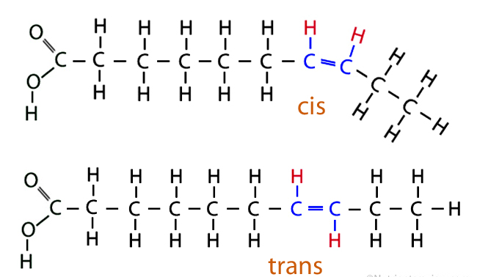
Unsaturated faty acids
Unsaturated fatty acids can be cis or trans isomers
In unsaturated fatty acids in living organisms the hydrogen atoms are nearly always on the same side of carbons atoms which are double bonded. These unsaturated fatty acids are called cis-fatty acids.
The alternative is for the hydrogen atoms to be on both sides of the double bonded carbon atoms, these are called trans-fatty acids

Slide 28
Unsaturated faty acids
Unsaturated fatty acids can be cis or trans isomers
In unsaturated fatty acids in living organisms the hydrogen atoms are nearly always on the same side of carbons atoms which are double bonded. These unsaturated fatty acids are called cis-fatty acids.
The alternative is for the hydrogen atoms to be on both sides of the double bonded carbon atoms, these are called trans-fatty acids

Slide 29
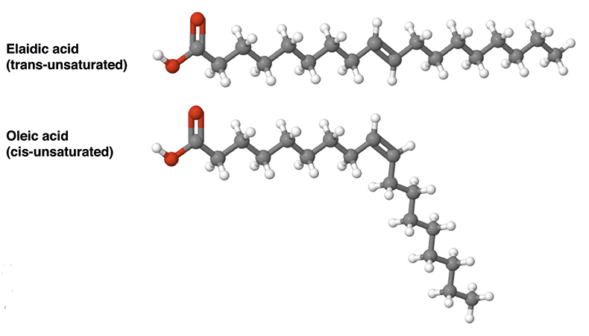
Unsaturated faty acids
Unsaturated fatty acids can be cis or trans isomers
In cis-fatty acids there is a bend in the hydrogen chain at the double bond. This simple feature makes the triglycerides containing cis-fatty acids less good at packing together in regular arrays like is the case with saturated fatty acids, lowering it melting point. This makes them usually liquid at room temperature.
Trans-fatty acids do not have this bend and therefor a higher melting point making them solid at room temperature.

Slide 30
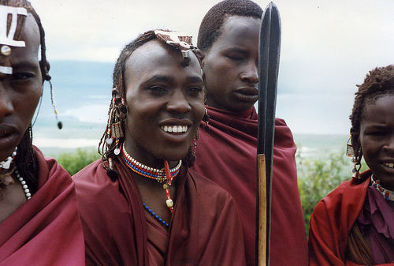
Health risks of fat
Scientific evidence of health risks of trans-fats and saturated fats
Several health risks have been associated to the consumption of these types of fats. Mainly coronary heart diseases where coronary arteries become partially blocked by fatty deposits. The blood supply to the heart muscle is stopped leading to heart attacks.
There are some exception to this rule. The Masai tribe in Kenia has a diet very rich in saturated and trans fats but there is almost no incidence of coronary heart diseases.
LINK

Slide 31
Health risks of fat
Scientific evidence of health risks of trans-fats and saturated fats
In mediterreanean countries the diet often contains
LINK

Slide 32
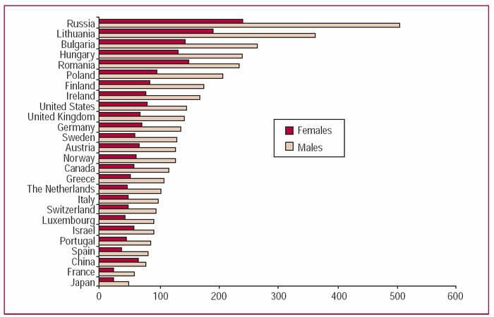
Rates per 100 000 inhabitants of people suffering from coronary heart disease

Slide 33
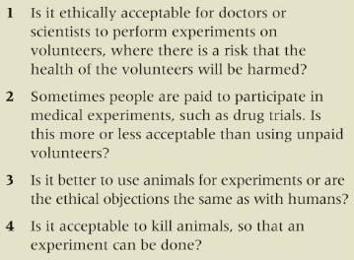
Activity
Pg 84 – Nature of science question: Using volunteers in experiments
Read the text on page 84.
TIP
Use the instructions on pg 85 for your next evaluation of a lap report. They might come in handy!

Slide 34
Activity
Pg 84 – Nature of science question: Using volunteers in experiments

Slide 35
Topic 2 Molecular biology
2.3 Carbohydrates and lipids

