Slide 1
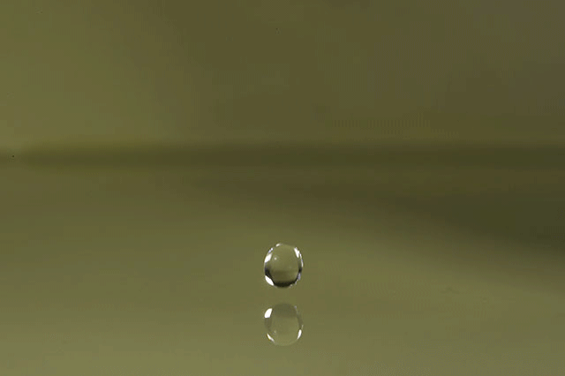
Topic 2 Molecular biology
2.2 Water

Slide 2
Nature of science
Use theories to explain natural phenomena—the theory that hydrogen bonds form between water molecules explains the properties of water. (2.2)
Understandings:
Water molecules are polar and hydrogen bonds form between them.
Hydrogen bonding and dipolarity explain the cohesive, adhesive, thermal and solvent properties of water.
Substances can be hydrophilic or hydrophobic.

Slide 3
Applications and skills
Application: Comparison of the thermal properties of water with those of methane.
Application: Use of water as a coolant in sweat.
Application: Modes of transport of glucose, amino acids, cholesterol, fats, oxygen and sodium chloride in blood in relation to their solubility in water
ToK
Claims about the “memory of water” have been categorized as pseudoscientific. What are the criteria that can be used to distinguish scientific claims from pseudoscientific claims?
Essential idea: Water is the medium of life.

Slide 4
Some important notes
Students should know at least one example of a benefit to living organisms of each property of water.
Transparency of water and maximum density at 4°C do not need to be included.
Comparison of the thermal properties of water and methane assists in the understanding of the significance of hydrogen bonding in water.

Slide 5
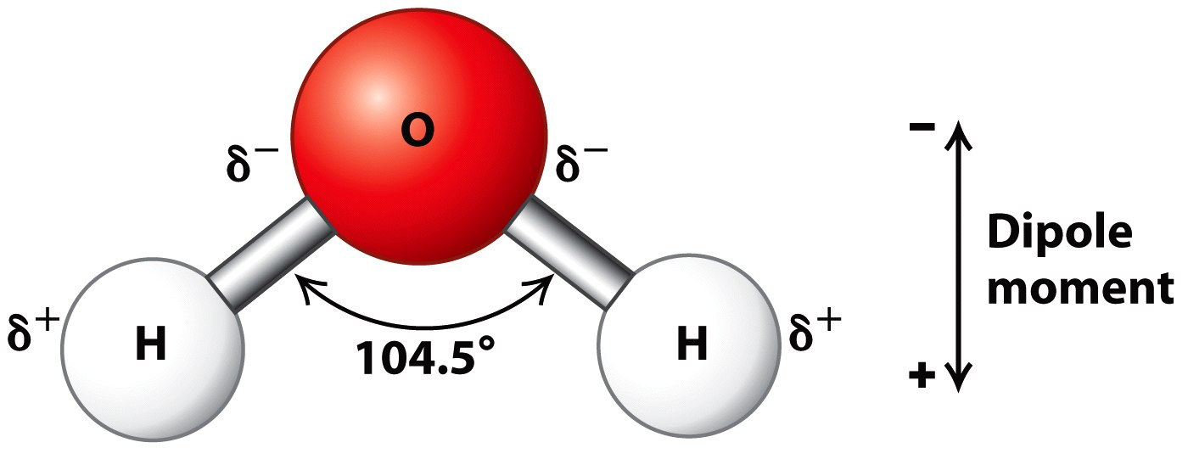
Hydrogen bonding in water
Water molecules are polar and hydrogen bonds form between them.
A molecule of water is made from one atom of oxygen and two atoms of hydrogen. Covalent bonds (sharing of electrons) keeps the atoms together. The structure of a water molecule is fixed: the (small) hydrogen atoms bond
to the (larger) oxygen atom at a fixed angle.

Slide 6
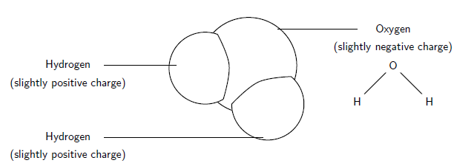
Hydrogen bonding in water
Water molecules are polar and hydrogen bonds form between them.
Although the electrons are shared, oxygen pulls harder at them than hydrogen. This results in a slightly negative oxygen atom and slightly positive hydrogen atoms. Since positive and negative charges attract, there will be an attraction force (hydrogen bond) between the (slightly positive) hydrogen of one water molecule and the (slightly negative) oxygen of the adjacent molecule.
Due to the water molecule having a (slightly) positive and a (slightly) negative side, we can say it has two poles: a positive and a negative pole. That means that water is polar and that polar solutes are likely to dissolve in it, whereas non-polar molecules will not. Hydrogen bonding in water is a result of its polarity.

Slide 7
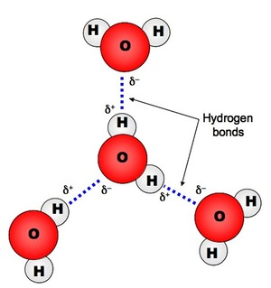
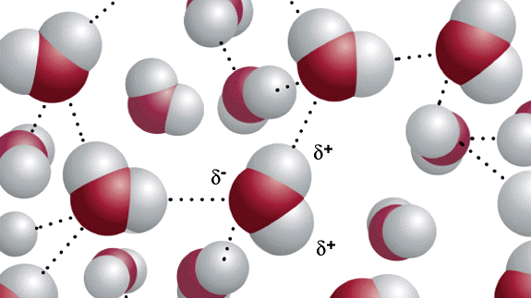
Hydrogen bonding in water
Water molecules are polar and hydrogen bonds form between them.
Hydrogen bonds are not complete chemical bonds. There is no sharing or transferring of electrons. Instead, it is an attraction force between a slightly positive hydrogen atom and a slightly negative oxygen atom. Hydrogen bonds are much weaker than covalent or ionic bonds. They are significant though, because they are very common.

Slide 8
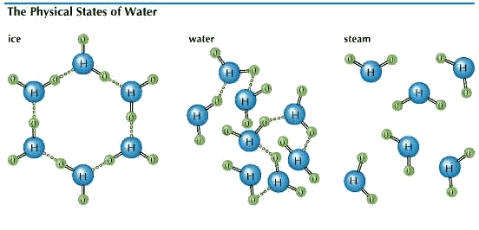
Properties of water
Hydrogen bonding and dipolarity explains the cohesive,
adhesive, termal and solvent properties of water.
The properties of water all come from the fact that it is polar. As a result of its polarity, there are attraction forces between the molecules and this gives water its cohesive properties.
When an object is warmed up, its particles (e.g. molecules) will move faster. This means that they have to break away from cohesion with adjacent molecules more times per minutes. Due to the cohesive properties of water, this takes a lot of energy.
The same goes for evaporation. A water molecule that evaporates, escapes from the liquid and the other water molecules with which it interacted. Again, due to cohesion, this requires a lot of energy.

Slide 9
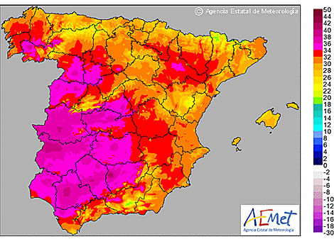
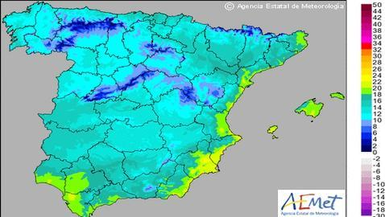
Properties of water
Hydrogen bonding and dipolarity explains the cohesive,
adhesive, termal and solvent properties of water.
Water has a high ‘specific heat capacity’ wich means that water will not warm up much, even when the sun shines on it all day. You know that because when you go to the beach on a warm day, the water is much cooler than the sand. Water needs to take in a lot of energy to go from liquid to gas, this is called the ‘latent heat of vaporisation’. That means that the water evaporating from the sea on a hot day will take up a lot of the energy of the sun shining on it instead of warming up the rest of the water. In winter, water will give off the energy as heat. So, near the sea, the summers are not as hot and the winters not as cold.
Spain in summer
Spain in winter

Slide 10
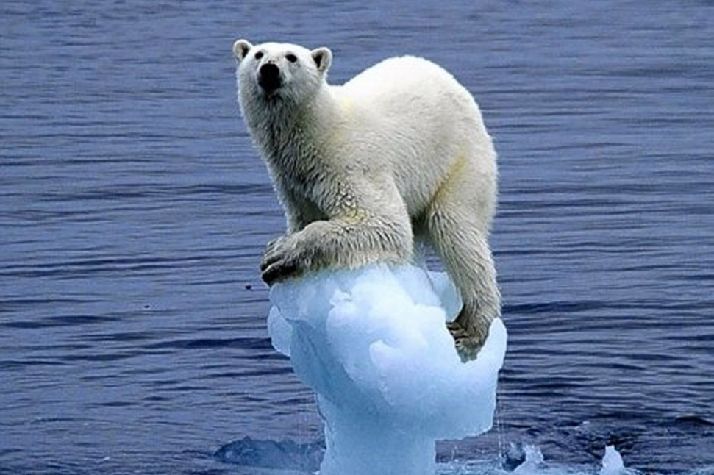
Properties of water
Hydrogen bonding and dipolarity explains the cohesive,
adhesive, termal and solvent properties of water.
High boiling points.
The boiling point of a substance is at the temperature at which it changes from a liquid to a gaseous state. Water has a high latent heat for vaporisation, so naturally its boiling point is also high.
As the range of temperatures at which water is liquid is large, between 0ºC and 100ºC, we find water in most of the ecosystems on Earth.

Slide 11
Properties of water
Hydrogen bonding and dipolarity explains the cohesive,
adhesive, termal and solvent properties of water.
Water is a very good solvent and can dissolve many solids and gases. This property is very important in living things because it acts as a medium for reactions and also a medium for transport of materials around the body, particularly in the blood and lymph systems.
This animation revises the properties of water well

Slide 12
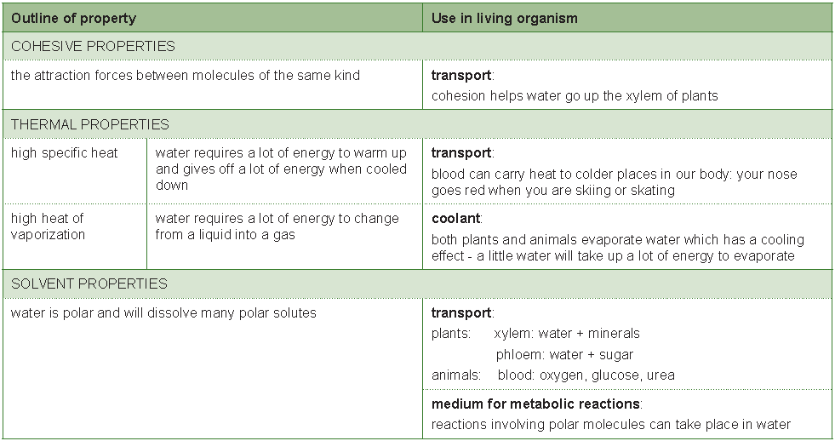
A summary

Slide 13
Hydrophilic and hydrophobic
Substances have hydrophilic and hydrophobic properties
Hydrophilic = water loving Hydrophobic = water fearing
Some substances mix well with water and other don’t, this makes the hydrophilic or hydrophobic. All substances you can dissolve in water, including polar molecules like glucose, or particles with a positive or negative charge, like sodium or chloride are hydrophilic.
Substances without a charge or no polarity simply don’t ‘stick’ to the water molecules and therefore won’t mix. Lipids like fats and oils are good examples.
If non polar molecules are added to water then the molecules will form hydrogen bonds between themselves but not with the water.
The force between the water molecules will always be stronger than the force between the non polar molecules, so the non polar molecules are attracted to each other form every time larger groups.
The forces that join non-polar molecules to each other into groups in water are called hydrophobic attractions.
LINK

Slide 14
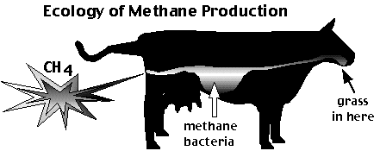
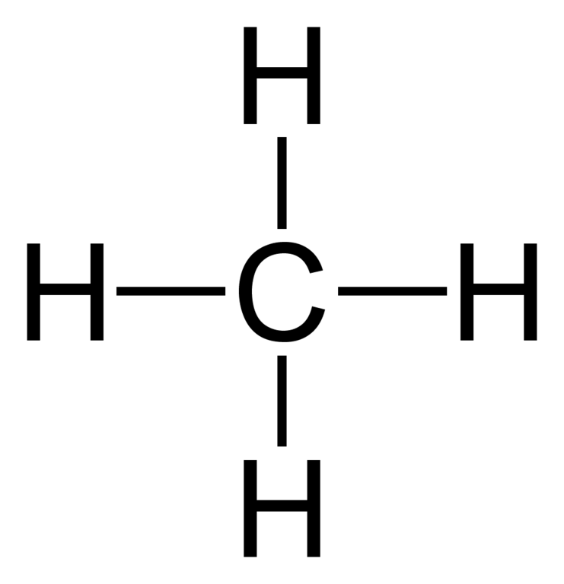
Comparing water and methane
Comparing between the termal properties of water and those of methane
Methane is the waste product of anaerobic respiration, many bacteria produce it and they are present in lot’s of ecosystems, like in the gut of vertebrates.
LINK
Methane can be used as a fuel but if it accumulates in the atmosphere it contributes to the greenhouse effect too.

Slide 15
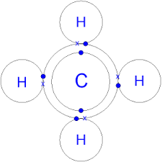
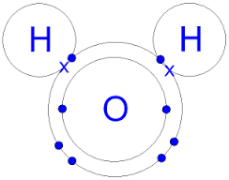
Comparing water and methane
Comparing between the termal properties of water and those of methane
Both water and Methane are small molecules, made by small atoms which are linked by covalent bonds.
The difference is that water is polar and forms hydrogen bonds, as methane is non-polar it cannot form hydrogen bonds, this changes their physical properties.

Slide 16
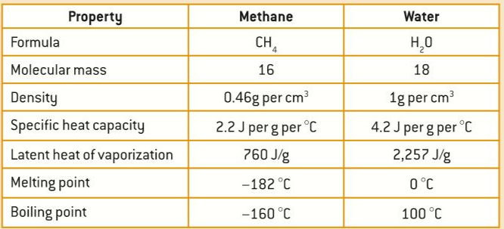
Comparing water and methane
Comparing between the termal properties of water and those of methane
Both water and Methane are small molecules, made by small atoms which are linked by covalent bonds.
The density of Methane is much lower
The specific heat capacity of water is much higher
The latent heat of vaporization of water is much higher
The boiling and melting points of water are much higher

Slide 17
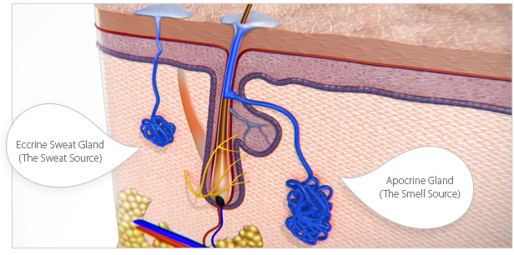
Cooling the body with sweat
Use of water as a coolant in sweat.
Sweat is secreted through the skin by sweat glands as you see below.
The heat needed for evaporation of the water is taken from the skin, and the blood below the skin cools down. Some solutes present in sweat, like sodium, are left behind and give a salty taste to your skin.

Slide 18
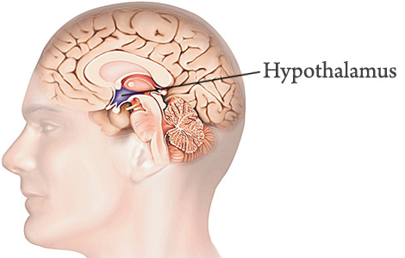
Cooling the body with sweat
Use of water as a coolant in sweat.
The order for sweat to be secreted comes from the hypothalamus in the brain. There are receptor to monitor the temperature of the blood and of the skin. You can secrete up to two litres of sweat per hour.
Usually the threshold temperature for sweat is higher than your body temperature but under the influence of adrenaline sweat can be made too, this is called ‘cold sweat’. Panting in dogs works with the same principle.

Slide 19
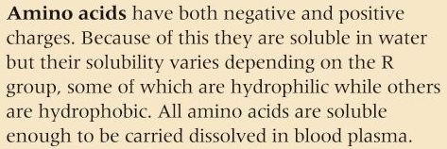
Transport in blood plasma
Methods of transport of glucose, amino acids, cholesterol, oxygen, fats and sodium chloride in blood in relation to their solubility in water.
Blood transports a wide variety of substances using various method and always ensuring they reach the destination in the right amounts.

Slide 20
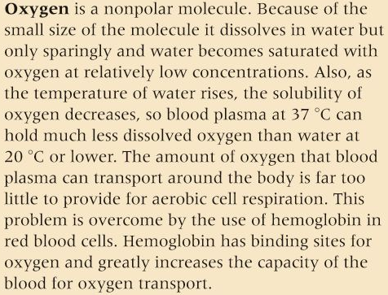
Transport in blood plasma
Methods of transport of glucose, amino acids, cholesterol, oxygen, fats and sodium chloride in blood in relation to their solubility in water.
Blood transports a wide variety of substances using various method and always ensuring they reach the destination in the right amounts.

Slide 21
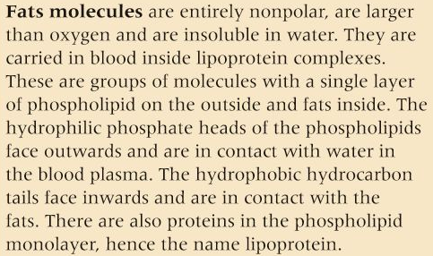
Transport in blood plasma
Methods of transport of glucose, amino acids, cholesterol, oxygen, fats and sodium chloride in blood in relation to their solubility in water.
Blood transports a wide variety of substances using various method and always ensuring they reach the destination in the right amounts.

Slide 22
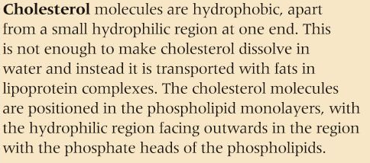
Transport in blood plasma
Methods of transport of glucose, amino acids, cholesterol, oxygen, fats and sodium chloride in blood in relation to their solubility in water.
Blood transports a wide variety of substances using various method and always ensuring they reach the destination in the right amounts.

Slide 23
Topic 2 Molecular biology
2.2 Water

