Slide 1
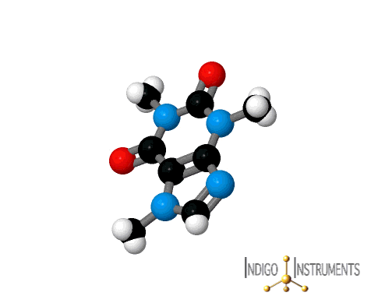
Topic 2 Molecular biology
2.1 Molecules to metabolism

Slide 2
Nature of science
Falsification of theories—the artificial synthesis of urea helped to falsify vitalism. (1.9)
Understandings:
Molecular biology explains living processes in terms of the chemical substances involved.
Carbon atoms can form four covalent bonds allowing a diversity of stable compounds to exist.
Life is based on carbon compounds including carbohydrates, lipids, proteins and nucleic acids.
Metabolism is the web of all the enzyme-catalysed reactions in a cell or organism.
Anabolism is the synthesis of complex molecules from simpler molecules including the formation of macromolecules from monomers by condensation reactions.
Catabolism is the breakdown of complex molecules into simpler molecules including the hydrolysis of macromolecules into monomers.

Slide 3
Applications and skills
Application: Urea as an example of a compound that is produced by living organisms but can also be artificially synthesized.
Skill: Drawing molecular diagrams of glucose, ribose, a saturated fatty acid and a generalized amino acid.
Skill: Identification of biochemicals such as sugars, lipids or amino acids from molecular diagrams.
ToK
A number of scientific discoveries are claimed to be incidental or serendipitous. To what extent might some of these scientific discoveries be the result of intuition rather than luck?
Essential idea: Cell division is essential but must be controlled

Slide 4
Some important notes
Only the ring forms of D-ribose, alpha–D-glucose and beta-D-glucose are expected in drawings.
Sugars include monosaccharides and disaccharides.
Only one saturated fat is expected and its specific name is not necessary.
The variable radical of amino acids can be shown as R. The structure of individual R-groups does not need to be memorized.
Students should be able to recognize from molecular diagrams that triglycerides, phospholipids and steroids are lipids. Drawings of steroids are not expected.
Proteins or parts of polypeptides should be recognized from molecular diagrams showing amino acids linked by peptide bonds.

Slide 5
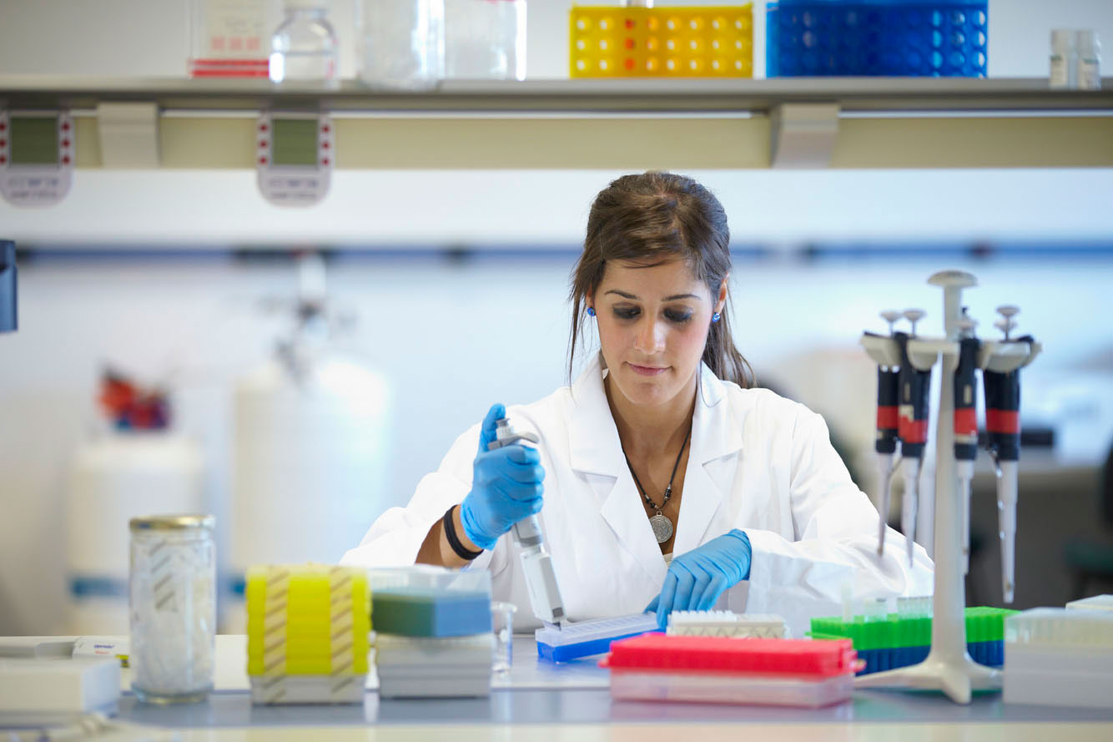
Molecular biology
Molecular biology explains lving processes in terms of the chemical substances involved.
Biological processes can be explained from their structure and the interaction between them. Biological molecules are very diverse and the interactions between them are very complex. The science studying the functioning of biomolecules is called molecular biology.

Slide 6
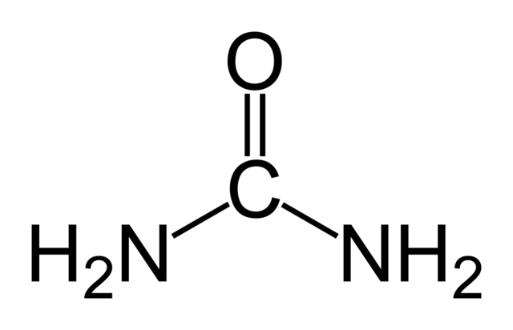
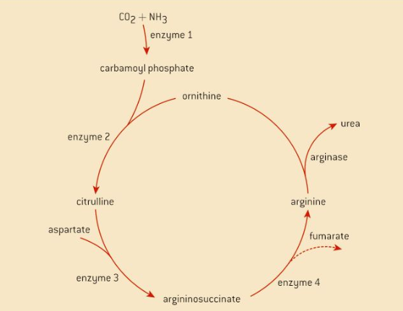
Synthesis of Urea
Urea is a nitrogen containing compound with a relatively simple structure.
It is a component of urine, where it first was discovered. It is released when there is an excess of amino acids in the body. A cycle of reactions, catalysed by enzymes, takes place to produce it. This production takes place in the liver, from there it will be transported to the blood where the kidneys filter it out and add it to the urine, which is stored later in the bladder.

Slide 7
Urea and the falsification of vitalism
In the 18th century it was believed organic molecules could only be made with the help of a vital principle. The theory of vitalism say that ‘The origin and phenomena of life are due to a vital principle, differently from pure physical and chemical forces’.
Urea was the first chemical compound to be synthesised artificially. This was a big step because no vital principle was used in the process.
It was clear now that if urea could be made without a vital principle than other organic compounds could as well. The theory of vitalism was falsified. Still, like always when this happens, it took a while for the scientific community to accept this (think about the evolution theory of Darwin).
LINK

Slide 8
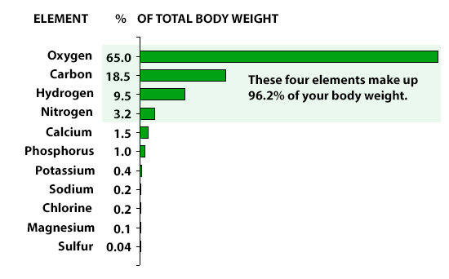
Carbon compounds
Carbon atoms can form four bonds, allowing a diversity of compounds to exist
Carbon is not the most abundant element on Earth, it only occupies the 15th place, but it is present in many molecules as it allows for the formation of a large diversity.
Carbon atoms form covalent bonds (bonds in which the electrons are shared between the atoms in the molecule, like H₂O). Covalent bonds are the strongest bonds so very stable molecules are produced. If you burn any type of organic material, only carbon will be left.

Slide 9
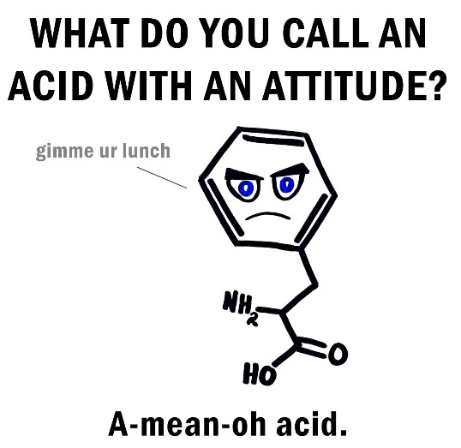
Draw the following molecular diagrams:
Glucose
Ribose
A saturated fatty acid
A generalized amino acid

Slide 10
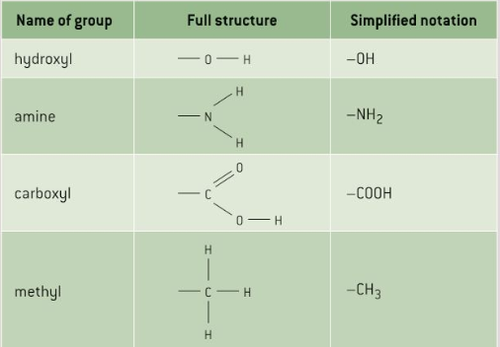
Drawing compounds

Slide 11
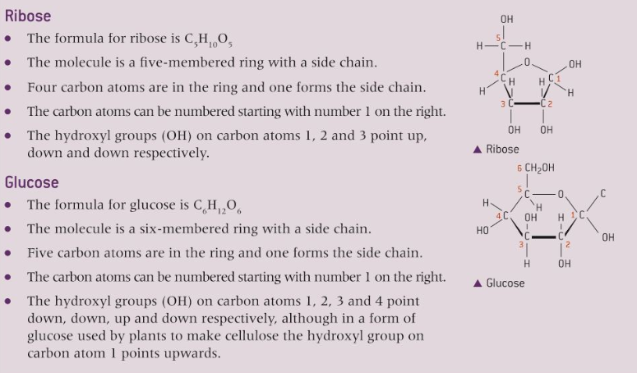
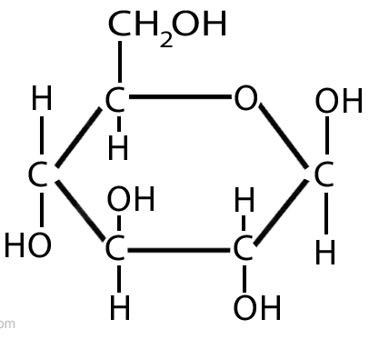
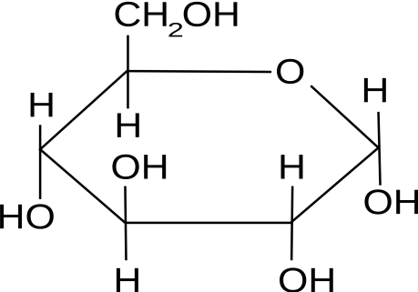
Drawing compounds
β D - Glucose
α D - Glucose

Slide 12
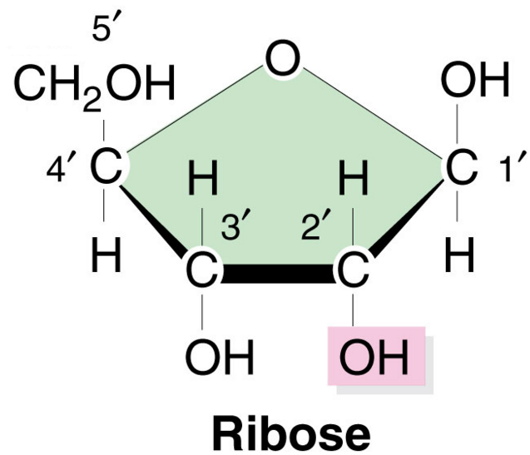
Drawing compounds

Slide 13
Drawing compounds
b D - Glucose
α D - Glucose

Slide 14
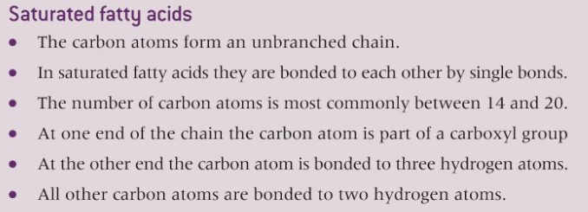
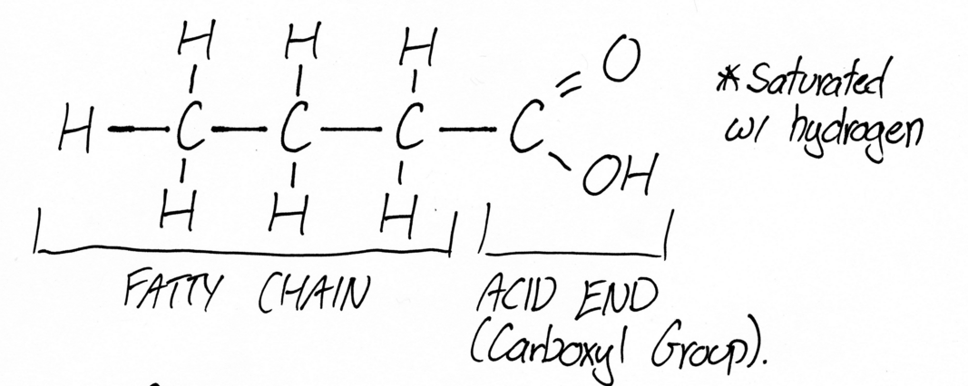
Drawing compounds

Slide 15
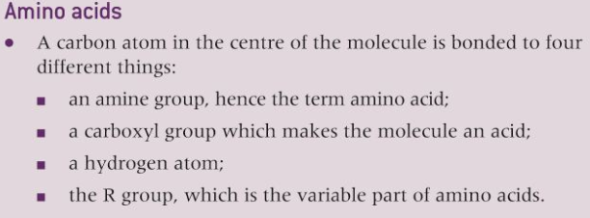
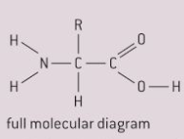
Drawing compounds
Amine group
Carboxyl group

Slide 16
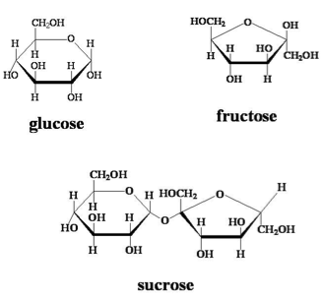
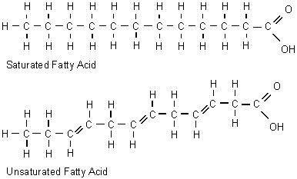
Carbon compounds
Carbon atoms can form four bonds, allowing a diversity of compounds to exist
The bonds can be made with other carbon atoms and make rings, like in sugars, or chains, like in fatty acids.

Slide 17
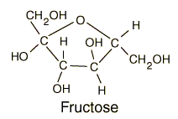
Classifying carbon compounds
Life is based on carbon compounds, including, carbohydrates,
lipids, proteins and nucleic acids
Carbohydrates
They are composed of carbon, hydrogen and oxygen. The ratio between carbon and hydrogen atoms is 2 hydrogen atoms to 1 carbon atom. This is where the name carbohydrate comes from.
Examples of monosaccharides include:
glucose
fructose
galactose
Examples of dissaccharides are:
maltose
sucrose
lactose
Examples of polysaccharides are:
starch
glycogen
cellulose

Slide 18
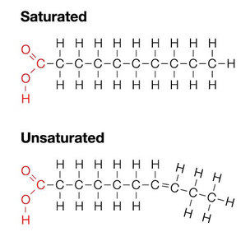
Classifying carbon compounds
Life is based on carbon compounds, including, carbohydrates,
lipids, proteins and nucleic acids
Lipids
A broad class of molecules which are insoluble in water. These includes steroids, waxes, fatty acids, triglycerides. Triglycerides are fats which are solid at room temperature and oils if they are liquid at room temperature.

Slide 19
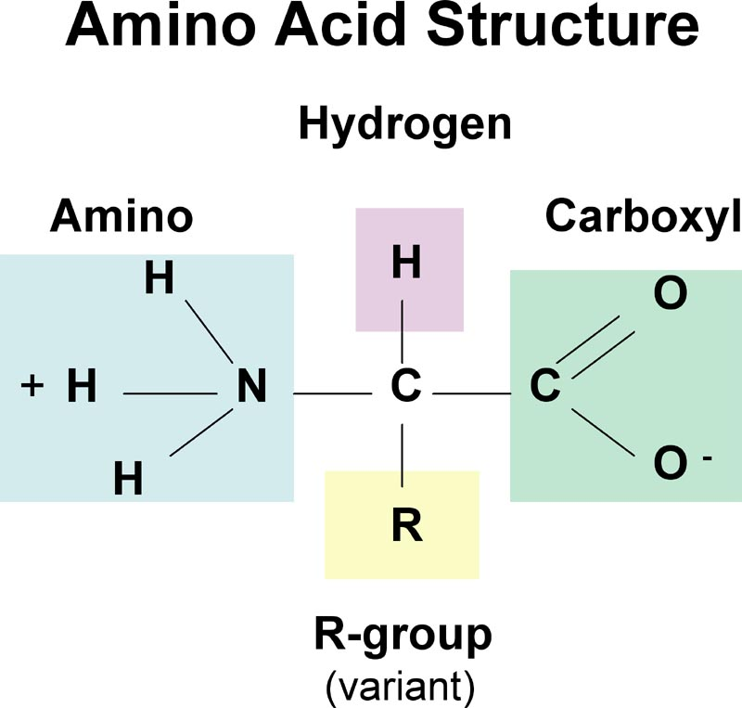
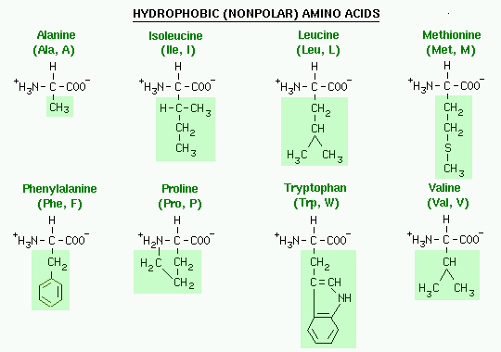
Classifying carbon compounds
Life is based on carbon compounds, including, carbohydrates,
lipids, proteins and nucleic acids
Proteins
They are composed out of two or more amino acids. All these amino acids contain, carbon, oxygen, hydrogen and nitrogen. There are two of the twenty amino acids which contain also sulphur.

Slide 20
Classifying carbon compounds
Life is based on carbon compounds, including, carbohydrates,
lipids, proteins and nucleic acids
Proteins
They are composed out of two or more amino acids. All these amino acids contain, carbon, oxygen, hydrogen and nitrogen. There are two of the twenty amino acids which contain also sulphur.

Slide 21
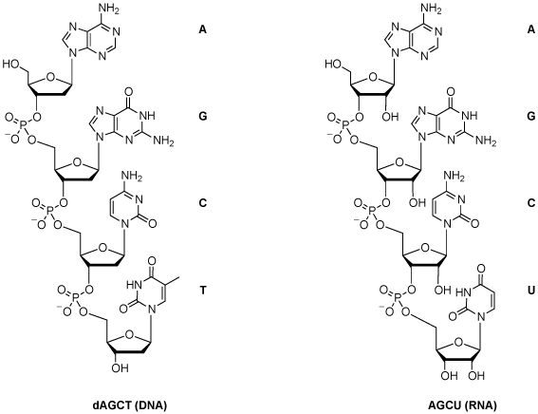
Classifying carbon compounds
Life is based on carbon compounds, including, carbohydrates,
lipids, proteins and nucleic acids
Nucleic acids
They are chains of subunits called nucleotides. They contain carbon, oxygen, hydrogen, nitrogen and phosphorus. The most common nucleic acids are RNA (ribonucleic acid) and DNA (deoxyribonucleic acid).

Slide 22
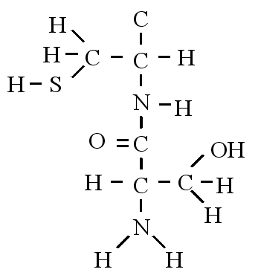
Identifying molecules
It is not difficult to identify the different biomolecules
Proteins contain CHON, carbohydrates and lipids only CHO
Many proteins contain sulphur, carbohydrates and lipids don’t
Carbohydrates contain H and O in a ratio of 2:1 (ex. C₆H₁₂O₆, or C₅H₁₀O₅)
Lipids contain less oxygen than carbohydrates

Slide 23
Metabolism Metabolism is the web of all the enzyme catalysed reactions in a cell or organism
All chemical reactions taking place in a cell are catalysed (speeded up) by enzymes. Most happen in the cytoplasm but some are extra cellular, like the enzymes excreted in your digestive system which break down the biomolecules of your food. So, metabolism is the sum of all the chemical reactions in a cell or organism. The thyroid plays an important role in your metabolism: LINK
Metabolism is usually perform in a series of steps, breaking down big molecules into small ones (catabolism) or constructing molecules (anabolism).
Metabolic reactions can be extremely complex
LINK

Slide 24
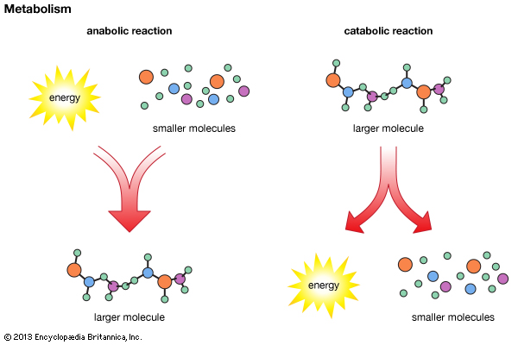

Slide 25
Anabolism

Slide 26
Catabolism

Slide 27
Topic 2 Molecular biology
2.1 Molecules to metabolism

