Slide 1

Topic 2 Cells
2.1 Cell Theory

Slide 2
Assessment statements
2.1.1 Outline cell theory
2.1.2 Discuss the evidence for the cell theory
2.1.3 State that unicellular organisms carry out all functions of life
2.1.4 Compare the relative sizes of molecules, cell membranes thickness, viruses, bacteria, organelles and cells, using the appropriate SI unit.
2.1.5 Calculate the linear magnification drawings and the actual size of specimens in images of known magnification.
2.1.6 Explain the importance of the surface area to volume ratio as a factor of limiting cell size.
2.1.7 State that multicellular organisms show emergent properties.
2.1.8 Explain that cells in multicellular organisms differentiate to carry out specialized functions by expressing some of their genes but not others.
2.1.9 State that stem cells retain the capacity to divide and have the ability differentiate along different pathways.

Slide 3
2.1.1 Outline cell theory
2.1.2 Discuss the evidence for the cell theory
There are three main principles of the cell theory:
All organisms are composed of one or more cells
Cells are the smallest units of life
All cells come from pre-existing cells
Although it is called a theory it has a tremendous credibility. Especially after the invention of the first microscope.
1590 -The Dutch optician Zacharias Jansen invents the compound microscope.
1665-The Englishman Robert Hooke studies cork with a compound microscope and names the structures ‘cells’.
1675- Another Dutchman, Antonie van Leeuwenhoek, discovers unicellular organisms.
1838- Mathias Schleiden from Germany suggests that all plants were made of cells.
1839 - Theodor Schwann, also from Germany, suggests that all animals were also made of cells.
1840 – The Czech Jan Evangelista Punkinje names the cell content ‘protoplasm’.
1855 – Rudolf Virchow from Germany suggests that ‘All cells come from existing cells’.

Slide 4
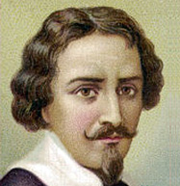
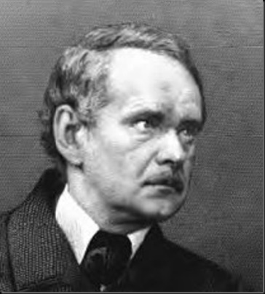
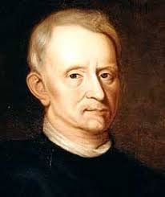
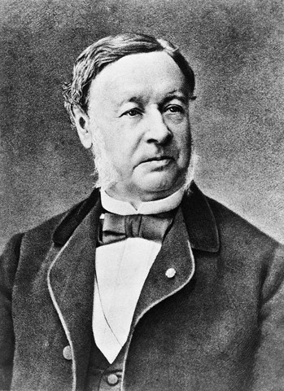
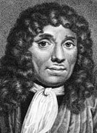
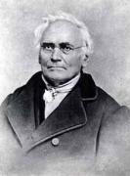
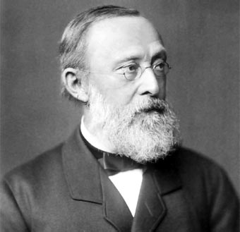
2.1.1 Outline cell theory
2.1.2 Discuss the evidence for the cell theory
1590 -The Dutch optician Zacharias Jansen
1665-The Englishman Robert Hooke
1675- Another Dutchman, Antonie van Leeuwenhoek
1838- Mathias Schleiden from Germany
1839 - Theodor Schwann, also from Germany
1840 – The Czech Jan Evangelista Punkinje
1855 – Rudolf Virchow from Germany

Slide 5
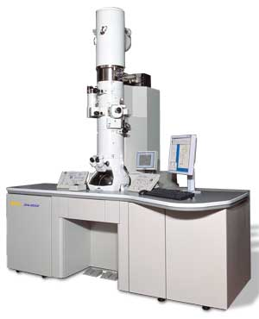
2.1.1 Outline cell theory
2.1.2 Discuss the evidence for the cell theory
Although it is called a theory it has a tremendous credibility.
The cell theory is widely accepted and advances in
technology have allowed us to greatly increase our
knowledge of cells. In particular the development of the
electron microscope (EM) has allowed us to study the
ultra structure of cells (see Topic 2.3) in more detail than
Robert Hooke could ever have imagined.
Video

Slide 6
2.1.3 State that unicellular organisms carry out all functions of life
All organisms exist either in a unicellular or a multicellular form. And all organisms carry out all functions of life. These functions include:
Metabolism. Includes all chemical reactions which occur in an organism.
Growth. Growth may be limited but is always evident in one way or another.
Reproduction. Involved hereditary molecules that can be passed on to offspring.
Response. Response to the environment is imperative to the survival of the organism.
Homeostasis. Refers to maintaining a constant internal environment, like temperature or acid-base levels.
Nutrition. Is all about providing a constant source of compounds with many chemical bonds which can be broken to provide the organism with energy and the nutrients necessary to maintain life.

Slide 7
Cells and sizes
2.1.4 Compare the relative sizes of molecules, cell membranes thickness, viruses, bacteria, organelles and cells, using the appropriate SI unit.
When we talk about cells we need to use units probably unfamiliar to you because of their, and especially their organelles’, extremely small sizes.
As you know, a millimetre is a thousand of a meter, so 1 m=1000 mm
When we refer to cell and organelle sizes we use micrometres (µm)
µ is called ‘Micro sign’ in Office
1 millimetre (mm) = 1000 micrometres (µm)
1 micrometre (µm) = 1000 nanometres (nm)
Most cells are up to 100 micrometres
Organelles are up to 10 micrometres
Bacteria are up to 1 micrometre
Viruses are up to 100 nanometres
Membranes are 10 nanometres thick
Molecules are near 1 nanometre

Slide 8
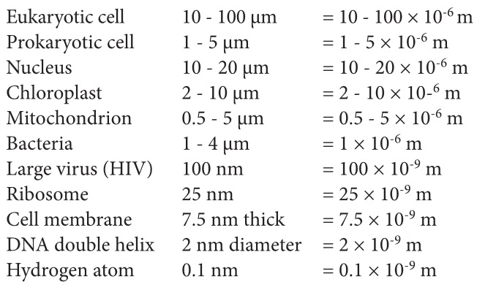
Some examples

Slide 9

The Scale of the Universe

Slide 10
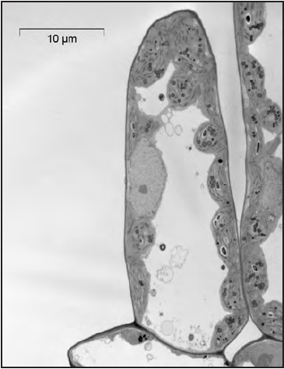
2.1.5 Calculate the linear magnification drawings and the actual size of specimens in images of known magnification.
Diagrams and photographs can be shown larger or smaller than reality. To indicate the real size of the object, the magnification can be indicated next to the diagram or picture or a scale bar can be given.
Magnification 2x
The size of the bar is 10µm, so 10x10⁻⁶m.
How large is the cell?

Slide 11
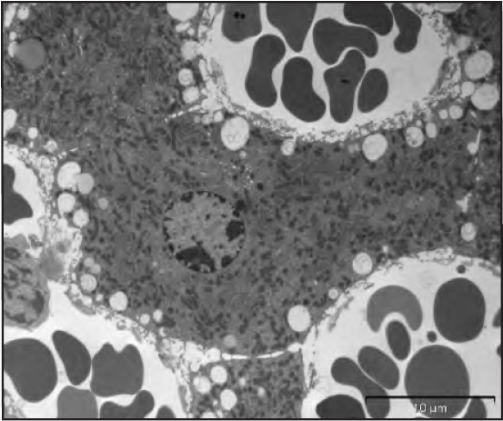
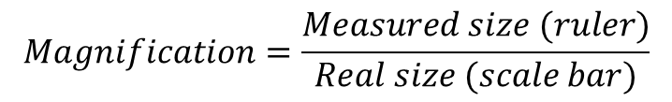

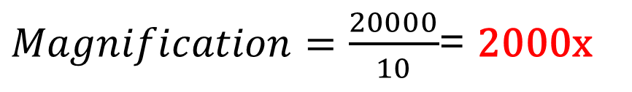
Calculating the magnification
To calculate the magnification used to establish the image on the right you need to apply a very simple formula;
Be able to turn around the formula and calculate it the other way around as well. So:
$$Magnification=\frac{Measured size (ruler)}{Real size (scale bar)}$$
$$Magnified size=Real size x magnification$$
The real size of the scale bar is 10 µm.
The measured size with a ruler would be 20 mm.
$$Real size=\frac{Magnified size (ruler)}{Magnification}$$
$Magnification=\frac{20000}{10}$= 2000x
10 µm

Slide 12
Off course you use the same procedure to calculate the size of organelles you observe on the image.
If you want to calculate the size of the nucleus of the liver cell you see on the image, you use the same magnification you just calculated.
So real size: = 14 mm or 14000 µm
= 14000 µm/2000
= 7 µm
10 µm

Slide 13
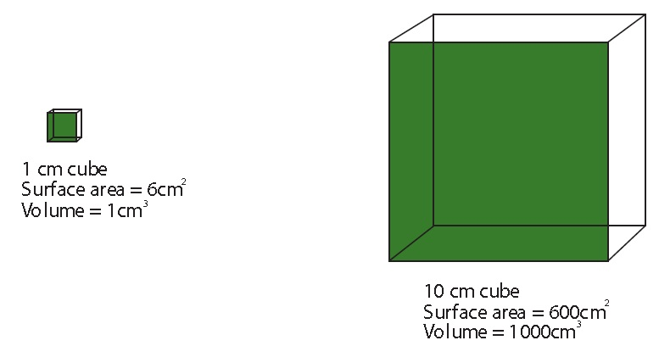
2.1.6 Explain the importance of the surface area to volume ratio as a factor of limiting cell size.
The size of a cell is limited by its need to exchange materials with its environment. If a cell becomes too large, its diffusion distance becomes too long to be efficient and its surface to volume ratio becomes too small to allow the necessary exchange.
The surface area is larger than the volume.
Surface to volume ratio = 6:1
The surface are is smaller than the volume.
Surface to volume ratio = 0,6:1

Slide 14
The rate with which a cell produces heat/waste and consumes resources (food/oxygen) is directly proportional to its volume. However, since the uptake of resources and the removal of heat/waste goes via the cell membrane, the rate of uptake/removal is proportional to its surface area.
The surface area is larger than the volume.
Surface to volume ratio = 6:1
The surface are is smaller than the volume.
Surface to volume ratio = 0,6:1
So a volume of 1cm³ has a surface area of 6 cm² in the small cube, and a volume of 1cm³ in the big cube only of 0.6cm², so a tenth the amount.

Slide 15
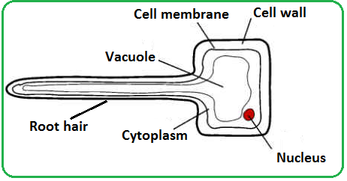
Some statements regarding surface area to volume ratio:
as size increases both surface area and volume increase, but volume increases more
ratio of surface area to volume decreases as size of cell increases
rate of metabolism is a function of its mass to volume ratio
surface area limits/affects the rate at which substances can enter (or leave) the cell.
volume determines the rate at which material is produced/used
oxygen/nutrients/substances will take too long to diffuse into/out of the centre of the cell if it is too big
excretory products would take too long to be eliminated
heat will take too long to be eliminated
example of cell adaptation to increase the ratio of surface area:volume e.g. root hair cell;

Slide 16
Check out this animation to understand the concept a bit better
LINK

Slide 17
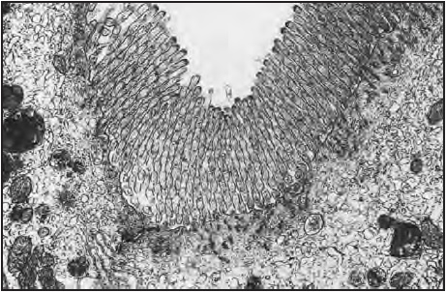
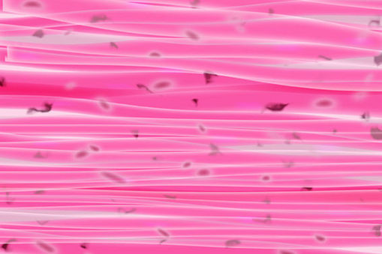
Ways of dealing with volume surface area ratios.
Increasing the surface area is the best way to facilitate a proper diffusion of substances through the cell membrane. Cells do that by:
Having protruding extensions
For example the epithelium of the gut has small extensions to increase the surface area and facilitate the absorption of substances in the blood.
Flattening the cells.
This makes the diffusion distance much smaller, like the muscle cells on the image.
Link to image

Slide 18
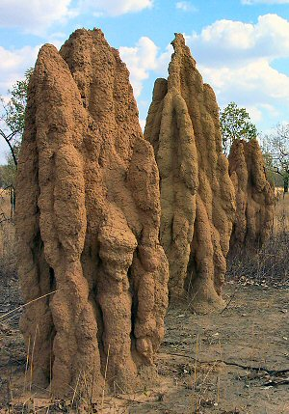
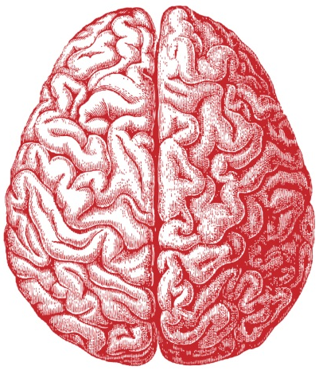
2.1.7 State that multicellular organisms show emergent properties.
Emergent properties are those where the whole is more than the sum of their parts.
LINK
A termite can not live alone, only with the cooperation of thousands they can survive.
The same counts for the neuron, millions are needed to make the brain operational.
The levels of life can also be considered emergent properties. Each level emerges form a level below. Organelles cooperate to form cells, cells to form tissues, tissues to form organs, organs to form organ systems, organs systems to form the organism.
Link to image
Link to image

Slide 19

2.1.7 State that multicellular organisms show emergent properties.
Multicellular organisms show emergent properties. This means that the organism can achieve more than the sum of what each cell could achieve individually. This is caused by the fact that cells interact, allowing them to perform tasks together that they not achieve, even in part, if they
were alone.

Slide 20
2.1.8 Explain that cells in multicellular organisms differentiate to carry out specialized functions by expressing some of their genes but not others.
Cells duplicate by the process of mitosis. As you have learned before, mitosis ends with two exact copies of the mother cell.
Remember that your life has started as just one first cell, the zygote. That cell divided, copying the same DNA over and over again to the multicellular creature you are today.
So each cell in your body contains exactly the same genetic information (with the exception of tiny mutations here and there).
But clearly you brain is different from your skin, how is this possible?
Cell division

Slide 21
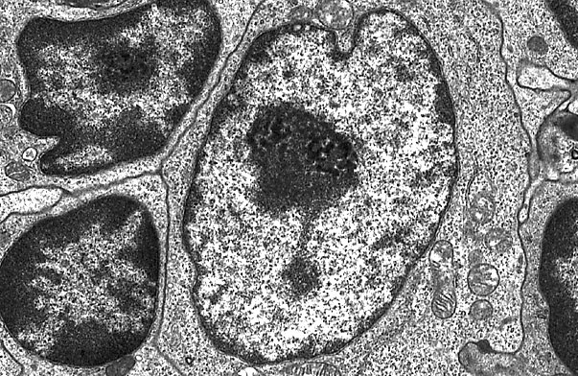
2.1.8 Explain that cells in multicellular organisms differentiate to carry out specialized functions by expressing some of their genes but not others.
So cells differentiate by expression of some of their genes and not others. The genes which are not expressed by the cell, remain present in the nucleus but are packed away so tightly that they cannot be accessed.
Euchromatin is light grey when viewed with an EM, and heterochromatin is dark grey.
Euchromatin often
represents the genes that are used (transcribed), while heterochromatin tends to contain the inactive genes.
Link to image

Slide 22
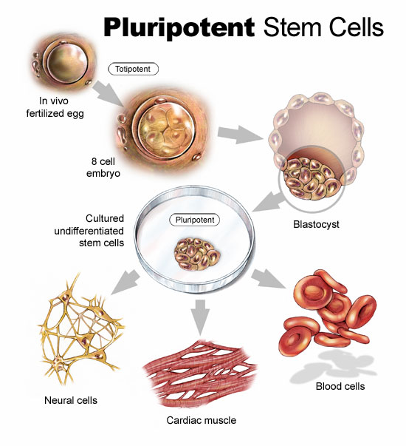
2.1.9 State that stem cells retain the capacity to divide and have the ability differentiate along different pathways.
Stem cells are the cells of an organism that are not specialised for any function. They can multiply actively maintaining that state, and are able to transform into any of the 200 cell types that an adult has (heart, nerve, kidney, etc).
All animals and vegetables possess stem cells in maturity (they can be obtained from tissues such as bone marrow, the umbilical cord or the liver), but they are abundant in embryos and fetuses.
Stem cells were first isolated in 1998.
Link to image

Slide 23
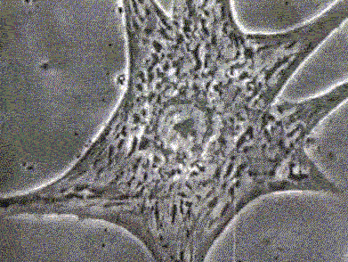
2.1.9 State that stem cells retain the capacity to divide and have the ability differentiate along different pathways.
Stem cells are different from ‘normal’ cells in two ways:
Stem cells are undifferentiated. This means that they have not yet specialised into a certain type of cell. As a result, all (or most) of their genes can still be expressed.
2. Stem cells are self-sustaining. They can divide and
replicate for long periods of time.
The most interesting characteristic of stem cells is their ability to differentiate into specialised cells when given a certain chemical signal.
Theoretically, you could make a stem cell replicate and then differentiate into liver cells and grow a new liver this way.
VIDEO

Slide 24
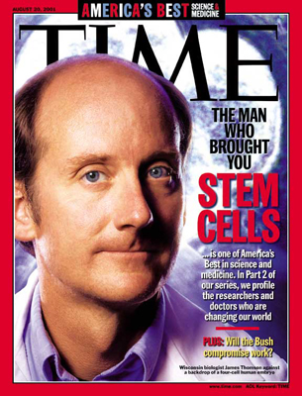
2.1.9 State that stem cells retain the capacity to divide and have the ability differentiate along different pathways.
In reality, research has only been going on since about 1998 when a group led by Dr. James Thomson at the University of Wisconsin developed a technique to isolate and grow the cells. In some countries, stem cell research is restricted by legal measures.
In Denmark, Spain, Sweden and the UK, stem cell research is allowed using cells from embryos less than 14 days old but only Denmark and the UK allow the creation of embryos for research purposes.
Research regulations per European country

Slide 25
2.1.10 Outline one therapeutic use of stem cells.
The therapeutic use of stem cells is sometimes referred to as cell therapy. In cell therapy, cells that do not work well are replaced with healthy, functioning cells.
The most common example of cell therapy is a bone marrow transplant. This technique has been used for more than 40 years. Cells in the bone marrow produce blood cells. People with leukaemia can receive a transplant of healthy, functioning bone marrow which may cure their disease.
Here are some examples for stem cell therapy uses:
Brain damage
Deafness
Cancer
Spinal cord injuries
Heart damage
Blindness
Etc.
VIDEO

Slide 26
Topic 2 Cells
2.1 Cell Theory

