Slide 1
Unjumble the key words from this topic:
OIPLED
IENEGYCTROATVILET
ULOCMLEE
ULOCMLEE
RFOCE
OAANTTTRCI
LEOECRNT
ONN-BGDIONN
PAIARTL
TEEOCTRSLTAIC

Slide 2
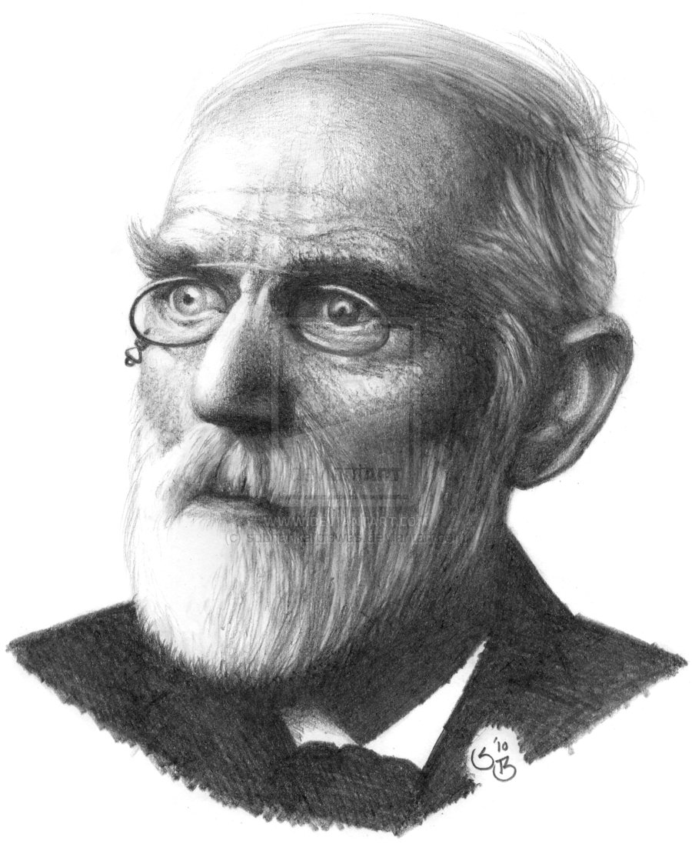
Van der Waals forces
Mr Canning´s words of wisdom – “All molecules have these forces”
Complete the blanks with the words in the box:
A …………. dipole is formed on a molecule due to the …………. movement of the electrons.
This temporary dipole …………. a dipole on any molecule passing close to it.
We now have a temporary dipole and an induced dipole.
There is a ………………. attraction between the 2 dipoles.
These forces of attraction are the ………… of the three.
random
induces
weakest
electrostatic
temporary
Why do bigger molecule have stronger V der W forces of attraction?
Find diagrams of the structures of these molecules and explain which may the highest and lowest boiling point:
Methane
Butane
Methylpropane
Find out the actual boiling points.

Slide 3
Permanent dipole-dipole
Mr Canning´s words of wisdom – “Only polar molecules have these forces”
What does “polar” mean when we talk about molecules?
Work out the difference in negativity between the 2 atoms in each of these molecules using the Pauling scale:
HBr
HCl
HI
Find a graph showing the boiling points of these molecules:
Why do we draw intermolecular forces with dotted lines and NOT solid line?
Find a 3D diagram of tetrafluoromethane (use simulation on http://phet.colorado.edu/en/simulation/molecule-polarity). Why is it not a polar molecule?
Compare the graph with the electronegativity difference:

Slide 4
Hydrogen bonding
Mr Canning´s words of wisdom – “We must have a hydrogen bonded to either an …………… , ……………. or a ……………..”
What is ironic about the term “hydrogen bonding”?
Name 5 molecules that can have hydrogen bonding:
….
….
….
….
….
Delete the incorrect answer:
It is the strongest / weakest intermolecular force.
The O, N or F must have at least 1 lone electron / pair of electrons.
In ammonia, the nitrogen atom has 1 / 2 / 3 lone pairs.
In these molecule the hydrogen has a partial positive / negative charge because the atoms they are bonded to are very electropositive / electronegative.
The H is attracted to / repelled by a lone pair.
Find a diagram showing all the outer electrons in hydrogen chloride:
Does it have any lone pairs? ……
So why do we not get hydrogen bonding?

Slide 5
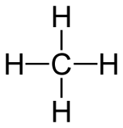
Complete this table by adding the structures of each compound, stating the bonding types and its boiling point.
Compound | Structure | Van der Waals | Permanent dipole-dipole | Hydrogen bonding | Boiling point (ºC)
Methane |  | Yes | No | No | -162
Propane
Hydrogen iodide
Methoxy methane
Ethanol
Water

