Slide 1
Unit 1
Statistical analysis

Slide 2
Assessment Statements |  | Obj.
1.1.1 | State that error bars are a graphical representation of the variability of data. | 1
1.1.2 | Calculate the mean and standard deviation of a set of values Using Excel (Using your graphing calculator) | 2
1.1.3 | State that the term standard deviation (s) is used to summarize the spread of values around the mean, and that 68% of all data fall within (±) 1 standard deviation of the mean. | 1
1.1.4 | Explain how the standard deviation is useful for comparing the means and the spread of data between two or more samples. | 3
1.1.5 | Deduce the significance of the difference between two sets of data using calculated values for t and the appropriate tables. We will also do this with P values using Excel in lab reports. | 3
1.1.6 | Explain that the existence of a correlation does not establish that there is a causal relationship between two variables. | 3

Slide 3
Why are statistics important?
Hans Rosling

Slide 4
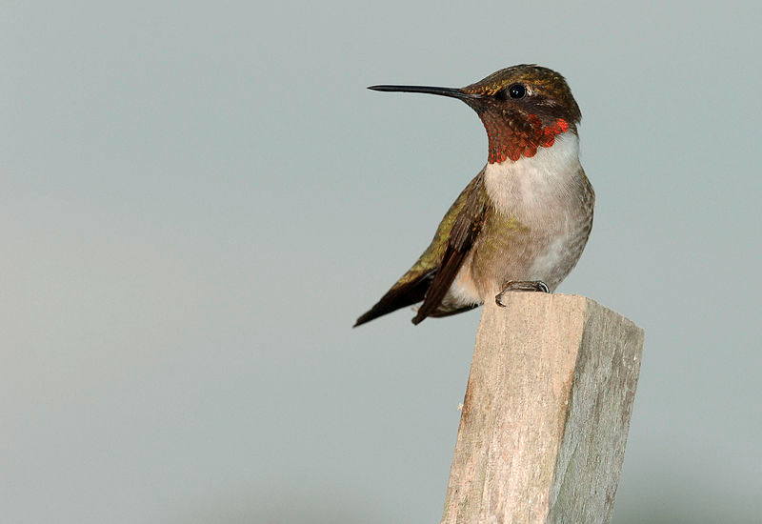
An example
Researchers studying comparative anatomy collect data on bill-length in two species of hummingbirds: Archilochus colubris
(red-throated hummingbird) and
Cynanthus latirostris (broadbilled
hummingbird).
To do this, they need to collect sufficient
relevant, reliable data so they can test
the Null hypothesis (H₀) that:
“there is no significant difference
in bill length between the two species.”
Photo: Archilochus colubris (male), wikimedia commons, by Joe Schneid

Slide 5
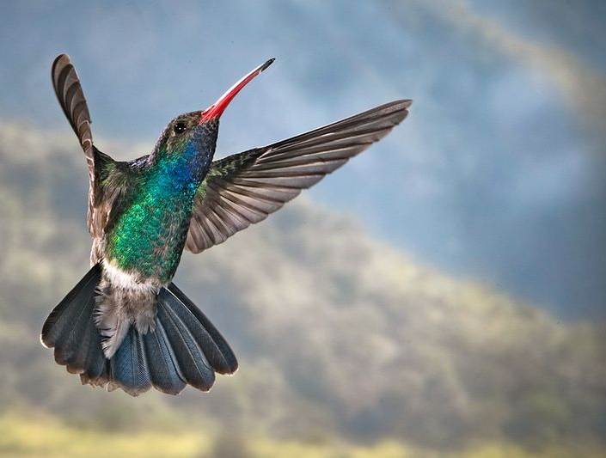
The sample size must
be large enough to provide sufficient reliable data and for us to carry out relevant statistical tests for significance.
We must also be mindful of uncertainty in our measuring tools and error in our results.
Photo: Broadbilled hummingbird (wikimedia commons).

Slide 7
1.1.2 | Calculate the mean and standard deviation of a set of values Using Excel | 2
Definition: The mean is the sum of all values devided by the number of all values
For example, consider the following values: 2; 4; 8; 11; 12; 13; 14; 14; 23; 24
The mean is calculated as follows: $\frac{150}{11}=14$
Download and open table 1 from the website

Slide 8
The mean is a measure of the central tendency
of a set of data.
Calculate the mean using:
Your calculator
(sum of values / n)
Excel
 | Table 1: Raw measurements of bill length in A. colubris and C. latirostris.
 |  | Bill length (1mm)
 | n | A. colubris | C. latirostris
 | 1 | 13,0 | 17,0
 | 2 | 14,0 | 18,0
 | 3 | 15,0 | 18,0
 | 4 | 15,0 | 18,0
 | 5 | 15,0 | 19,0
 | 6 | 16,0 | 19,0
 | 7 | 16,0 | 19,0
 | 8 | 18,0 | 20,0
 | 9 | 18,0 | 20,0
 | 10 | 19,0 | 20,0
 | Mean
 | s
n = sample size. The bigger the better.
In this case n=10 for each group.
All values should be centred in the cell, with decimal places consistent with the measuring tool uncertainty.
=AVERAGE(highlight raw data)

Slide 9
The mean is a measure of the central tendency
of a set of data.
 | Table 1: Raw measurements of bill length in A. colubris and C. latirostris.
 |  | Bill length (±1mm)
 | n | A. colubris | C. latirostris
 | 1 | 13,0 | 17,0
 | 2 | 14,0 | 18,0
 | 3 | 15,0 | 18,0
 | 4 | 15,0 | 18,0
 | 5 | 15,0 | 19,0
 | 6 | 16,0 | 19,0
 | 7 | 16,0 | 19,0
 | 8 | 18,0 | 20,0
 | 9 | 18,0 | 20,0
 | 10 | 19,0 | 20,0
 | Mean | 15,9 | 18,8
 | s
Descriptive table title and number.
Uncertainties must be included.
Raw data and the mean need to have consistent decimal places (in line with uncertainty of the measuring tool)

Slide 10
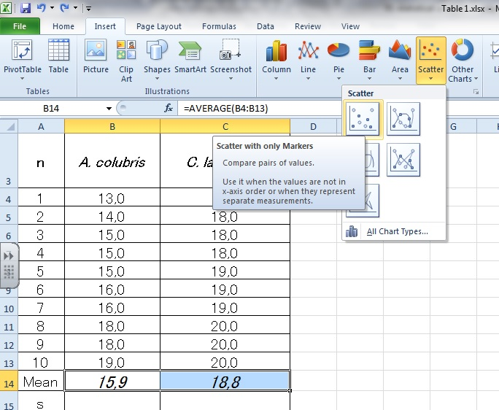

Slide 11
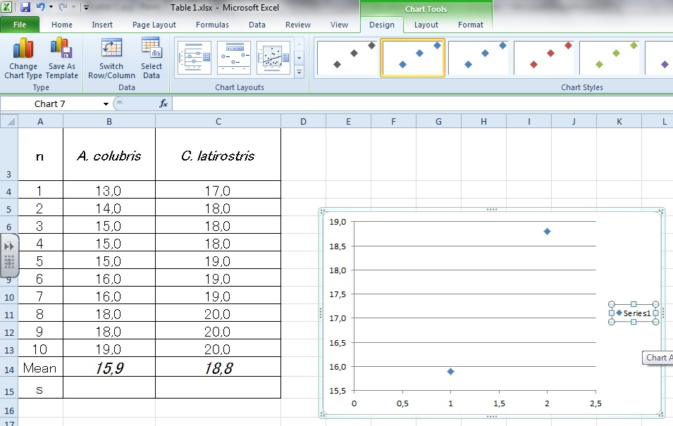
DELETE
Delete

Slide 12
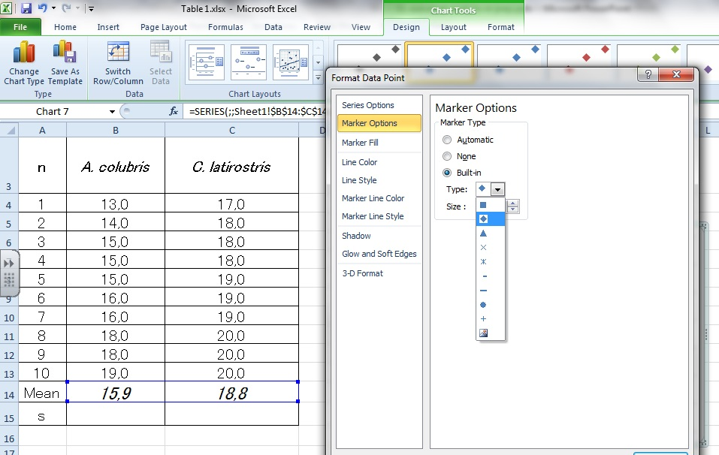
Double click on
a marker to format.
Select the cross

Slide 13
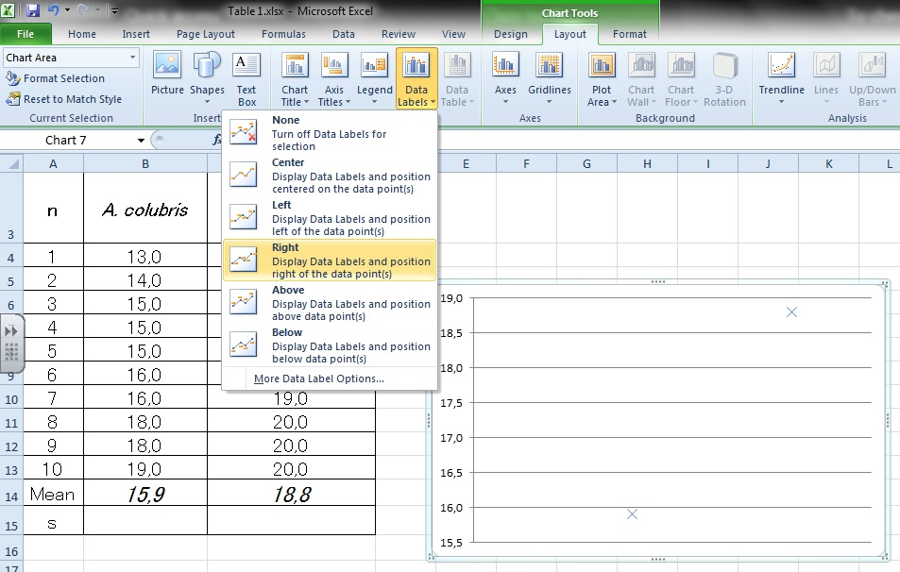

Slide 14
Try to get these done!
Descriptive title, with graph number.
Labeled point
Y-axis clearly labeled, with uncertainty.
Make sure that the y-axis begins at zero.
x-axis labeled

Slide 15
From the means alone you might conclude that C. latirostris has a longer bill than A. colubris.
But the mean only tells part of the story.

Slide 20
1.1.2 | Calculate the mean and standard deviation of a set of values Using Excel | 2
Definition: The standard deviation summarises the spread of data around the mean
The standard deviation measures how widely spread the vales in a set of data are.
If the data points are close to the mean, then the standard deviation is small.
Conversely, if many data points are far from the mean, then the standard deviation is large.
If all values are equal, then the standard deviation is zero.

Slide 21
1.1.3 | State that the term standard deviation (s) is used to summarize the spread of values around the mean, and that 68% of all data fall within (±) 1 standard deviation of the mean. | 1

Slide 26
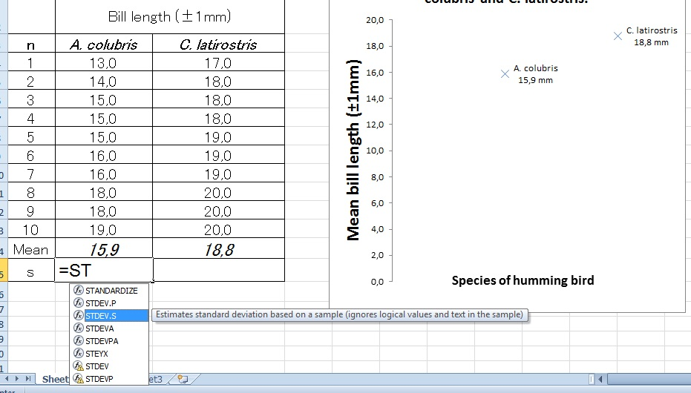
Make sure you select STDEV.S

Slide 27
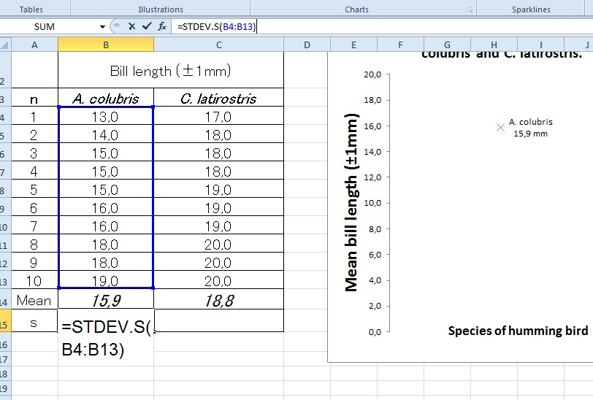
Select the entire range of data. In this case from B4 to B14. Close with a bracket = )

Slide 28
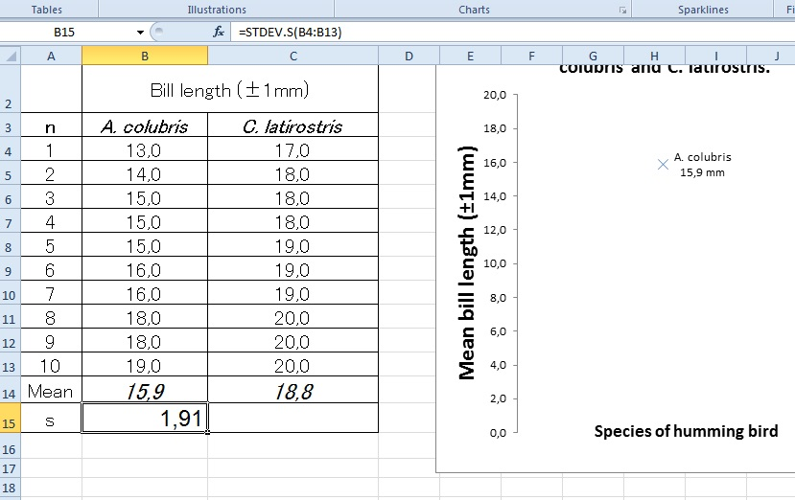
Move your pointer to the bottom right corner of the cell with the SD calculated (B15), click, hold, and drag to C15 to copy the formula.

Slide 29
Standard deviation is a measure of the spread of most of the data.
 | Table 1: Raw measurements of bill length in A. colubris and C. latirostris.
 |  | Bill length (±0.1mm)
 | n | A. colubris | C. latirostris
 | 1 | 13.0 | 17.0
 | 2 | 14.0 | 18.0
 | 3 | 15.0 | 18.0
 | 4 | 15.0 | 18.0
 | 5 | 15.0 | 19.0
 | 6 | 16.0 | 19.0
 | 7 | 16.0 | 19.0
 | 8 | 18.0 | 20.0
 | 9 | 18.0 | 20.0
 | 10 | 19.0 | 20.0
 | Mean | 15.9 | 18.8
 | s | 1.91 | 1.03
Which of the two sets of data has:
The longest mean bill length?
The greatest variability in the data?
Standard deviation can have one more decimal place.
=STDEV.P (highlight RAW data).

Slide 30
Standard deviation is a measure of the spread of most of the data.
1.1.4 | Explain how the standard deviation is useful for comparing the means and the spread of data between two or more samples. | 3
 | Table 1: Raw measurements of bill length in A. colubris and C. latirostris.
 |  | Bill length (±0.1mm)
 | n | A. colubris | C. latirostris
 | 1 | 13.0 | 17.0
 | 2 | 14.0 | 18.0
 | 3 | 15.0 | 18.0
 | 4 | 15.0 | 18.0
 | 5 | 15.0 | 19.0
 | 6 | 16.0 | 19.0
 | 7 | 16.0 | 19.0
 | 8 | 18.0 | 20.0
 | 9 | 18.0 | 20.0
 | 10 | 19.0 | 20.0
 | Mean | 15.9 | 18.8
 | s | 1.91 | 1.03
Which of the two sets of data has:
The longest mean bill length?
The greatest variability in the data?
C. latirostris
A. colubris
Standard deviation can have one more decimal place.
=STDEV (highlight RAW data).

Slide 31
1.1.1 | State that error bars are a graphical representation of the variability of data.
All measurements are subject to errors and it is important to recognise this in the way ata is recorded and manipulated.
Error bars can be used either to show the range of data or the standard deviation on several repeats of one experimental measurement.

Slide 32
Standard deviation is a measure of the spread of most of the data. Error bars are a graphical representation of the variability of data.
Error bars could represent standard deviation, range or confidence intervals.
Which of the two sets of data has:
The highest mean?
The greatest variability in the data?
A
B

Slide 33
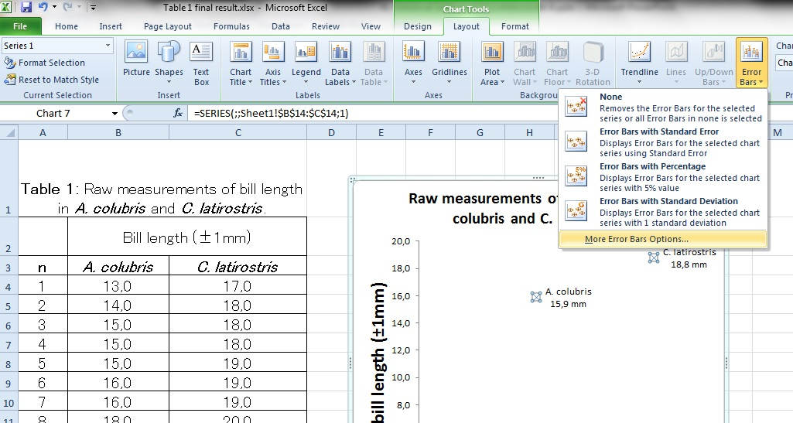
Add error bars for standard deviation to your graph.
Click on ‘More Error Bar Options’

Slide 34
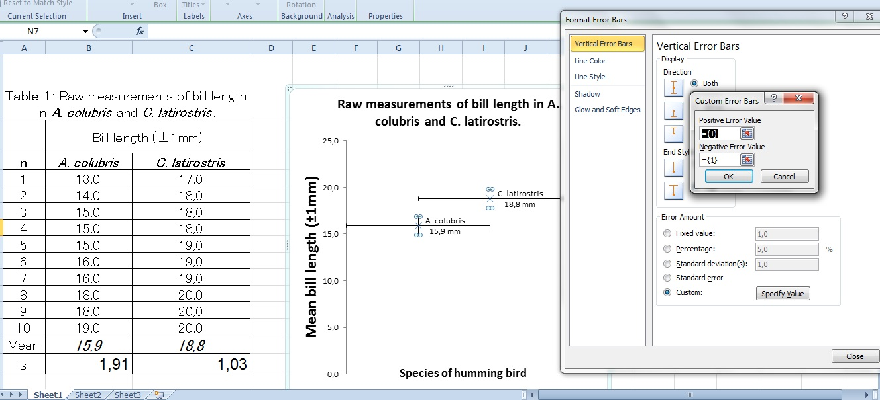
Select both s values for the positive and the negative Error value box

Slide 35
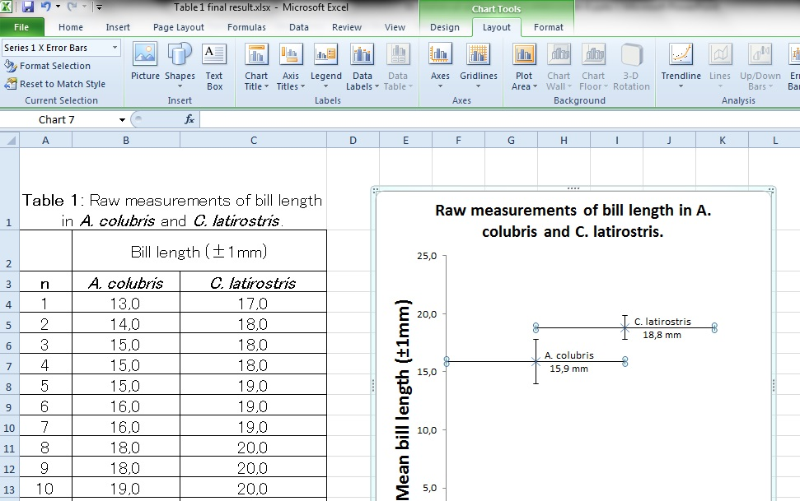
Select and delete the horizontal bars

Slide 36
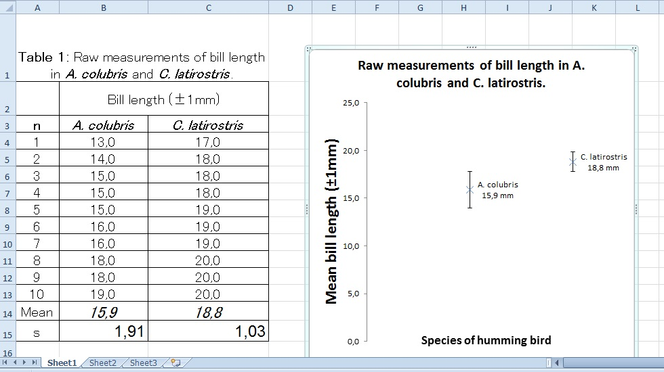

Slide 37
Title is adjusted to show the source of the error bars. This is very important.
You can see the clear difference in the size of the error bars.
Variability has been visualised.
The error bars overlap somewhat.
What does this mean?

Slide 38
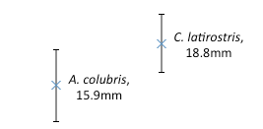
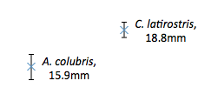
The overlap of a set of error bars gives a clue as to the significance of the difference between two sets of data.
Large overlap
No overlap
Lots of shared data points within each data set.
Results are not likely to be significantly different from each other.
Any difference is most likely due to chance.
No (or very few) shared data points within each data set.
Results are more likely to be significantly different from each other.
The difference is more likely to be ‘real’.

Slide 39
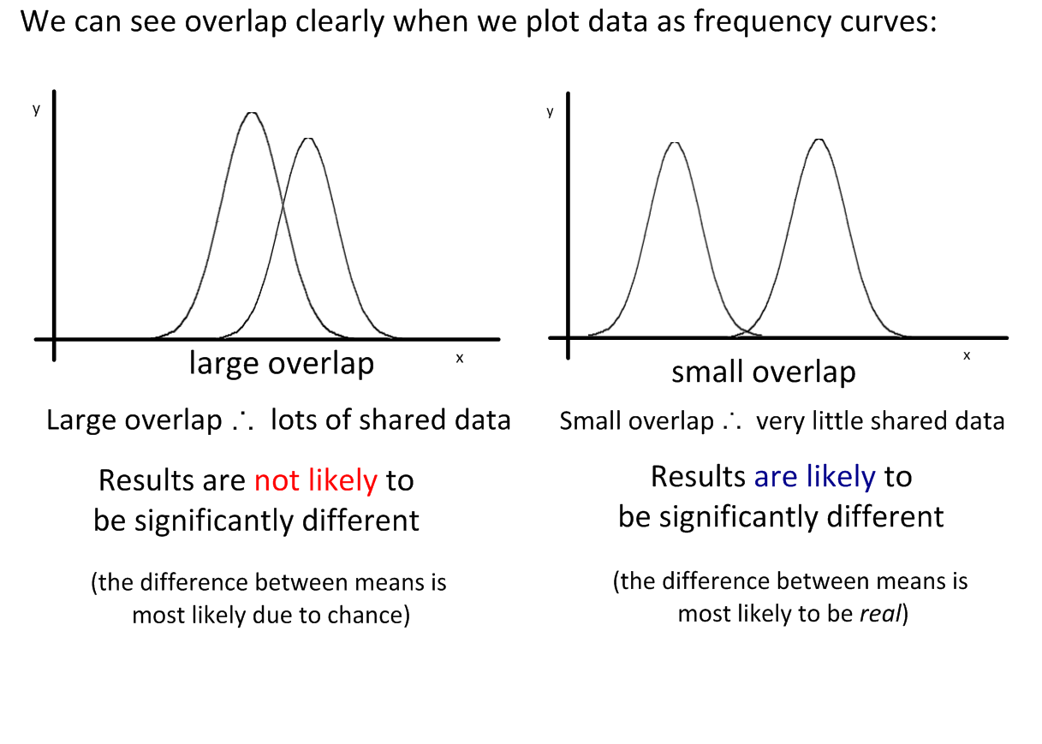

Slide 40
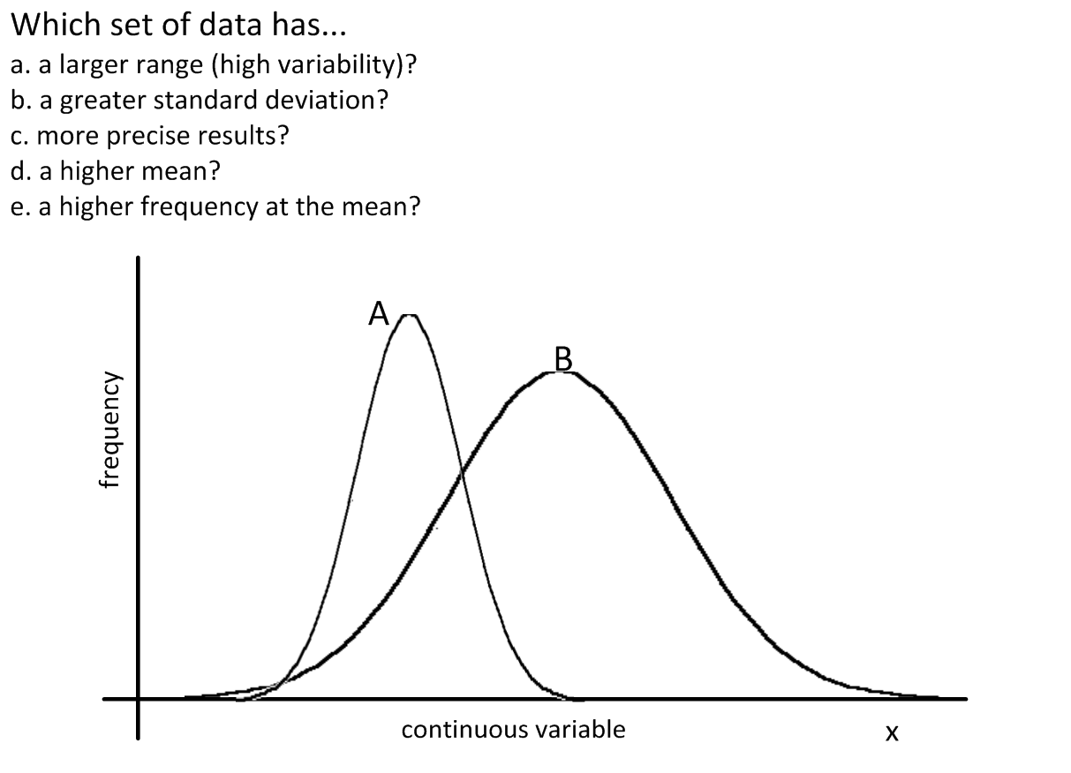

Slide 41
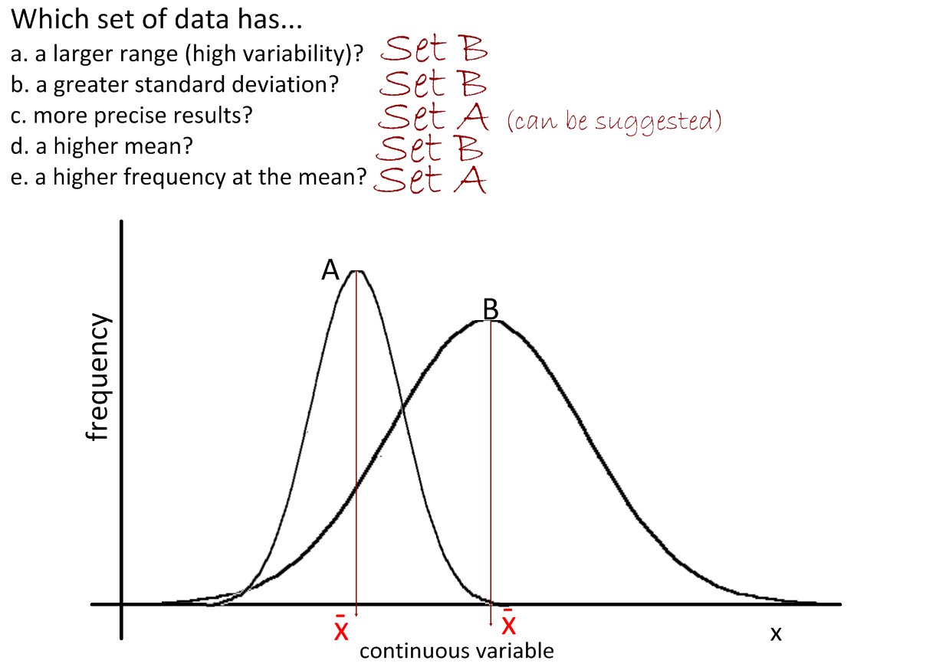

Slide 42
T-Test
1.1.5 | Deduce the significance of the difference between two sets of data using calculated values for t and the appropriate tables. We will also do this with P values using Excel in lab reports. | 3

Slide 43
Our results show a very small overlap between the two sets of data.
So how do we know if the difference is significant or not?
We need to use a statistical test.
The t-test is a statistical test that helps us determine the significance of the difference between the means of two sets of data.

Slide 46
We can calculate the value of ‘t’ for a given set of data and compare it to critical values that depend on the size of our sample and the level of confidence we need.
Example two-tailed t-table.
“Degrees of Freedom (df)” is the total sample size minus two.
What happens to the value of P as the confidence in the results increases?
What happens to the critical value as the confidence level increases?
P value = |  | 0.1 | 0.05 | 0.02 | 0.01
confidence |  | 90% | 95% | 98% | 99%
degrees of freedom | 1 | 6.31 | 12.71 | 31.82 | 63.66
 | 2 | 2.92 | 4.30 | 6.96 | 9.92
 | 3 | 2.35 | 3.18 | 4.54 | 5.84
 | 4 | 2.13 | 2.78 | 3.75 | 4.60
 | 5 | 2.02 | 2.57 | 3.37 | 4.03
 | 6 | 1.94 | 2.45 | 3.14 | 3.71
 | 7 | 1.89 | 2.36 | 3.00 | 3.50
 | 8 | 1.86 | 2.31 | 2.90 | 3.36
 | 9 | 1.83 | 2.26 | 2.82 | 3.25
 | 10 | 1.81 | 2.23 | 2.76 | 3.17
“critical values”

Slide 47
We can calculate the value of ‘t’ for a given set of data and compare it to critical values that depend on the size of our sample and the level of confidence we need.
Example two-tailed t-table.
“Degrees of Freedom (df)” is the total sample size minus two.
We usually use P<0.05 (95% confidence) in Biology, as our data can be highly variable
P value = |  | 0.1 | 0.05 | 0.02 | 0.01
confidence |  | 90% | 95% | 98% | 99%
degrees of freedom | 1 | 6.31 | 12.71 | 31.82 | 63.66
 | 2 | 2.92 | 4.30 | 6.96 | 9.92
 | 3 | 2.35 | 3.18 | 4.54 | 5.84
 | 4 | 2.13 | 2.78 | 3.75 | 4.60
 | 5 | 2.02 | 2.57 | 3.37 | 4.03
 | 6 | 1.94 | 2.45 | 3.14 | 3.71
 | 7 | 1.89 | 2.36 | 3.00 | 3.50
 | 8 | 1.86 | 2.31 | 2.90 | 3.36
 | 9 | 1.83 | 2.26 | 2.82 | 3.25
 | 10 | 1.81 | 2.23 | 2.76 | 3.17
“critical values”

Slide 48
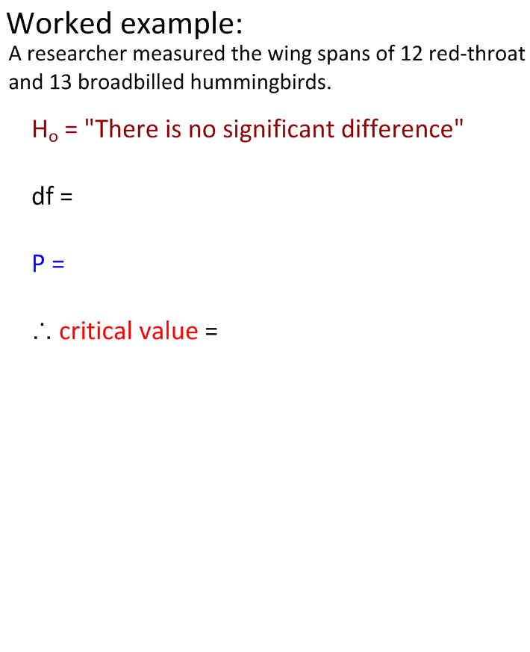
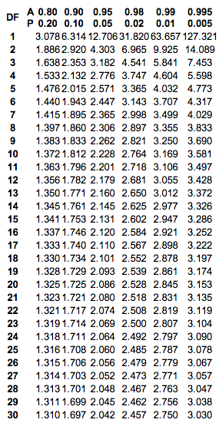
2-tailed t-table source: http://www.medcalc.org/manual/t-distribution.php

Slide 49
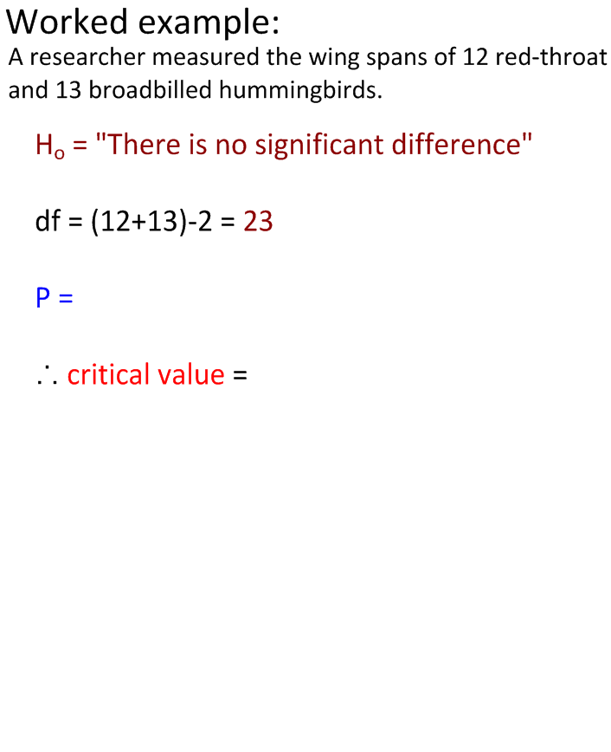
t was calculated as 2.15 (this is done for you)
t cv
2.15
If t < cv, accept H₀ (there is no significant difference)
If t > cv, accept H₀ (there is a significant difference)
2-tailed t-table source: http://www.medcalc.org/manual/t-distribution.php

Slide 50
0.05
t was calculated as 2.15 (this is done for you)
t cv
2.15
If t < cv, accept H₀ (there is no significant difference)
If t > cv, accept H₀ (there is a significant difference)
2-tailed t-table source: http://www.medcalc.org/manual/t-distribution.php

Slide 51
0.05
2.069
t was calculated as 2.15 (this is done for you)
t cv
2.15 > 2.069
If t < cv, accept H₀ (there is no significant difference)
If t > cv, accept H₀ (there is a significant difference)
2-tailed t-table source: http://www.medcalc.org/manual/t-distribution.php

Slide 52
0.05
2.069
t was calculated as 2.15 (this is done for you)
t cv
2.15 > 2.069
If t < cv, accept H₀ (there is no significant difference)
If t > cv, accept H₀ (there is a significant difference)
Conclusion:
“There is a significant difference in the wing spans of the two populations of birds.”
2-tailed t-table source: http://www.medcalc.org/manual/t-distribution.php

Slide 53
2-tailed t-table source: http://www.medcalc.org/manual/t-distribution.php

Slide 54
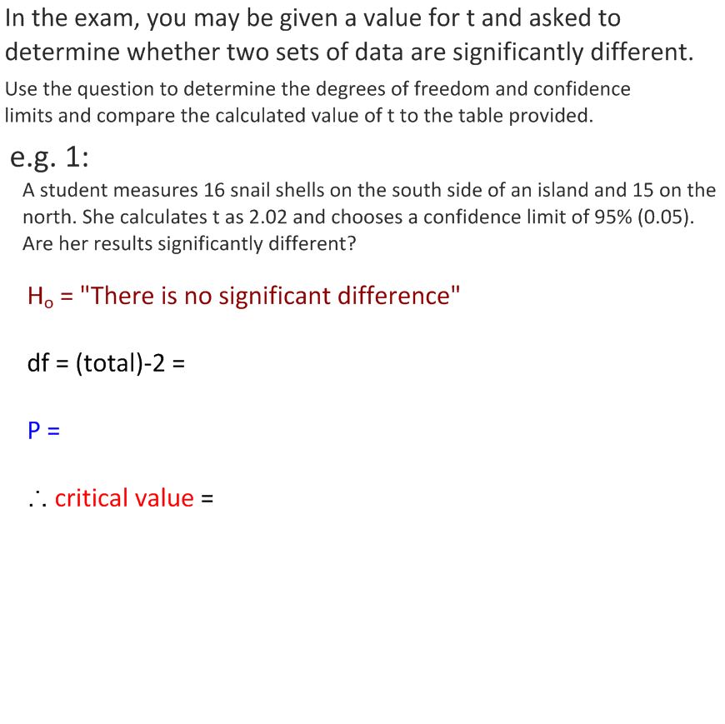
1.61
2-tailed t-table source: http://www.medcalc.org/manual/t-distribution.php

Slide 55
2.045
2.045
“There is no significant difference in the size of shells between north-side and south-side snail populations.”
2-tailed t-table source: http://www.medcalc.org/manual/t-distribution.php

Slide 56
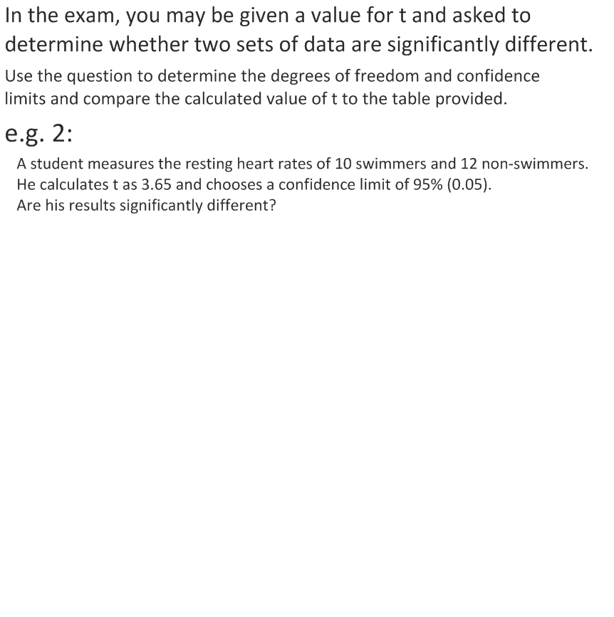
2-tailed t-table source: http://www.medcalc.org/manual/t-distribution.php

Slide 57
2.086
2.086
“There is a significant difference in the resting heart rates between the two groups of swimmers.”
2-tailed t-table source: http://www.medcalc.org/manual/t-distribution.php

Slide 58
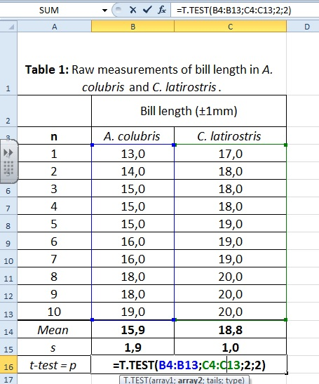
Excel can jump straight to a value of P for our results.
One function (=T.TEST) compares both sets of data.
As it calculates P directly (the probability that the difference is due to chance), we can determine significance directly.
The first value (array1) is the data of A. colubris.
The second value (array2) is the column of C. latirostris.
The third and fourth values (tails and type) are both 2.
In this case, P=0.00051
This is much smaller than 0.005, so we are confident that we can:
reject H₀.
The difference is unlikely to be due to chance.
Conclusion:
There is a significant difference in bill length between A. colubris and C. latirostris.

Slide 59
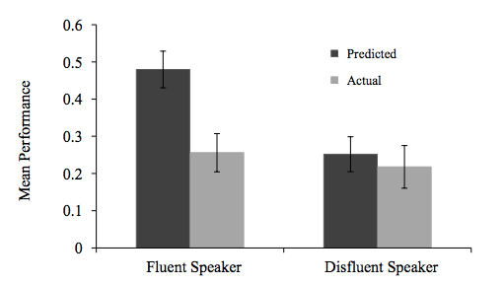
Interesting Study: Do “Better” Lecturers Cause More Learning?
Students watched a one-minute video of a lecture. In one video, the lecturer was fluent and engaging. In the other video, the lecturer was less fluent.
They predicted how much they would learn on the topic
(genetics) and this was compared to their actual score.
(Error bars = standard deviation).
Is there a significant difference in the actual learning?
Find out more here: http://priceonomics.com/is-this-why-ted-talks-seem-so-convincing/

Slide 60
CORRELATION vs CAUSATION
1.1.6 | Explain that the existence of a correlation does not establish that there is a causal relationship between two variables. | 3
A logical question a researcher may ask is if the bill length has any correlation with the weight of the bird.
To find out a graph should be plotted and the correlation should be calculated and represented in that graph.
Download table 2 from the website

Slide 61
Try to get this done!

Slide 62
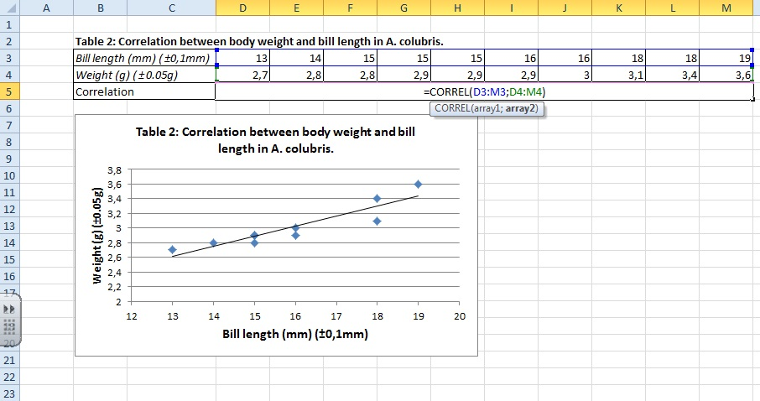
CORRELATION vs CAUSATION
The trendline show a positive correlation, but to be sure you can calculate it with excel.

Slide 63
CORRELATION vs CAUSATION
Table 2: Correlation between body weight and bill length in A. colubris.
Bill length (mm) (±0,1mm) |  | 13 | 14 | 15 | 15 | 15 | 16 | 16 | 18 | 18 | 19
Weight (g) (±0.05g) |  | 2,7 | 2,8 | 2,8 | 2,9 | 2,9 | 2,9 | 3 | 3,1 | 3,4 | 3,6
Correlation (r) |  | 0,92
r = 0,92
The official annotation to refer to the correlation is ‘r’. Notice it is in lower case and in italic.
In this set of data there is a strong positive correlation between bill length and body weight.
Data fit the trend line closely
Data range from:
+1 (Perfect fit to line = positive trend)
-1 (Perfect fit to line = negative trend)
The closer the value is to zero the less correlation there is between the data.

Slide 66
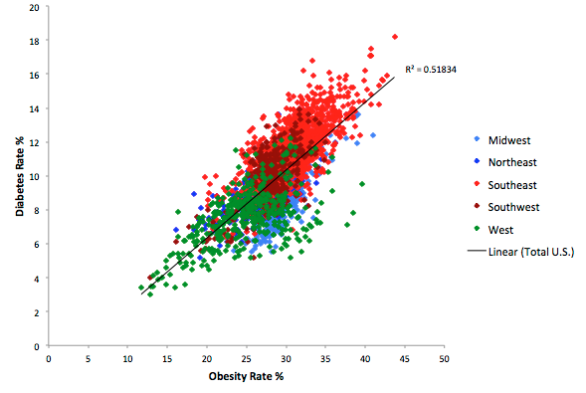
Diabetes and obesity are ‘risk factors’ of each other.
There is a strong correlation between them,
but does this mean one causes the other?
http://diabetes-obesity.findthedata.org/b/240/Correlations-between-diabetes-obesity-and-physical-activity

Slide 67
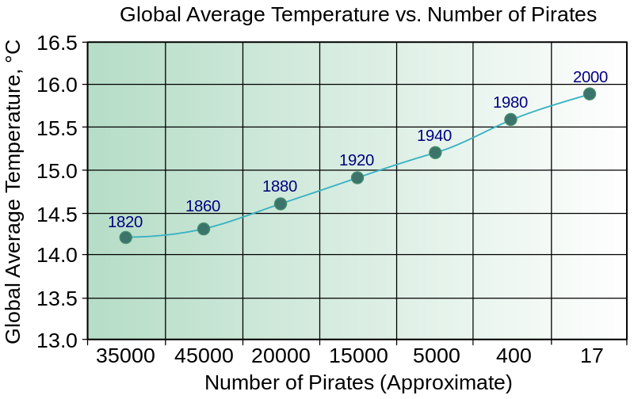
Correlation does not imply causality.
Pirates vs global warming, from http://en.wikipedia.org/wiki/Flying_Spaghetti_Monster#Pirates_and_global_warming

Slide 68
Correlation does not imply causality.
Where correlations exist, we must then design solid scientific experiments to determine the cause of the relationship. Sometimes a correlation exist because of confounding variables – conditions that the correlated variables have in common but that do not directly affect each other.
To be able to determine causality through experimentation we need:
One clearly identified independent variable
Carefully measured dependent variable(s) that can be attributed to change in the independent variable
Strict control of all other variables that might have a measurable impact on the dependent variable.
We need: sufficient relevant, repeatable and statistically significant data.
Some known causal relationships:
Atmospheric CO₂ concentrations and global warming
Atmospheric CO₂ concentrations and the rate of photosynthesis
Temperature and enzyme activity
Pirates vs global warming, from http://en.wikipedia.org/wiki/Flying_Spaghetti_Monster#Pirates_and_global_warming

Slide 69
Unit 1
Statistical analysis

Slide 70
P value = |  | 0.1 | 0.05 | 0.02 | 0.01 | 0.005
confidence |  | 90% | 95% | 98% | 99% | 99.50%
degrees of freedom | 1 | 6.31 | 12.71 | 31.82 | 63.66 | 127.34
 | 2 | 2.92 | 4.30 | 6.96 | 9.92 | 14.09
 | 3 | 2.35 | 3.18 | 4.54 | 5.84 | 7.45
 | 4 | 2.13 | 2.78 | 3.75 | 4.60 | 5.60
 | 5 | 2.02 | 2.57 | 3.37 | 4.03 | 4.77
 | 6 | 1.94 | 2.45 | 3.14 | 3.71 | 4.32
 | 7 | 1.89 | 2.36 | 3.00 | 3.50 | 4.03
 | 8 | 1.86 | 2.31 | 2.90 | 3.36 | 3.83
 | 9 | 1.83 | 2.26 | 2.82 | 3.25 | 3.69
 | 10 | 1.81 | 2.23 | 2.76 | 3.17 | 3.58
degrees of freedom | 11 | 1.80 | 2.20 | 2.72 | 3.11 | 3.50
 | 12 | 1.78 | 2.18 | 2.68 | 3.05 | 3.43
 | 13 | 1.77 | 2.16 | 2.65 | 3.01 | 3.37
 | 14 | 1.76 | 2.14 | 2.62 | 2.98 | 3.33
 | 15 | 1.75 | 2.13 | 2.60 | 2.95 | 3.29
 | 16 | 1.75 | 2.12 | 2.58 | 2.92 | 3.25
 | 17 | 1.74 | 2.11 | 2.57 | 2.90 | 3.22
 | 18 | 1.73 | 2.10 | 2.55 | 2.88 | 3.20
 | 19 | 1.73 | 2.09 | 2.54 | 2.86 | 3.17
 | 20 | 1.72 | 2.09 | 2.53 | 2.85 | 3.15
degrees of freedom | 21 | 1.72 | 2.08 | 2.52 | 2.83 | 3.14
 | 22 | 1.72 | 2.07 | 2.51 | 2.82 | 3.12
 | 23 | 1.71 | 2.07 | 2.50 | 2.81 | 3.10
 | 24 | 1.71 | 2.06 | 2.49 | 2.80 | 3.09
 | 25 | 1.71 | 2.06 | 2.49 | 2.79 | 3.08
 | 26 | 1.71 | 2.06 | 2.48 | 2.78 | 3.07
 | 27 | 1.70 | 2.05 | 2.47 | 2.77 | 3.06
 | 28 | 1.70 | 2.05 | 2.47 | 2.76 | 3.05
 | 29 | 1.70 | 2.05 | 2.46 | 2.76 | 3.04
 | 30 | 1.70 | 2.04 | 2.46 | 2.75 | 3.03
degrees of freedom | 31 | 1.70 | 2.04 | 2.45 | 2.74 | 3.02
 | 32 | 1.69 | 2.04 | 2.45 | 2.74 | 3.02
 | 33 | 1.69 | 2.03 | 2.44 | 2.73 | 3.01
 | 34 | 1.69 | 2.03 | 2.44 | 2.73 | 3.00
 | 35 | 1.69 | 2.03 | 2.44 | 2.72 | 3.00
 | 36 | 1.69 | 2.03 | 2.43 | 2.72 | 2.99
 | 37 | 1.69 | 2.03 | 2.43 | 2.72 | 2.99
 | 38 | 1.69 | 2.02 | 2.43 | 2.71 | 2.98
 | 39 | 1.68 | 2.02 | 2.43 | 2.71 | 2.98
 | 40 | 1.68 | 2.02 | 2.42 | 2.70 | 2.97

