Slide 1
Topic 1: Cell biology
The evolution of multicellular organisms allowed cell specialization and cell replacement.

Slide 2

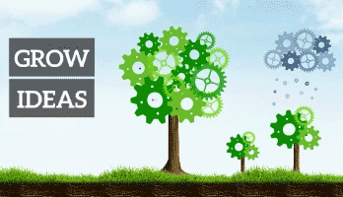
SNOWBALL!
1. Brainstorm what details you can remember about CELLS.

Slide 3
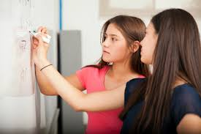
You are going to introduce the topic of cells to a year 9 class.
2. How would you do it?

Slide 4
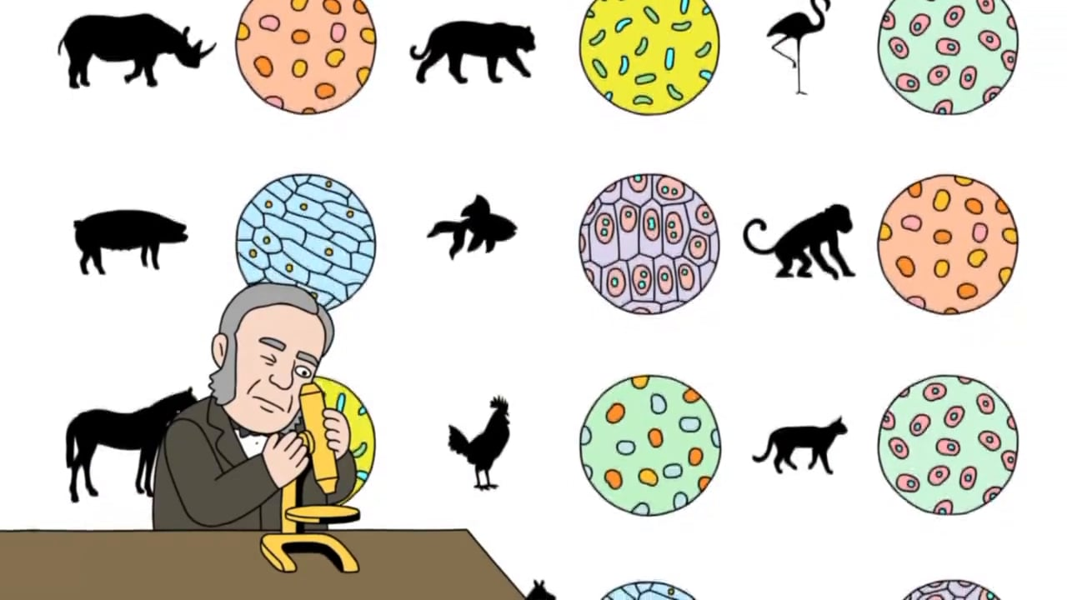
According to the cell theory, living organisms are composed of cells.
Organisms consisting of only one cell carry out all functions of life in that cell.
Cells only arise from pre-existing cells
3. Are there any exceptions to these rules?

Slide 5
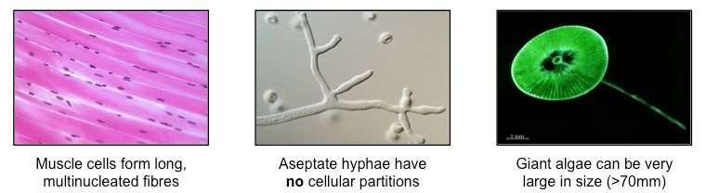
Striated muscle fibres:
Muscle cells fuse to form fibres that may be very long (>300mm)
This means they have multiple nuclei despite being surrounded by a single, continuous plasma membrane
Challenges the idea that cells always function as autonomous units

Slide 6
Aseptate fungal hyphae:
Fungi may have filamentous structures called hyphae, which are separated into cells by internal walls called septa
Some fungi are not partitioned by septa and so have a continuous cytoplasm along the length of the hyphae
Challenges the idea that living structures are composed of discrete cells

Slide 7
Giant Algae
Certain species of unicellular algae may grow to very large sizes (e.g. Acetabularia may exceed 7 cm in length)
Challenges the idea that larger organisms are always made of many microscopic cells

Slide 8
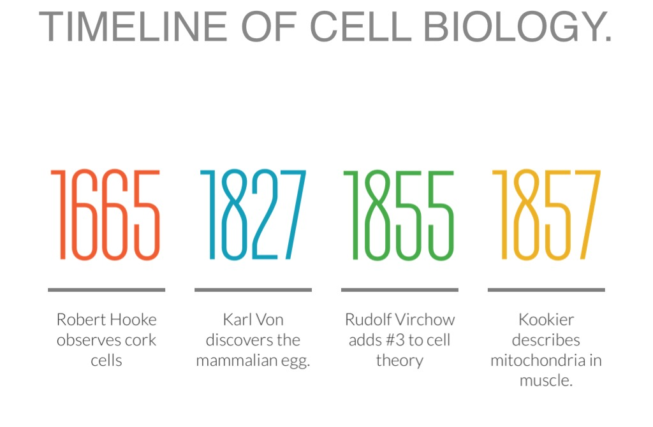
Timeline activity
4. Produce a timeline that shows the evolution of cell theory.

Slide 9
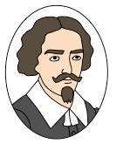
Who Invented the first compound microscope?
Zacharias Janssen
1590

Slide 10
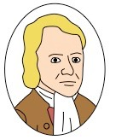
Who Used light microscope to look at thin slices of plant tissue (cork)?
Robert Hooke
Saw tiny chambers and coined the term ‘cell’
1675

Slide 11
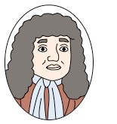
Who First to see living microscopic organisms (in pond water)?
Anton van Leeuwenhoek
Termed these microorganisms ‘animalcules’
1673

Slide 12
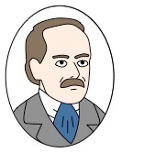
Who Concluded that: “All living plants are made of cells”?
Matthias Schleiden
Credited for developing first two tenets of cell theory (with Schwann)
1838

Slide 13
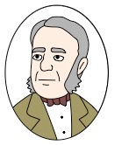
Who Concluded that: “All living animals are made of cells”?
Theodore Schwann
Credited for developing first two tenets of cell theory (with Schleiden)
1839

Slide 14
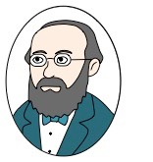
Who concluded that: “Where a cell exists, there must have been a pre-existing cell”?
Rudolph Virchow
Credited for developing the third tenet of the cell theory
1855

Slide 15
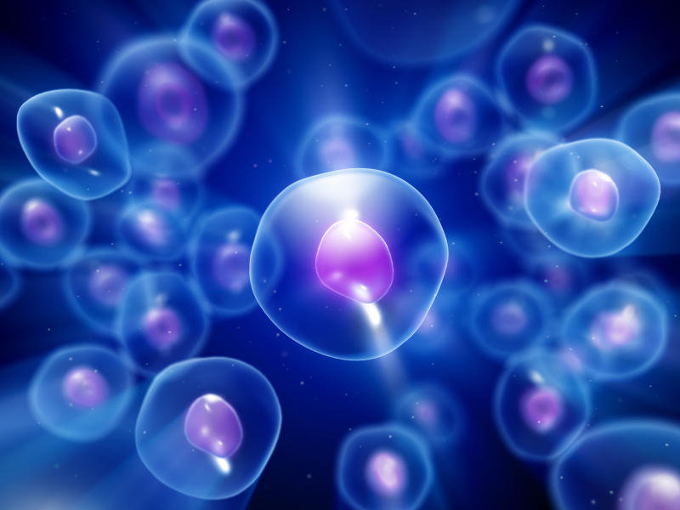
There is an unbroken chain of life from the first cells on Earth, to all cells in organisms alive today
Cells can only be formed by division of pre-existing cells, but The first cells must have arisen from non-living materiaL
5. What theories can you find that suggest how the first cells were formed?

Slide 16
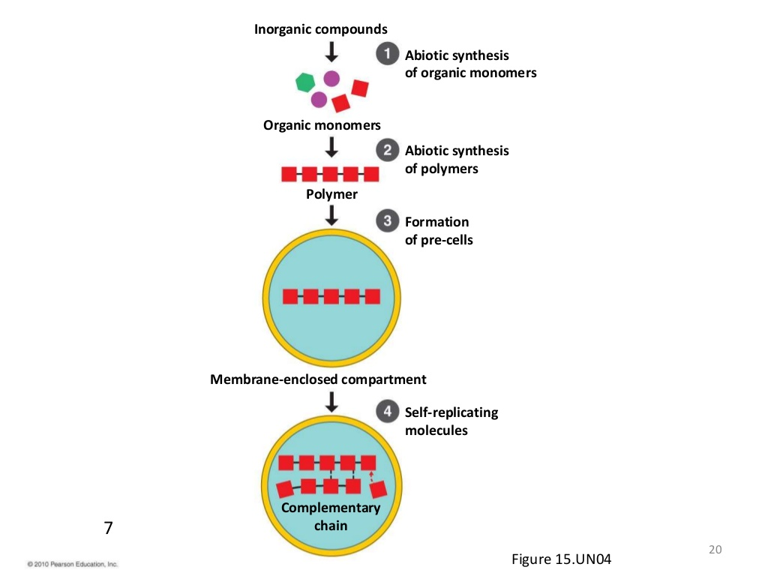
The theory that living cells arose from non-living matter is known as abiogenesis
There was non-living synthesis of simple organic molecules (from primordial inorganic molecules)
These simple organic molecules became assembled into more complex polymers
Certain polymers formed the capacity to self-replicate(enabling inheritance)
These molecules became packaged into membranes with an internal chemistry different from their surroundings (protobionts)
This process is theorised to have occurred over four key stages:

Slide 17
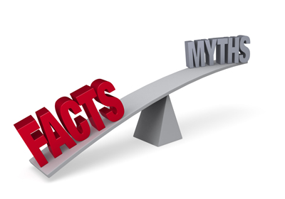
6. Can you find any evidence thaT Supports The theory that living cells arose from non-living matter?

Slide 18

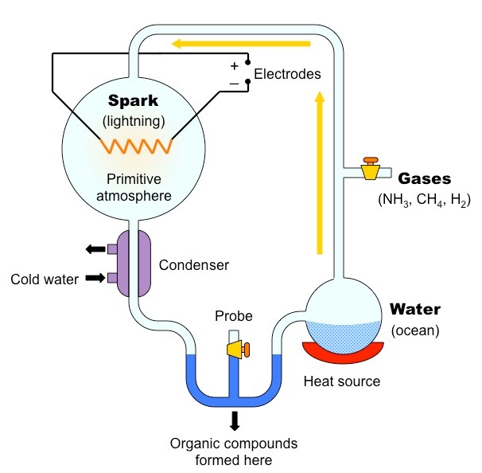
Miller-Urey Experiment
The non-living synthesis of simple organic molecules has been demonstrated by the Miller-Urey experiment
Stanley Miller and Harold Urey recreated the postulated conditions of pre-biotic Earth using a closed system of flasks and tubes
Water was boiled to vapour to reflect the high temperatures common to Earth’s original conditions
The vapour was mixed with a variety of gases (including H₂, CH₄, NH₃) to create a reducing atmosphere (no oxygen)
This mixture was then exposed to an electrical discharge (simulating the effects of lightning as an energy source for reactions)
The mixture was then allowed to cool (concentrating components) and left for a period of ~1 week
After this time, the condensed mixture was analysed and found to contain traces of simple organic molecules

Slide 19
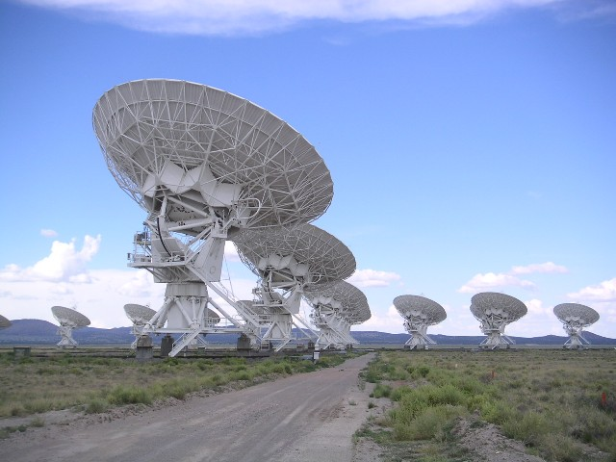
Science news:
Unusual Organic Molecule Discovered At The Heart Of The Milky Way
Some 27,000 light-years away from Earth, at the center of the Milky Way, lies the giant star-forming dust cloud Sagittarius B2. This cloud has billions upon billions of liters of alcohol inside it, such as methanol, vinyl-alcohol and ethanol. Researchers have also discovered the presence of a branched, carbon-based organic molecule called iso-propyl cyanide. Its structure is the closest discovered so far to the complex organic molecules of life that we are familiar with.
The structure of iso-propyl cyanide is a common feature in many molecules that are required for life, such as amino acids which are what proteins are made up of. Tantalizingly, this could suggest that biologically critical molecules, such as amino acids that are often found in meteorites, are forged in the early stages of star formation. Astronomers are hopeful that one day, amino acids will be discovered in our galaxy. If it turns out that they are widespread throughout the Milky Way, then it may well be that so is life.

Slide 20
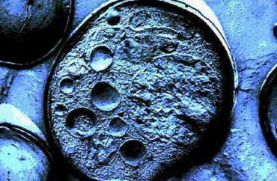
Biogenesis
The chemical processes that contributed to the initial formation of biological life required specific conditions to proceed
This included a reducing atmosphere and high temperatures (>100ºC) or electrical discharges to catalyse chemical reactions
These conditions do not commonly exist on modern Earth and hence living cells cannot arise independently by abiogenesis
Instead, cells can only be formed by the division of pre-existing cells (biogenesis)

Slide 21
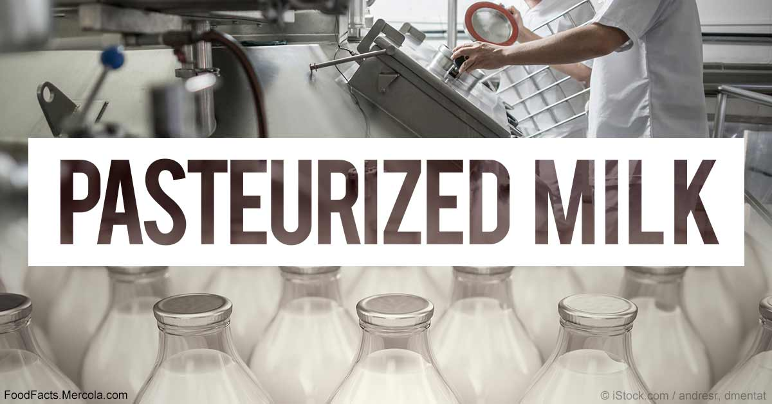
7. Who is credited as proving the theory of biogenesis?
And disproving Spontaneous Generation theory?
How was it done?

Slide 22
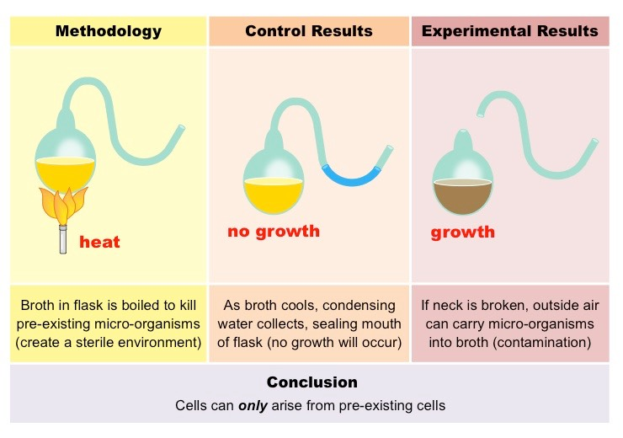
Application:
• Evidence from Pasteur’s experiments that spontaneous generation of cells and organisms does not now occur on Earth
Pasteur, demonstrated that emergent bacterial growth in nutrient broths was due to contamination by pre-existing cells
Broths were stored in vessels that contained long tubes (swan neck ducts) that did not allow external dust particles to pass
The broths were boiled to kill any micro-organisms present in the growth medium (sterilisation)
Growth only occurred in the broth if the flask was broken open, exposing the contents to contaminants from the outside
From this it was concluded that emergent bacterial growth came from external contaminants and did not spontaneously occur

Slide 23
8. If we asume that the organisms in the experiment were unicellular, what life processes must each cell be able to perform?
“Organisms consisting of only one cell carry out all functions of life in that cell.”

Slide 24

Understanding:
• unicellular Organisms carry out all functions of life in that cell
Metabolism – Living things undertake essential chemical reactions
Reproduction – Living things produce offspring, either sexually or asexually
Sensitivity – Living things are responsive to internal and external stimuli
Homeostasis – Living things maintain a stable internal environment
Excretion – Living things exhibit the removal of waste products
Nutrition – Living things exchange materials and gases with the environment
Growth – Living things can move and change shape or size
Mnemonic: MR SHENG
Unicellular organisms (e.g. Euglena, amoeba) are the smallest organisms capable of independent life.
All living things carry out 7 basic functions integral to survival:

Slide 25
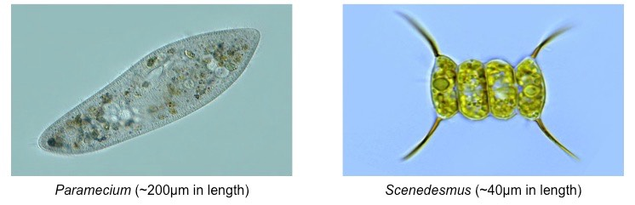
Application: Investigate the functions of life in Paramecium and one named photosynthetic unicellular organism
1. Paramecium (heterotroph)
2. Scenedesmus (autotroph)
Paramecia are surrounded by small hairs called cilia which allow it to move (responsiveness)
Paramecia engulf food via a specialised membranous feeding groove called a cytostome (nutrition)
Food particles are enclosed within small vacuoles that contain enzymes for digestion (metabolism)
Solid wastes are removed via an anal pore, while liquid wastes are pumped out via contractile vacoules (excretion)
Essential gases enter (e.g. O₂) and exit (e.g. CO₂) the cell via diffusion (homeostasis)
Paramecia divide asexually (fission) although horizontal gene transfer can occur via conjugation (reproduction)
Scenedesmus exchange gases and other essential materials via diffusion (nutrition / excretion)
Chlorophyll pigments allow organic molecules to be produced via photosynthesis (metabolism)
Daughter cells form as non-motile autospores via the internal asexual division of the parent cell (reproduction)
Scenedesmus may exist as unicells or form colonies for protection (responsiveness)

Slide 26
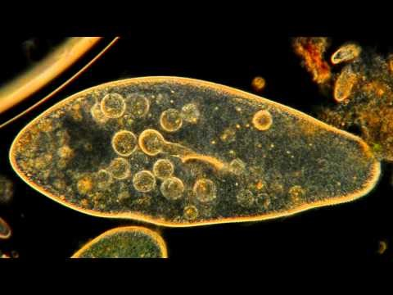
Paramecium Feeding Heterotrophically

Slide 27
1. Paramecium (heterotroph)
Paramecia are surrounded by small hairs called cilia which
allow it to move (responsiveness)
Paramecia engulf food via a specialised membranous feeding groove called a cytostome (nutrition)
Food particles are enclosed within small vacuoles that contain enzymes for digestion (metabolism)
Solid wastes are removed via an anal pore, while liquid wastes are pumped out via contractile vacoules (excretion)
Essential gases enter (e.g. O₂) and exit (e.g. CO₂) the cell via diffusion (homeostasis)
Paramecia divide asexually (fission) although horizontal gene transfer can occur via conjugation (reproduction)

Slide 28
2. Scenedesmus (autotroph)
Scenedesmus exchange gases and other
essential materials via diffusion
(nutrition / excretion)
Chlorophyll pigments allow organic molecules to be produced via photosynthesis (metabolism)
Daughter cells form as non-motile autospores via the internal asexual division of the parent cell (reproduction)
Scenedesmus may exist as unicells or form colonies for protection (responsiveness)

Slide 29

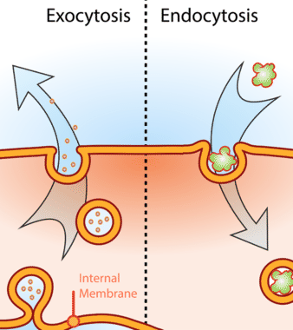
Endocytosis and Exocytosis
Substances are transported across plasma membrane in bulk via small vesicles
Endocytosis
  Part of the plasma membrane sinks into the cell
  Forms a vesicle with substances from outside
  Seals back onto the plasma membrane again
  Phagocytosis: endocytosis brings solid material into the cell
  Pinocytosis: endocytosis brings fluid materials into the cell
Exocytosis
  Vesicle is formed in the cytoplasm //May form from an edge of the Golgi apparatus
  Moves towards plasma membrane and fuses with plasma membrane
  Contents are pushed outside cell
  Insulin is secreted from cells in this way
What property of the membrane allows this to happen?

Slide 30
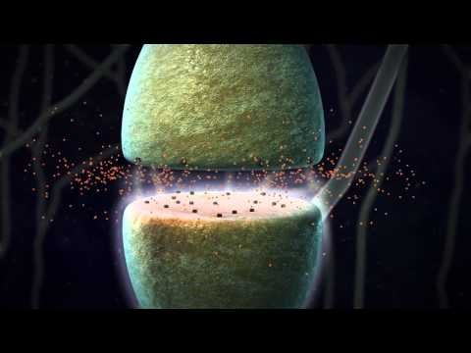
You have seen an example of exocytosis before:

Slide 31
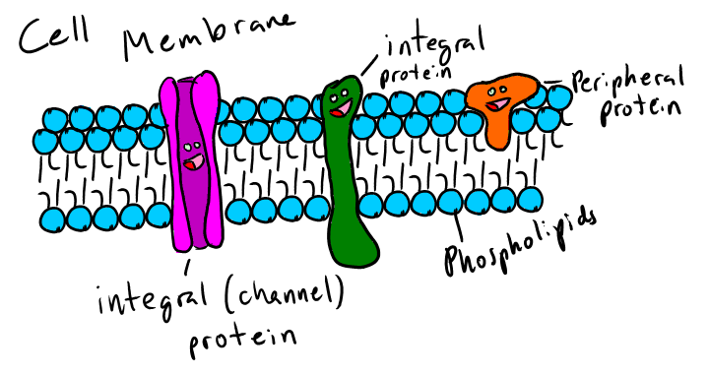
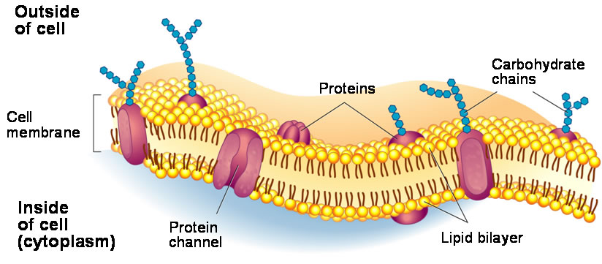
Cell membranes
The fluidity of the cell membrane allows
endocitosis and exosytosis to occur
Understandings:
Phospholipids form bilayers in water due to the amphipathic properties of phospholipid molecules.
Membrane proteins are diverse in terms of structure, position in the membrane and function.
Cholesterol is a component of animal cell membranes.

Slide 32
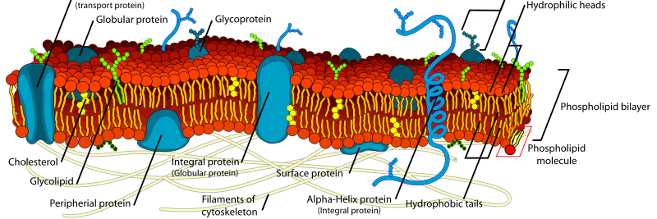
Fluid-mosaic model
Plasma membrane consists of a phospholipid bilayer, with embedded proteins, polysaccharides, lipids
The lipid bilayer is semipermeable
  Regulates passage of substances into and out of the cell
  H2O and some small, uncharged, molecules (O2, CO2) can pass through
Phospholipids have two parts
  "Head": hydrophilic → attracts and mixes with H2O
  Two "fatty acid tails": hydrophobic

Slide 33
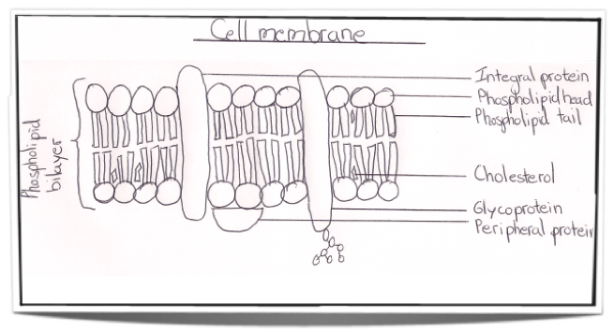
Drawing the phospholipid bilayer
Sharp pencil, use a ruler to label the diagram
Draw and label the:
Outside and inside
Hydrophilic heads
Hydrophobic tails
Cholesterol
Integral protein
Peripheral protein
Glycoprotein
Carbohydrate chain
Bracket and label the phospholipid bilayer

Slide 34
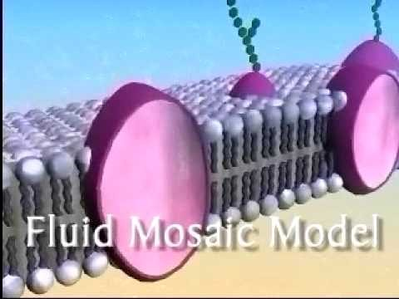
9. Create a diagram of the cell membrane

Slide 35
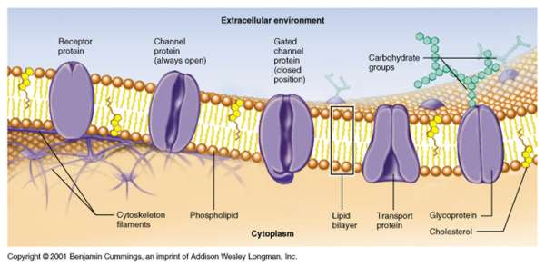
Understandings:
Particles move across membranes by simple diffusion, facilitated diffusion, osmosis and active transport.
10. Describe the role of proteins in the active and passive transport of substances across the cell membrane.

Slide 36
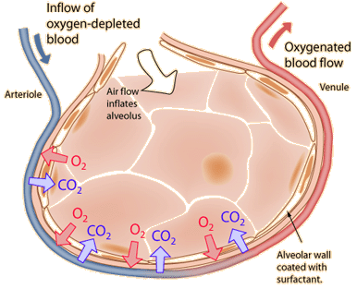
2.4.4 Define diffusion and osmosis.
There are two general types of transport through the cell membrane; passive transport and active transport. Passive transport does not require energy and active transport does.
Diffusion and osmosis are two examples of passive transport.
Diffusion
In diffusion particles move from a high to a low concentration down a concentration gradient until equilibrium is achieved.
Osmosis
Osmosis is the net movement of water molecules across a partially permeable membrane, from a high to a low concentration.

Slide 37
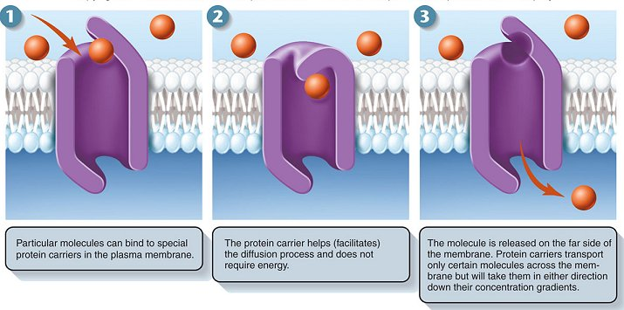
2.4.5 Explain passive transport across membranes by simple diffusion and facilitated diffusion.
Simple diffusion in possible for small non-polar (not charged) molecules. They can diffuse through the membrane without any extra help or energy.
For polar molecules, so ions or charged molecules, the crossing is more difficult. For them facilitated diffusion is needed. There are two possibilities for facilitated diffusion, both use proteins in the membrane, channel proteins and transport proteins.

Slide 38
2.4.5 Explain passive transport across membranes by simple diffusion and facilitated diffusion.
Transport proteins can help move substances such as glucose into the cell. In that case it has a binding site specific for glucose. When glucose binds the protein changes its structure and the molecule will be carried into the cell. The transport protein will then move back to its original shape.

Slide 39
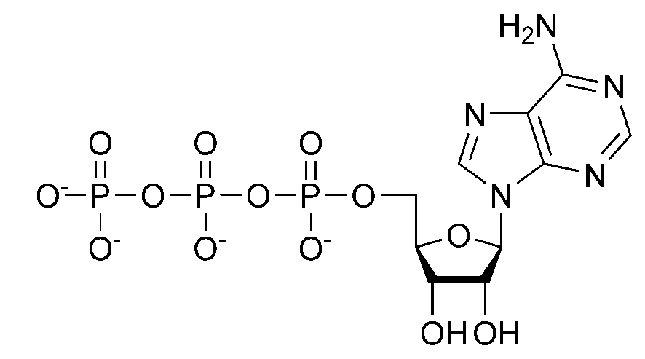
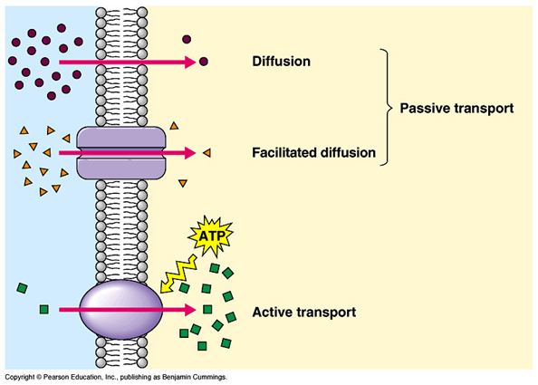
2.4.6 Explain the role of protein pumps and ATP in active transport across membranes.
Active transport requires energy. It will not take place unless ATP is present. (Adenosine you might remember as a DNA base).
Particles are moving against the concentration gradient, from low to high concentration.
A good example is the sodium potassium pump

Slide 40
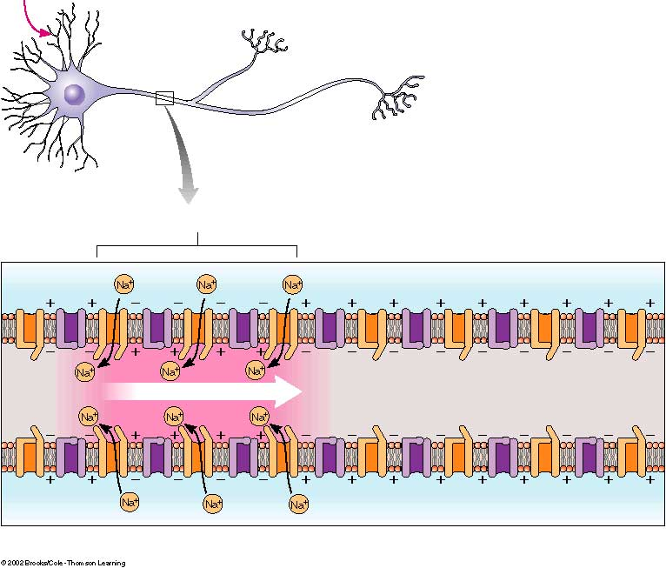
2.4.6 Explain the role of protein pumps and ATP in active transport across membranes.
Remember that the process is very similar to facilitated transport but the difference is that energy is needed and the particles can move from low to a high concentration. Like you saw before, the sodium potassium pump is a great example of a transport protein (sometimes called carrier proteins or membrane pumps). The sodium potassium pump is important in the functioning of a nerve cell.
The protein pumps are selective so will only react with a certain type of substance.
= SPECIFIC

Slide 41
Understandings:
Particles move across membranes by simple diffusion, facilitated diffusion, osmosis and active transport.
Membranes control the composition of cells by active and passive transport
11. Find a good video that explains how sodium potassium pumps work and post a link on todaysmeet.com
Application: Structure and function of sodium–potassium pumps for active transport and potassium channels for facilitated diffusion in axons.

Slide 42
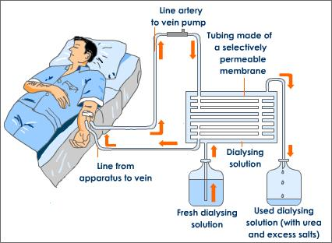
Kidney dialysis
12.
Why do people need to have this procedure?
How does it work?
Is dialysis a suitable treatment in the modern age?
Is it posible there will be a better alternative in the future?

Slide 43
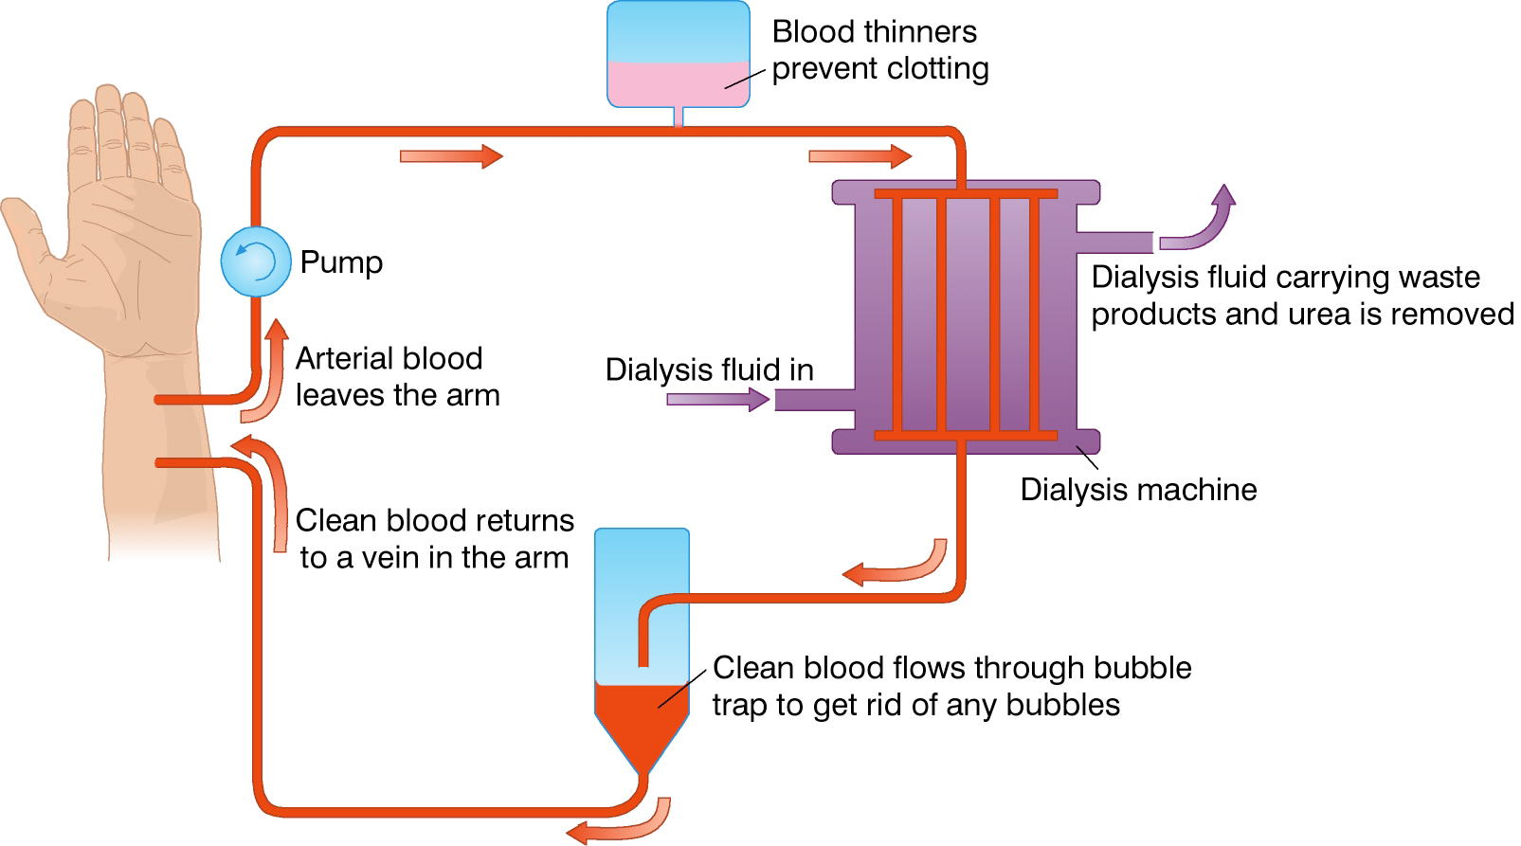
Kidney dialysis: involves the external filtering of blood to remove metabolic wastes in patients with kidney failure

Slide 44
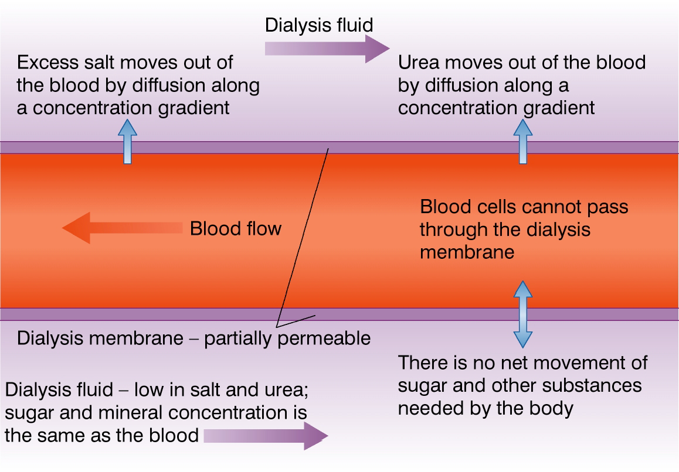

Slide 45
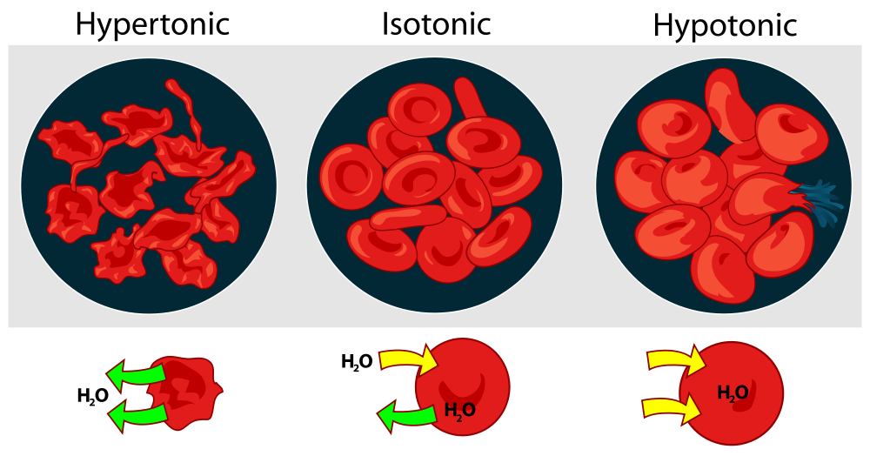
Application: Tissues or organs to be used in medical procedures must be bathed in a solution with the same osmolarity as the cytoplasm to prevent osmosis.
Prevents cellular dessication
Solution must be isotonic
In hypertonic solutions, water will leave the cell causing it to shrink (crenation)
In hypotonic solutions, water will enter the cell causing it to swell and potentially burst (lysis)

Slide 46
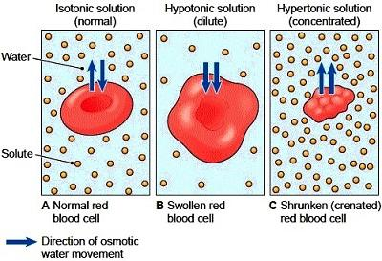
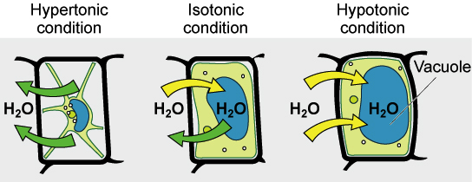
In plant tissues, the effects of uncontrolled osmosis are controlled by the rigid cell wall:
In hypertonic solutions, the cytoplasm will shrink (plasmolysis) but the cell wall will maintain a structured shape
In hypotonic solutions, the cytoplasm will expand but will not burst because of the cell wall
Blood Cells:
Plant Cells:

Slide 47
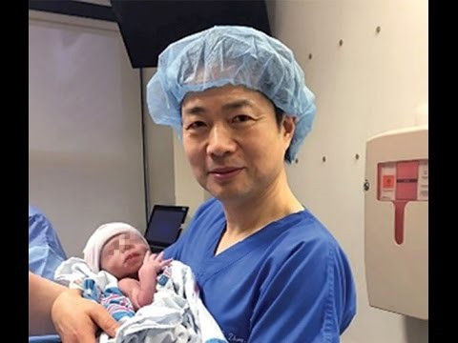
3 parent babies
The solutions used in the following procedures would have to be isotonic solutions, so the cells are not damaged in any way:
Full story: http://ow.ly/lhWZ304C5zu

Slide 48
Understandings:
The origin of eukaryotic cells can be explained by the endosymbiotic theory. (1.5)
13. research the above theory so you can give a brief description of its main points

Slide 49
Understandings:
The origin of eukaryotic cells can be explained by the endosymbiotic theory. (1.5)
An endosymbiont is a cell which …………….
Eukaryotic cells are believed to have evolved from early prokaryotes that…………..
Through the process of …………………….
This contributed new functionality (for example ……………………..) to the original cell so………………
Over subsequent generations ……………………..

Slide 50
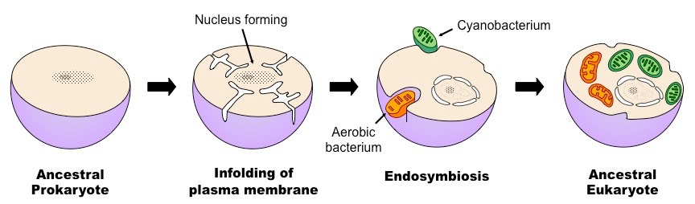
Understandings:
The origin of eukaryotic cells can be explained by the endosymbiotic theory. (1.5)
An endosymbiont is a cell which lives inside another cell with mutual benefit
Eukaryotic cells are believed to have evolved from early prokaryotes that were engulfed by phagocytosis
The engulfed prokaryotic cell remained undigested as it contributed new functionality to the engulfing cell
(e.g. photosynthesis)
Over generations, the engulfed cell lost some of its independent utility and became a supplemental organelle
Overview of the Process of Endosymbiosis

Slide 51
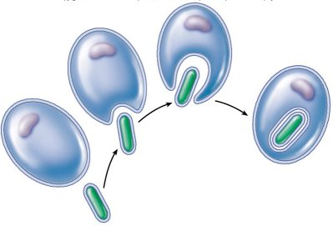
Understandings:
The origin of eukaryotic cells can be explained by the endosymbiotic theory. (1.5)
Mitochondria and chloroplasts are both organelles suggested to have arisen via endosimbiosis.
14. What evidence is there to support this theory?

Slide 52
Evidence for Endosymbiosis
Mitochondria and chloroplasts are both organelles suggested to have arisen via endosimbiosis.
Evidence that supports the extracellular origins of these organelles can be seen by looking at certain key features:
Membranes (double membrane bound)
Antibiotics (susceptibility)
Division (mode of replication)
DNA (presence and structural composition)
Ribosomes (size)
Mnmemonic: MAD DR (mad doctor)

Slide 53
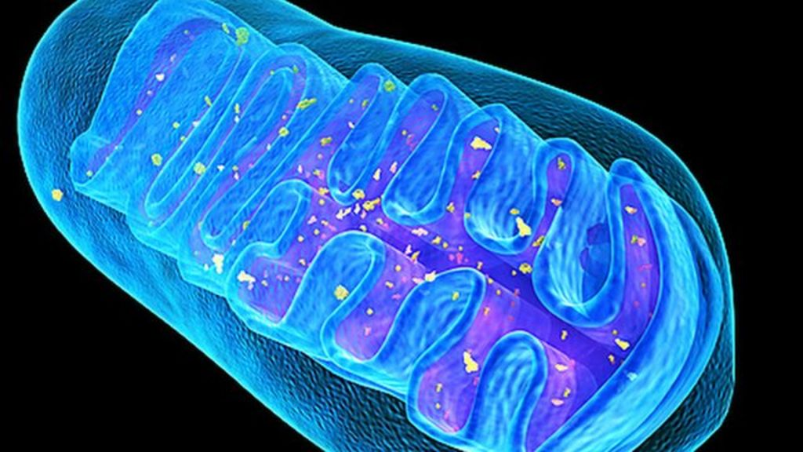
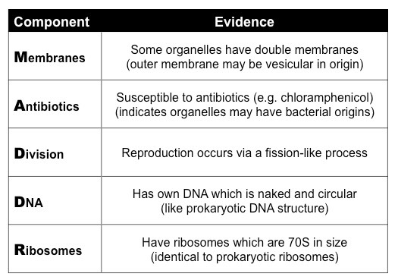
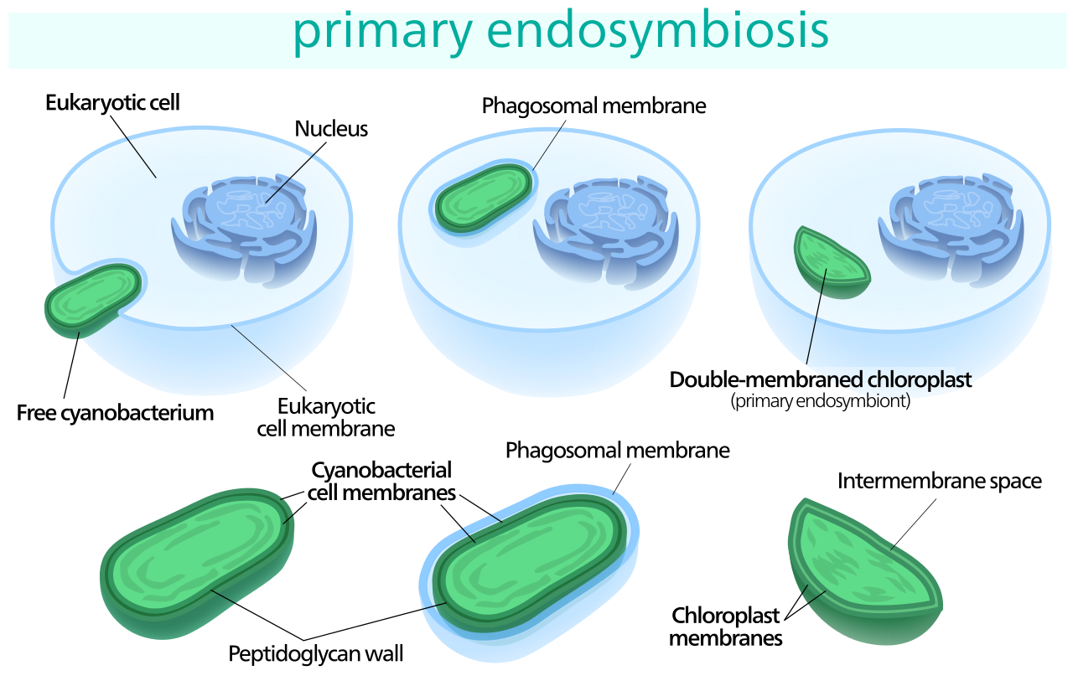
Chloroplast and Mitochondrial Evidence
Theory of knowledge: Biology is the study of life, yet life is an emergent property. Under what circumstances is a systems approach productive in biology and under what circumstances is a reductionist approach more appropriate? How do scientists decide between competing approaches?

Slide 54
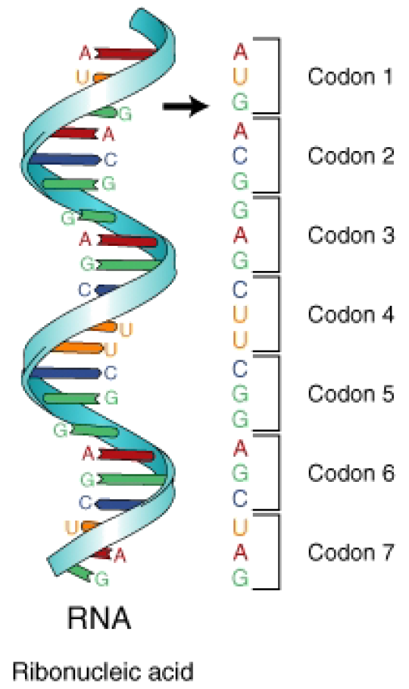
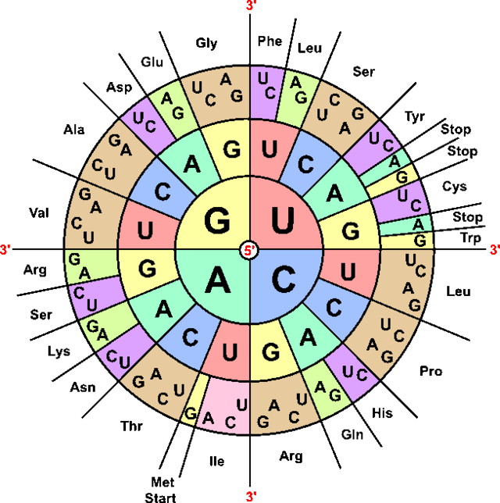
Genetic engineering Works because:
15. Define genetic engineering
All living organisms share a common ancestor, therefore we share a common structure for a our genetic material.
The nucleotides (A,T,G,C and U) are the same, and are arranged in the same triplet code (codons).

Slide 55
Genetic engineering Works because:
The 64 codons in the genetic code have the same meanings in nearly all organisms, but that there are some minor variations that are likely to have accrued since the common origin of life on Earth (it´s been a long time!).

Slide 56
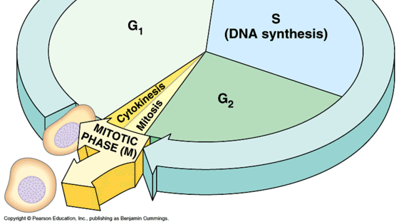
1.6 Cell division
Understandings:
Mitosis is division of the nucleus into two genetically identical daughter nuclei.
Chromosomes condense by supercoiling during mitosis.
Cytokinesis occurs after mitosis and is different in plant and animal cells.
Interphase is a very active phase of the cell cycle with many processes occurring in the nucleus and cytoplasm.
Cyclins are involved in the control of the cell cycle.
Mutagens, oncogenes and metastasis are involved in the development of primary and secondary tumours
Nature of science:
Serendipity and scientific discoveries—the discovery of cyclins was accidental. (1.4)

Slide 57
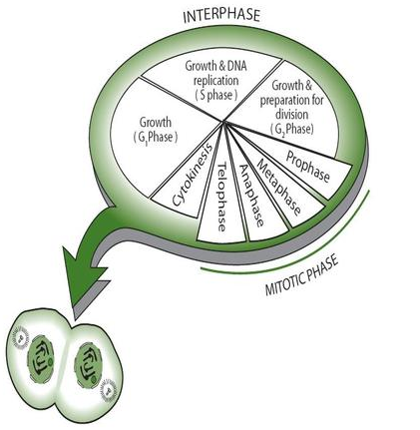
Interphase
Only a small part of the cell’s life cycle is in mitosis, which is the division of the nucleus. Cytokinesis is the division of the cell and follows immediately after mitosis. It can even start before the last phase of mitosis is completely finished. Most of the time in the cell cycle, the cell is in interphase.

Slide 58
Interphase
Stages G1, S and G2 together are called interphase. Rather than being a ‘resting phase’ as once thought, Interphase is a very active period in the life of a cell, where many biochemical reactions, DNA transcription and translation/DNA replication, occur. Also cell respiration and protein synthesis occur during the interphase.

Slide 59
Interphase
In order for the cell to function properly, the right reactions must take place at the right time. Within a cell, chemical reactions usually only take place in the presence of the correct enzyme. Enzymes are proteins and are produced by the process of transcription and translation.
As described above, replication of DNA takes place during the S phase of interphase.
The number of mitochondria and chloroplasts in the cell increases mostly during G2 phase.
All through interphase, the chloroplasts and mitochondria absorb material from the cell and grow in size.

Slide 60

Supercoiling of the chromatin
Chromosomes condense by supercoiling during the mitosis
During mitosis the two chromatids which make up a chromosome must be separated to opposite poles of the cell. The nucleus is about 5µm long, but molecules of DNA can be 50 000µm long, so you can imagine that then must condense a lot to be able to fit in! This process in known as the condensation of chromosomes and happens in the fist stage of mitosis.
Condensation happens by supercoiling the DNA into short, wide chromosomes. The proteins called histones which are associated with the eukaryotic chromosomes help with this process, just as several enzymes.

Slide 61
Summary
Prophase
• Chromosomes become visible (supercoiling).
• Centrioles move to opposite poles.
• Spindle formation.
• Nucleolus becomes invisible.
• Nuclear membrane disappears.
• At this stage, each chromosome consists of two identical sister chromatids, held together by a centromere
Metaphase
• Chromosomes move to the equator.
• Spindle microtubules attach to the centromeres.
Anaphase
• Centromeres separate.
• Chromatids separate and move to opposite poles - they
are now called chromosomes.
Telophase
• Chromosomes have arrived at poles.
• Spindle disappears.
• Centrioles replicate (in animal cells).
• Nuclear membrane reappears.
• Nucleolus becomes visible.
• Chromosomes become chromatin.
The division of the cell is sometimes included as the last stage of telophase; strictly speaking, however, cytokinesis
is not a part of mitosis.

Slide 62
The role of mitosis
Mitosis is the division of the nucleus into two genetically identical daughter nuclei
You must be able to recognise the phases of mitosis under a microscope
The DNA is copied into two genetically identical chromatids, which will be separated into each new daughter cell in mitosis.
Mitosis occurs for many different reasons, like for example; asexual reproduction, embryonic development, tissue repair or growth.
Mitosis is divided into four phases, Prophase, Metaphase, Anaphase and Telophase.

Slide 63

The role of mitosis
Mitosis is the division of the nucleus into two genetically identical daughter nuclei
Coloured EM time-lapse of mitosis. Do You recognise the phases?

Slide 64


Phases of mitosis
You must be able to recognise the phases of mitosis under a microscope
One of the best places to find cells in mitosis is in the tips of roots. Roots grow fast so many cells in their tips are dividing. This can be done with a simple lab practical. To recognise the phases you should understand what happens in each one of them. So let’s revise them one by one.
Prophase
Interphase
Prophase
What are the differences between interphase and prophase?

Slide 65


Phases of mitosis
You must be able to recognise the phases of mitosis under a microscope
Metaphase

Slide 66



Phases of mitosis
You must be able to recognise the phases of mitosis under a microscope
Anaphase

Slide 67



Phases of mitosis
You must be able to recognise the phases of mitosis under a microscope
Telophase

Slide 68

Cytokinesis
Cytokinesis occurs after mitosis and is different in plant and animal cells
When there are two genetically equal nuclei in a cell the cell needs to divide in two, this process is called cytokinesis.
The process of cytokinesis is different in plant and animal cells.
Animal cells
In animal cells the plasma membrane is pulled inwards around the equator of a cell to form a cleavage furrow. This is done by the use of contractile proteins in the form of a ring, around the cell´s equator. The proteins are called actin and myosin, similar to the proteins which cause muscles to contract.
LINK

Slide 69

Cytokinesis
Cytokinesis occurs after mitosis and is different in plant and animal cells
Plant cells
In pant cells vesicles are moved towards the equator where they form tubular structures.
More vesicles will join and they together will form two new plasma membranes. This is how the cytoplasm is split in two.
Now pectin and other substances are moved to the newly formed membranes and will deposit between them by endocytosis. This will form the middle lamella which will form the new cell walls. Cellulose will accumulate and the walls are finished. Now there are two complete
daughter cells.

Slide 70



Cyclins and the control of the cell cycle

Slide 71

Cyclins and the control of the cell cycle

Slide 72

Mitotic index
X 100

Slide 73

Mitotic index

Slide 74
Applications and skills
Application: The correlation between smoking and incidence of cancers.
Skill: Identification of phases of mitosis in cells viewed with a microscope or in a micrograph.
Skill: Determination of a mitotic index from a micrograph.
ToK
Serendipity and scientific discoveries—the discovery of cyclins was accidental. (1.4)
A number of scientific discoveries are claimed to be incidental or serendipitous. To what extent might some of these scientific discoveries be the result of intuition rather than luck?

Slide 75

Diabetes and obesity are ‘risk factors’ of each other.
There is a strong correlation between them,
but does this mean one causes the other?
correlation
vs
causation

Slide 76

Correlation does not imply causality.
Pirates vs global warming, from http://en.wikipedia.org/wiki/Flying_Spaghetti_Monster#Pirates_and_global_warming

Slide 77

Smoking and lung cancer
The correlation between smoking and lung cancer
A correlation in science is a relationship between two variables.
The relation between cancer and smoking is a clear example of a correlation. When there is a positive relation, then one variable positively influences the other, if the correlation is negative, one variable negatively influences the other. Please include this analysis in your lab reports!

Slide 78


Smoking and lung cancer
The correlation between smoking and lung cancer

Slide 79

Smoking and lung cancer
The correlation between smoking and lung cancer
There is a clear correlation between smoking and cancers:

Slide 80
The main categories of cancer
Cancers can be grouped according to the type of cell they start in. There are 5 main categories:
Carcinoma – cancer that begins in the skin or in tissues that line or cover internal organs.
Sarcoma – cancer that begins in the connective or supportive tissues such as bone, cartilage, fat, muscle, or blood vessels
Leukaemia – cancer that starts in blood forming tissue such as the bone marrow and causes large numbers of abnormal blood cells to be produced and go into the blood
Lymphoma and myeloma – cancers that begin in the cells of the immune system
Brain and spinal cord cancers – these are known as central nervous system cancers
Note: Cancers can also be classified according to where they start in the body, such as breast cancer or lung cancer.
http://www.cancerresearchuk.org/about-cancer/what-is-cancer/how-cancer-starts/types-of-cancer

Slide 81

Tissue Renewal and rates of cancer
Tissue renewal determines the rate of cell division. In many tissues, renewal derives from stem cells. The mitotic rate of specialised cells from stem cells sets the relative risk of cancer.
About 90% of human cancers arise in epithelial tissues. Epithelial layers in certain organs, such as the intestine and skin, renew continuously throughout life.
The epithelium of the human colon turns over at least once per week throughout life. As cells die at the surface, they are replaced by new cell divisions. By age 60, a person has been through at least 3,000 replacement cycles, which means that some cell lineages must pass through many generations. Those renewing lineages would be at high risk for accumulating mutations and progressing to cancer.

Slide 82


Slide 83

How have each of these cells become specialised to perform a specific function?
Differentiation involves the expression of some genes, and not others, in a cell´s genome

Slide 84

ES cells
Embryonic stem (ES) cells are formed as a normal part of embryonic development. They can be isolated from an early embryo and grown in a dish.
Potential as therapy
ES cells have the potential to become any type of cell in the body, making them a promising source of cells for treating many diseases.

Slide 85

The stem cell debate:

Slide 86
Consider the following:
Why are stem cells considered so valuable for medical research?
What are three sources of stem cells and the advantages and disadvantages associated with using each?
How might a stem cell be used to treat a disease such as Stargardt’s Disease?
What issues surround the debate over government funding of stem cell research?
What issue do you think needs to be debated as we make decisions about stem cell research?

Slide 88
Stargardt´s disease
disease
Use of stem cells
Recessive genetic disease
Affecrs children between 6 and 12 yrs
Degeneration of photoreceptive cells in the retina
Can result in blindness
Embyonic SCs are made into retina cells
Injected into eyes of mice
Not rejected, no tumours developed
Attached to retina
Eyesight improved

