Slide 1
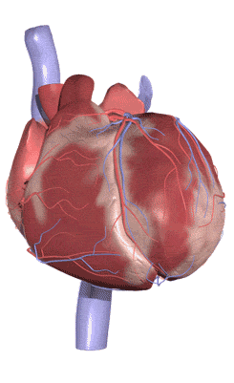
Topic 6: Human Health and Physiology
6.2 The Transport system

Slide 2
ASSESSMENT STATEMENTS
6.2.1 Draw and label a diagram of the heart showing the four chambers, associated blood vessels, valves and the route of blood through the heart. (Care should be taken to show the relative wall thickness of the four chambers. Neither the coronary vessels nor the conductive system are required.)
6.2.2 State that the coronary arteries supply heart muscle with oxygen and nutrients.
6.2.3 Explain the action of the heart in terms of collecting blood, pumping blood, and opening and closing of valves.
6.2.4 Outline the control of the heartbeat in terms of myogenic muscle contraction, the role of the pacemaker, nerves, the medulla of the brain and epinephrine (adrenaline).
6.2.5 Explain the relationship between the structure and function of arteries, capillaries and veins.
6.2.6 State that blood is composed of plasma, erythrocytes, leucocytes (phagocytes and lymphocytes) and platelets.
6.2.7 State that the following are transported by the blood: nutrients, oxygen, carbon dioxide, hormones, antibodies, urea and heat.

Slide 3
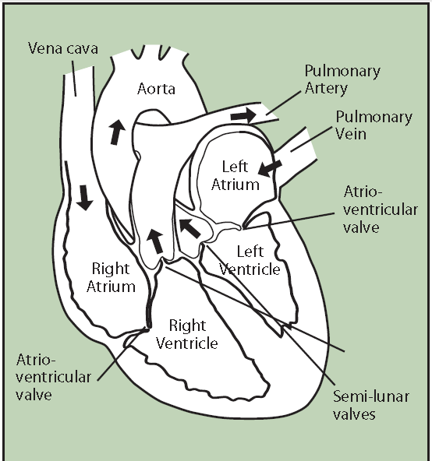
6.2.1 Draw and label a diagram of the heart showing the four chambers, associated blood vessels, valves and the route of blood through the heart. (Care should be taken to show the relative wall thickness of the four chambers. Neither the coronary vessels nor the conductive system are required.)

Slide 4
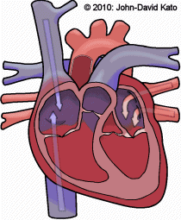
6.2.1 Draw and label a diagram of the heart showing the four chambers, associated blood vessels, valves and the route of blood through the heart. (Care should be taken to show the relative wall thickness of the four chambers. Neither the coronary vessels nor the conductive system are required.)
The human heart is a very specialised organ that pumps blood through the body. It is divided into a left and right atrium (plural: atria) and a left and right ventricle, each of which has specific characteristics defined by its role in moving the blood through the body. The atria have thin walls since they only have to put enough pressure on the blood to move it into the ventricles, which are next to the atria. The wall of the ventricles is thicker because they need to move the blood further. The wall of the left ventricle is thicker than that of the right ventricle since the left ventricle pumps the blood around
the entire body and the right ventricle only pumps the blood to the lungs. The thicker the wall, the more pressure can be put on the blood and the further it can be pumped.

Slide 5
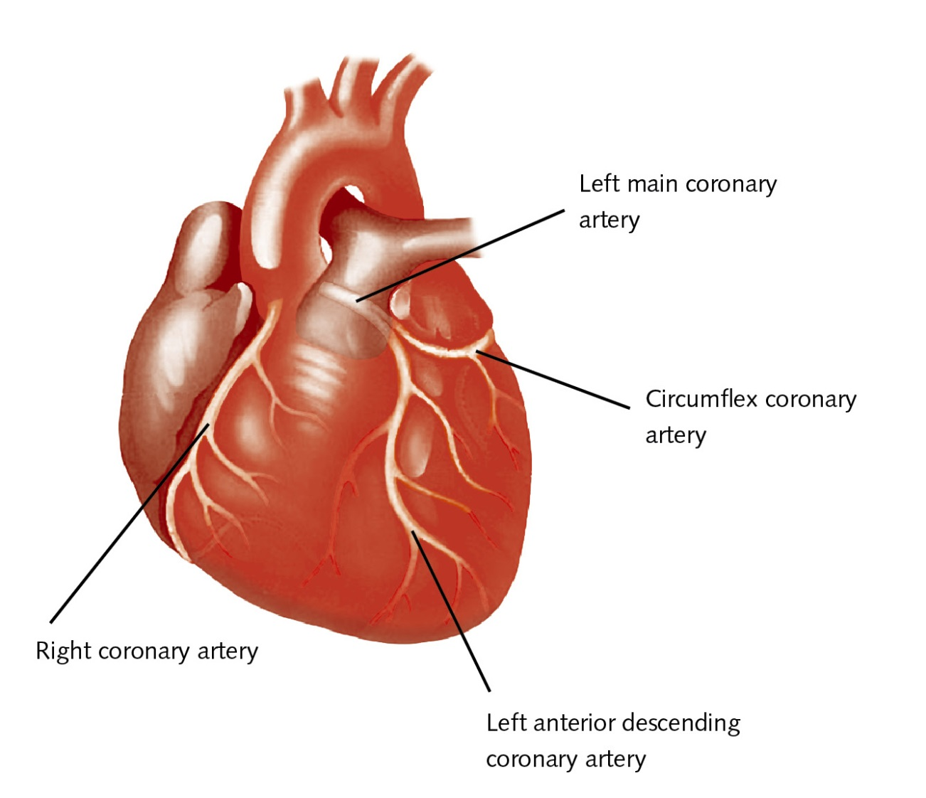
6.2.2 State that the coronary arteries supply heart muscle with oxygen and nutrients.
Since the heart is an active muscle, it needs food (glucose) and oxygen in order to release the energy (in cellular respiration) to contract. The heart cannot readily absorb oxygen and nutrients from the blood passing through its chambers, so coronary arteries supply the heart muscles with its requirements.

Slide 6
6.2.3 Explain the action of the heart in terms of collecting blood, pumping blood, and opening and closing of valves.
A major component of the heart is muscle tissue. The heart collects blood from the body and lungs in the right and left atria, respectively. The blood is then pumped into the right and left ventricles, which are found directly below the atria. The right ventricle will pump the blood to the lungs.
The wall is thicker than that of the atria but thinner than that of the left ventricle. The left ventricle pumps the blood into the aorta and from there it goes to the rest of the body. Since this is the longest distance that the blood must travel, it needs to be pushed out of the heart with some force. This explains why the wall of the left ventricle is the thickest wall of all the chambers of the heart.
LINK

Slide 7
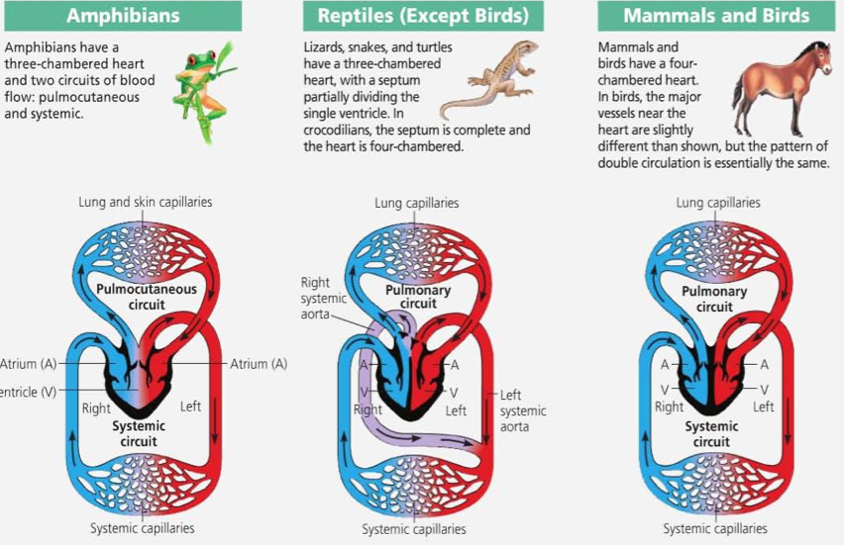
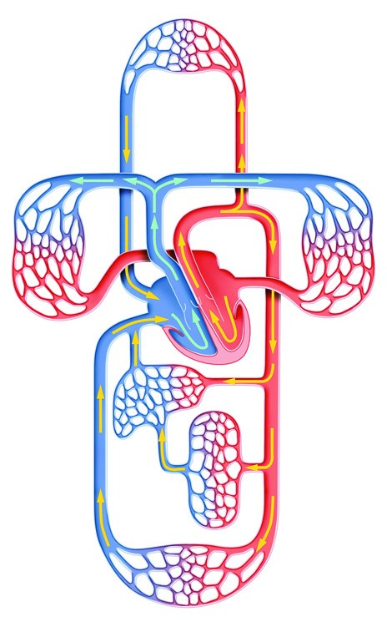
6.2.3 Explain the action of the heart in terms of collecting blood, pumping blood, and opening and closing of valves.
Mammals have a double circulation, this means the blood coming from the body goes through the heart, to the lungs, back to the heart and then to the body. The heart is therefore divided into a right and a left side. Each side has an atrium and a ventricle.

Slide 8
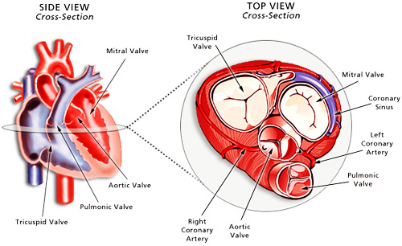
6.2.3 Explain the action of the heart in terms of collecting blood, pumping blood, and opening and closing of valves.
The direction of the blood flow is controlled by the valves. Valves are flaps of tissue without muscle. Valves are opened and closed by the flow of blood. As long as the blood flows in the right direction, the valves remain pushed open. As soon as the blood starts to flow in the wrong direction, they are pushed shut.
LINK

Slide 9
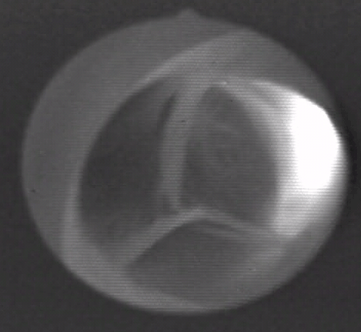
6.2.3 Explain the action of the heart in terms of collecting blood, pumping blood, and opening and closing of valves.
The atrio-ventricular valve (AV valve) between the right atrium and the right ventricle is called the tricuspid valve; the one between the left atrium and left ventricle is called the bicuspid valve. The valves in the pulmonary artery and an the aorta are semi-lunar valves. The valves have some strings of connective tissue attached to them. This prevents them from opening to the wrong side.

Slide 10
6.2.4 Outline the control of the heartbeat in terms of myogenic muscle contraction, the role of the pacemaker, nerves, the medulla of the brain and epinephrine (adrenaline).
The contractions of the cardiac muscles are myogenic which means they originate from within the heart muscle. They are brought about by nerve impulses which originate not from the brain but from inside the heart from a specific region of the right atrium: the Sino-Atrial Node (SA node) also known as the cardiac pacemaker. The SA node is made from specialised muscle cells. The SA node releases an impulse at regular intervals which spreads across the walls of the atria, causing simultaneous contractions.
The impulse cannot spread to the muscles of the ventricles except in the region of the Atrio-Ventricular Node (AV node). The AV node is connected to the ‘bundle of His’ (specialised cardiac fibres) which branches out into the Purkinje tissue. From the AV node, the impulse travels through the bundle of His down to the apex of the heart and from there spreads up through the Purkinje tissue. This causes the ventricular contractions to start at the apex and push the blood up into the arteries.
LINK

Slide 11
6.2.4 Outline the control of the heartbeat in terms of myogenic muscle contraction, the role of the pacemaker, nerves, the medulla of the brain and epinephrine (adrenaline).
Although the heart is largely autonomous in its contractions, the brain and some hormones influence the frequency of the heartbeats. Impulses from the lower part of the brain stem (the medulla oblongata) via the parasympathetic part of the autonomous nervous system (controls mainly involuntary actions), decrease the cardiac frequency. Impulses from the brain, via the sympathetic nerves, will increase cardiac frequency (heart rate).
Some hormones also have an effect on the heart rate. For example adrenaline (epinephrine) from the adrenal glands near the kidneys, increases cardiac frequency. If the SA node does not function properly, it is quite possible to implant an artificial pacemaker to carry out this function. With a well-adjusted pacemaker, a person with a malfunctioning SA node can live a long and active life.
LINK

Slide 12
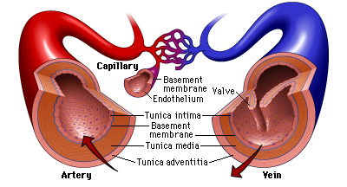
6.2.5 Explain the relationship between the structure and function of arteries, capillaries and veins.
Blood is circulated through the body by the contractions of the heart. Mammals (unlike, for example, insects) have a closed circulatory system, this means the blood is confined to blood vessels. There are three kinds of blood vessels.

Slide 13
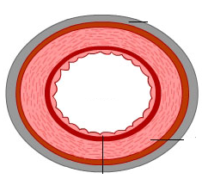
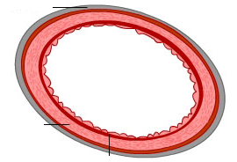
6.2.5 Explain the relationship between the structure and function of arteries, capillaries and veins.
Arteries
transport blood away from the heart
carry oxygenated blood (except Pulmonary Artery)
have thick muscular walls but no valves
move blood at high speed (10-40 cm/s)
contain blood at high pressure (80-120 mmHg)
Capillaries
small numerous blood vessels in tissue
very thin walls to allow easy exchange of materials e.g. respiratory gases
move blood at low speed (< 0.1 cm/s)
contain blood at moderate pressure (15 mmHg)
Veins
transport blood towards the heart (except hepatic portal vein)
carry de-oxygenated blood (except Pulmonary Vein)
have quite thin walls and valves
move blood at moderate speed (5-20 cm/s)
contain blood at low pressure (< 10 mmHg)
have valves to prevent blood from flowing back

Slide 14
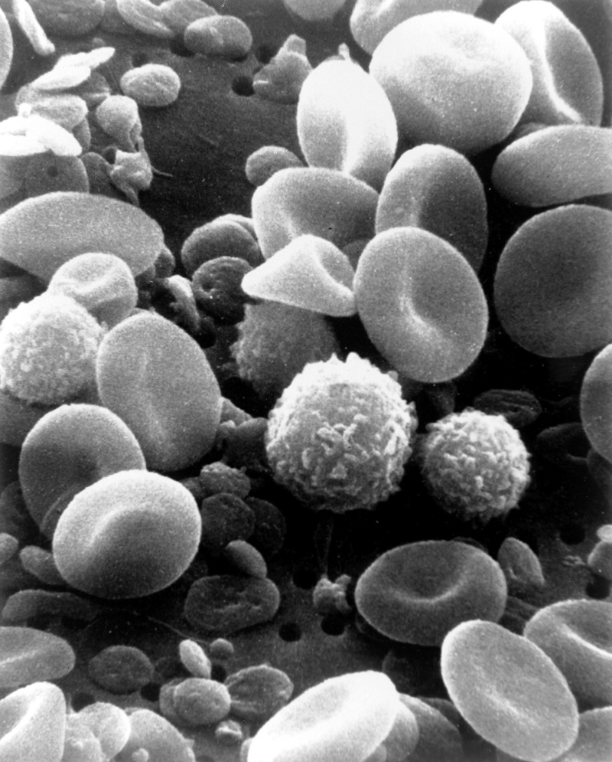
6.2.6 State that blood is composed of plasma, erythrocytes, leucocytes (phagocytes and lymphocytes) and platelets.
By weight, about 8% of the human body is blood. It has the following composition; plasma (50-55%) and cells (45-50%).
The plasma is 90% water and dissolved in it are:
proteins (e.g. fibrinogen, globulins, albumins)
dissolved nutrients
hormones
waste materials
The cells are:
erythrocytes (red blood cells) (90%)
leucocytes (white blood cells)
- phagocytes (70%): non-specific defence: phagocytosis of antigens
- lymphocytes (30%): specific defense: production of antibodies
thrombocytes (platelets)
LINK

Slide 15
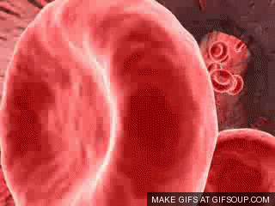
6.2.7 State that the following are transported by the blood: nutrients, oxygen, carbon dioxide, hormones, antibodies, urea and heat.
The function of the circulatory system is transport. The following are transported by the blood:
nutrients e.g. glucose
oxygen
carbon dioxide
hormones e.g. insulin
antibodies
waste products e.g. urea
Heat
Transport of oxygen and carbon dioxide is associated with the erythrocytes (Red blood cells); all the other substances listed are dissolved in the blood.

Slide 16
Topic 6: Human Health and Physiology
6.2 The Transport system

