Slide 1
Topic 4: Genetics
4.2 Meiosis

Slide 2
ASSESSMENT STATEMENTS
4.2.1 State that meiosis is a reduction division of a diploid nucleus to form haploid nuclei.
4.2.2 Define homologous chromosomes.
4.2.3 Outline the process of meiosis, including pairing of homologous chromosomes and crossing over, followed by two divisions, which results in four haploid cells.
4.2.4 Explain that non-disjunction can lead to changes in chromosome number, illustrated by reference to Down syndrome (trisomy 21).
4.2.5 State that, in karyotyping, chromosomes are arranged in pairs according to their size and structure.
4.2.6 State that karyotyping is performed using cells collected by chorionic villus sampling or amniocentesis, for pre-natal diagnosis of chromosome abnormalities.
4.2.7 Analyse a human karyotype to determine gender and whether nondisjunction has occurred.

Slide 3
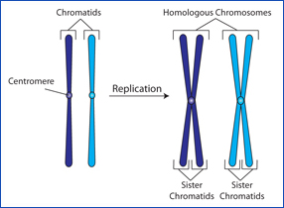
4.2.2 Define homologous chromosomes.
Homologous chromosomes (or a homologous pair) are two chromosomes, one from each parent, that look the same. They are the same size and they will show the same banding pattern in a karyotype. They carry the same genes but not necessarily the same alleles, for example, both homologous chromosomes will carry the gene for eye colour but one may have the allele ‘brown’ while the other may have the allele ‘blue’. Homologous chromosomes will pair up and split up during meiosis.

Slide 4
4.2.1 State that meiosis is a reduction division of a diploid nucleus to form haploid nuclei.
Meiosis is called a “reduction division” because the daughter cells have only half of the number of chromosomes as the original parent cell.
The purpose of meiosis is to produce gametes. A (haploid) gamete (sex cell, sperm or egg cell) has half the number of chromosomes compared to a (diploid) somatic cell (body cell). A male and a female gamete may then fuse (fertilisation) to form a zygote, which will have the same number of chromosomes as a somatic cell.
The number of chromosomes in a haploid cell is often given as ‘n’. The number of chromosomes in a diploid cell is often given as ‘2n’. For example:
in a human somatic cell 2n = 46
in a gamete of a camel n = 35
in a somatic cell of an apple 2n = 34
LINK

Slide 5
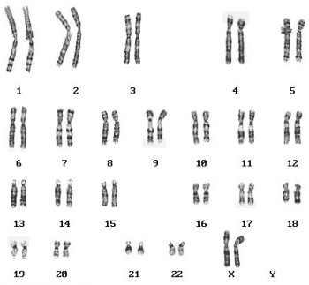
4.2.1 State that meiosis is a reduction division of a diploid nucleus to form haploid nuclei.
Homologous chromosomes (or a homologous pair) are two chromosomes, one from each parent, that look the same. They are the same size and they will show the same banding pattern in a karyotype. They carry the same genes but not necessarily the same alleles, for example, both homologous chromosomes will carry the gene for eye colour but one may have the allele ‘brown’ while the other may have the allele ‘blue’. Homologous chromosomes will pair up and split up during meiosis.

Slide 6
4.2.3 Outline the process of meiosis, including pairing of homologous chromosomes and crossing over, followed by two divisions, which results in four haploid cells.
The process of meiosis can be divided into two main stages:
Meiosis I
Meiosis II.
Both Meiosis I and II are subdivided into:
Prophase
Metaphase
Anaphase
Telophase
The key to the process of meiosis is the pairing of homologous chromosomes in Prophase I and the splitting of the homologues in Anaphase I.
LINK
Task: Do a prezi on Meiosis including all phases and a short description of each

Slide 7
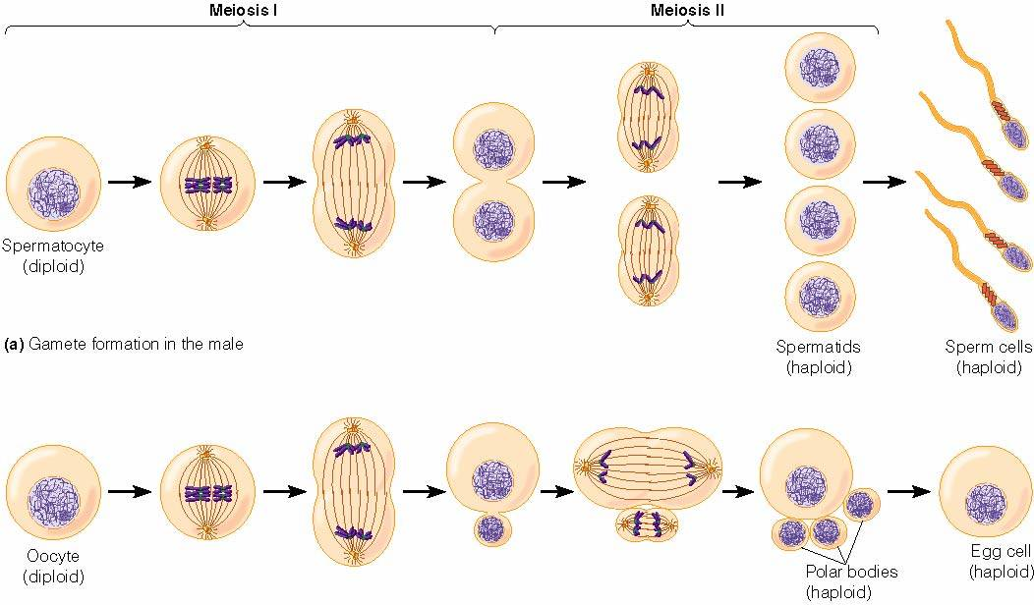
4.2.3 Outline the process of meiosis, including pairing of homologous chromosomes and crossing over, followed by two divisions, which results in four haploid cells.
One event that can take place during meiosis is crossing over. Crossing over is the exchange of genetic material between two homologous chromosomes which have paired up during Prophase I.
LINK

Slide 8
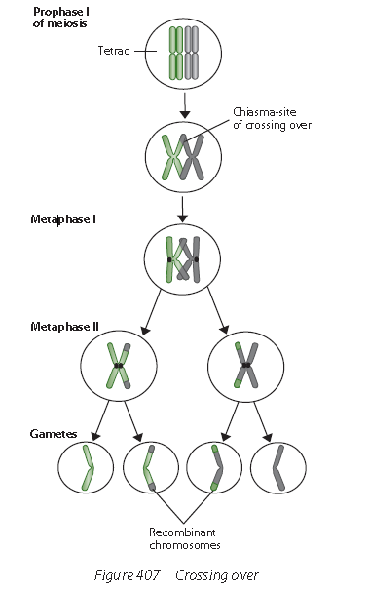
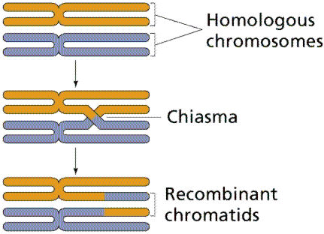
4.2.3 Outline the process of meiosis, including pairing of homologous chromosomes and crossing over, followed by two divisions, which results in four haploid cells.
The result of crossing over is genetic recombination: an exchange of genes. The points where the homologous chromosomes cross over are called chiasmata.
LINK

Slide 9
4.2.3 Outline the process of meiosis, including pairing of homologous chromosomes and crossing over, followed by two divisions, which results in four haploid cells.
Meiosis I The first stage of meiosis I is prophase I.
In prophase I the chromosomes pair up so that the chromosomes in each pair are homologous. Once the homologous chromosomes are paired up, crossing over occurs. Crossing over is the exchange of genetic material between non-sister chromatids. The nuclear membrane also starts to break down and the spindle microtubules stretch out from each pole to the equator.
The second stage is metaphase I.
Here the paired up homologous chromosomes line up at the equator and the spindle fibbers attach to the chromosomes in a way that ensures that for each homologous pair, one chromosome moved to one pole and the other moves to the opposite pole.
The third stage is anaphase I.
This is the stage where the homologous chromosomes are separated and pulled to opposite poles. This halves the chromosome number however each chromosome is still composed of two sister chromatids. The cell membrane starts to prepare for its separation at the equator to form two cells.
The fourth stage is telophase I. Here each chromosome from the homologous pair are found at opposite poles and the nuclear membrane reforms around each daughter nucleus. The membrane then divides through cytokinesis.
There is a brief interphase stage before the start of meiosis II. This stage does not include the S phase.

Slide 10
4.2.3 Outline the process of meiosis, including pairing of homologous chromosomes and crossing over, followed by two divisions, which results in four haploid cells.
Meiosis II The first stage of meiosis II is prophase II.
Here the cell has divided into two daughter haploid cells however the process does not end here as these two cells immediately start to divide again. The spindle microtubules stretch out from each pole again and the nuclear membrane breaks down as in prophase I.
The second stage is metaphase II.
Here the chromosomes in each cell line up at the equator and the spindle microtubules attach to the centromere of each chromosome.
The third stage is anaphase II.
Here the centromere devised as a result of the spindle microtubules pulling each sister chromatid to opposite poles in both cells. Each sister chromatid then becomes a chromosome.
The fourth stage is telophase II.
Here the nuclear membrane reforms around the four sets of daughter chromosomes. Cytokinesis then follows to divide the cytoplasm of the two cells and so the result is four daughter cells each with a haploid set of chromosomes.
LINK

Slide 11
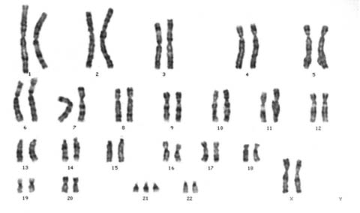
4.2.4 Explain that non-disjunction can lead to changes in chromosome number, illustrated by reference to Down syndrome (trisomy 21).
The pairing up of homologous chromosomes during Prophase I is called synapsis. Each resulting pair of homologous chromosomes (both chromosomes consisting of two identical ‘sister’ chromatids) is called tetrad or bivalent.
The separation of homologous chromosomes during Anaphase I is called disjunction. Failure of chromosomes to separate can lead to aneuploidy, which means having one extra chromosome or missing one
chromosome. In extreme cases, all homologous pairs fail to separate. This is called total non-disjunction and will lead to polyploidy, where the organisms has one complete extra set of chromosomes and becomes, for example, 3n.
LINK

Slide 12
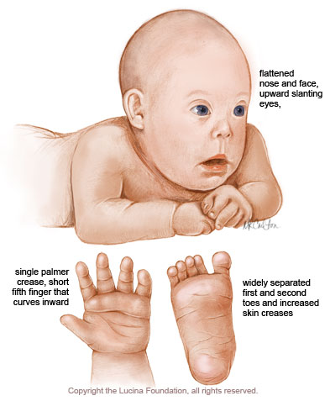
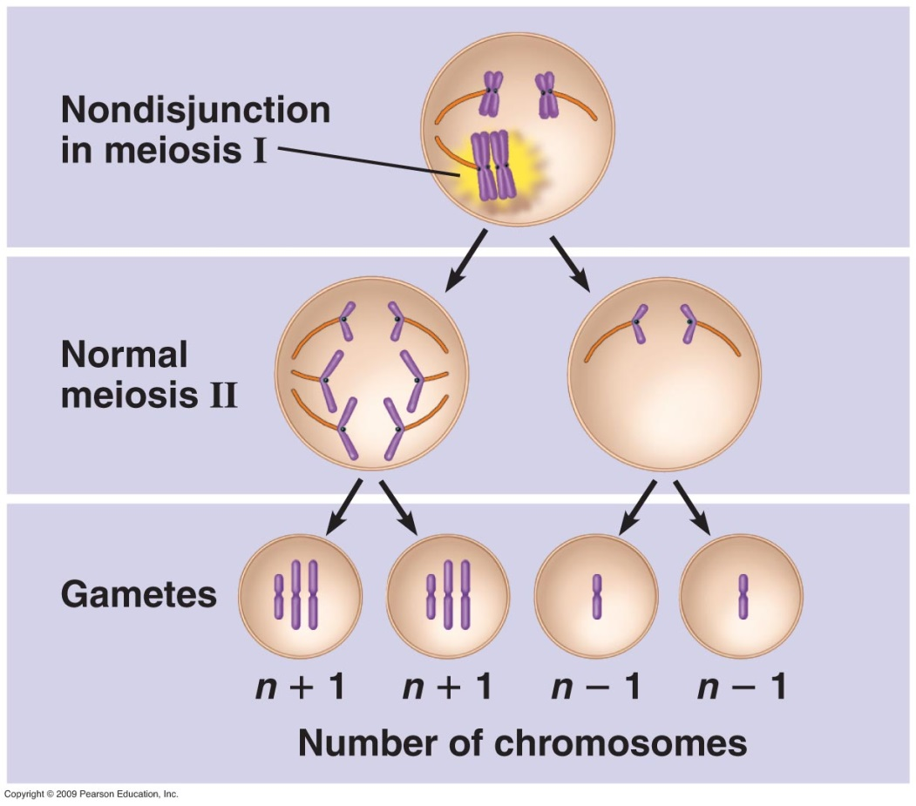
4.2.4 Explain that non-disjunction can lead to changes in chromosome number, illustrated by reference to Down syndrome (trisomy 21).
One of the best known examples of aneuploidy is Down Syndrome. If non-disjunction occurs in either parent, one of the two gametes will carry two copies of chromosome 21. When the zygote is formed, it will contain three copies of chromosome 21 and will be aneuploid. It is also referred
to as trisomy 21. The resulting symptoms are called Down Syndrome and are accompanied by (varying degrees of) disability.

Slide 13
4.2.5 State that, in karyotyping, chromosomes are arranged in pairs according to their size and structure.
Karyotyping is the process of finding the chromosomal characteristics of a cell. Chromosomes can be stained to show banding. This is used in the process of karyotyping. Chromosome structure and banding can be used to arrange the chromosomes in their pairs. To make a karyotype, the chromosomes in the picture would be cut out and arranged in pairs, starting with the largest.
Try it yourself!

Slide 14
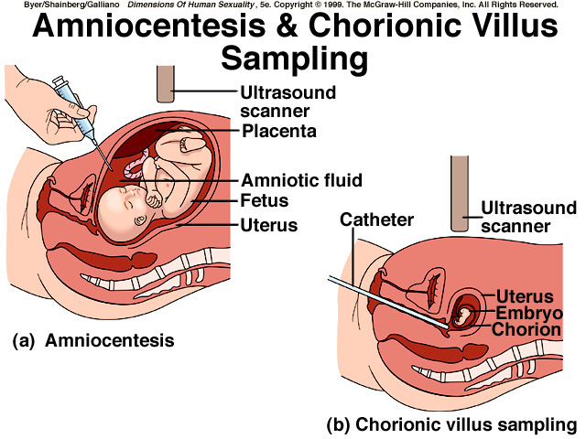
4.2.6 State that karyotyping is performed using cells collected by chorionic villus sampling or amniocentesis, for pre-natal diagnosis of chromosome abnormalities.
One application of karyotyping can be found in an amniocentesis. The risk of having a child with Down’s syndrome increases with the mother’s age. Non-disjunction, which can cause Down syndrome, also seems to have a
genetic component so that it can be said that people with relatives with Down syndrome have an increased chance of having a baby with this genetic disorder, as have mothers over the age of 35.
In either situation, it is possible to do pre-natal testing. There are two common tests:
chorionic villus sampling
amniocentesis

Slide 15
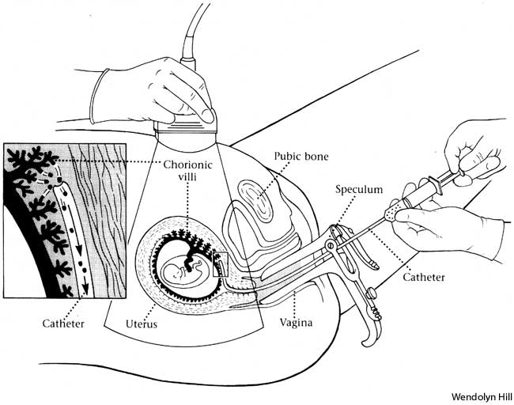
4.2.6 State that karyotyping is performed using cells collected by chorionic villus sampling or amniocentesis, for pre-natal diagnosis of chromosome abnormalities.
Chorionic villus sampling is a pre-natal test that can be done at 11-12 weeks of pregnancy. It involves taking a sample of the chorionic villi in order to obtain cells from tissue that originally came from the zygote. The cells will
therefore have the same genetic composition as the cells of the unborn baby so a karyotype can be made. This should take less than two weeks. The risks associated with chorionic villus sampling (around 1%) are slightly larger than of amniocentesis (around 0.5%).
LINK

Slide 16
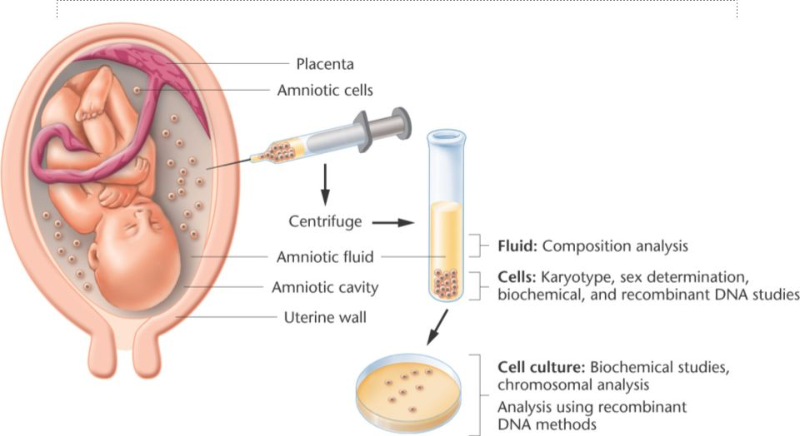
4.2.6 State that karyotyping is performed using cells collected by chorionic villus sampling or amniocentesis, for pre-natal diagnosis of chromosome abnormalities.
Amniocentesis can be done around the 16th week of the pregnancy. A sample of the amniotic fluid (containing fetal cells) is taken and a culture is made. When sufficient cells have been obtained, a karyotype can be done to detect chromosome abnormalities. The dividing cells are photographed and, using these pictures, the chromosomes are arranged in homologous pairs. Some genetic disorders can be detected this way (e.g. Down syndrome). This process takes approximately 3 weeks.
LINK

Slide 17
4.2.6 State that karyotyping is performed using cells collected by chorionic villus sampling or amniocentesis, for pre-natal diagnosis of chromosome abnormalities.
When analysing a human karyotype to determine gender and the occurrence of non-disjunction, the karyotype must be carefully examined and pairs of chromosomes need to be identified and placed together. This can be done using pictures on paper or on a computer screen. If nondisjunction has occurred there will either be one, or three copies, of a particular chromosome
Ordering chromosomes

Slide 18
Topic 4: Genetics
4.2 Meiosis

