Slide 1
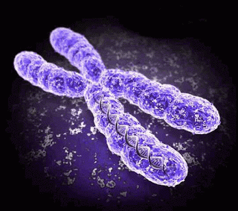
Topic 4: Genetics
4.1 Chromosomes, genes, alleles and mutations

Slide 2
ASSESSMENT STATEMENTS
4.1.1 State that eukaryote chromosomes are made of DNA and proteins.
4.1.2 Define gene, allele and genome.
4.1.3 Define gene mutation.
4.1.4 Explain the consequence of a base substitution mutation in relation to the processes of transcription and translation, using the example of sickle-cell anemia.

Slide 3
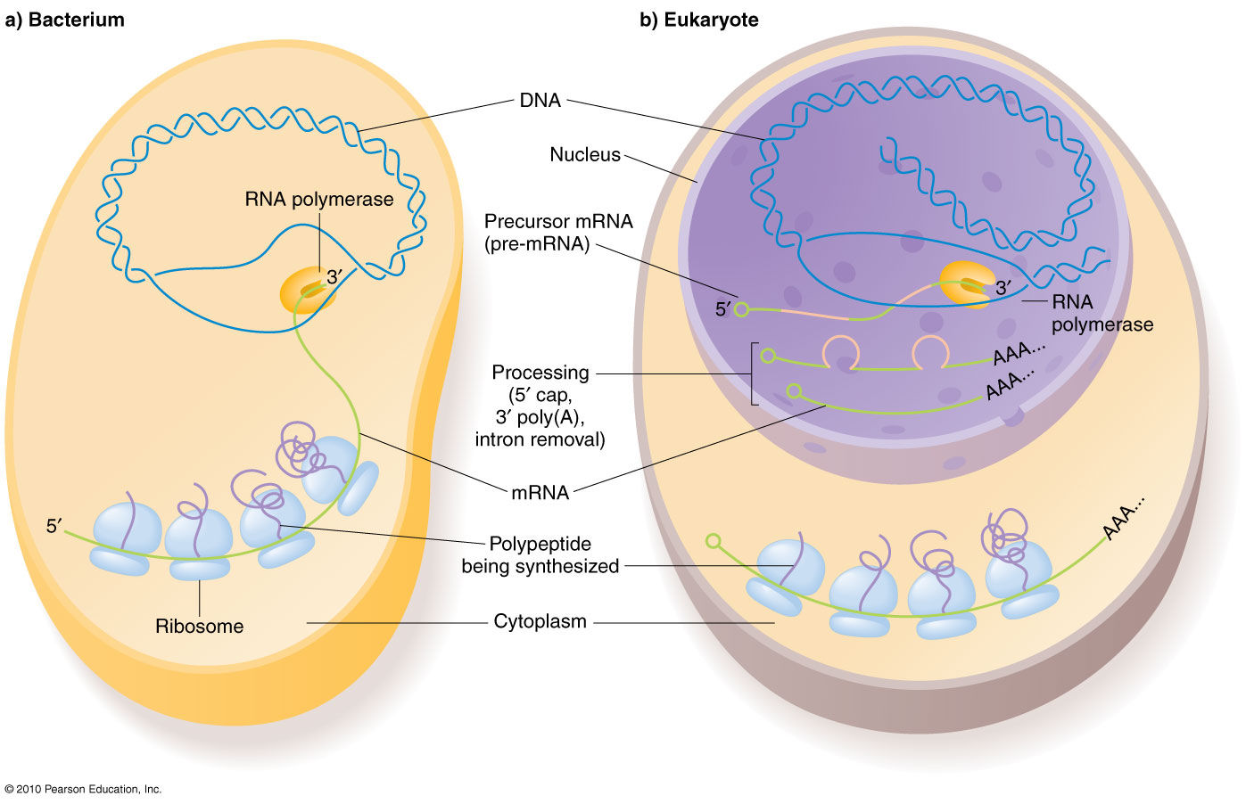
4.1.1 State that eukaryote chromosomes are made of DNA and proteins.
As you know from previous topics, prokaryotic chromosomes are circular. Prokaryotes also have some DNA in the form of small loops called plasmids. Prokaryotic DNA is found in the nucleoid area of the cell, not in a nucleus. Prokaryotic chromosomes contain DNA but no protein.
Eukaryotic chromosomes are found inside a nucleus. There are usually more than one chromosome and they are linear. Eukaryotic chromosomes contain DNA and proteins.

Slide 4
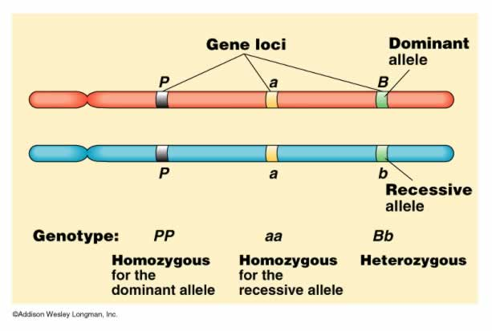
4.1.2 Define gene, allele and genome.
A gene is a heritable factor that controls a specific characteristic (such as eye colour), consists of a length of DNA and occupies a position on a chromosome known as a locus.
The term allele refers to one specific form of a gene, differing from other alleles by one or a few bases only and occupying the same gene locus as other alleles of the gene.
A genome is the total genetic material of an organelle, cell or organism.
The gene pool refers to the total of the genes carried by the individual members of a population.

Slide 5
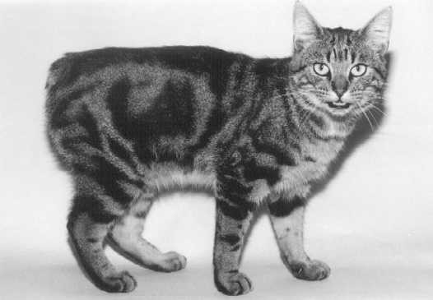
4.1.3 Define gene mutation.
A gene mutation may be defined as a permanent change in the sequence of base pairs in the DNA that makes up a gene. A mutation may involve just one nucleotide or it may affect a large section of the gene.
An example of a mutation occurs in the Manx cat shown. Due to a mutation, some Manx cats were born without tails. This was selected for by breeders and a tailless breed of cats was created.
LINK

Slide 6
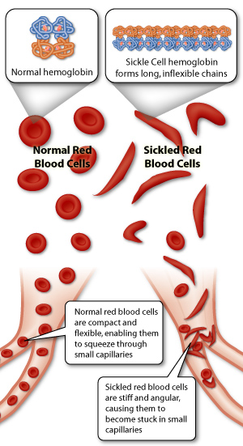
4.1.4 Explain the consequence of a base substitution mutation in relation to the processes of transcription and translation, using the example of sickle-cell anemia.
It is often thought that a mutation which involves a smaller number of nitrogenous bases in the DNA will be less significant than one where a larger number of bases is changed. This is not necessarily true and a good example is found in the gene that controls sickle-cell anaemia where a change of only one base leads to a protein with one amino acid changed and the resulting disease of sickle‑cell anaemia.
Haemoglobin is made of four polypeptide chains: two alpha chains and two beta chains. When an A to T base substitution occurs in the region of the gene coding for the 6th amino acid in the beta chain, the codon GAG (glutamic acid) becomes GTG (valine).
LINK

Slide 7
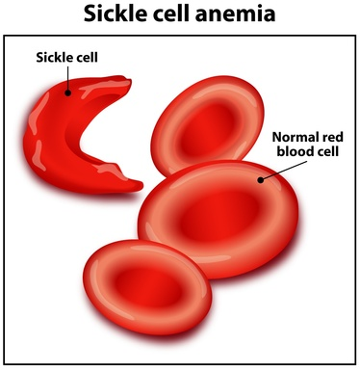
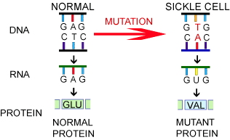
4.1.4 Explain the consequence of a base substitution mutation in relation to the processes of transcription and translation, using the example of sickle-cell anemia.
The resulting polypeptide is different and the haemoglobin formed is commonly known as HbS; the ‘normal’ haemoglobin is known as HbA.
The result of this is a slightly different structure, by one amino acid of the
haemoglobin molecule which makes it crystallise at low oxygen levels (e.g. in the capillaries). The erythrocyte (red blood cell) in which the haemoglobin can be found will then change from a biconcave shape into a sickle-cell shape and can block the small capillaries, and is less efficient at transporting oxygen. Even when the oxygen concentration increases again, the cells keep their sickle shape.

Slide 8
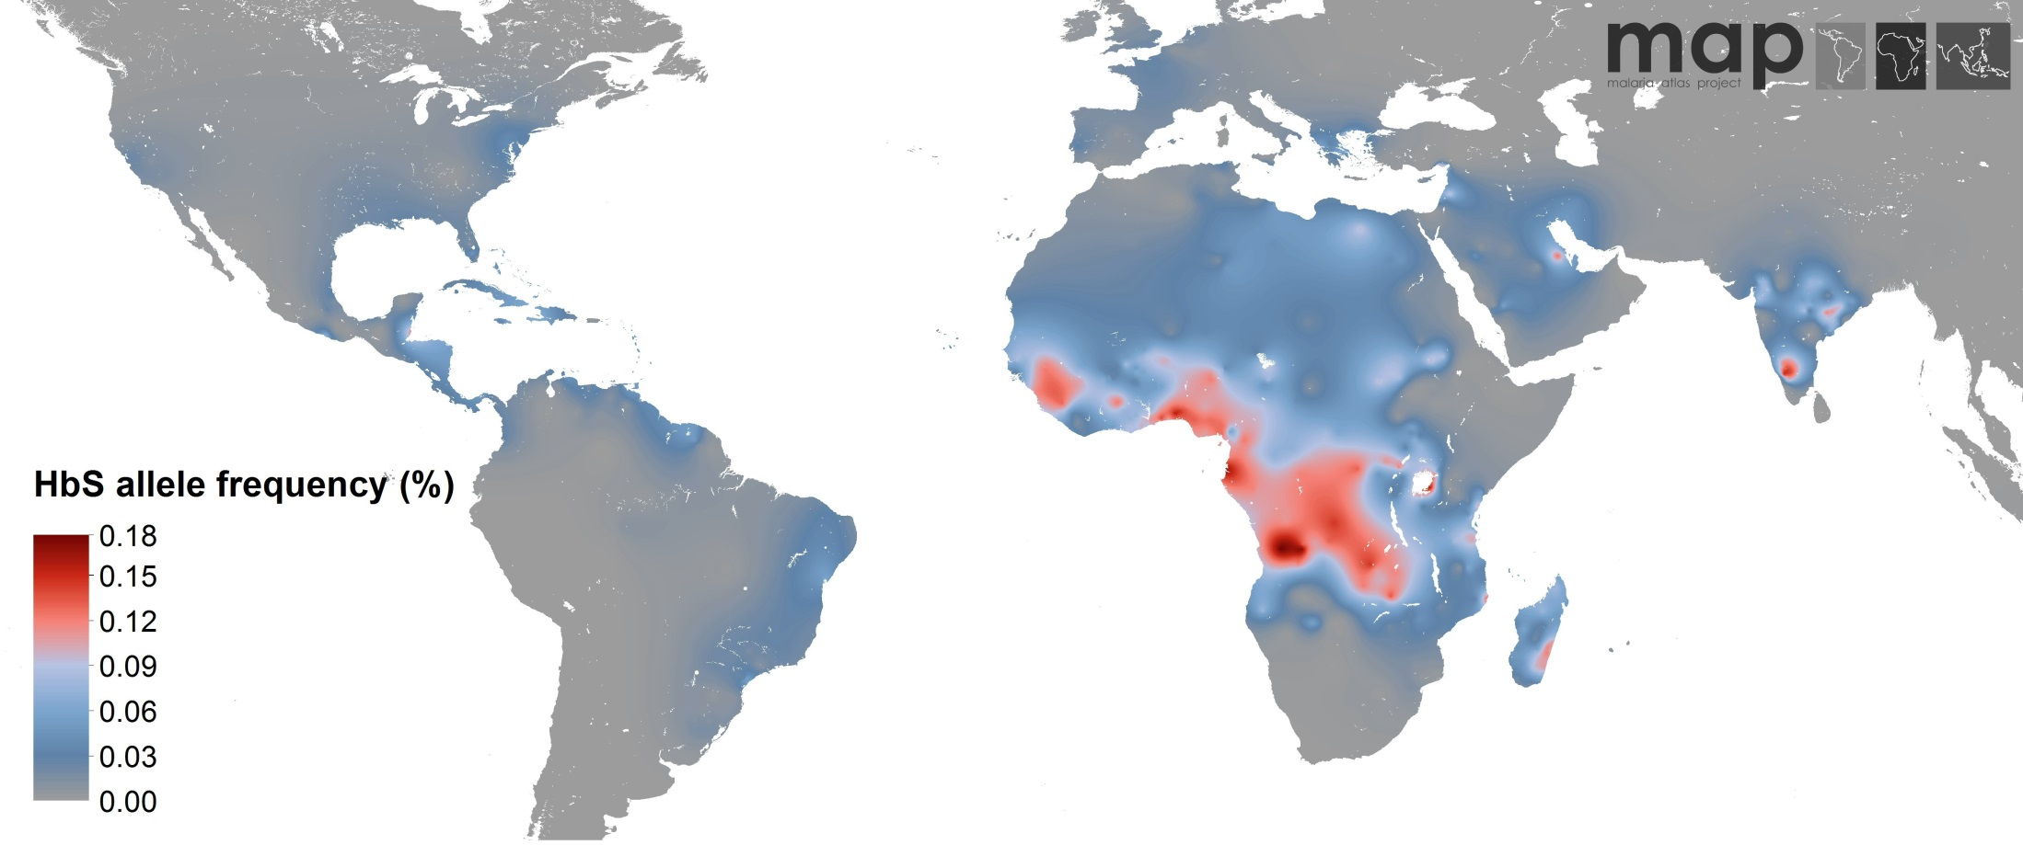
World map of sickle cell anaemia allele frequency. Why is central Africa so red?

Slide 9
4.1.4 Explain the consequence of a base substitution mutation in relation to the processes of transcription and translation, using the example of sickle-cell anemia.
The symptoms of sickle-cell anaemia are acute anaemia, which causes physical weakness. The lack of oxygen may be severe enough to cause damage to the heart and kidneys or even death (in homozygous individuals).
The gene for sickle-cell anaemia is co-dominant with the “normal” allele although the latter is expressed more strongly in the heterozygous individual.
Heterozygous individuals (carriers) have some HbS but more normal haemoglobin. They may suffer from mild anaemia. The selective advantage of being a carrier is found in malaria infested areas.
Plasmodium (the protist causing malaria) cannot reproduce in erythrocytes with HbS. This means that individuals heterozygous for the sickle-cell trait have a reduced chance of contracting malaria. Natural selection has ensured that the sickle-cell trait is more common among people living in malaria-infested
areas such as West Africa

Slide 10
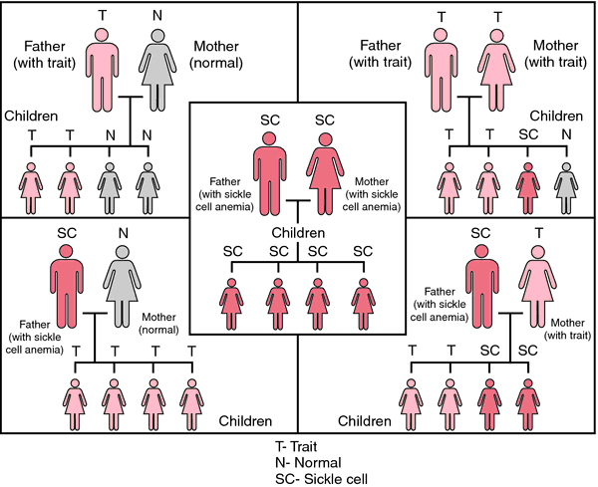

Slide 11
Topic 4: Genetics
4.1 Chromosomes, genes, alleles and mutations

