Slide 1
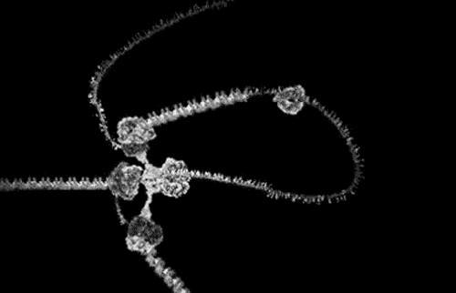
Topic 3: The chemistry of life
3.4 DNA replication

Slide 2
ASSESSMENT STATEMENTS
HERE THEY COME!!
3.4.1 Explain DNA replication in terms of unwinding the double helix and separation of the strands by helicase, followed by formation of the new complementary strands by DNA polymerase.
3.4.2 Explain the significance of complementary base pairing in the conservation of the base sequence of DNA.
3.4.3 State that DNA replication is semiconservative.

Slide 3
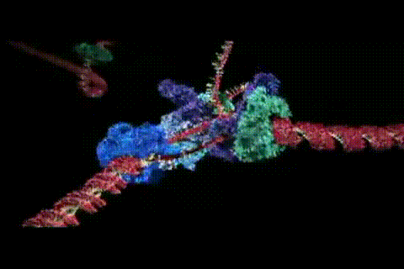
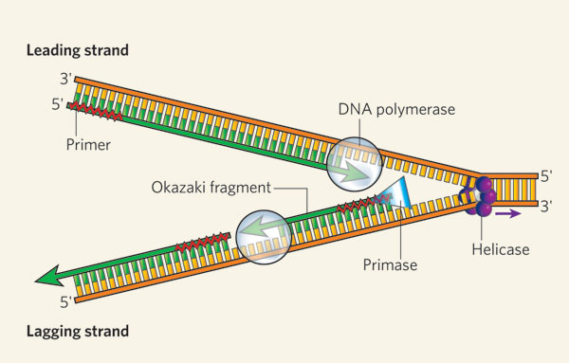
3.4.1 Explain DNA replication in terms of unwinding the double helix and separation of the strands by helicase, followed by formation of the new complementary strands by DNA polymerase.
DNA replication requires several processes to take place. First the DNA double helix needs to unwind and the two strands need to separate
(or ‘unzip’). The enzyme ‘helicase’ is responsible for this process.
LINK
Free nucleotides which are ‘floating around’ in the nucleus form complementary pairs with the nucleotides of both of the DNA strands.
The nucleotides which have formed complementary base pairs with the nucleotides on the old strand now join each other to form a new strand of DNA. The enzyme ‘DNA polymerase’ is responsible for this process. All these processes result in two identical DNA double helices, each consisting of one ‘old’ and one ‘new’ strand.
Helicase

Slide 4
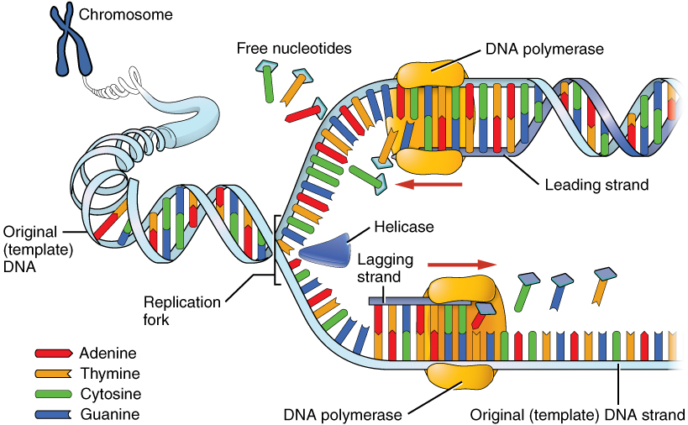
3.4.2 Explain the significance of complementary base pairing in the conservation of the base sequence of DNA.
Since every organic base will only ‘fit’ with one other one (complementary base pairing), the ‘new’ strand of DNA will be identical to one from which the ‘old’ strand just separated.
So (theoretically) this process can continue forever without any change to the genetic material. Mistakes however do occur and these are called mutations.

Slide 5
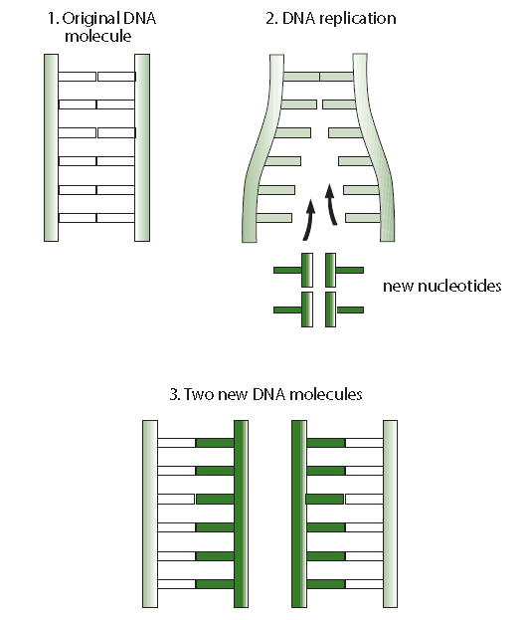
3.4.3 State that DNA replication is semiconservative.
When a DNA double helix replicates into 2 DNA double helices, one strand of each helix is an ‘old’ while the other is ‘new’.
When DNA replication is described as ‘semi-conservative’ it is meant that each of the two DNA molecules will have a ‘new’ strand and an ‘old strand.

Slide 6
Topic 3: The chemistry of life
3.4 DNA replication

