Slide 1
Highlight the elements from the same type of substance in the same colour:
1. RED - The elements in your ionic compounds: sodium, carbon, oxygen, iron, sulfur, chlorine
2. BLUE - The elements in your covalent compounds: carbon, hydrogen, oxygen, chlorine
3. GREEN - atoms in your metallic compounds: magnesium, copper, zinc, iron
What do you notice about the location of the atoms in the same type of substance?
H
H
He
Li
Be
B
C
N
O
F
Ne
Na
Mg
Al
Si
P
S
Cl
Ar
K
Ca
Sc
Ti
V
Cr
Mn
Fe
Co
Ni
Cu
Zn
Ga
Ge
As
Se
Br
Kr
Rb
Sr
Y
Zr
Nb
Mo
Tc
Ru
Rh
Pd
Ag
Cd
In
Sn
Sb
Te
I
Xe
Cs
Ba
La
Hf
Ta
W
Re
Os
Ir
Pt
Au
Hg
Tl
Pb
Bi
Po
At
Rn
Fr
Ra
Ac
Rf
Db
Sg
Bh
Hs
Mt
?
?
?

Slide 2
Find a periodic table that shows the atomic radius (the size) of atoms in the periodic table (e.g. period 3). Paste it below:

Slide 3
Use the internet to explain why the size of an atom gets bigger as you go down a group in the periodic table: Hints: Look at the number of shells. Do you know what the term “shielding” means?

Slide 4
Use the internet to explain why the size of an atom gets smaller as you move from the left side of the periodic table to the right side? Hints: As you move across the periodic table, each element has 1 more electron. Do the electrons go into the same shell or a different one? Atoms also gain 1 more proton. What effect will this have on the outer shell? The diagram on the next page may be helpful.

Slide 5
….this may help with the previous question.

Slide 6
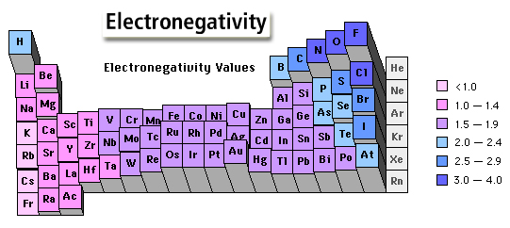
What is electronegativity? ....................................................................................................................................................................................................................
Is there a relation to the atomic radii graph from the question before? ………………………………………………………………………………………………………………………………………………………………………………………………………………………………………………………………………………………………………………………………………………………………………………………………

Slide 7
What is the name of the scale that measures electronegativity → P……………… Scale
Find a diagram that shows the electronegativity values of all elements in the periodic table:

Slide 8
Why do metals and non-metals form ionic bonds? E.g magnesium and chlorine:
Why do non-metals and non-metals form covalent bonds? E.g chlorine and chlorine:

Slide 9
Why do metals form metallic bonds? E.g magnesium atoms:

Slide 10
The periodic table and its properties?
On the periodic table below,
Label the different ´Group numbers´ and ´Period numbers´:
Show where metals and non-metals are divided.
H
He
Li
Be
B
C
N
O
F
Ne
Na
Mg
Al
Si
P
S
Cl
Ar
K
Ca
Sc
Ti
V
Cr
Mn
Fe
Co
Ni
Cu
Zn
Ga
Ge
As
Se
Br
Kr
Rb
Sr
Y
Zr
Nb
Mo
Tc
Ru
Rh
Pd
Ag
Cd
In
Sn
Sb
Te
I
Xe
Cs
Ba
La
Hf
Ta
W
Re
Os
Ir
Pt
Au
Hg
Tl
Pb
Bi
Po
At
Rn
Fr
Ra
Ac
Rf
Db
Sg
Bh
Hs
Mt
?
?
?

Slide 11
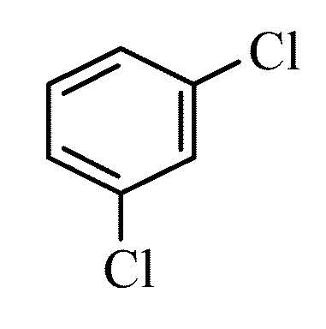
Find a the structure of substance:
Potassium bromide:
Potassium iodide:
Sodium chloride:
1-naphthol:
1,2-dichlorobenzene:
Magnesium metal:
Zinc metal:
Copper metal:

