Slide 1
Unit 2 Cells
2.2 Prokariotic cells

Slide 2
Assessment statements
2.2.1 Draw and label a diagram of the ultrastructure of Escherichia coli (E. coli) as an example of a prokaryote.
(The diagram should show the cell wall, plasma membrane, cytoplasm, pili, flagella, ribosomes and nucleoid (region containing naked DNA).
2.2.2 Annotate the diagram from 2.2.1 with the functions of each named structure.
2.2.3 Identify structures from 2.2.1 in electron micrographs of E. coli.
2.2.4 State that prokaryotic cells divide by binary fission.

Slide 3
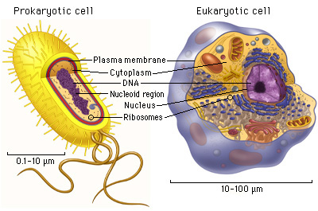
Introduction
As you remember from previous years we can divide cells in two major groups, prokaryotic and eukaryotic cells. The main characteristics are very similar but there are various structural differences between the two types of cells. (the differences on the next slide don’t need to be studied)
Link to image

Slide 4
 | Eukaryotic Cell | Prokaryotic Cell
Nucleus: | Present | Absent
Number of chromosomes: | More than one | One--but not true chromosome:Plasmids
Cell Type: | Usually multicellular | Usually unicellular (some cyanobacteria may be multicellular)
True Membrane bound Nucleus: | Present | Absent
Example: | Animals and Plants | Bacteria and Archaea
Genetic Recombination: | Meiosis and fusion of gametes | Partial, undirectional transfers DNA
Lysosomes and peroxisomes: | Present | Absent
Microtubules: | Present | Absent or rare
Endoplasmic reticulum: | Present | Absent
Mitochondria: | Present | Absent
Cytoskeleton: | Present | May be absent
DNA wrapping on proteins.: | Eukaryotes wrap their DNA around proteins called histones. | Multiple proteins act together to fold and condense prokaryotic DNA. Folded DNA is then organized into a variety of conformations that are supercoiled and wound around tetramers of the HU protein.
Ribosomes: | larger | smaller
Golgi apparatus: | Present | Absent
Chloroplasts: | Present (in plants) | Absent; chlorophyll scattered in the cytoplasm
Flagella: | Microscopic in size; membrane bound; usually arranged as nine doublets surrounding two singlets | Submicroscopic in size, composed of only one fiber
Permeability of Nuclear Membrane: | Selective | not present
Plasma membrane with steriod: | Yes | Usually no
Cell wall: | Only in plant cells and fungi (chemically simpler) | Usually chemically complexed
Cell size: | 10-100um | 1-10um

Slide 5
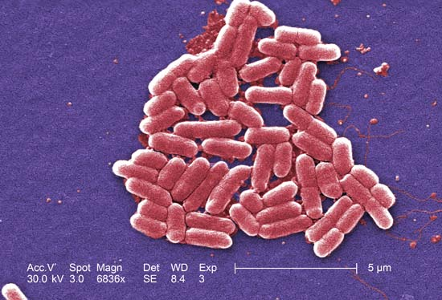
2.2.1 Draw and label a diagram of the ultrastructure of Escherichia coli (E. coli) as an example of a prokaryote.
Link to image

Slide 6
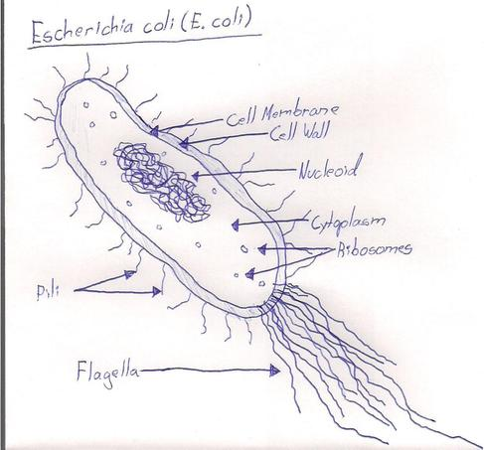
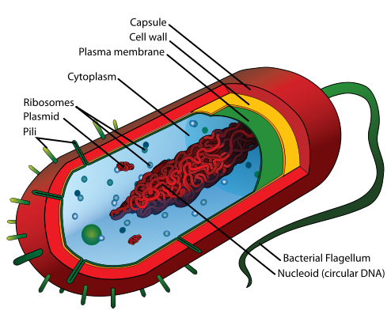
2.2.1 Draw and label a diagram of the ultrastructure of Escherichia coli (E. coli) as an example of a prokaryote.
Copy this drawing in your notebooks
Link to image

Slide 7
2.2.2 Annotate the diagram from 2.2.1 with the functions of each named structure.
Make sure you understand the following descriptions of each part
Cell wall
The cell wall is made of protein-sugars whereas plant cell walls are made of cellulose.
It gives the cell its shape, protects the bacterium from external damage and prevents bursting if the cell has taken up a lot of water (e.g. in a hypotonic medium).
It also anchors the pili and flagella which help some bacteria move.

Slide 8
2.2.2 Annotate the diagram from 2.2.1 with the functions of each named structure.
Plasma membrane
The plasma membrane controls which materials enter and leave the cell, either by active or passive transport. It is selectively permeable. It also plays a role in binary fission.

Slide 9
2.2.2 Annotate the diagram from 2.2.1 with the functions of each named structure.
Cytoplasm
Cytoplasm is a watery fluid that contains enzymes that control metabolic reactions in the cell and also contains the organelles of the cell.

Slide 10
2.2.2 Annotate the diagram from 2.2.1 with the functions of each named structure.
Pili
Pili are thin protein tubes. They are found on the outside of the plasma membrane.
There are two types of pili: attachment pili (sometimes known as fimbriae) and conjugation pili (sometimes known as sex pili).
Prokaryotes are likely to have many attachment pili. At the end of the pilus, there is a sticky section which allows E. coli to stick to a surface such as the cell membrane of another cell.

Slide 11
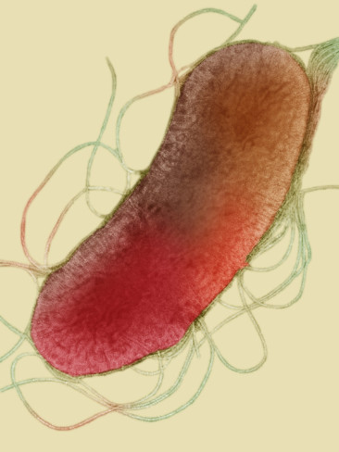
2.2.2 Annotate the diagram from 2.2.1 with the functions of each named structure.
Pili
There tend to be only a few conjugation pili. They are much longer than the attachment pili and play a role in bacterial conjugation. They build a bridge between the cytoplasms of two bacterial cells and allow a plasmid to be
transferred from one bacterial cell to another.

Slide 12
2.2.2 Annotate the diagram from 2.2.1 with the functions of each named structure.
Flagella
Flagellae are long thread-like structures, made of protein. They are attached to the cell surface and they allow the bacterium to move in a fluid environment.

Slide 13
2.2.2 Annotate the diagram from 2.2.1 with the functions of each named structure.
Ribosome
Ribosomes consist of RNA and proteins, they play a key role in protein synthesis. The process is called translation (see also Topic 3.5 later in this course). They are present in very high numbers in cells with high protein production.

Slide 14
2.2.2 Annotate the diagram from 2.2.1 with the functions of each named structure.
Nucleoid region
The nucleoid region of the cell contains the DNA which contains the genetic material. It is the area from which all processes in the cell are
controlled. It is composed out of one singular, long, continuous threat of circular DNA. In addition to the bacterial DNA, some bacteria also have a plasmid, small, circular DNA molecules which are not connected to the main bacterial chromosome.

Slide 15
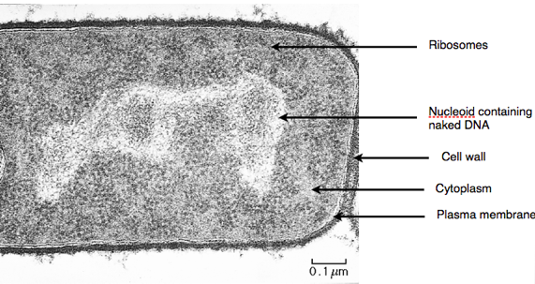
2.2.3 Identify structures from 2.2.1 in electron micrographs of E. coli.

Slide 16
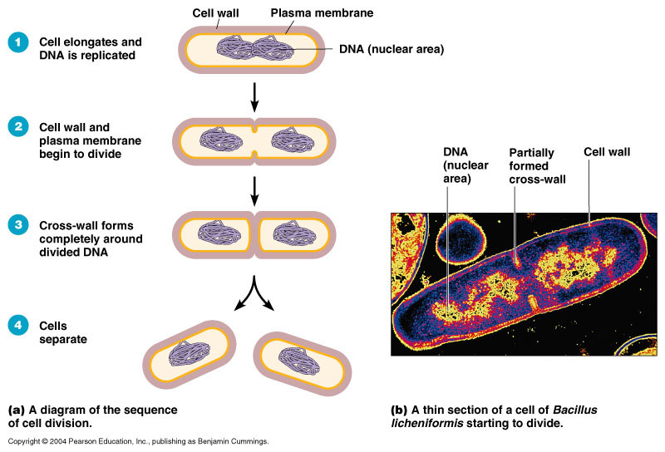
2.2.4 State that prokaryotic cells divide by binary fission.
Prokaryotic cells divide by binary fission.
The process of binary fission starts with DNA replication which is followed by the separation of the two circular strands of DNA to either side of the cell.
Then cytokinesis occurs, where the cell divides into two.
Each new cell receives about half of the cytoplasm.
Subsequent growth will restore each cell to full size.
Link to animation

Slide 17
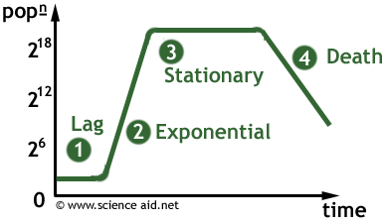
2.2.4 State that prokaryotic cells divide by binary fission.

Slide 18
Unit 2 Cells
2.2 Prokariotic cells

